Slide 1
CNES – Spot and Pléiades data
Steven Hosford

Slide 2
Acquisitions over GFOI R&D Study Sites
Pléiades
Data purchased and made available at no cost by CNES to R&D (science) users
Priority areas identified – 2014 data available on 3 sites, tasking underway on 9 sites
Volumes to be refined, but up to 10000 km2/year should be possible

Slide 3
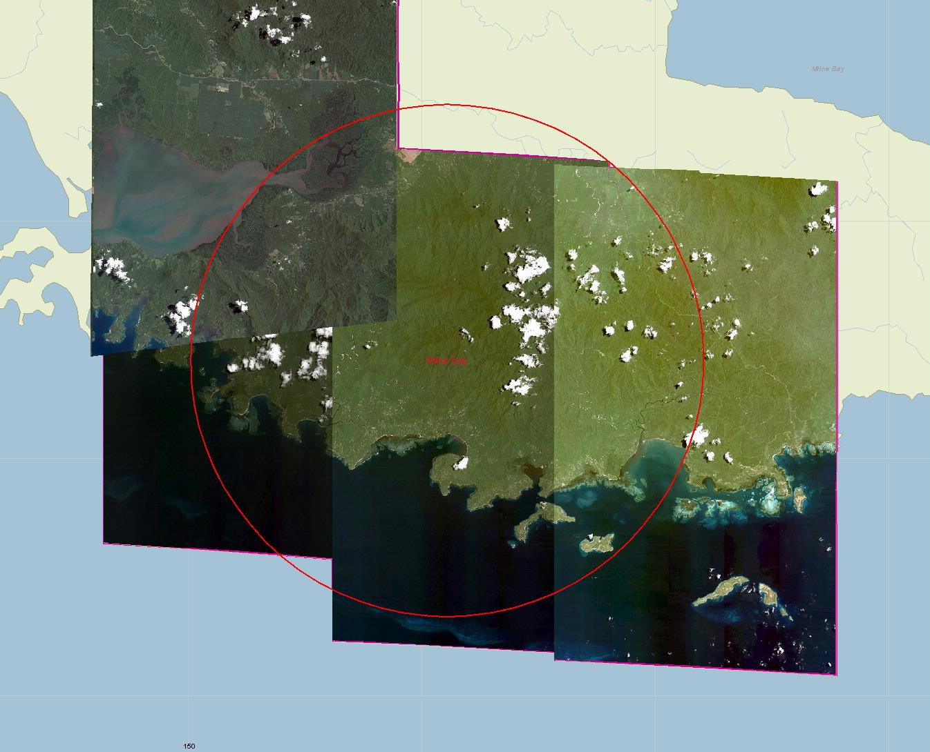
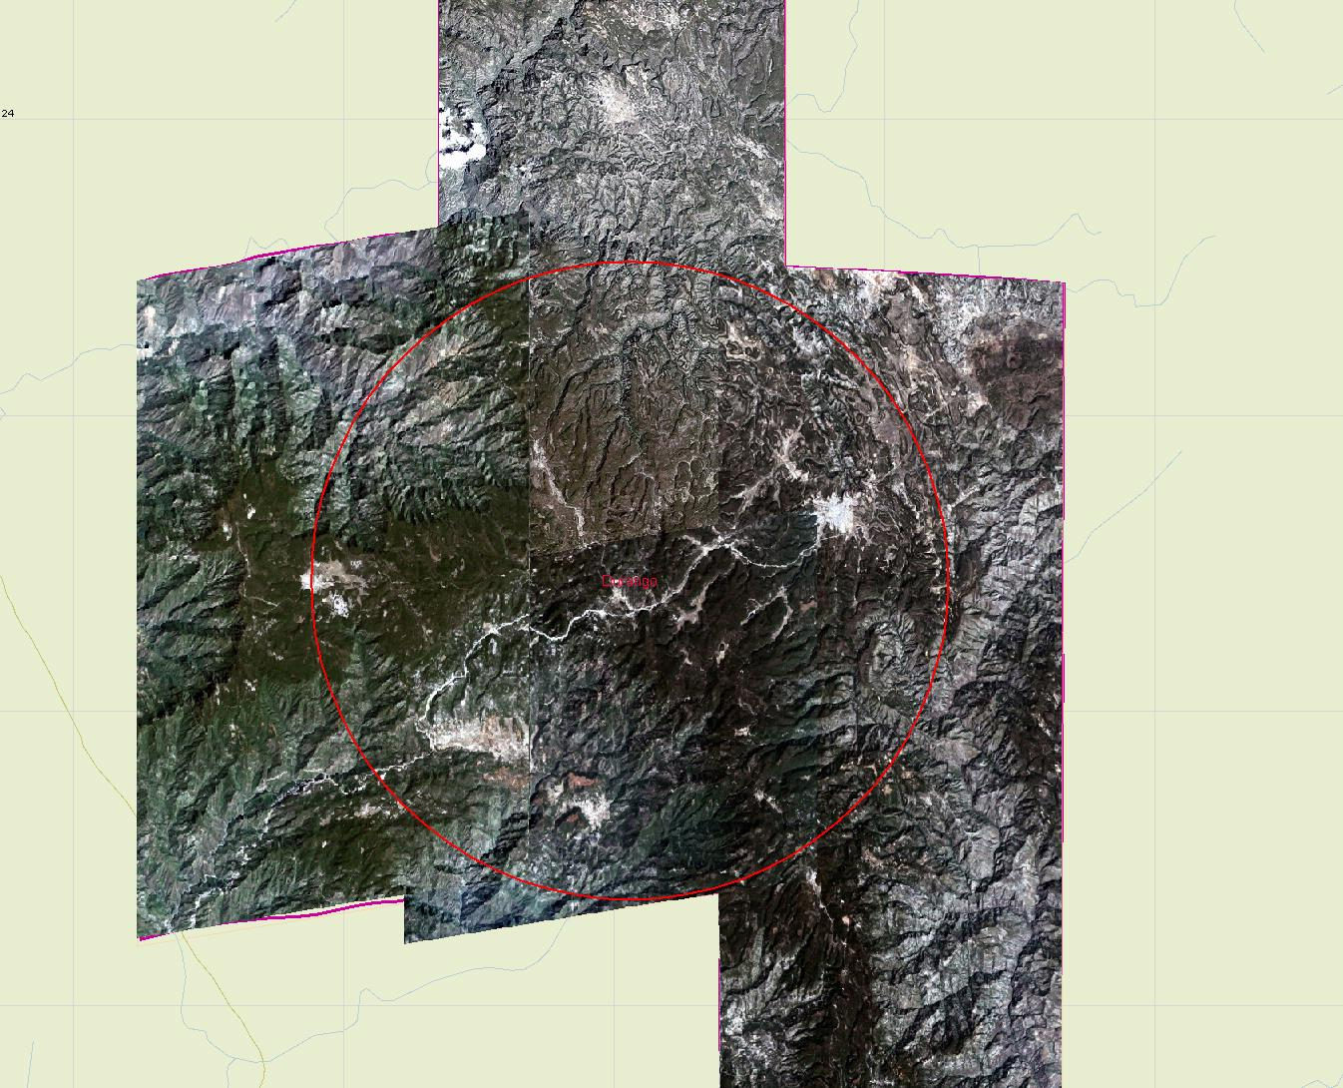
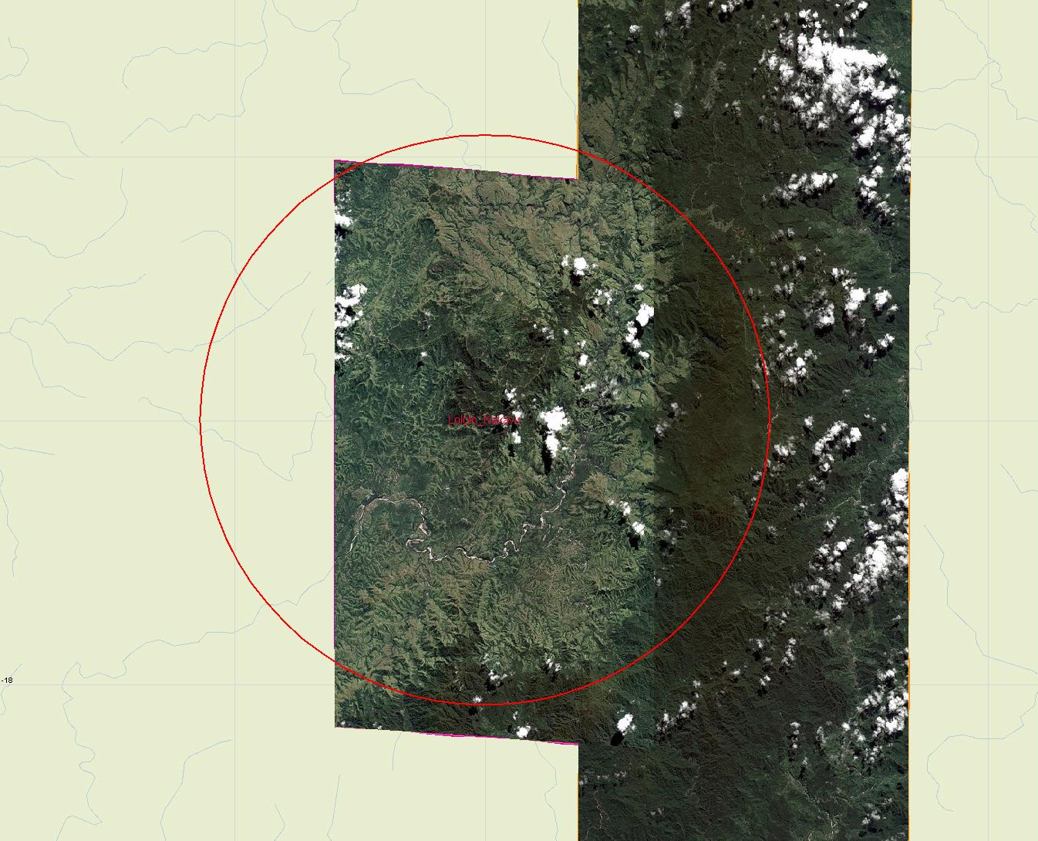
Acquisitions over GFOI R&D Study Sites
Site code | Site name | Pleiades Status
FCT-AU-1 | Mathinna (Tasmania) | Tasking underway
BRA-1 | Mato Grosso | Tasking underway
COL-6 | Caqueta | Tasking underway
FIJ-1 | Lololo & Nakavu | Available
FCT-GUY-1 | GFC-1 | Tasking underway
FCT-GUY-2 | GFC-2 | Tasking underway
FCT-BOR-3 | Mawas | Tasking underway
FCT-SUM-2 | Harapan | Tasking underway
FCT-MEX-2 | Chiapas-1 | Tasking underway
MEX-8 | Durango | Available
PNG-1 | Kokoda | Tasking underway
PNG-2 | Milne bay | Available

Slide 4
Acquisitions over GFOI R&D Study Sites
Pléiades
Inputs required from R&D users on
precise Areas of Interest – contribution in km2 not number of images
Required image products (orthorectified?, file type etc.)

Slide 5
Acquisitions over GFOI R&D Study Sites
SPOT 1-5
Access to archive data possible through Spot World Heritage programme
Analysis completed over R&D study sites
2386 images available in archive
Processing underway, available at level 1A shortly, orthorectified images within 6 months

Slide 6
Acquisitions over GFOI R&D Study Sites
Site Code | Site name | Nb of SPOT 1-5 Scenes | Country | Coordinates
 |  |  |  | lat | long
FCT-AU-1 | Mathinna (Tasmania) | 50 | Australia | S41.37 | E147.76
FCT-AU-2 | Takone (Tasmania) | 30 |  | S41.19 | E145.60
FCT-AU-3 | Warra (Tasmania) | 43 |  | S43.1046 | E146.6560
AU-4 | Robson Creek (QL) | 47 |  | S17.119 | E145.631
BRA-1 | Mato Grosso | 26 | Brazil | S11.75 | W54.25
CAN-1 | TBA |  | Canada | TBA | TBA
FCT-COL-3 | Pacifico-Bajo_Mira | 115 | Colombia | N1.65 | W78.76
FCT-COL-4 | Amazonia-Tinigua | 192 |  | N2.17 | W74.15
FCT-COL-5 | Andes-Antioquia | 109 |  | N7.83 | W76.45
COL-6 | Caqueta | 82 |  | N1.4079 | W73.5747
FIJ-1 | Lololo & Nakavu | 320 | Fiji | S17.833 | E177.833
FIN-1 | Hyytiälä | 319 | Finland | N61.85 | E24.32
FIN-2 | Sodankylä | 104 |  | N67.48 | E26.34
GAB-1 | Gabon | 0 | Gabon | N0.0181 | E10.1906
FCT-GUY-1 | GFC-1 | 29 | Guyana | N6.00 | W60.00
FCT-GUY-2 | GFC-2 | 24 |  | N7.00 | W59.00
FCT-GUY-3 | GFC-3 | 13 |  | N3.00 | W59.00

Slide 7
Acquisitions over GFOI R&D Study Sites
Site Code | Site name | Nb of SPOT 1-5 Scenes | Country | Coordinates
 |  |  |  | lat | long
ICE-1 | Hallormsstadur | 116 | Iceland | N65.12 | W14.68
FCT-BOR-3 | Mawas | 27 | Indonesia | S2.24 | E114.48
FCT-SUM-2 | Harapan | 52 |  | S2.20 | E103.38
FCT-MEX-2 | Chiapas-1 | 37 | Mexico | N16.45 | W91.40
MEX-8 | Durango | 57 |  | N23.74 | W105.49
PNG-1 | Kokoda | 105 | Papua New Guinea | S9.184 | E147.374
PNG-2 | Milne bay | 190 |  | S10.598 | E150.185
PNG-3 | Yus | 78 |  | S6.028 | E146.745
RUS-1 | Pechora-Ilych | 52 | Russia | N62.18 | E59.18
FCT-TNZ-5 | Amani | 142 | Tanzania | S5.13 | E38.63
FCT-TNZ-6 | Liwale | 27 |  | S9.50 | E38.17

Slide 8
Acquisitions over GFOI R&D Study Sites
The 2386 images mentioned here are held in Toulouse, many other images may be available in the direct reception stations (Australia, South Africa, French Guiana, …)
Access to these would be possible if processed locally

