Slide 1
ASI Contributing Data Stream Report
COSMO-SkyMed
Space Data Support to GFOI R&D
Laura Candela, Anna Rita Pisani, Simona Zoffoli
Agenzia Spaziale Italiana

Slide 2

Agenda
What’s new: COSMO- SkyMed
“Open Call for Science”
GFOI R&D Study Sites
COSMO-SkyMed background mission data on forests

Slide 3
COSMO-SkyMed Open Call for Science and AO
The Open Call for Science is started on 25th February 2015;
The Open Call is open to national and international scientific community;
Open Call Objectives
promote basic and applied research;
development of new technologies, algorithms;
improvement of existing applications;
innovative;
synergies with the other EO missions;
The Call is limited to PI from Institutional Entities;
Commercial or operational activities are not supported.

Slide 4
COSMO-SkyMed Open Call for Science and AO
Submission of proposals will be accepted anytime;
The selected projects will be supported for two years with a quota of data free-of-charge;
Land Cover & Vegetation is among the primary application domains;
Submission process is available on the ASI website at the following link:
http://www.asi.it/en/agency/bandi_en/calls/cosmoskymed_open_call_for_science
ASI is open to explore the possibility of a coordinated Announcement of Opportunity (AO) for R&D on GFOI key science questions with CEOS partners.

Slide 5
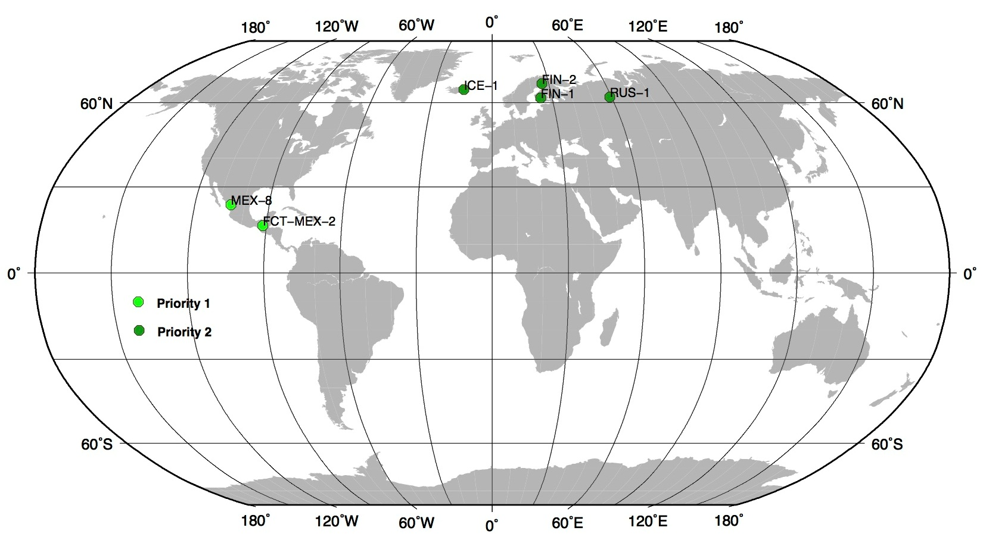
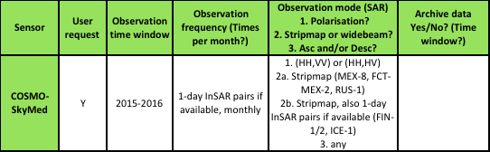
GFOI R&D Study Sites
Some archive data available, mostly in stripmap himage (updated oct. 2014).
Archive access conditions: research/institutional users @ the official COSMO-SkyMed: http://87.241.31.78/index.php by subscription.
gmt.soest.hawaii.edu
Projects requests

Slide 6
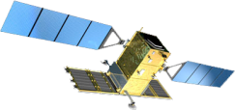
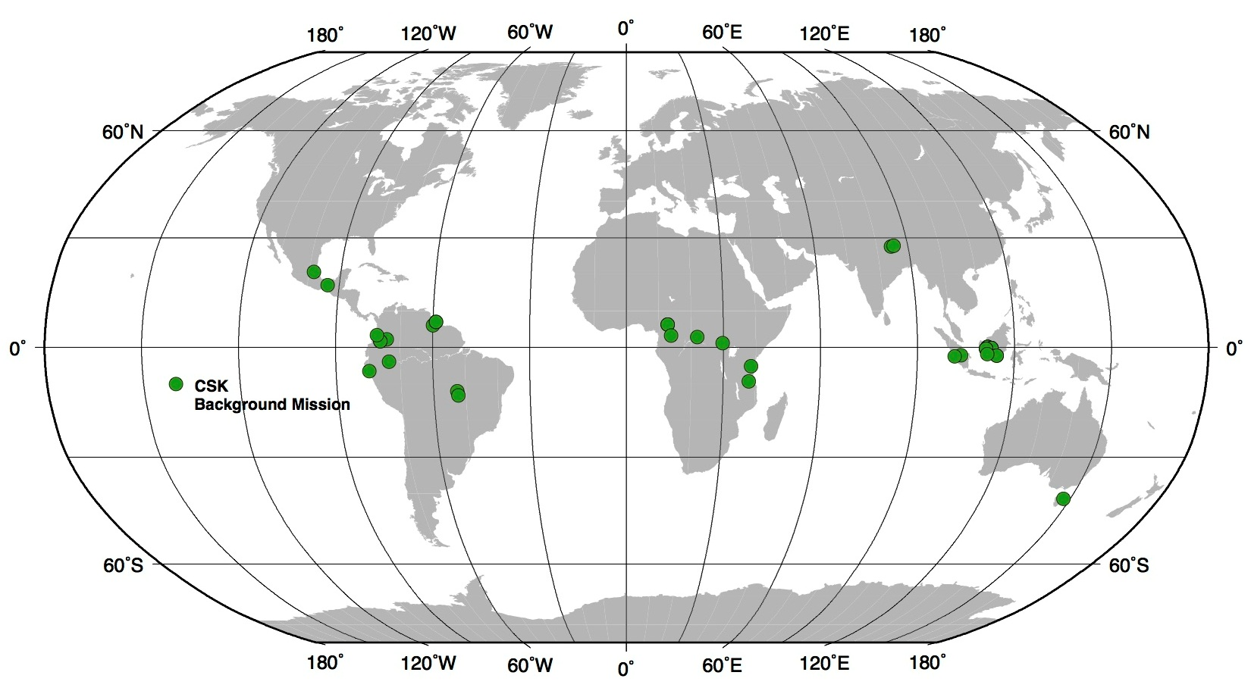
COSMO-SkyMed bck data
gmt.soest.hawaii.edu
COSMO-SkyMed (CSK) Background Mission data on forests
updated to October 2014
Archive are data available in stripmap himage.

