Slide 1
Session 7: Baseline Global Observation Scenario
USGS Core Data Stream Report

Slide 2
USGS Core Data Stream Report
Landsat 7 and Landsat 8 Status
Land Change Monitoring, Assessment and Prediction (LCMAP)

Slide 3
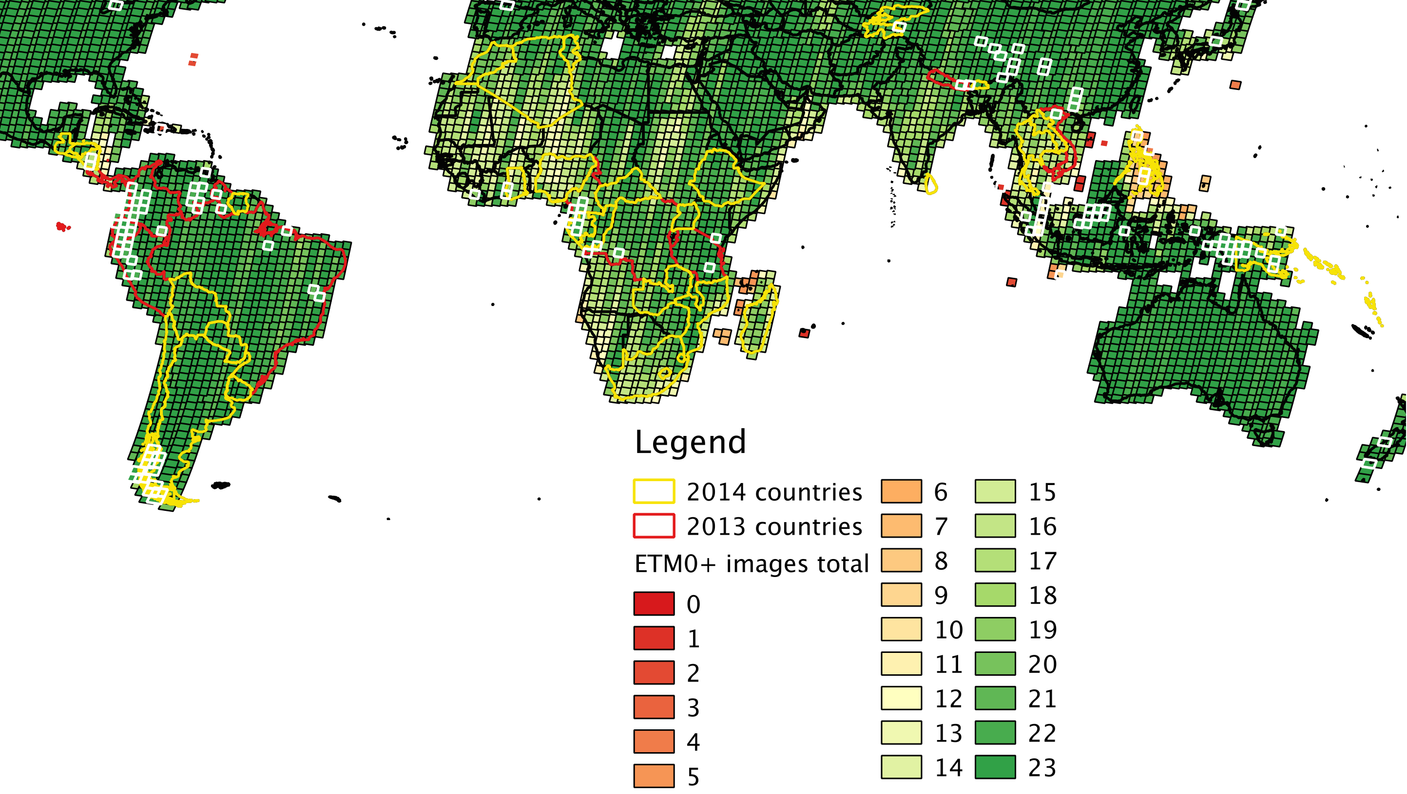
Landsat 7 status
2013
  Median: 385 images/day
  Max: 462 images/day
2014
  Median: 444 images/day
  Max: 525 images/day
Number of images
Scenes with minimum cloud cover greater than 20% in white

Slide 4
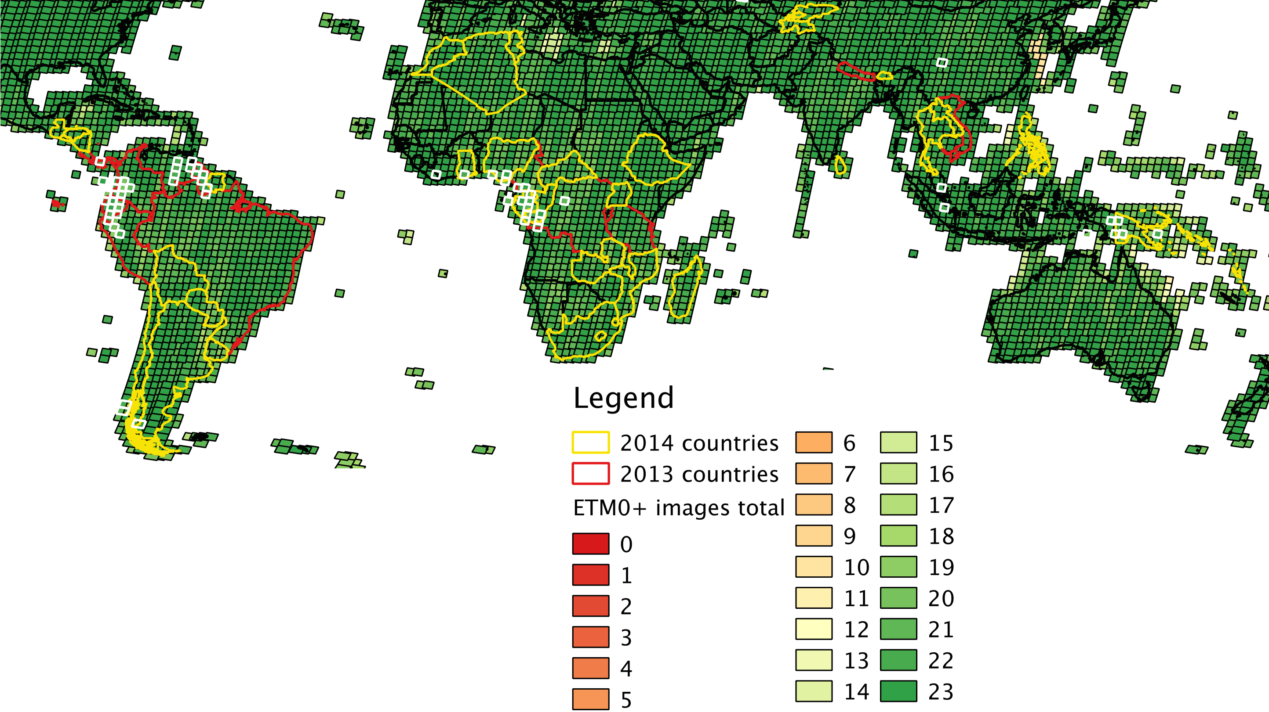
Landsat 8 status
2014 (before 7/26)
  Median: 583 images/day
  Max: 720 images/day
2014 (after 7/26)
  Median: 732 images/day
  Max: 764 images/day
Number of images
Scenes with minimum cloud cover greater than 20% in white
Since Dec 2014
Mid latitude (57°)
  422 images/day
  Reject 1
  image/day
  99.7%
High latitude
  270 images/day
  Reject 32
  images/day
  89.3%

Slide 5
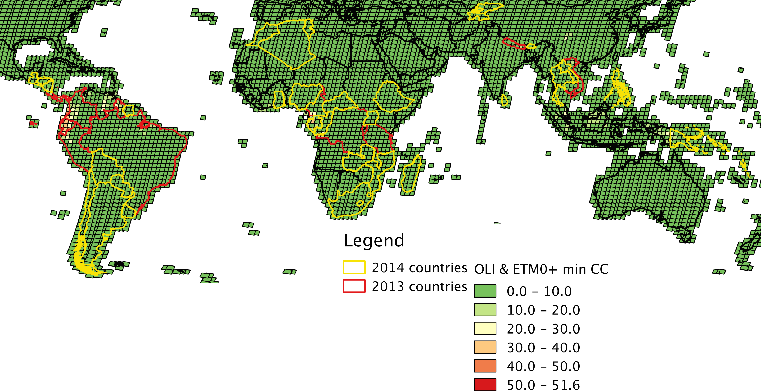
Landsat 7 & 8 combined

Slide 6
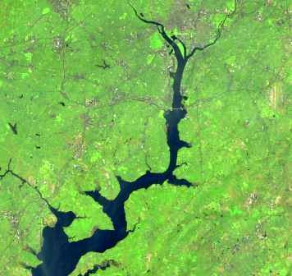
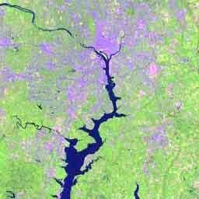
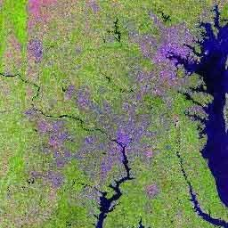
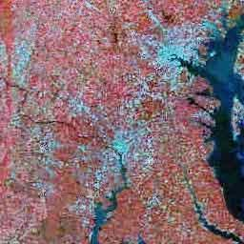
U.S. Landsat Archive Overview
(Jan 2, 2015)
OLI-TIRS: Landsat 8
  385,345 scenes
    average scene size 1813 MB
ETM+: Landsat 7
  1,858,501 scenes
    average scene size 487 MB
TM: Landsat 4 & Landsat 5
  1,988,982 scenes
    average scene size 263 MB
MSS: Landsat 1 through 5
  1,299,626 scenes
    average scene size 32 MB
Total:
  5,532,454 scenes
All average scenes sizes are for uncompressed data
Notes:
The end result is a vast archive of Landsat acquisitions covering 4 decades.
The 41 year Landsat archive contains over 5 million scenes covering an astounding 171 Billion squ. km.

Slide 7
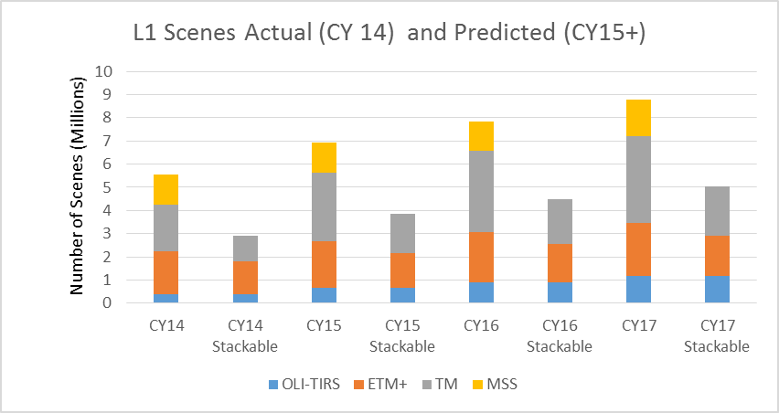
Archive Distribution Products
Notes:
Goal is precision terrain corrected products. Without manual intervention, systematic products are not stackable or ready for higher-level processing.
While certain MSS products are stackable, we don’t consider them ready for higher-level processing yet.

Slide 8
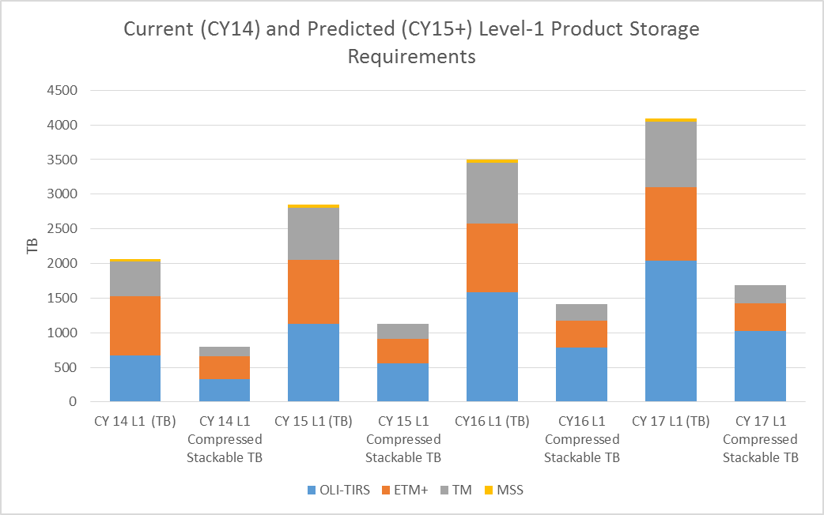
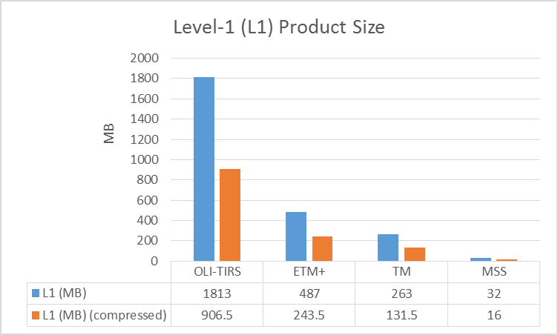
Distribution Product Volume
Notes:
The archive continues to grow. This chart shows the current and expected increase in volume in the upcoming years. Landsat Global Archive Consolidation Project continues to grow the historical missions.

Slide 9
Analysis Ready Data
Construct Analysis Ready Data (ARD) consistent across sensors
  Enhance and Improve Level-1 Product
    Consistent quality bands (masks)
    Better product accuracy (more L1T products)
    Top of Atmosphere (TOA) Reflectance
    Data providence – manage as collections/versions
    More flexible storage format rather than gzip’d GeoTIFF files
  Perform Surface Reflectance (SR) and Surface Temperature (ST) Corrections (LEDAPS provisional products available)
  Composites
  Essential Climate Variables (e.g. Surface Water Extent, Burn Area, etc)
  Format data in a common grid
  Enable pixel-level exploitation!
Notes:
Steps to Enable Further Exploitation of the Data
Consistently process to the highest scientific standards and highest level possible for applications access to construct ARD

Slide 10
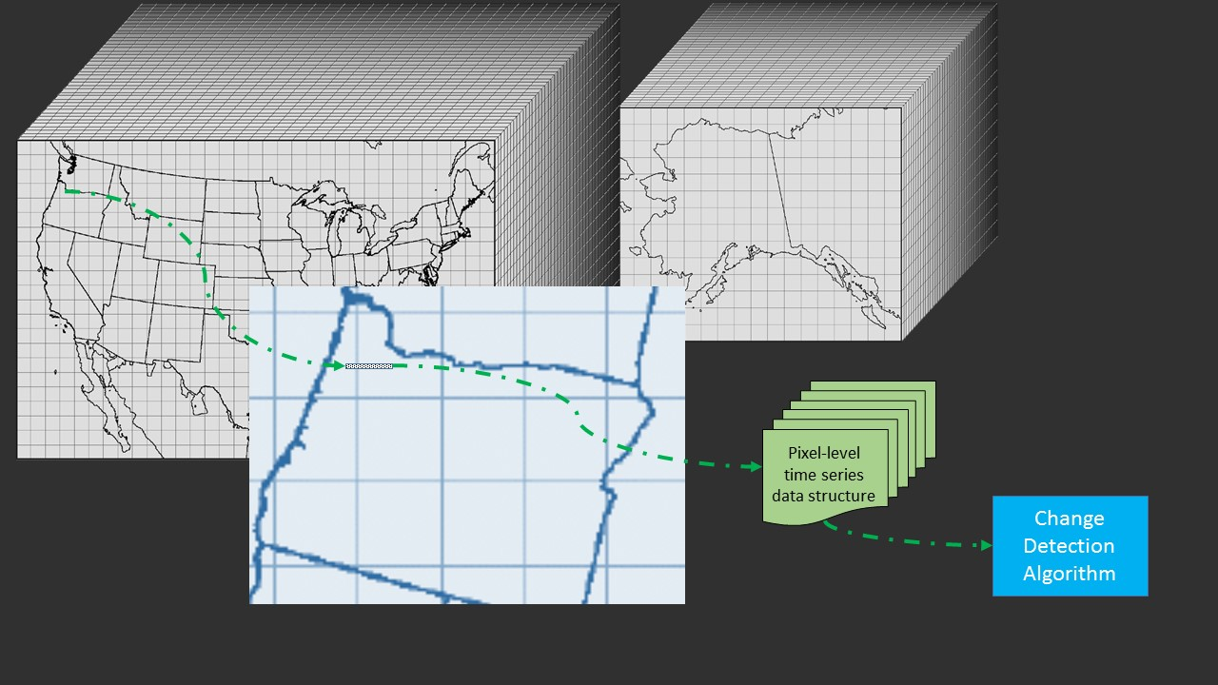
ARD Access
Enable a Rich Application Programmer Interface (API) for direct algorithm access to enable automation
User interface for selection – return only information requested by user

Slide 11
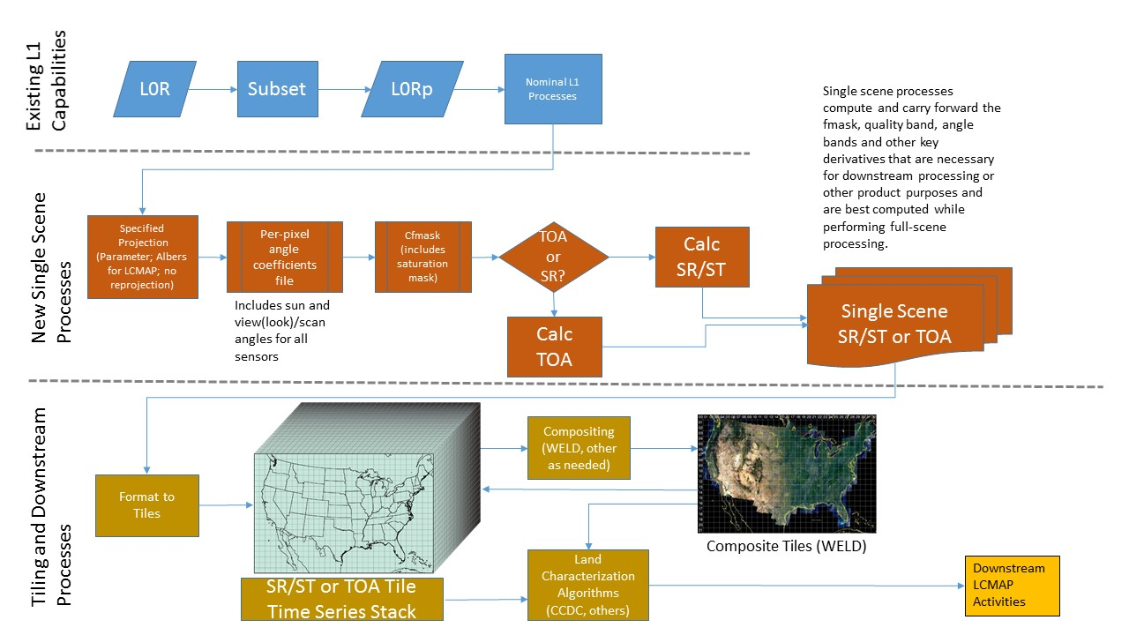
Processes
Notes:
Steps to Enable Further Exploitation of the Data
Consistently process to the highest scientific standards and highest level possible for applications access to construct Analysis Ready Data (ARD)
Climate Data Record Products
Perform Surface Reflectance (SR) and Surface Temperature (ST) Corrections (LEDAPS provisional products available)
Format data in a common grid – e.g. WELD developed by David Roy at SDSU

Slide 12
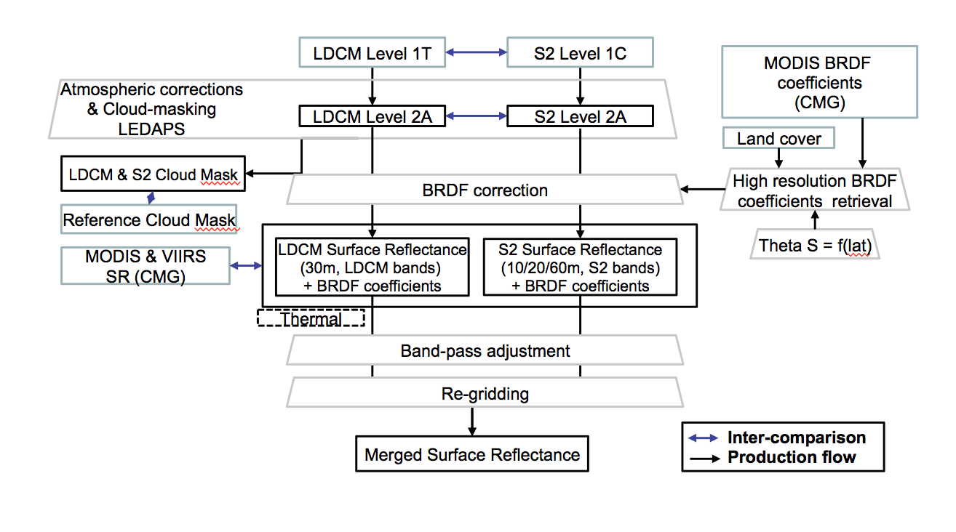
Landsat and Sentinel-2

Slide 13
Landsat Processing for LCMAP

Slide 14
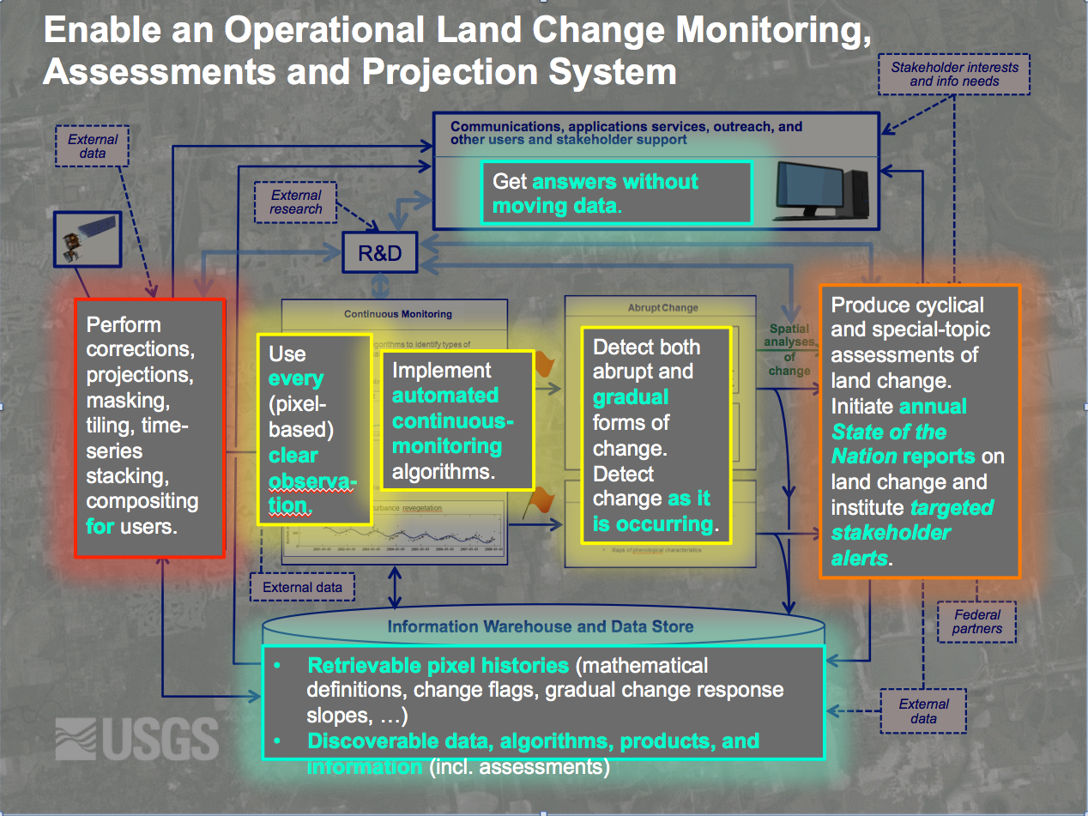

Slide 15
Many Challenges
How to Provide All Data Online
  Reprocessing in the Cloud?
  Processing Support from Partners?
What is the best solution for rapid access of the data cube for land change detection and other algorithms?
  Technologies / Approaches?
How to Create a more Flexible Architecture
  Distributed Archives, Processing, and/or Storage?
MSS data from Landsats 1-5
  Enable pixel-level analysis on all MSS data!
Cross-Platform Exploitation
  E.g. Landsat and Sentinel 2
Future Missions
  Long-Term Vision to Extend Landsat Data Record for Decades to Come
Notes:
As the cache size increases, what are ways to cost-effectively augment processing capability when reprocessing?
Are there more effective distribution architectures to create a more resilient archive and responsive distribution?
How to create an effective cross-platform product and distribution model to more seamlessly augment Landsat with other sensor data and products?
Maybe most importantly, assure the continuity of observations and extension of the 41-year Landsat data record for decades:
The US Administration has, for the first time in the Landsat Program history, committed to develop a long-term strategy for systematic sustained land observations

