Slide 1
SDCG-7 Meeting Introduction & Objectives
SDCG-7 Session 1

Slide 2
Historical Context
See the Prezi timeline
Concept and planning phases complete
Deliverables defined and nearing readiness (MGD, Space Data)
SDCG consolidating its approach
Coherent overall country engagement strategy for GFOI required

Slide 3
SDCG-7 Objectives
Confirm the SDCG Element 3 R&D Strategy, and finalise for presentation at SIT-30.
Confirm the SDCG Three-Year Work Plan, and confirm 2015 tasking.
Review the implementation and status of the Global Baseline Observation Strategy.
Review and progress the pilot implementation of the Space Data Services, including the SDMS.

Slide 4
SDCG-7 Objectives
Confirm linkages to the development process of the MGD component, including the MGD Portal.
Discuss and confirm the understanding between the GFOI Lead Team and across components on the modus operandi for country interaction.
Confirm linkages to FAO and World Bank and how the objectives and plans of these groups will be complemented by, and align with, those of the SDCG.
Confirm linkages to SilvaCarbon, including any potential support to Cambodia and Colombia.

Slide 5
SDCG-7 Objectives
Identify and agree space data service provision to Kenya’s SLEEK program.
Contribute to the discussion and agreement by GFOI on a country(s) for a cross component (CB, MGD, Space Data) focus in 2015.

Slide 6
Objectives By SDCG-7 Session
Objective Session: | 1 | 2 | 3 | 4 | 5 | 6 | 7 | 8 | 9 | 10 | 11
1. Confirm the SDCG Element 3 R&D Strategy, and finalise for presentation at SIT-30. |  | ◆ |  |  |  |  |  |  |  | ◆ | ◆
2. Confirm the SDCG Three-Year Work Plan, and confirm 2015 tasking. |  |  |  |  |  | ◆ | ◆ | ◆ |  | ◆ | ◆
3. Review the implementation and status of the Global Baseline Observation Strategy. |  |  |  |  |  |  | ◆
4. Review and progress the pilot implementation of the Space Data Services, including the SDMS. | ◆ |  |  | ◆ |  |  |  | ◆ |  |  | ◆
5. Confirm linkages to the development process of the MGD component, including the MGD Portal. | ◆ |  |  | ◆ |  |  |  | ◆
6. Discuss and confirm the understanding between the GFOI Lead Team and across components on the modus operandi for country interaction. |  |  | ◆ | ◆ |  |  |  | ◆ | ◆ |  | ◆
7. Confirm linkages to FAO and World Bank and how the objectives and plans of these groups will be complemented by, and align with, those of the SDCG. |  |  | ◆ | ◆ |  |  |  | ◆ | ◆ |  | ◆
8. Confirm linkages to SilvaCarbon, including any potential support to Cambodia and Colombia. |  |  | ◆ |  |  |  |  | ◆ | ◆ |  | ◆
9. Identify and agree space data service provision to Kenya’s SLEEK program. |  |  |  |  |  |  |  | ◆ | ◆ |  | ◆
10. Contribute to the discussion and agreement by GFOI on a country(s) for a cross component (CB, MGD, Space Data) focus in 2015. |  |  | ◆ |  |  |  |  | ◆ | ◆ |  | ◆

Slide 7
Agenda (1/6)
Wednesday 4th March
Transport (Coogee -> Nielsen Park) |  | 30 | 8:00 | 8:30
Registration and Coffee |  | 30 | 8:30 | 9:00
Session 1: MGD Portal Development Planning | Session Chair: Carly Green
Objective: The Methods and Guidance documentation has become a key GFOI product, touching on several of the GFOI components, and providing a valuable resource for countries considering or implementing national MRV systems. This session will provide a brief status of current progress, a preview of future work with "MGD 2.0". This Session will provide an opportunity for a discussion on how this work can be best aligned to support (and receive support from) the community. It is also the time for more detailed feedback on the Portal presentation from Monday.
Item | Presenter(s) | Duration | Start | End
GFOI MGD Portal Session - Introduction, Background and Context | Carly Green | 15 | 9:00 | 9:15
GFOI MGD Portal Session | Carly Green Chair | 60 | 9:15 | 10:15
Break |  | 30 | 10:15 | 10:45
Session 2: GFOI R&D Component Planning | Session Chair: Alex Held
Objective: The GFOI R&D Plan was released in 2014, and the direction of this component was passed to the GFOI Office. Consideration is being given to future direction of the GFOI R&D component. This session will start with a brief summary of current status and feature a discussion on the issues that need to be addressed to move the R&D component forward.
Item | Presenter(s) | Duration | Start | End
GFOI R&D Component Session - Introduction, Background and Context | Alex Held | 15 | 10:45 | 11:00
GFOI R&D Session | Alex Held Chair | 60 | 11:00 | 12:00
Lunch |  | 60 | 12:00 | 13:00

Slide 8
Agenda (2/6)
Session 3: Capacity Building Component | Session Chair: Sylvia Wilson
Objective: The GFOI Capacity Building component is being lead by the US SilvaCarbon program, with a series of workshops having been conducted across the Americas, Africa, and Asia. These workshops have featured significant contributions from FAO, and the MGD and space data components. This session will start with a brief overview of the current status, and plans for 2015-2016, and then feature a discussion on coordination issues including linkages to FAO and the other components of GFOI.
Item | Presenter(s) | Duration | Start | End
GFOI Capacity Building Session - Introduction, Background and Context | Sylvia Wilson | 15 | 13:00 | 13:15
GFOI Capacity Building Session | Sylvia Wilson Chair | 60 | 13:15 | 14:15
Session 4: Advances in Technological Resources | Session Chair: Jim Baker
Objective: This session will provide an update on progress being made on IT infrastructure design and products to improve delivery, storage, management and end-use of space data.
Item | Presenter(s) | Duration | Start | End
Australian Geoscience Data Cube | Adam Lewis | 30 | 14:15 | 14:45
Break |  | 15 | 14:45 | 15:00
Development of a Data Cube for GFOI outcomes (initial pilot for Kenya) | Brian Killough | 30 | 15:00 | 15:30
CSET Space Data Management Tools | Brian Killough | 30 | 15:30 | 16:00
Improvements in Space Data delivery by FAO | Erik Lindquist | 30 | 16:00 | 16:30
Improvements in Australia's Inventory System | Shanti Reddy | 30 | 16:30 | 17:00
Transport (Nielsen Park -> Coogee) |  | 30 | 17:15 | 17:45

Slide 9
Agenda (3/6)

Slide 10
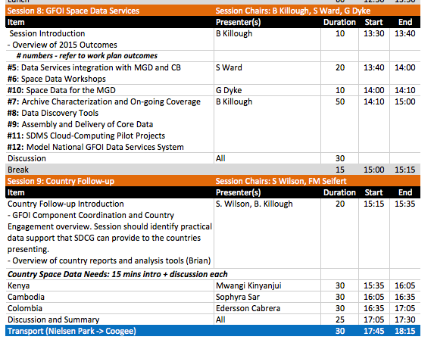
Agenda (4/6)

Slide 11
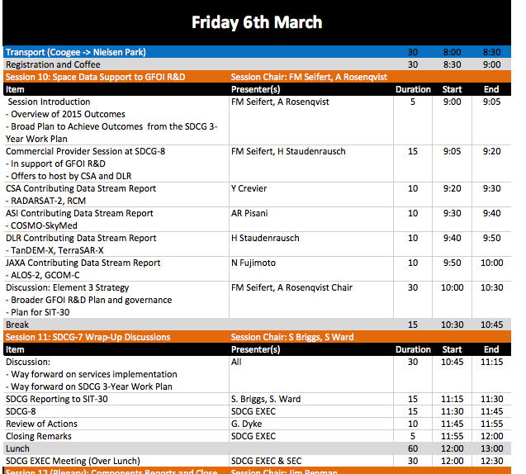
Agenda (5/6)

Slide 12
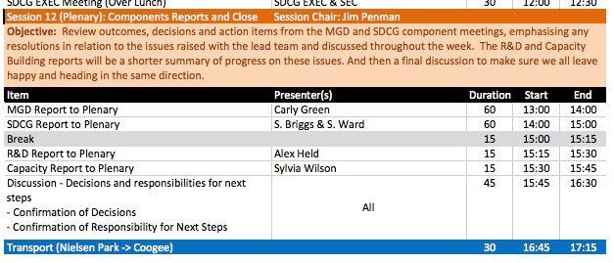
Agenda (6/6)

Slide 13
Socials
This evening, 18:30
Coogee Pavilion, 169 Dolphin St, Coogee
Casual food & drinks (no-host)
Speak with George if you wish to attend
Friday evening, 19:30
Local Taphouse, 122 Flinders St, Darlinghurst
Craft beers and food (table in name of Stephen Ward)
Speak with Stephen if you wish to attend
5 of Brian’s team, Yves + 1, Matt, Stephen confirmed

Slide 14
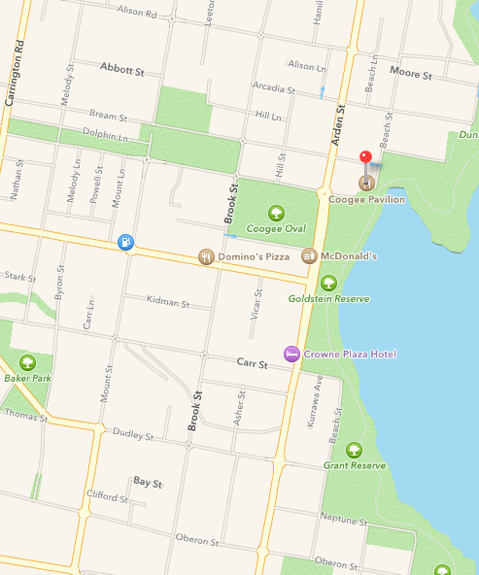
Coogee Pavilion

Slide 15
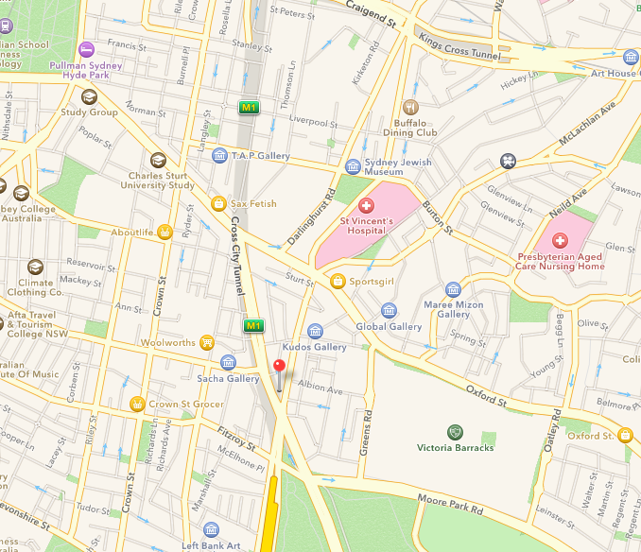
Local Taphouse

