Slide 1


GOFC-GOLD activities
&
Opportunities to improve linkages with GFOI
Brice Mora
GFOI Component Meeting, Sydney, March 2-6, 2015

Slide 2
Outline
Complementarities between MGD and REDD Sourcebook
REDD Sourcebook: update
Structure and content of the REDD training materials
REDD training materials: next steps (in discussion)
Integration of training materials with GFOI activities

Slide 3
GOFC-GOLD Sourcebook and GFOI MGD
• Sourcebook an annually updated review of science
• MGD step-by-step advice on readily implementable
Approaches
• Documents are complementary! – use them together to provide estimates of REDD+ activities consistent with IPCC Guidance as required by the UNFCCC COP.

Slide 4
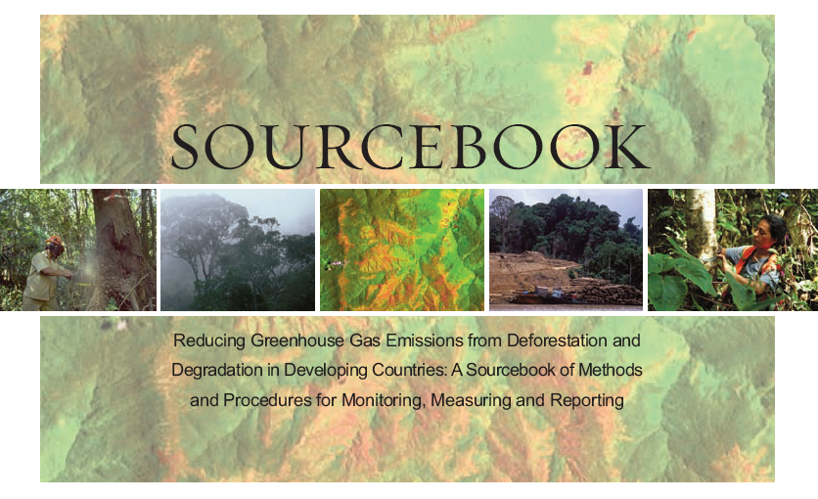
REDD+ activities of GOFC-GOLD LC PO
A sourcebook of methods and procedures for monitoring and reporting anthropogenic greenhouse gas emissions and removals associated with deforestation, gains and losses of carbon stocks in forests remaining forests, and forestation
Last version: released for COP 20, December 2014

Slide 5
GOFC-GOLD Sourcebook: last update
Warsaw Framework
Relationship between MGD and sourcebook
But also:
  emission uncertainty estimation, community forest monitoring, deforestation and forest degradation monitoring, biomass burning, evolving technologies: sub-section on UAVs, new sensors and datasets: list updated

Slide 6
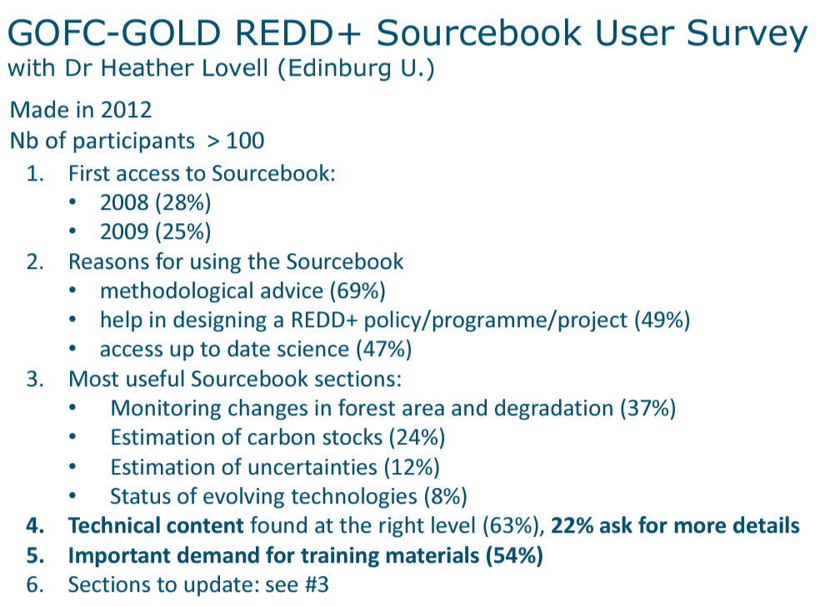

Slide 7




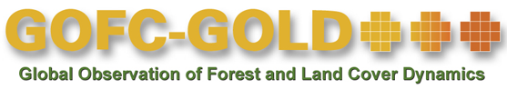



GOFC-GOLD Training Material: Coordination Team and Developers
World Bank FCPF
GOFC-GOLD LC PO & Wageningen U.: Martin Herold, Brice Mora, Erika Romijn

Slide 8
GOFC-GOLD training Material: Objectives and approach
Respond to the need for technical assistance and guidance for countries to develop REDD+ MRV systems
Provide a set of modular training materials to be used by developing countries and capacity development efforts in combination with complementary guidance documents (i.e. IPCC GPG, GOFC-GOLD, GFOI, FAO/UN-REDD);
Develop materials that include lecture materials, concrete country examples and short tutorials and exercises;
Create materials by building upon the GOFC-GOLD expert network, using country experts to provide examples and support independent review process
Make the training material available online on the GOFC-GOLD project office (next to Sourcebook) and the WorldBank FCPF websites. Other media of dissemination to be considered as well
Additional educational and pedagogical tools (e.g. distance and interactive learning) and more specific methods (i.e. use of specific software systems) can be implemented at a later stage.

Slide 9
Training material for REDD+ Monitoring and Reporting: Overview of Modules
REDD+ background and design
  1 UNFCCC context and requirements and introduction to IPCC guidelines
  M. Herold, E. Romijn, B. Mora
  2 Framework for building national forest monitoring systems for REDD+
  E. Romijn, M. Herold, B. Mora
  3 Assessing and analyzing drivers of deforestation and forest degradation E. Romijn, M. Herold
  4 Monitoring activity data for forests using remote sensing
  J. Miettinen, A. Langner, F. Achard, B. Mora
  5 Monitoring activity data for forests remaining forests (incl. forest degr.)
  C. Souza, S. Brown, J. Miettinen, F. Achard, M. Herold
  6 Estimating emission factors for forest cover change (def. and degr.)
  S. Brown, L. Murray, F.Casarim
  7 Incorporating community based approaches in national REDD+ monitoring - M. Skutsch, A. Balderas Torres
  8 Estimation of carbon emissions from deforestation and forest degr.
  S. Brown, L. Murray
  9 Estimation of GHG emissions from biomass burning
  L. Boschetti
  10 Estimation of uncertainties
  G. Grassi, S. Monni, F. Achard, A. Langner, M. Herold
  11 Overview and status of evolving technologies
  B. Mora, E. Romijn
REDD+ measuring and monitoring
REDD+ assessment and reporting
  12 National data organization and management
  E. Romijn, V. De Sy
  13 Data and guidance on developing REDD+ reference levels
  M. Herold, E. Romijn, S. Brown
  14 Guidance on reporting REDD+ performance using IPCC Guidelines and Guidance - G.Grassi, E. Romijn, M. Herold

Slide 10

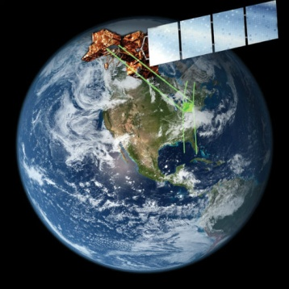
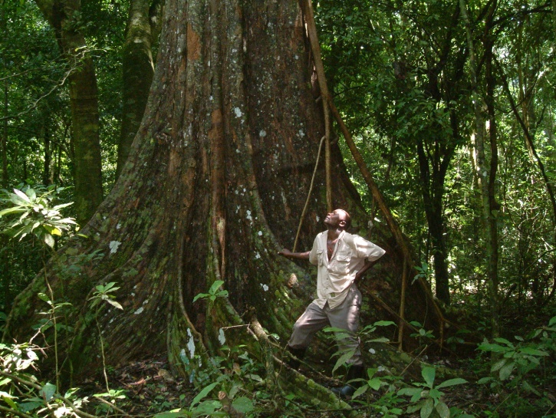
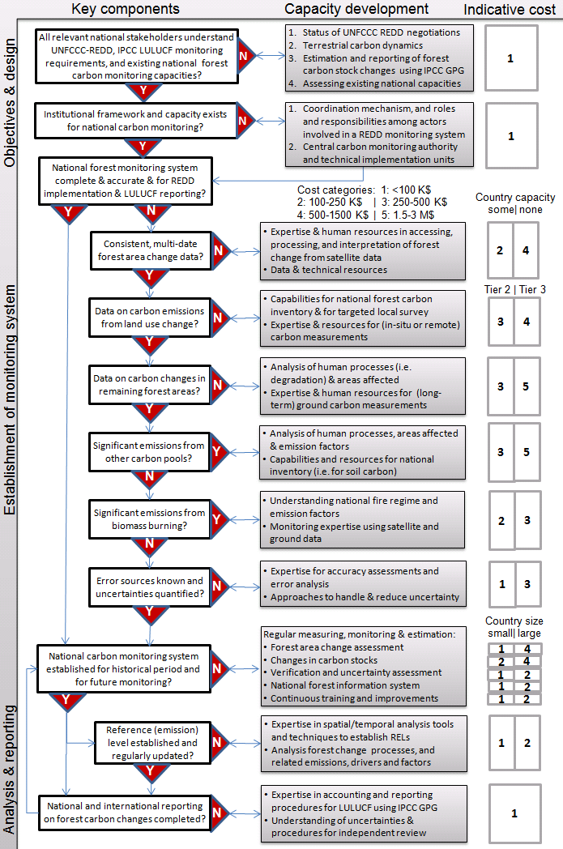
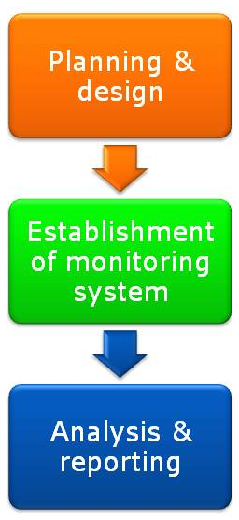
Set up of Modules & Target users
Background lectures
Background lectures
Introducing and presenting the background; relevance of topic & overview of possible methodological options and approaches
Intended for: REDD+ national and international policy makers; Project managers and Technical staff
Module 1.2 Framework for building national forest monitoring systems for REDD+
Module developers:
Erika Romijn
Martin Herold
Brice Mora
After the course the participants should be able to:
Understand the needs and priorities of a national REDD+ policy and implementation strategy
Assess and characterize forest monitoring and reporting capacities of developing countries in different national circumstances
Develop a roadmap for building sustained in-country capacities for REDD+ MRV
GOFC-GOLD training materials for REDD+ monitoring and reporting
Module 1.2 Framework for building national forest monitoring systems for REDD+
Country examples
Biomass density map (in T dry matter) for 2007 for Mexico, derived from INEGI vegetation map (2007) and INFyS 2004-2008 plot data.
Practical examples
of successful implementation activities in developing countries; experiences presenting different national circumstances
Intended for: MRV project managers & Designers and Technical staff
Practical exercises
Process for establishing a NFMS
Practical exercises and short tutorials
to provide simple hands-on exercises for implementation, data processing and analysis
Intended for: Technical staff

Slide 11
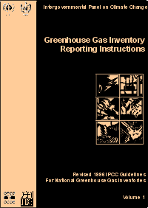
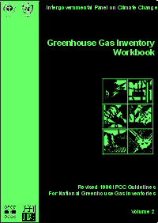
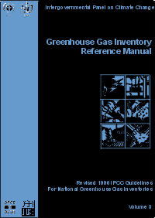
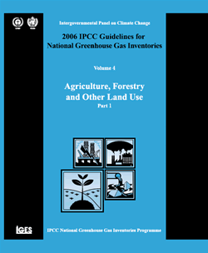
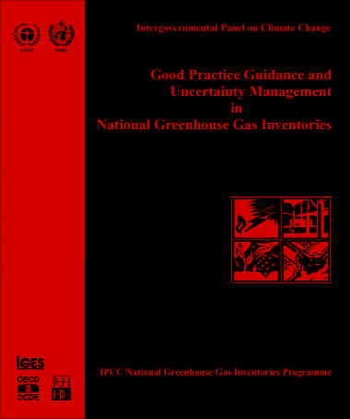
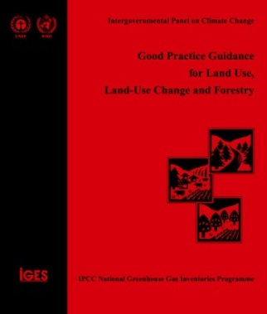

Module 1.1 UNFCCC context and requirements and introduction to IPCC guidelines
Module developers:
  Martin Herold, Wageningen University
  Erika Romijn, Wageningen University
  Brice Mora, Wageningen University
After the course the participants should be able to:
Understand the UNFCCC context and requirements for monitoring and reporting of REDD+ activities
Explain fundamental concepts of the IPCC guidelines for national GHG inventories and reporting for forest related activities
V1, January 2015
Creative Commons License

Slide 12
Background material
GOFC-GOLD Sourcebook, 2014. Section 1
http://www.gofcgold.wur.nl/redd/index.php
  IPCC Good Practice Guidelines and Guidance
  http://www.ipcc-nggip.iges.or.jp/public/index.html
  Methods and Guidance from the Global Forest Observation Initiative, 2014. (GFOI MGD) Integrating remote-sensing and ground-based observations for estimation of emissions and removals of greenhouse gases in forests.
  http://www.gfoi.org/methods-guidance-documentation
  Hewson, J., Steininger, M. and Pesmajoglou, S., eds. 2013. REDD+ Measurement, Reporting and Verification (MRV) Manual. USAID-supported Forest Carbon, Markets and Communities Program. Washington, DC, USA.
  http://www.fcmcglobal.org/documents/mrvmanual/MRV_Manual.pdf

Slide 13
Outline of lecture
1. Introduction to UNFCCC REDD+ process
2. UNFCCC context and requirements for measurement and reporting of REDD+ activities
3. IPCC guidelines for national GHG inventories and reporting for forest land
  a. Reporting principles
  b. Estimation of carbon emissions
Notes:
This lecture will start with introducing the principles of the UNFCCC REDD+ mechanism.
The UNFCCC context and requirements for MRV of REDD+ activities are outlined; including the modalities related to REDD+ monitoring from CP.19. Also, the concepts and difference of MRV and national forest monitoring systems are explained.
The last part of the lecture explains the requirements from the IPCC guidelines for national GHG inventories and reporting for forest related activities.

Slide 14
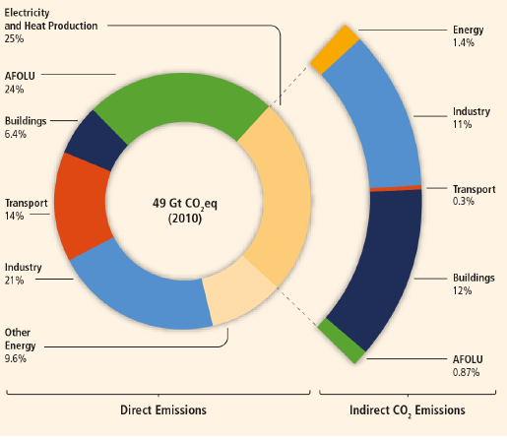
Greenhouse gas emissions by economic sectors in 2010
Electricity and
Heat Production 25%
Energy 1.4%
AFOLU 24%
Industry 11%
Buildings 6.4%
Transport 0.3%
Transport 14%
Industry 21%
Buildings 12%
Other energy 9.6%
AFOLU 0.87%
Source: IPCC, 2014
Notes:
IPCC, 2014: The figure shows the total anthropogenic GHG emissions (GtCO2eq/yr) by economic sectors for 2010. The inner circle shows direct GHG emission per sector in percentage of the total anthropogenic GHG emissions. Pull-out shows how indirect CO2 emission shares (in % of total anthropogenic GHG emissions) from electricity and heat production are attributed to sectors of final energy use.
The Agriculture, Forestry and Other Land Use (AFOLU) sector includes land-based CO2 emissions from forest fires, peat fires and peat decay that approximate to net CO2 flux from the Forestry and Other Land Use (FOLU) sub-sector (also referred to as LULUCF – Land Use, Land-Use Change, and Forestry – a sub-set from AFOLU). For more information see chapter 11 of the report.
From 1970-2010, total anthropogenic GHG emissions have increased with larger absolute increases toward the end of this period. About half of cumulative anthropogenic CO2 emissions between 1750 and 2010 have occurred in the period from 1970-2010. Cumulative CO2 emissions from Forestry and Other Land Use (FOLU) since 1750 increased from 490±180 GtCO2 in 1970 to 680±300 GtCO2 in 2010.
Source: IPCC, 2014. IPCC 5th assessment report. IPCC Working Group III Contribution to AR5. Climate Change 2014: Mitigation of Climate Change. Summary for policy makers:
Available at: http://www.ipcc.ch/report/ar5/ ; http://mitigation2014.org/report/summary-for-policy-makers

Slide 15
Greenhouse gas emissions by economic sectors in 2010
...
Notes:
IPCC, 2014: The figure shows the total anthropogenic GHG emissions (GtCO2eq/yr) by economic sectors for 2010. The inner circle shows direct GHG emission per sector in percentage of the total anthropogenic GHG emissions. Pull-out shows how indirect CO2 emission shares (in % of total anthropogenic GHG emissions) from electricity and heat production are attributed to sectors of final energy use.
The Agriculture, Forestry and Other Land Use (AFOLU) sector includes land-based CO2 emissions from forest fires, peat fires and peat decay that approximate to net CO2 flux from the Forestry and Other Land Use (FOLU) sub-sector (also referred to as LULUCF – Land Use, Land-Use Change, and Forestry – a sub-set from AFOLU). For more information see chapter 11 of the report.
From 1970-2010, total anthropogenic GHG emissions have increased with larger absolute increases toward the end of this period. About half of cumulative anthropogenic CO2 emissions between 1750 and 2010 have occurred in the period from 1970-2010. Cumulative CO2 emissions from Forestry and Other Land Use (FOLU) since 1750 increased from 490±180 GtCO2 in 1970 to 680±300 GtCO2 in 2010.
Source: IPCC, 2014. IPCC 5th assessment report. IPCC Working Group III Contribution to AR5. Climate Change 2014: Mitigation of Climate Change. Summary for policy makers:
Available at: http://www.ipcc.ch/report/ar5/ ; http://mitigation2014.org/report/summary-for-policy-makers

Slide 16
In summary
REDD+ is a UNFCCC process following COP decisions
Countries measure and report on the 5 REDD+ activities and carbon pools defined by IPCC; significant pools and activities should not be omitted
COP decisions require use of IPCC guidance and guidelines
National forest monitoring systems needed for measurement, reporting and verification of REDD+ activities
The GFOI MGD has described how to use IPCC guidance and guidelines to do this

Slide 17
Country examples and exercises
Country examples
Review of FCPF country REDD+ readiness preparation proposals
Phased approach to improving greenhouse gas inventories in Mexico
Experiences from Annex-I countries using Tier-3 models for carbon accounting
Exercises
Exercises will start in Module 1.2

Slide 18
Recommended modules as follow up
Module 1.2 as a continuation of the UNFCCC context within a country and to learn more about building a national forest monitoring system for REDD+
Modules 2. to continue with REDD+ measuring and monitoring
Modules 3. to learn more about REDD+ assessment and reporting

Slide 19
Coordination team, Developers & Reviewers
Development team:
Suvi Monni (Benviroc), Frédéric Achard, Giacomo Grassi, Andreas Langner, Jukka Miettinen, Yosio Shimabukuro (European Commission, Joint Research Center), Carlos Souza (Imazon), Luigi Boschetti (University of Idaho), Arturo Balderas Torres, Margaret Skutsch (Universidad Nacional Autónoma de Mexico), Martin Herold, Brice Mora, Veronique De Sy, Erika Romijn (Wageningen University), Sandra Brown, Felipe Casarim, Lara Murray (Winrock International)
Independent reviewers:
Naikoa Aguilar-Amuchastegui, Valerio Avitabile, Veronique De Sy, Sandro Federici, Carly Green, Inge Jonckheere, Ben de Jong, Gabrielle Kissinger, Pham Manh Cuong, Ron McRoberts, Anthea Mitchel, Jim Penman, Rosa Maria Roman Cuesta, Arief Wijaya, Sylvia Wilson

Slide 20
Distribution License of Training Materials
Allowing commercial use of the materials
Restricting distribution of adaptations
=­> Creative Commons Attribution-NoDerivatives 4.0 International License

Slide 21
Training Materials: a Few Stats and Access
Stats:
14 modules
669 lecture slides
28 country examples
22 exercises
… and more (support documents, notes, references)
Website:
http://www.gofcgold.wur.nl/redd/Training_materials.php

Slide 22
Training Materials: Next Steps
Online release of the training material (March 2015)
Translation in French and Spanish
In discussion
Dissemination events (SBSTA, COP)
Planned activities with FCPF countries (training workshops)
Video recordings
Webinars

Slide 23
Integration of training materials with the GFOI activities
Further cross-referencing (in documents and websites)
Develop additional hands-on exercises linked to the modules of the training materials
Discuss possible use of the training materials by FAO, SylvaCarbon, and GFOI activities in general
Early access to materials on demand

Slide 24
R&D framework and impact pathways
R&D plan
Users (countries,
UN-REDD, FCPF, etc.)
Research
priorities
Donors
R&D
activities
SDCG
Implementation
R&D/science
community
MGD, GOFC-GOLD
Sourcebook
Synthesis
Workshops
Capacity development
Outreach

Slide 25

THANK YOU
brice.mora@wur.nl
Follow us:
Twitter: @gofcgold_lc
Facebook: www.facebook.com/gofcgold.lc.po
Newsletter: www.gofcgold.wur.nl

