Slide 1
Progress report on Boston Meeting Actions
Jim Penman (on behalf of participants)
MGD Segment
GFOI Meetings
Sydney, March 2015

Slide 2
Meeting Description
Accuracy assessment workshop
Boston University, Earth and Environment, June 2014
Participants: Danny Donoghue, Erik Lindquist, Ron McRoberts^{a)}, Erik Næsset, Pontus Olofsson^{b)}, Jim Penman, Christophe Sannier, Pete Watt, Sylvia Wilson, Curtis Woodcock^{b)}
Remote engagement: Simon Eggleston, Carly Green, Martin Herold, Steve Stehman
Notes:
a) Chair
b) Hosts

Slide 3
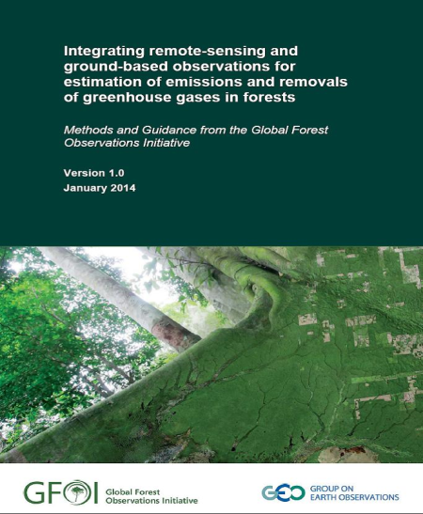
Context
GFOI Methods and Guidance Document (MGD) says how to estimate REDD+ activities based on IPCC GHG methodologies
IPCC methodologies require …neither over nor under estimates so far as can be judged and uncertainties reduced as far as practicable

Slide 4
Treatment of Uncertainties in the MGD
Stratify according to ecosystem and management criteria; detect change
Use statistical inference to assess activity data uncertainty and correct for possible bias due to map classification errors (MGD §3.7)
Obtain carbon densities and associated uncertainties from NFI (if available) or by sampling the strata (MGD § 2.1 (includes decision tree); Annex D)
Overall quantification of uncertainties – use IPCC approach (MGD § 4)

Slide 5
Questions for Workshop
What other statistical approaches may there be to complement those in MGD Version 1?
Need for decision tree to choose between methods identified?
Extend MGD material on relationship between remote sensing and the stock change method?
What can we say about accuracy of global data sets?
If this is a two-year task, what interim advice is possible? – see next slide

Slide 6
Outputs
 | Product | Status | Lead
1 | Statistical inference decision tree | First draft prepared at meeting, revised and circulated Aug 2014 | PO
2 | Review paper with decision tree | First draft expected March 2015 | RMR
3 | Country case studies (will be annexes to (2) | Pending | See below
4 | Module on statistical inference | Pending | RMR
5 | Module on use of global datasets | Publication imminent March 2015 | JP
6 | Training material | May 2015 | PO
7 | Review paper on experiences with global data sets | Pending, to take account of work underway in Gabon (CS), Tanzania (EN), Guyana (PW,DD) | RMR
Proposed country case studies (product 3) Gabon (CS); Guyana (PW, DD); DRC, Ecuador (EL,PO); Republic of Congo (EL, CS); Peru (PO,SVS); USA (RMR); Norway or Sweden (EN, RMR); Mexico (PO, RMR to consider); Colombia (PO)

Slide 7
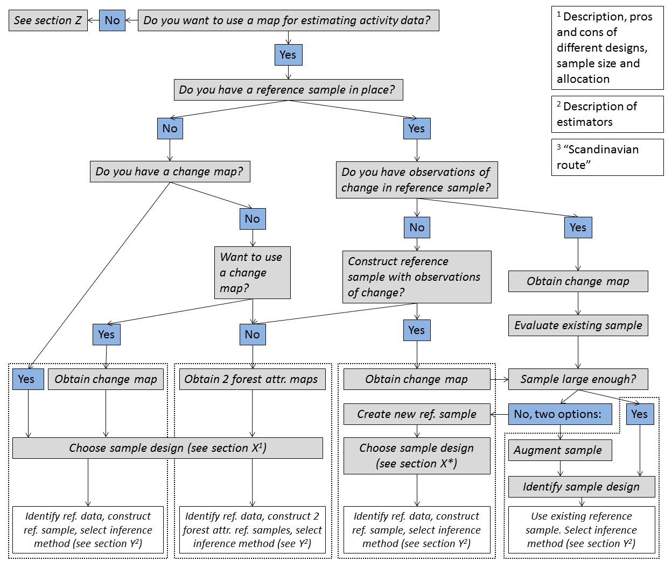

Slide 8
Outputs
 | Product | Status | Lead
1 | Statistical inference decision tree | First draft prepared at meeting, revised and circulated Aug 2014 | PO
2 | Review paper with decision tree | First draft expected March 2015 | RMR
3 | Country case studies (will be annexes to (2) | Pending | See below
4 | Module on statistical inference | Pending | RMR
5 | Module on use of global datasets | Publication imminent March 2015 | JP
6 | Training material | May 2015 | PO
7 | Review paper on experiences with global data sets | Pending, to take account of work underway in Gabon (CS), Tanzania (EN), Guyana (PW,DD) | RMR
Proposed country case studies (product 3) Gabon (CS); Guyana (PW, DD); DRC, Ecuador (EL,PO); Republic of Congo (EL, CS); Peru (PO,SVS); USA (RMR); Norway or Sweden (EN, RMR); Mexico (PO, RMR to consider); Colombia (PO)

Slide 9
Outputs
 | Product | Status | Lead
1 | Statistical inference decision tree | First draft prepared at meeting, revised and circulated Aug 2014 | PO
2 | Review paper with decision tree | First draft expected March 2015 | RMR
3 | Country case studies (will be annexes to (2) | Pending | See below
4 | Module on statistical inference | Pending | RMR
5 | Module on use of global datasets | Publication imminent March 2015 | JP
6 | Training material | May 2015 | PO
7 | Review paper on experiences with global data sets | Pending, to take account of work underway in Gabon (CS), Tanzania (EN), Guyana (PW,DD) | RMR
Proposed country case studies (product 3) Gabon (CS); Guyana (PW, DD); DRC, Ecuador (EL,PO); Republic of Congo (EL, CS); Peru (PO,SVS); USA (RMR); Norway or Sweden (EN, RMR); Mexico (PO, RMR to consider); Colombia (PO)

Slide 10
Outputs
 | Product | Status | Lead
1 | Statistical inference decision tree | First draft prepared at meeting, revised and circulated Aug 2014 | PO
2 | Review paper with decision tree | First draft expected March 2015 | RMR
3 | Country case studies (will be annexes to (2) | Pending | See below
4 | Module on statistical inference | Pending | RMR
5 | Module on use of global datasets | Publication imminent March 2015 | JP
6 | Training material | May 2015 | PO
7 | Review paper on experiences with global data sets | Pending, to take account of work underway in Gabon (CS), Tanzania (EN), Guyana (PW,DD) | RMR
Proposed country case studies (product 3) Gabon (CS); Guyana (PW, DD); DRC, Ecuador (EL,PO); Republic of Congo (EL, CS); Peru (PO,SVS); USA (RMR); Norway or Sweden (EN, RMR); Mexico (PO, RMR to consider); Colombia (PO)

Slide 11
Outputs
 | Product | Status | Lead
1 | Statistical inference decision tree | First draft prepared at meeting, revised and circulated Aug 2014 | PO
2 | Review paper with decision tree | First draft expected March 2015 | RMR
3 | Country case studies (will be annexes to (2) | Pending | See below
4 | Module on statistical inference | Pending | RMR
5 | Module on use of global datasets | Publication imminent March 2015 | JP
6 | Training material | May 2015 | PO
7 | Review paper on experiences with global data sets | Pending, to take account of work underway in Gabon (CS), Tanzania (EN), Guyana (PW,DD) | RMR
Proposed country case studies (product 3) Gabon (CS); Guyana (PW, DD); DRC, Ecuador (EL,PO); Republic of Congo (EL, CS); Peru (PO,SVS); USA (RMR); Norway or Sweden (EN, RMR); Mexico (PO, RMR to consider); Colombia (PO)

Slide 12
Is there existing national capacity to produce products set out in MGD Table 6? (note a)
Do you need maximum accuracy at the minimum mapping unit level? (note b)
N
Y
Develop national capacity to produce products set out in MGD Table 6 (note c)
Y
N
Use national capacity. Consider global maps as cross-check
Consider use of global data sets as described in this module (see note d)
Notes:
a) All cases assume joint use of mapped and reference data.
b) E.g. for interacting with stakeholders, identifying drivers or associating remotely sensed and ground-based data.
c) Use of global datasets could be an interim step while national capacity is developed.
d) Factors identified in the text include preferences for national ownership, cost relativities of national mapping or global datasets plus increased reference sample size, and ability to respond to technological developments.

Slide 13
Outputs
 | Product | Status | Lead
1 | Statistical inference decision tree | First draft prepared at meeting, revised and circulated Aug 2014 | PO
2 | Review paper with decision tree | First draft expected March 2015 | RMR
3 | Country case studies (will be annexes to (2) | Pending | See below
4 | Module on statistical inference | Pending | RMR
5 | Module on use of global datasets | Publication imminent March 2015 | JP
6 | Training material | May 2015 | PO
7 | Review paper on experiences with global data sets | Pending, to take account of work underway in Gabon (CS), Tanzania (EN), Guyana (PW,DD) | RMR
Proposed country case studies (product 3) Gabon (CS); Guyana (PW, DD); DRC, Ecuador (EL,PO); Republic of Congo (EL, CS); Peru (PO,SVS); USA (RMR); Norway or Sweden (EN, RMR); Mexico (PO, RMR to consider); Colombia (PO)

Slide 14
Outputs
 | Product | Status | Lead
1 | Statistical inference decision tree | First draft prepared at meeting, revised and circulated Aug 2014 | PO
2 | Review paper with decision tree | First draft expected March 2015 | RMR
3 | Country case studies (will be annexes to (2) | Pending | See below
4 | Module on statistical inference | Pending | RMR
5 | Module on use of global datasets | Publication imminent March 2015 | JP
6 | Training material | May 2015 | PO
7 | Review paper on experiences with global data sets | Pending, to take account of work underway in Gabon (CS), Tanzania (EN), Guyana (PW,DD) | RMR
Proposed country case studies (product 3) Gabon (CS); Guyana (PW, DD); DRC, Ecuador (EL,PO); Republic of Congo (EL, CS); Peru (PO,SVS); USA (RMR); Norway or Sweden (EN, RMR); Mexico (PO, RMR to consider); Colombia (PO)

Slide 15
Summary
Effective core group established for advancing work on statistical issues
Outputs peer reviewed
Consolidated advice in prospect on statistical inference applied to area estimation, applicable to all circumstances likely to be encountered in practice
Module on global data sets about to be published; work-stream established
Areas identified for incorporation in MGD version 2; completion on outputs anticipated by June 2015.

