Slide 1
NFMS Focus on monitoring functions
National Forest Monitoring System
to disseminate forest-related geospatial data on the web
Dr. Inge Jonckheere, FAO UN-REDD
October 2014, Oslo, Vietnam

Slide 2
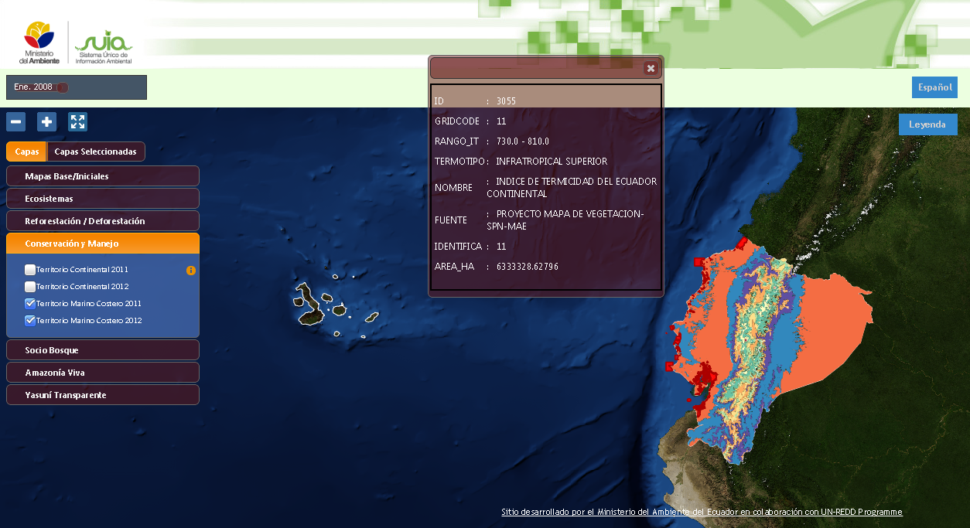
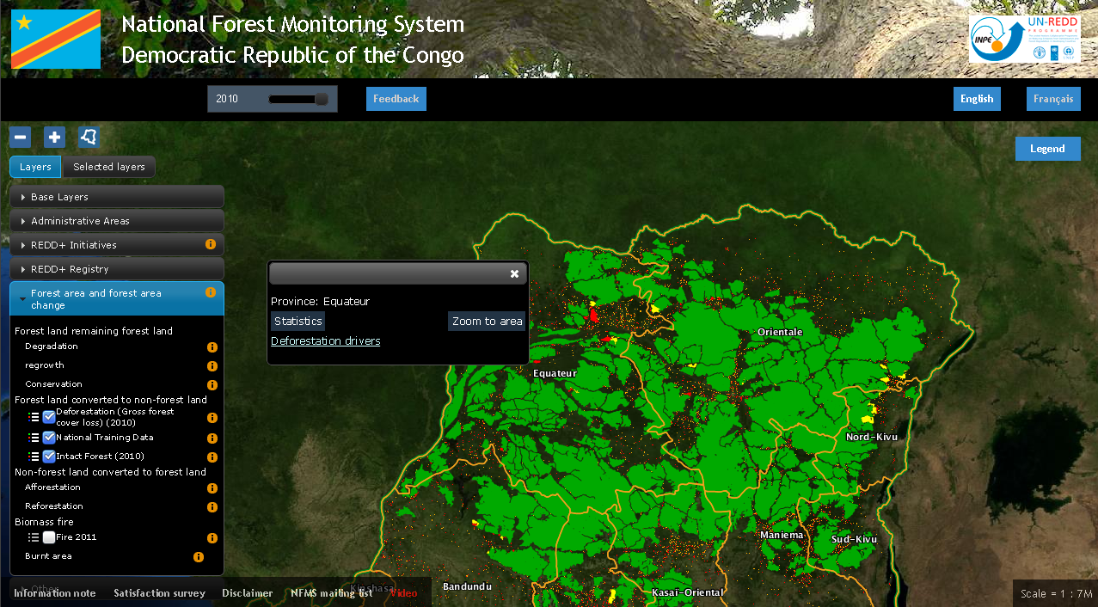
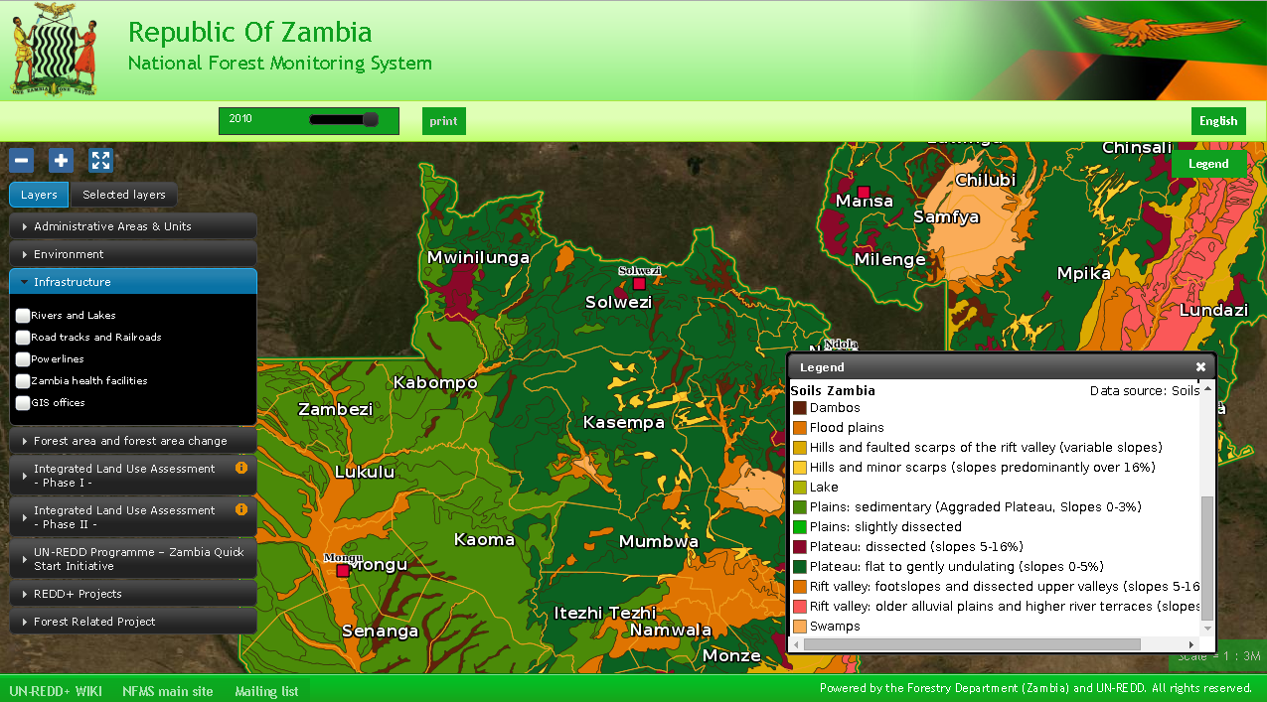
NFMS is an Open data portal
End-users browse national maps, display charts, read papers related to forest assessment and redd+ initiatives

Slide 3
Data generation
In country mapping
Existing national products (historical maps & products)
Space Data Management System (SDMS): cloud based approach of all open source modules for the processing of data up to the desired processing level of the country
(pilot finalised, actually under review for funding)
Global products being applied op national scale
Disseminate good practices at national levels
Introduce easy-to-use assessment tools
Enhance capacity within national ministries
Assess utility of historic maps
Assess utility of global tree cover (UMD) product
Build realistic reference levels

Slide 4
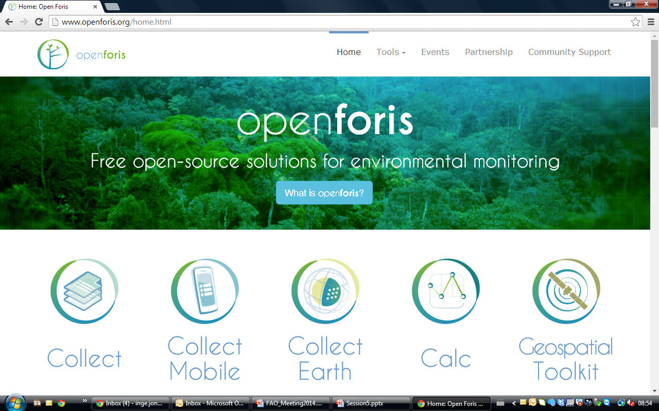
Tools for national forest inventory and forest statistics: collection, calculation and analysis

Slide 5
Cloud computing structure
(SDMS)

Slide 6
SDMS structure
User menu will allow to access data & tools available on the portal
Optical and radar, public and private satellite data will be made available
Relevant algorithms for the respective data sets, modular approach
Process automatization (started already), more in the future
Tools to select and upload the relevant satellite data sources
Following "products" to be made available during the project period Tree/non-tree cover (Forest/non-forest cover in GFOI MDG) Tree cover change (Forest cover change in MDG) Land use/land cover Land conversion category (activity data) Near real-time change indicators (early warning system)
Countries can download the final product ( or raw data )
All methods / tools developed will be made available

Slide 7
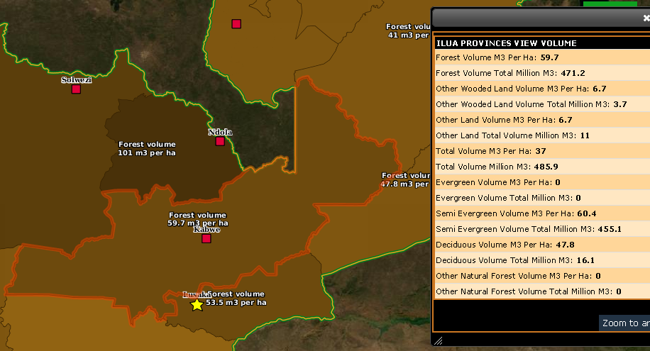
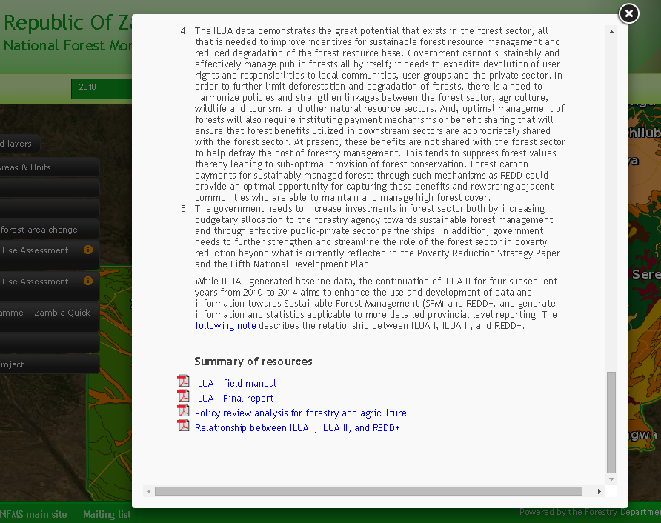
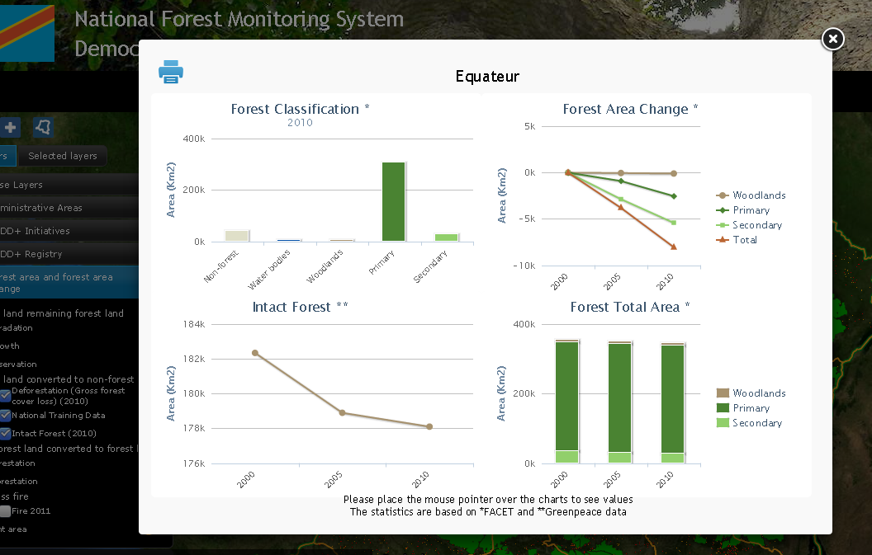
Management of Data (1/3)
NFMS web portal is focused on Geospatial data, both Raster and Vector
- it is not a wiki or a document management system -
Time series dataset (data available on several points in time)
landcover, land use
forests masks
Auxiliary data: feature info(1), documents(2), Charts(3)
Static dataset
admin boundaries & cities (mandatory)
Infrastructure roads, powerlines
natural parks and protected areas
biophysical maps (Vegetation, Soils, Geology)
redd+ initiatives/projects
Auxiliary data: feature info(1), documents(2), photos
1
2
3
Fig.1, 2, 3 - Examples of auxiliary data

Slide 8
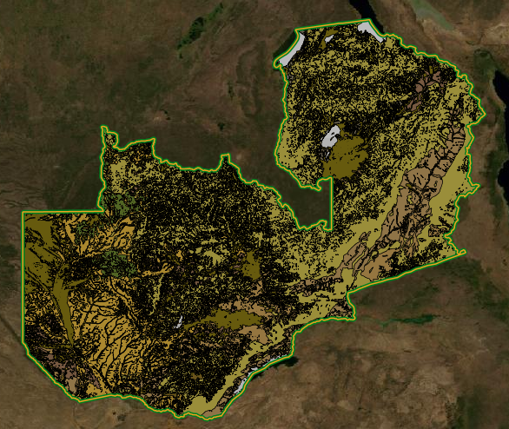
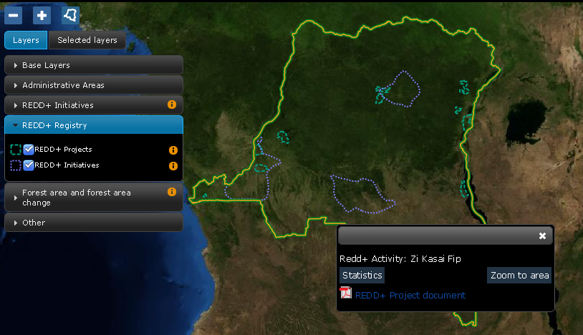
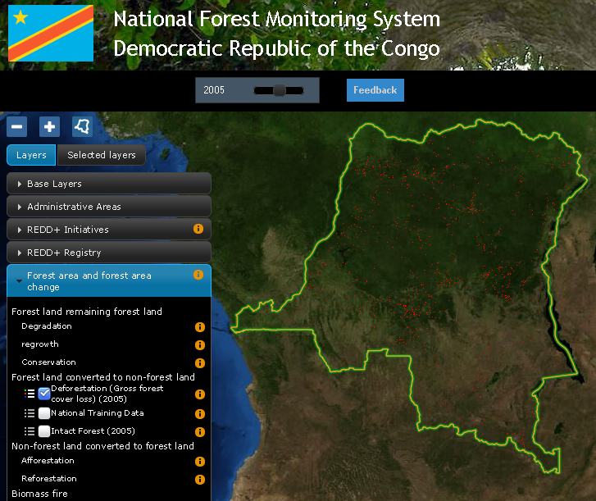
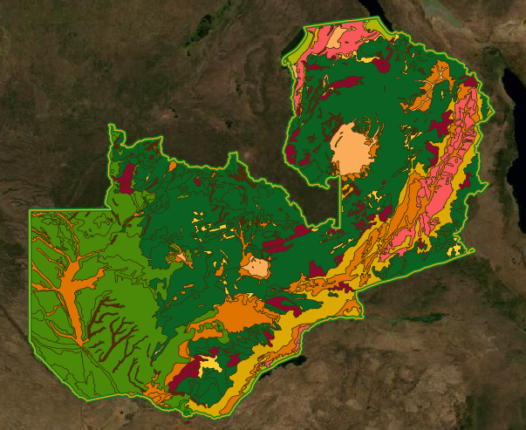
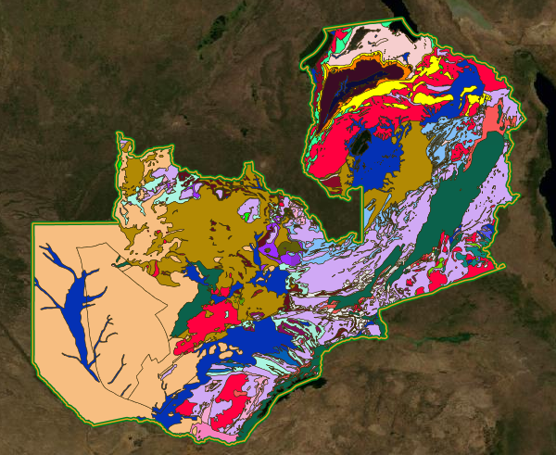
Management of Data (2/3) examples
STATIC DATASET
REDD+ initiatives
STATIC DATASET
Biophysical Maps:
Zambia Vegetation, Soil and Geology layers
TIME SERIES DATA
Forest cover loss 2000 - 2005 - 2010
(Time can changed with the slider on the top menu)

Slide 9
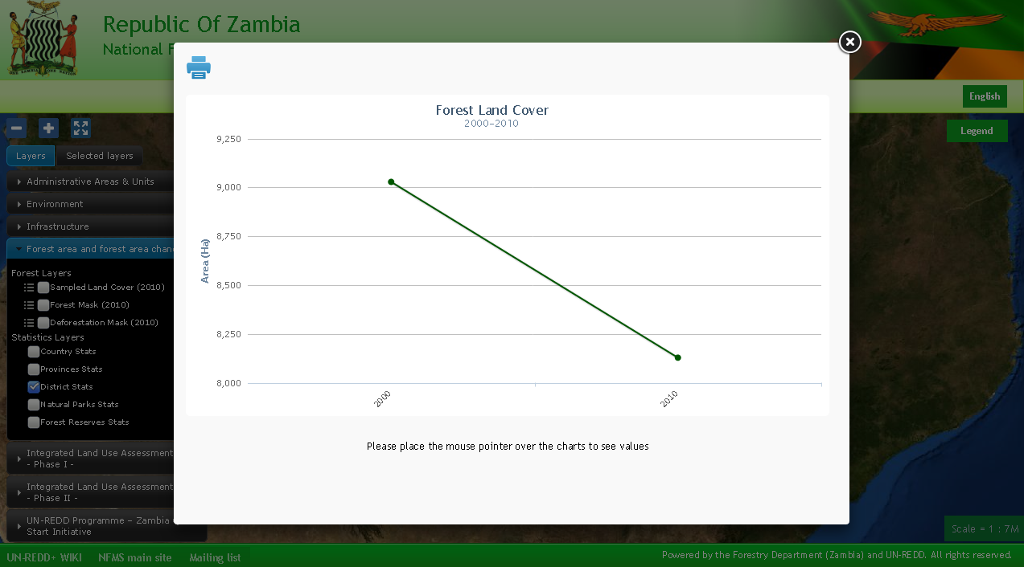
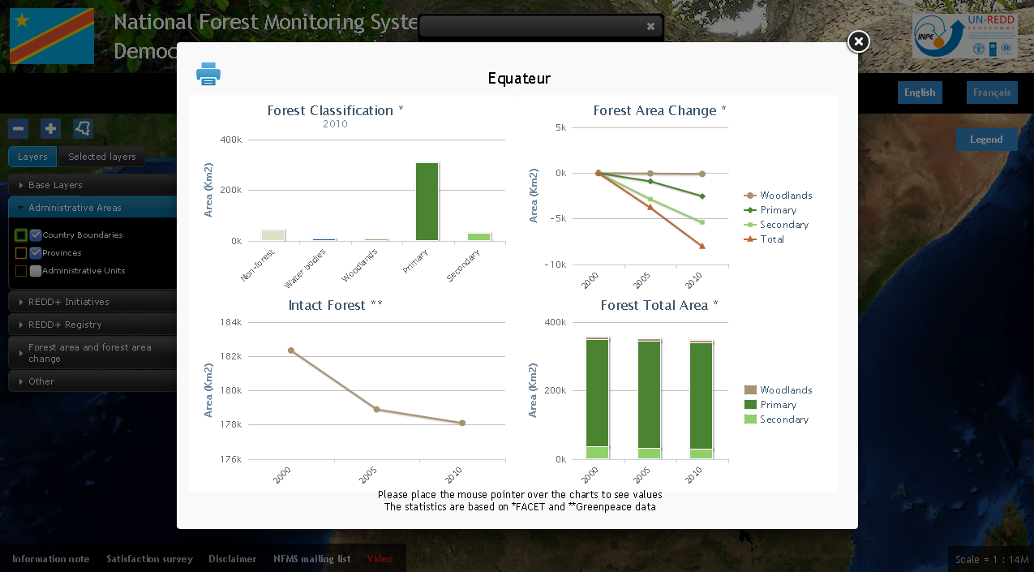
Management of Data (3/3) Stats/Charts
In order to a have a better understanding of the time series database, the portal can be configured with user-defined statistics to perform Raster Algebra computations.
The results of the computation are available in a raw CSV format and are displayed on the website as charts.

Slide 10
Audience
Country citizens are able to get acquainted about forest status without read long technical reports
Policy makers can use the tool (and statistics) for decision support for their legislative initiatives
International GIS-RS experts can use the platform to have a glance on the overall national forest dataset available

Slide 11
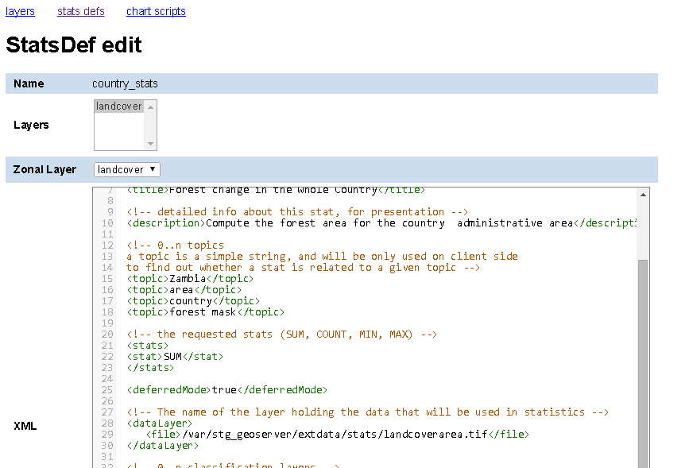
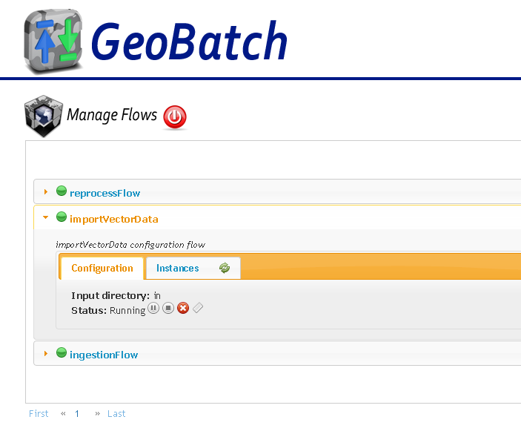
System administration
WebConsole to easy define/(re)compute statistics and charts based on timeseries data
Automatic stats computation and chart generation each time a new granule is added to a timeseries dataset
Ingest and publish new data uploading via ftp a tiff or a shp file

Slide 12
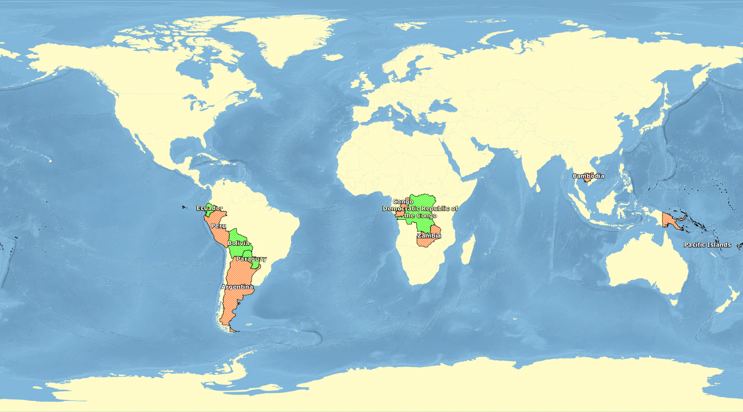
Supported countries
Democratic Republic of congo
http://www.rdc-snsf.org/
Paraguay
http://84.33.1.31/
Ecuador
http://geoportal.ambiente.gob.ec/portal/
Papua New Guinea
http://png-nfms.org/
Zambia
coming soon
Argentina
Bolivia
Perù
Congo
Cambodia
Pacific Islands
See more at http://nfms4redd.org/nfms-overview/

Slide 13
Core Technologies / Protocols
WEB protocols
HTTP
OGC Web Services: WMS and WFS protocols
http://www.opengeospatial.org/standards
Technologies and programming languages
Linux(Ubuntu LTS, CentOS6.x)
Java7
Tomcat
javascript
Chef
VMware virtualization systems
although any other virtualization system can be used

Slide 14
Geospatial data management
All the geospatial processing is performed with the following Open Source softwares:
The client application (what the end-user see) has been developed internally by the FAO Forestry Department.
It is built on top of:
GeoServer is an Open Source server for sharing geospatial data. Designed for interoperability, it publishes data from any major spatial data source using open standards.
GeoBatch is an Open Source Java enterprise application for the collection, processing and publication of geospatial data.
GeoTools is an open source Java library that provides tools for geospatial data.
OpenLayers is an open source JavaScript library for displaying map data in web browsers. It provides an API for building rich web-based geographic applications similar to Google Maps and Bing Maps.
PostGIS is a spatial database extender for PostgreSQL object-relational database. It adds support for geographic objects allowing location queries to be run in SQL.

Slide 15
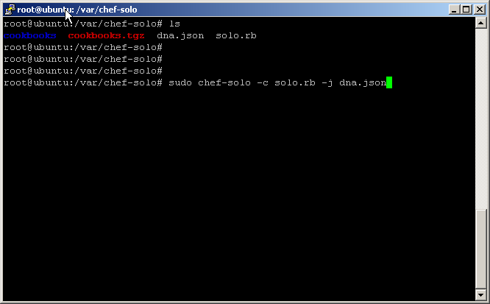
Automatized Deployment
NFMS architecture is modular and made of several software components, which implies that it require lot of time to be deployed on a new server.
Each country needs autonomous environment so an automatized deployment system has been developed using the chef technology.
Manual configuration and further tuning are required only for high-traffic needs
Deplyment of NFMS in 3 quick steps:
Copy a directory from github to the server
Review the files solo.rb dna.json changing default passwords
Run the chef-solo command and drink a coffee while chef is working for you

Slide 16
Skills required to get involved
In order to get involved as...
System Administrator(GIS/RS expert, junior GIS software engineer)
Basic knowledge of geospatial data format: shapefiles, postgis, geotiff
Basic knowledge of linux shell
Stats/Charts developer(GIS/RS expert, junior GIS software engineer)
Basic knowledge of geospatial data format: shapefiles, postgis, geotiff
Knowledge of XML and an interpreted language as python or groovy
System Engineer(GIS software engineer)
Deep knowledge of javaEE and spring framework
Deep knowledge of the javascript language
Knowledge of HTTP, WMS and WFS protocols
Deep knowledge of Linux OS

Slide 17
NFMS web portal Summary
Open data Web portal useful both for expert and generic users
Handle the most common raster and vector data formats
Handle time series datasets
Compute statistics and generate charts using an XML document as statistic definition
Provide a system administration back-end to update data and define statistics through a web GUI
Built on top of widely used OpenSource software components
Easy production-deploymemnt of the platform using a chef-cookbook

Slide 18
Thank you!
www.nfms4redd.org
Contact: inge.jonckheere@fao.org

