Slide 1
CBERS-4 Status and more... SDCG-6 Session 4, Item 35
Hilcéa Ferreira
INPE - Brazil

Slide 2
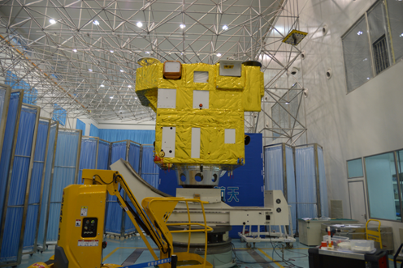
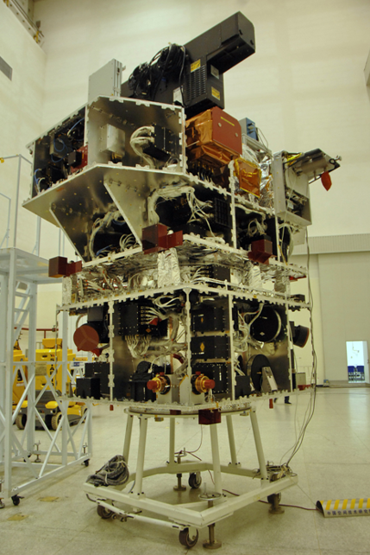
Plans for CBERS-4
7th of December 2014​ is the date planned for CBERS-4 launching, using a Long March rocket.
Up to now everything is fine:
CBERS-4 has already been subjected to electrical and environmental tests and has an estimated life of three years.
The 100 hours test was done, and the satellite was sent to the launching base in Taiwan, China, on October 17.

Slide 3
Other Missions
INPE and CAST are working on a proposal of a sixth satellite, CBERS-4A, to be released within three years.
Governments will define a proposal for CBERS-4A in January 2015
Sensors | Resolution | Bands | Swath | Revisit
MUX | 16 m | B, G, R, NIR | 94.9 km | 31 days
HRC | 2 m | B, G, R, NIR, MIR | 94.9 km | 31 days
WFI | 55 m | B, G, R, NIR | 683.9 km | 5 days
APD (Polarized Detector for Aerosol) | < 2.9 km | 0.76-2.05 (4 bands) | 833 km | -

Slide 4
Data access plans
August 2014, the Indian Space Research Organization (ISRO) and the Brazilian Space Agency (AEB) signed a Cooperative Program for the direct reception and distribution of Resourcesat-2 data.
INPE and USGS signed a Cooperative Program for the direct downlink of Landsat-7 and Landsat-8 data. We will start receiving Landsat-8 in November, 2014. INPE shall, in cooperation with USGS, receive, process, archive, distribute and exchange such data, in accordance to its free data policy.

Slide 5
Remote Sensing Data Center at INPE
More than 800 TB of satellite data: CBERS, LANDSAT, AQUA, TERRA, GOES METEOSAT, NOAA, ENVISAT, RADARSAT, UK-DMC-2, S-NPP, MetOp-B and RESOURCESAT.
Currently, we receive:
AQUA, TERRA, GOES-13, LANDSAT-7, NOAA-15, NOAA-16, NOAA-18, NOAA-19, MetOp-B and S-NPP
RESOURCESAT-2 (LISS-3 and AWiFS) and images will be available at INPE’s catalogue in October, 2014
Ready to receive LANDSAT-8, FY-3, and GOES-R, FORMOSAT-7/COSMIC-2, CBERS-4
Data is freely distributed from INPE’s data catalogue:
http://www.dgi.inpe.br/CDSR/

Slide 6
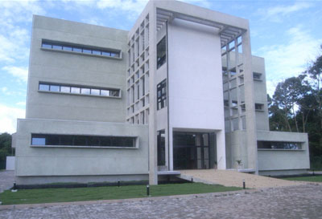
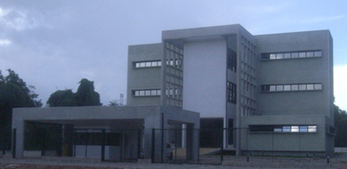
Capacity Building Initiatives – CRA/INPE
The activities of INPE´s Amazon Regional Center involve research and scientific development to becoming a world reference center in the monitoring of tropical forests:
Spreading Geotechnology in the region;
Being an international center for the dissemination of technology in order to monitor characteristics of tropical forests
http://www.inpe.br/cra/ingles/

Slide 7
Capacity Building Initiatives – CRA/INPE
Capacity Building Initiatives involve:
TerraAmazon System
Basic concepts on remote sensing, digital image processing and geoprocessing
Tutorials and Instructors (Portuguese, English, French and Spanish)
Presentations and hands-on activities
Video-classes (being developed)
Pre and pos students assessment
Online support after course
Forum of discussions
Publications
http://www.inpe.br/cra/projetos_pesquisas/capacitacao_internacional.php

Slide 8
Capacity Building Initiatives – CRA/INPE
FAO Project
African and German Funds
43 countries
3 years/project (2013-2016)
Capacity building, system development and countries assistance
ACTO (Amazon Cooperation Treaty Organization)
BNDES (Amazon Fund)
8 countries from Amazonian Basin
3 years project (2014-2017)
Capacity building, support to the countries, Observation Rooms assistance, contact with researchers from countries and regional data dissemination

Slide 9
Capacity Building Initiatives – CRA/INPE
86
85
76
53
30
2010
2011
2012
2013
2014
Number of Participants per year

Slide 10
Capacity Building Initiatives – CRA/INPE
COUNTRIES TRAINED – 2010 – 2014
SOUTH AMERICA: Bolivia, Colombia, Venezuela, French Guyana, Suriname, Peru, Ecuador and Paraguay
CENTRAL AMERICA: Belize, Guatemala, Jamaica, El Salvador, Panama, Mexico, Nicaragua, Costa Rica and Barbados
AFRICA: Angola, Mozambique, Congo Democratic Republic, Zambia, Cameroon, Senegal, Burkina Faso, Burundi, Chad, Congo e Saint Tome and Principe
ASIA: Malaysia, Indonesia, Bangladesh, Thailand, Cambodia, Vietnam, Papua New Guinea, Myanmar, Sri Lanka, Bhutan, Pakistan and Philippines

Slide 11
GFOI and Silva Carbon CB
12th Regional GEO GFOI Workshop on Monitoring Forest will be held from January 19 to 23, 2015 at INPE´s headquarters in Sao Jose dos Campos, SP

Slide 12
Thank you!
hilcea@dpi.inpe.br

