Slide 1
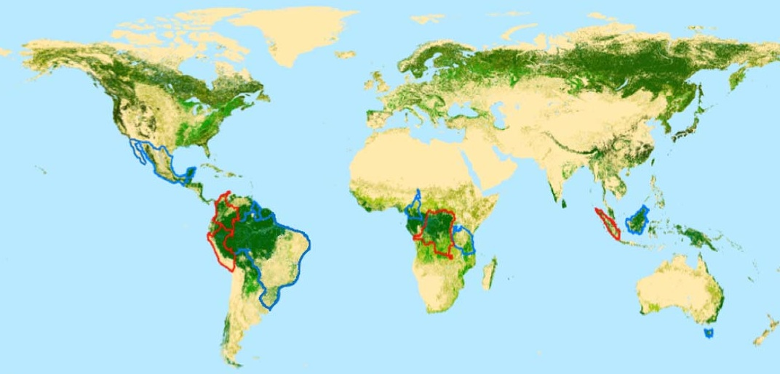

GFOI Baseline Global Data Strategy Document: Discussion
S. Ward, G. Dyke
Space Data Coordination Group meeting #2
Reston, VA, USA
13-14 September
2012
Forest Carbon Tracking
Global Forest Observation Initiative

Slide 2
Discussion Overview
Confirmation of Plenary Deliverables Plan
  Consider deferral and/or splitting deliverables
Confirmation of Writing Teams

Slide 3
Background and Purpose
The CEOS GFOI Space Data Coordination Group (SDCG) was established by the 25th CEOS Plenary (November 2011).
The SDCG serves to implement The CEOS Strategy for Space Data Coverage and Continuity in Support of the GEO Global Forest Observations Initiative (GFOI) and Forest Carbon Tracking (FCT) Task.

Slide 4
SDCG Deliverables
First draft of the Global Observation Strategy (Level-1) [CEOS Plenary October 2012]
First draft of the national acquisitions Data Strategy (Level-2).
Continued coordination of FCT acquisitions (Level-3).
Draft commercial operators interface plan
Others?

Slide 5
2012 Milestones and Key Meetings
March 6-8: SDCG-1, Montreal
26-30: SIT-27, LSI and CTF Meetings
La Jolla
September 10-12: CEOS SIT Workshop, USGS HQ
13-14: SDCG-2, USGS HQ (today)
October 24-26: 26th CEOS Plenary, Bangalore
November CBERS-3 launch

Slide 6
2013 Milestones and Key Meetings
February SDS-4, SDCG-3 (13th-15th, Canberra)
LDCM launch
March SIT-28
May
September CEOS SIT Workshop, SDCG-4 (TBC)
October 27th CEOS Plenary, Canada
Sentinel-1A launch
* All dates remain TBC.

Slide 7
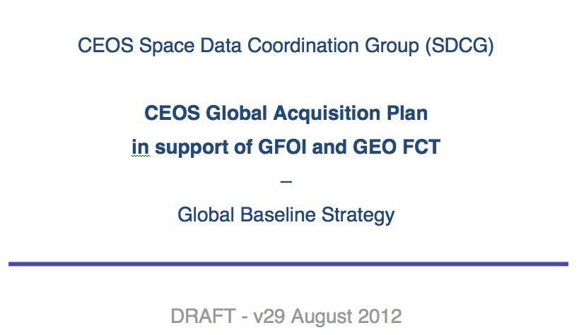
Current Level-1 Draft

Slide 8
Current Draft Status
Present draft includes “80%” of the information needed
Only includes “10%” of the SDCG added value required
Value expected is the merging and analysis of the information, which largely remains to be done

Slide 9
Level-1 Contents
Introduction (relatively complete)
Purpose, scope, contents
2. Data Requirements (partial draft)
Requirements that will drive the design of the global baseline data acquisition strategy.
3. Coverage and Gap Analysis (key analysis missing)
Business as usual coverage, gaps, and suggestions on how to mitigate gaps.
4. Baseline Global Acquisition Plan Concept (outline, but limited content)
Defines the baseline global strategy.
5. Implementation Time Schedule (not started)
Summarises the way forward for the SDCG and CEOS.
Annex: Mission Sensors (baseline information gathered)
Detailed information on missions and instruments.

Slide 10
Plenary Deliverables
Sample of SDCG progress to show we’re heading in the right direction
  Good agency participation mix
  Baseline report is on the way, expect to deliver in Feb 2013.
  Linkage to the (slower) evolution of GFOI – SDCG not the bottleneck
  Communicate some preliminary findings
  No document draft deliverables
  First version of full document SIT-28
  Formally request proper format to request “renewal” – work with Tim/Kerry
Sample visualizations from the SEO
  What message for visualizations?
  A few charts showing preliminary results

Slide 11
Writing Assignments
Section 1 Lead: Co-Leads, GFOI SEC
Section 2 Lead: Ake
Section 3 Lead: Ake
Section 4 Lead: John
Section 5 Lead: ?, with SEC support

Slide 12
Backup Materials

Slide 13
Objective of this Review
Review the draft section-by-section
  Status
  Issues
  Identify inputs required and actions
Agree on a top-level of key additional value added elements need to be included in the document

Slide 14
Example Elements Needed
Section 3: Coverage and Gap Analysis
Quantitative coverage maps showing anticipated total coverage annually and breakdown by type and individual missions.
Real world impact assessment of cloud and available light.
Sample national coverage maps - with description of anticipated resulting archive available to that govt.

Slide 15
Example Elements Needed
Section 4: Baseline Global Acquisition Plan Concept
Strategy analysis items to identify based on the coverage analysis.
Individual agency recommendations to formulate.

Slide 16
1. Introduction
Status: Section relatively complete.
Issues:
  Document summary and section descriptions will need to be updated once the rest of the strategy is complete.
  Will an executive summary be required?
Inputs and Actions: Stephen/Ake to update section as/when required.
Section Needs: N/A

Slide 17
2. Data Requirements
Status: Partial draft of this section complete.
Issues:
  Question on assumed required reporting frequency in section 2.1
  Need to make links to Jim Penman/UNFCCC clearer (2.2, 2.3)
  Resolve need to increase mention of X-band SAR
  Section 2.5 (observational requirements) incomplete
  Section 2.6 (Geographical focus areas) missing
  Section lacks wrap-up text

Slide 18
2. Data Requirements
Inputs and Actions:
  Ake/Stephen to request Jim Penman to contribute to 2.2, 2.3
  Ake to complete section 2.5
  Frank Martin to provide Section 2.6
Section Needs:
  TBD

Slide 19
3. Coverage and Gap Analysis
Status: Key analysis missing from draft section. Information content OK.
Issues:
  Needs SDCG value added in terms of analysis and presentation of information (3.5 and beyond incomplete)
  More detailed coverage tables following on from Table 3.3 are required
  Further coverage analysis (area, time, planned acquisitions) and maps required
  Clarification of categorization of missions (core and other)
  Requirement for an information management database and visitation tools (KML + Google Earth) to support analysis and presentation?
  Cover and gap analysis methodology needs to be confirmed

Slide 20
3. Coverage and Gap Analysis
Inputs and Actions:
  SDCG to ask for a volunteer to lead the coverage and gap analysis, and workers (3-4?) from SDCG membership
  Coverage and gap analysis lead to take responsibility for delivery of section 3, along with the analysis group
  SDCG Co-Leads to propose a way forward on the SDCG information management system (database + KML/Google Earth visualization)
  Agencies to be responsive to queries on their missions and instruments

Slide 21
3. Coverage and Gap Analysis
Section Needs:
  Quantitative coverage maps showing anticipated total coverage annually and breakdown by type and individual missions.
  Real world impact assessment of cloud and available light.
  Sample national coverage maps - with description of anticipated resulting archive available to that govt.

Slide 22
4. Baseline Global Acquisition Plan Concept
Status: Rough section outline but limited content.
Issues:
  This section is a key component of the SDCG value added, and remains to be completed
  Section outline needs to be refined before content is added in volume
  Dependency on section 3
  Section should read allowing individual agencies to understand what is being asked of their missions/instruments in terms of acquisitions
  Proposed time epochs should be agreed (2012-2013, 2014-2015, 2016+)

Slide 23
4. Baseline Global Acquisition Plan Concept
Inputs and Actions:
  Lead author to be appointed for section 4, to work with coverage and gap analysis lead
  Writing team members to be identified (1-2?)
  First task is to refine the outline of the section, making it clear how this links to section 3, and what it will contain (direction for agencies)

Slide 24
4. Baseline Global Acquisition Plan Concept
Section Needs:
  Strategy analysis items to identify based on the coverage analysis.
  Individual agency recommendations to formulate.

Slide 25
5. Implementation Time Schedule
Status: Not started.
Issues:
  No section outline, no lead author, no content
  Section should detail the steps for execution of the strategy implementation, resources, tasks, and the evolution of the baseline strategy

Slide 26
5. Implementation Time Schedule
Inputs and Actions:
  Agree on section lead author
  Lead author to develop section outline
Section Needs:
  To make it clear what the first/next steps will be in the implementation of the baseline strategy, how it will evolve and be updated
  Clarify the information communication strategy for SDCG (for example, a website with information about the targets and progress of the strategy – integrated with gfoi.org.)

Slide 27
Annex: Mission Sensors
Status: Baseline information gathered.
Issues:
  Good baseline information gathered
  More detailed, second order planning details will be required as input to sections 3 and 4, but not clear if this info will be documented in the Annex

Slide 28
Annex: Mission Sensors
Inputs and Actions:
  Authors to advise agencies if and when further details are required
  Agencies to review current details to ensure accuracy
Section Needs:
  Clear set of common mission/instrument performance parameters to enable analysis

Slide 29
Strategy Beyond the Level-1 Document
Further discussion of SDCG “information system”
Reporting acquisitions that have taken place

Slide 30
Level-2 and Level-3 Document Plans
Level-2: National acquisitions
  To be initiated at SDCD-3?
Level-3: FCT acquisitions
  Current status of plan
  Continuation of 2011, with noted losses of ALOS, LS-5 and Envisat?

Slide 31
Backup

