Slide 1
USGS Status
Tom Maiersperger, USGS EROS
SDCG-15
Hampton, VA
27 March, 2019

Slide 2
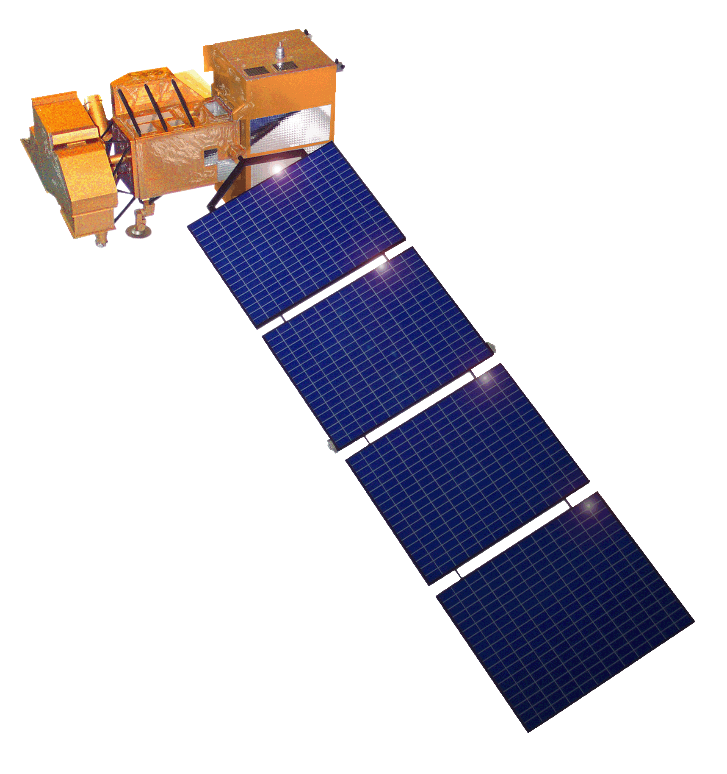
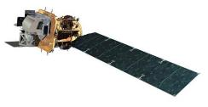
Landsat Operational Mission Status
Landsat 7
Acquiring ~470 scenes/day through a continental acquisition strategy
On-orbit observatory performance continues to be outstanding
13 active L7 international ground stations
Finalized end of mission planning to extend L7 science operations to overlap with L9
  Assumes December 2020 L9 launch readiness date
  Science mission life-cycle potential extends to July 2021
  Decommissioning will follow L9 launch or end of science mission operations, whichever comes first
Landsat 8
Acquiring ~740 scenes/day with continental acquisition strategy
On-orbit observatory performance continues to be outstanding
19 active L8 international ground stations and growing
Enhanced Landsat Ground Network (LGN) through use of international partnerships
Flight Operations now performed under USGS contract for combined mission operation and Landsat Multi-satellite Operations Center (LMOC) development

Slide 3
Landsat 9 Status
Joint development between NASA and USGS (same as Landsat 8)
  NASA responsible for space and launch segment, mission success through handover
  USGS responsible for ground segment and on-orbit operations after handover
Landsat 9 is a rebuild of Landsat 8 with targeted upgrades
  Upgrade to fully Class B (TIRS was a Class C instrument on Landsat 8)
  TIRS-2 address on-orbit issues with Landsat 8 TIRS (stray light and position encoder)
  Ground System upgraded to multi-mission capabilities (Landsat 9 development takes priority)
Overall mission making excellent progress
  Launch vehicle contract awarded in October 2017 to United Launch Alliance (ULA)
  Key Decision Point C was on December 6, 2017
  Ground System Critical Design Review planned in September 2018
  OLI-2 and TIRS-2 instruments in fabrication and on-track for mid-2019 delivery to the spacecraft
On-track for launch in December 2020 with transition-to-operations in March 2021

Slide 4
Sustainable Land Imaging (SLI) Architecture Study Team (AST)
NASA/DOI/USGS SLI AST kicked off a study for the design and implementation approach of a spaceborne system to provide global, continuous Landsat-quality multispectral and thermal infrared measurements for approximately a fifteen-year period starting in 2026
Oversight provided by the NASA Associate Administrator for Science and the DOI Assistant Secretary for Water and Science
AST-2019 will inform NASA and DOI/USGS acquisition strategies on options for both the space and ground segments, potential contributions from international partners and commercial Earth Observation data suppliers, and business model alternatives
Ground System a major driver for AST-2019 (and USGS)
Recommendation report to be delivered in August 2019 => September 2019

Slide 5
Collection 2 Definition Summary
Level-1 Products
Level-1 products will only undergo minor changes to preserve capabilities for users relying on current Collection 1 Level-1 offerings
  Angle bands (solar and sensor viewing zenith and azimuth) are being added to assist users who want to generate their own TOA reflectance and brightness temperature bands
  Minor metadata enhancements to support consistency with Level-2 products
  Will continue to be scene-based and UTM
Other processing changes
  Updated geometric registration base – Sentinel-2 Global Reference Image (GRI)
    Phased ESA delivery to be completed by 29 March 2019
  Improvements to precision modeling process to allow more products to process to Level-1TP
  Algorithm to detect Internal Calibrator (IC) shutter intrusion events and flag them in metadata
  Minor bug fixes and Cal/Val enhancements

Slide 6
Collection 2 Definition Summary
Level-2 Products
Level-2 products will be processed from all Level-1 inputs (Tier 1 and Tier 2) that meet the Solar Zenith Angle (SZA) constraint and that have required auxiliary data
  LEDAPS (L4-7) and LaSRC (L8-9) being integrated into the current processing system flows
  Auxiliary bands associated with Surface Temperature (ST) processing will be included with the product
    Ancillary data source is ongoing investigation (NARR vs. MERRA-2 vs. GEOS-5 FP vs. GEOS-5 FP-IT vs. split window)
  Including both L7 bands 6H and 6L still under discussion
Updated, consistent Quality Band specification for both Level-1 and Level-2 products
Landsat Collection 2 Level-1/2 products (SR/ST) to be global and CARD4L-compliant
  Coordinating interoperability efforts with ESA (Landsat/Sentinel-2)
  Global cloud-enabled data access (EarthExplorer, AWS, ODC, STAC, Enhanced visualization tool)
    Cloud Optimized GeoTIFF (COG) format
  Targeting production in September 2019 => December 2019
    Landsat 9 LPGS availability shifted from May 2019 to July 2019
    Early 2019 partial U.S. Government Shutdown

Slide 7
Addendum
SilvaCarbon Workshop, DC March, 25-27
Exchange of Experiences on Land Change Mapping

Slide 8
SilvaCarbon – GEE Collaboration
The plan is to develop code, apps & training materials to enable countries to participate at one of 3 levels according to their technical capabilities (the hope is for everyone to get to Plan A, but we might need fallbacks).
Plan A - (Colombia) Countries in this category are expected to be able to develop their own system running either on their own facilities or in the cloud, with only minimal technical assistance (ie: provide a menu of code they can pick and choose from and customize to their needs). Countries in this category include Colombia, Chile and Mexico.
Plan B - (Paraguay and Madagascar) Countries in this category have some developing technical capabilities, but they are unlikely to have any coding abilities. Instead, it's expected they'll be able to utilize tools such as FAO Collect Earth + SEPAL if they choose to generate their own training and validation data, spatially explicit maps and statistical, area based estimations. Ecuador is a country in this category (they've announced SEPAL as their tool of choice). Paraguay has limited coding capacity, but they did not choose SEPAL, and will need to graduate to PLAN A.
Plan C - (Laos) Countries in this category have virtually no technical capabilities and aren't expected to be able to manage the SEPAL interface. For these countries, we might be able to develop an app to assist them in producing a minimum viable product. Collect Earth Online can be used in countries at this stage to generate estimates.
Notes:
The goal of SilvaCarbon is to get as many countries as possible to plan A. Increasing capacity means to secure there is people trained in all aspects of remote sensing in countries, including coding capabilities. However, SilvaCarbon works in 23 countries, and with limited resources countries with very low technical capacity will not be able to fit into plan A. Plan B and C are choice better choices for them.

Slide 9
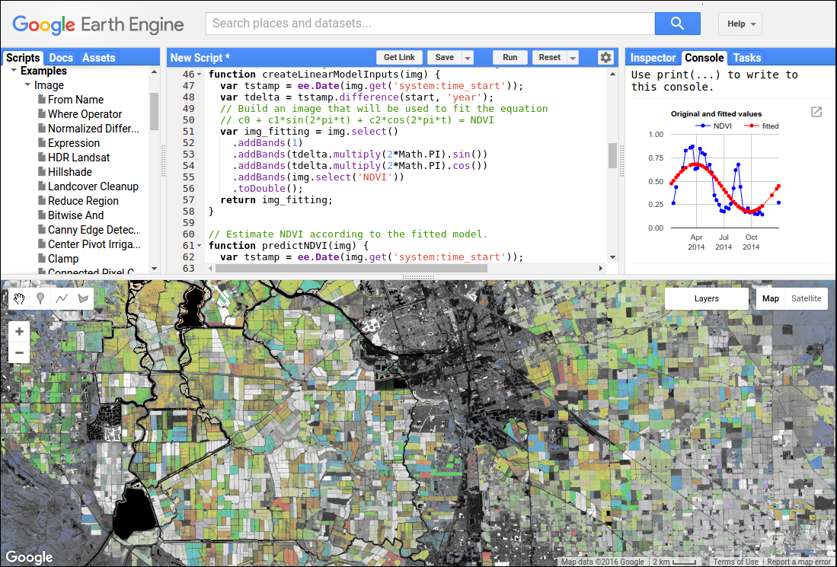

Slide 10


Notes:
For countries in plan A, we would like to se the toolbox developed my GEE, Boston University, SilvaCarbon and others. Give choices to countries that are capable to design and maintain their own national forest monitoring system.

Slide 11
Land Cover Toolbox
Data Prep
Reference Data
Activity Map
Area Est. & Accuracy Assessment
GHG Emissions

Slide 12
Land Cover Toolbox
Data Prep
Reference Data
Activity Map
Area Est. & Accuracy Assessment
GHG Emissions
TimeSync
Hansen GFCL
AREA2
IPCC Table
Landsat 7
ODK
Random Forest
--
--
Sentinel 2
Collect Earth
LandTrendr
--
--
Sentinel 1
--
Phase Coherence
--
--
Landsat 8
qGIS
PCA thresholds
AcATaMa
--
Notes:
These are multiple options from the toolbox

Slide 13
Land Cover Toolbox
Data Prep
Reference Data
GHG Emissions
Data Prep
Activity Map
Area Est. & Accuracy Assessment
GHG Emissions
TimeSync
Hansen GFCL
AREA2
IPCC Table
IPCC Table
Landsat 7
ODK
--
Landsat 7
Random Forest
--
--
Sentinel 2
Collect Earth
--
Sentinel 2
LandTrendr
--
--
Sentinel 1
--
--
Sentinel 1
Phase Coherence
--
--
Landsat 8
qGIS
--
Landsat 8
PCA thresholds
AcATaMa
--
Notes:
For the minimum accuracy required to report. We can use tools that are easy to implement, such TimeSync to collect reference data. Use the Hansen layer for reference data, implement an accuracy assessment and populate an IPCC table

Slide 14
Land Cover Toolbox
Data Prep
Reference Data
Activity Map
Area Est. & Accuracy Assessment
GHG Emissions
TimeSync
Hansen GFCL
AREA2
IPCC Table
Landsat 7
ODK
Random Forest
--
--
Sentinel 2
Collect Earth
LandTrendr
--
--
Sentinel 1
--
Phase Coherence
--
--
Landsat 8
qGIS
PCA thresholds
AcATaMa
--
Notes:
This is the Colombian process. AcaTaMa is their own collect earth type tool. They run it in house with HR dat

Slide 15
Land Cover Toolbox
Data Prep
Reference Data
Activity Map
Area Est. & Accuracy Assessment
GHG Emissions
TimeSync
Hansen GFCL
AREA2
IPCC Table
Landsat 7
ODK
Random Forest
--
--
Sentinel 2
Collect Earth
LandTrendr
--
--
Sentinel 1
--
Phase Coherence
--
--
Landsat 8
qGIS
PCA thresholds
AcATaMa
--
Notes:
If a country have high cloud cover, then using Sentinel and collecting training data with collect earth, using a classifier like random forest is an option.

