Slide 1
CEOS SDCG-15 Biomass Day:
An Overview from NASA Headquarters
Hank Margolis
Kathy Hibbard
Michael Falkowski
Terrestrial Ecology Program
NASA Headquarters
March-2019

Slide 2
Outline
NASA Carbon Cycle and Ecosystems Focus Area
Current NASA Biomass-Related Space Missions
(a) GEDI; (b) ICESat-2; (c) NISAR
ESA-NASA AFRISAR Airborne Campaign
Multi-Mission Algorithm and Analysis Platform (MAAP)
Carbon Monitoring System (CMS) research initiative
Decadal Survey & the Future of Monitoring Forest Biomass from Space for NASA

Slide 3

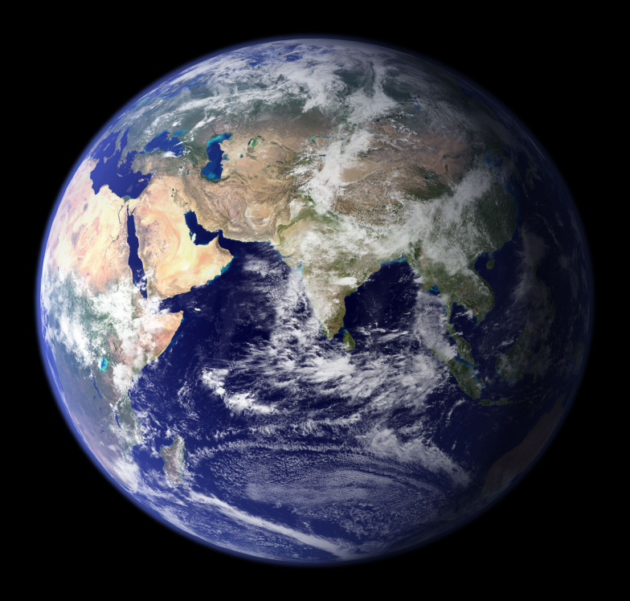

Carbon Cycle & Ecosystems Focus Area
How are ecosystems changing in response to environmental change and human actions?
How will they change in the future?
How do changes to ecosystems impact the other components of the Earth system?
How can carbon cycle and ecosystem science improve our capacity for mitigation and adaption to environmental change?

Slide 4


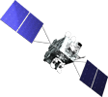


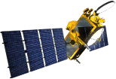


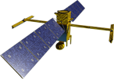


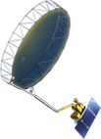


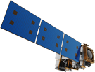



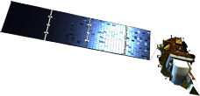

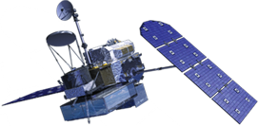

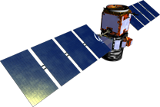

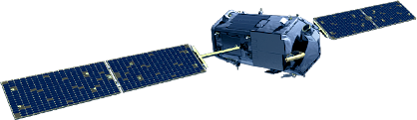
NASA Earth Science
Missions: Present through 2023
PREFIRE (2) (TBD)
(Pre)Formulation
PACE (2022)
Implementation
GeoCARB (~2021)
Primary Ops
TROPICS (12) (~2021)
Extended Ops
MAIA (~2021)
Landsat 9 (2020)
Sentinel-6A/B (2020, 2025)
ISS Instruments
LIS (2020), SAGE III (2020)
TSIS-1 (2018), OCO-3 (2019), ECOSTRESS (2019), GEDI (2020)
CLARREO-PF (2020), EMIT (TBD)
NI-SAR (2021)
SWOT (2021)
TEMPO (2018)
InVEST/CubeSats
RAVAN (2016)
RainCube (2018)
TEMPEST-D (2018)
CubeRRT (2018)
CSIM (2018)
CIRiS (2019)
HARP (2019)
SNoOPI*
HyTI*
CTIM*
TACOS*
* Launch date TBD
ICESat-2 (2021)
GRACE-FO (2) (2023)
NISTAR, EPIC
(DSCOVR / NOAA)
(2019)
CYGNSS (8) (2019)
JPSS-2 Instruments
OMPS-Limb (2019)
Suomi NPP (NOAA) (>2022)
SMAP
(>2022)
Landsat 7
(USGS) (~2022)
SORCE,
TCTE (NOAA) (2017)
Terra (>2021)
Landsat 8
(USGS) (>2022)
Aqua (>2022)
CloudSat (~2018)
GPM (>2022)
CALIPSO (>2022)
Aura (>2022)
OCO-2 (>2022)
OSTM/Jason-2 (NOAA) (>2022)
02.22.19
Notes:
Fleet - Earth Science Division - Missions (with color key; editable)
Aug. 18, 2018: GRACE-FO and ECOSTRESS moved to prime ops; QuickSCAT removed due to pending decommission; MAIA moved to implementation
Jan. 16, 2018: Reformatted, includes all missions, dates and cube sats
Dec. 15, 2015
Credit: NASA/J. Mottar
------------------------------
SLIDE INFO
CORRECTION DENNING PER RIVERA Feb 18, 2016
Changed misspelling of “Sentinal” to “Sentinel”
UPDATE DENNING PER FREILICH DECISIONS FEB 12, 2016
Changed OCO-3 to Formulation color and moved lower in list
Changed RBI to Formulation color
Changed GEDI to Implementation color and moved to line above it
Added TSIS-2 in Formulation color
UPDATE DENNING PER FREILICH DECISIONS FEB 4, 2016
Changed “Altimetry FO (Formulation in FY16) to “Sentinal-6A/B”
On Landsat 9, removed comma and TIRFF
Change I was going to make – “NISTAR, EPIC (NOAA’s DSCOVR) to green primary ops was already corrected
Dec. 15, 2015 – Updated: TEMPO changed to Implementation phase; NISTAR, EPIC changed to Primary Ops phase; ; OCO-3 and ECOSTRESS changed to Implementation phase; Aquarius removed; slide now fully editable. JMottar
May 18, 2015 – Added to SMD Multimedia Library.
May 18, 2015 – Updated the outdated 2014 version: TRMM was removed; NISTAR, EPIC (NOAA's DSCOVR) were added; SMAP icon was updated; moon at top left was removed; color key moved to top left.-JMottar
ID: I-EA-15-0040 (image)
ID: SL-EA-15-0068 (slide)

Slide 5
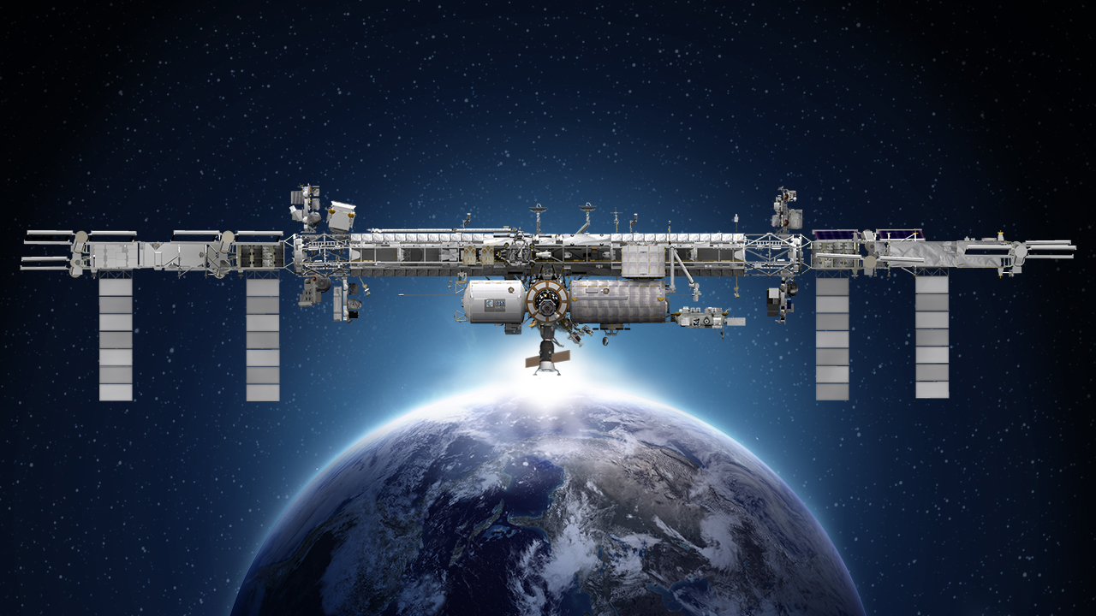
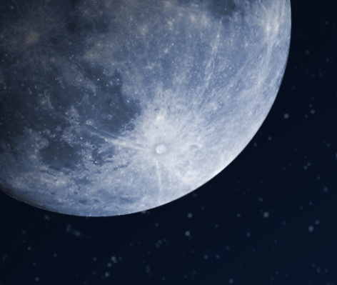
International Space Station
Earth Science Operating Missions
TSIS-1 (2018)
ELC-2
EMIT (TBD)
ELC-3
AMS
ESP-3
ELC-4
Columbus EF
JEMEF
ELC-1
OCO-3 (2019)
GEDI (2018)
ECOSTRESS (2018)
SAGE III (2020)
LIS (2020)
CLARREO PF (2020)
Formulation
External Logistics Carriers: ELC-1, ELC-2, ELC-3
External Stowage Platforms: ESP-3
Alpha Magnetic Spectrometer
Columbus External Payload Facility
Kibo External Payload Facility
Implementation
Primary Ops
Extended Ops
02.22.19
Notes:
Jan. 16, 2018: Updated as part of full set
UPDATED: COLORS AND CONTENT TO MATCH MISSION CHARTS; ADDED KEY AND DATE
12/20/17: Reformatted to 16:9; lost some content that was part of old background (title, moon, lower left box); tried to recreate
12/01/17: edited to remove CATS
5/23: removed TSIS-2
DGH changes 04/14/2017:
Added LIS date (2017); changed TSIS-1 to (2018), GEDI to (2018), OCO-3 to (2018), TISIS-2 to (2020), Ecostress to (2017), Clarreo PF to (2020) per main fleet chart; Removed RapidSCAT; changed istalled instruments to orange (consistent w/ fleet charts); put shadow behind text to make it easier to see; used fleet chart green for shapes
Changes EJD on Feb 4, 2016:
Deleted “CY” on years for SAGE III, CLARREO PF, LIS, OCO-3
Changed dates of TSIS-2 from (2020) to (2020/22)
Changed date of OCO-3 from (2018) to (2017)
Changed dates of GEDI from (2020) to (2018/20)

Slide 6
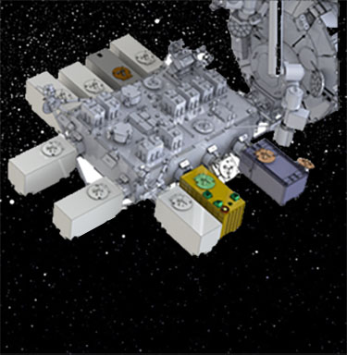
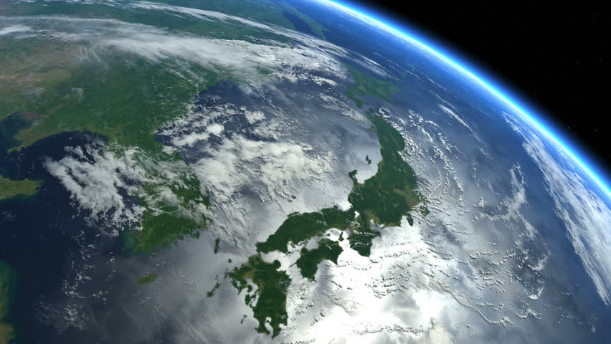

Global Ecosystem Dynamics Investigation
University of Maryland and Goddard Space Flight Center

Slide 7
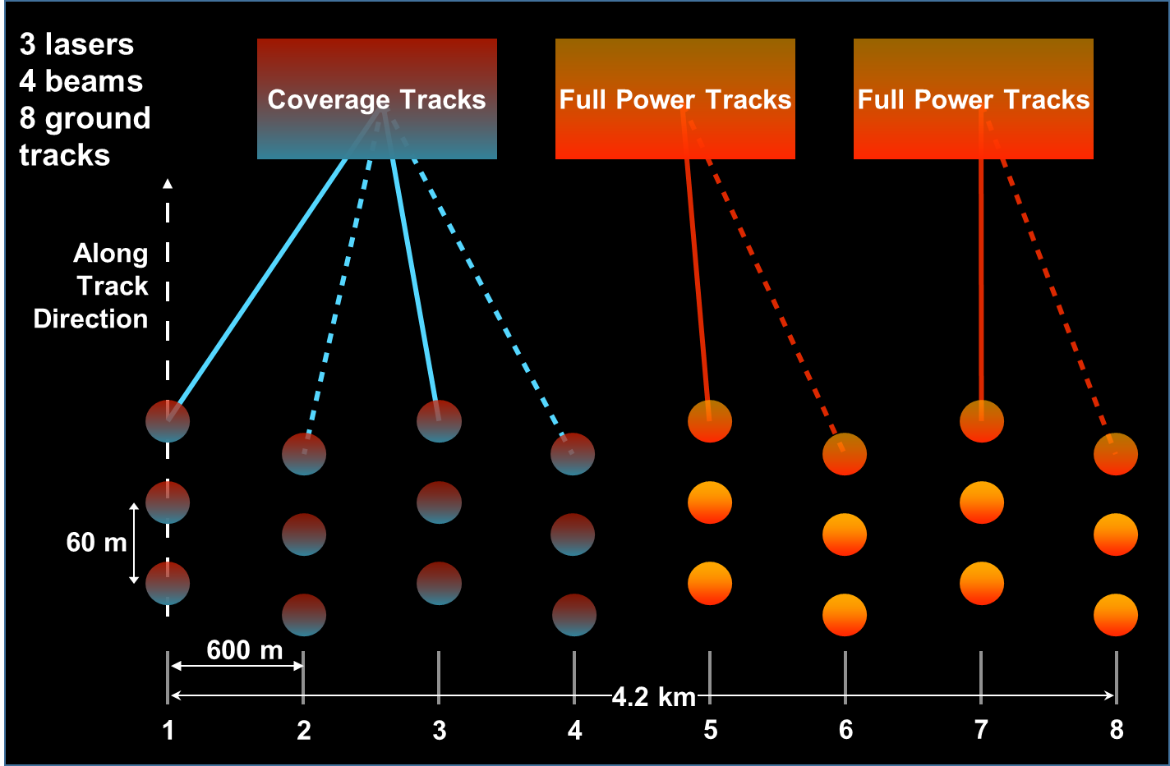
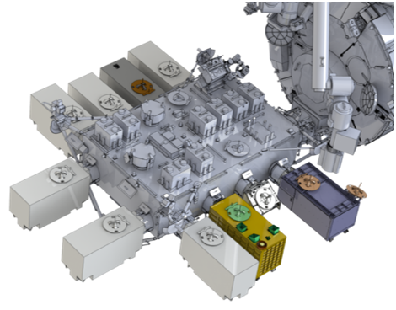
GEDI: High Resolution Laser Ranging Of Earth’s Forests and Topography from ISS
NASA’s Global Ecosystem Dynamics Investigation (GEDI) is a full waveform lidar system that launched to the International Space Station in December 2018.
GEDI’s 3 lasers return 8 tracks of ~25 m waveform samples, and will provide ~10 billion cloud-free surface structure observations over mission lifetime.
Notes:
Chart/image: https://gedi.umd.edu/mission/technology/ (Shown here is sample GEDI lidar waveform [left]. The light brown area under the curve represents return energy from the canopy, while the dark brown area signifies the return from the underlying topography. The black line is the cumulative return energy, starting from the bottom of the ground return (normalized to 0) to the top of the canopy (normalized to 1). Relative Height (RH) metrics give the height at which a certain quantile returned energy is reached relative to the ground (the center of the ground return). The diagram on the right shows the distribution of trees that produced the waveform on the left.)

Slide 8
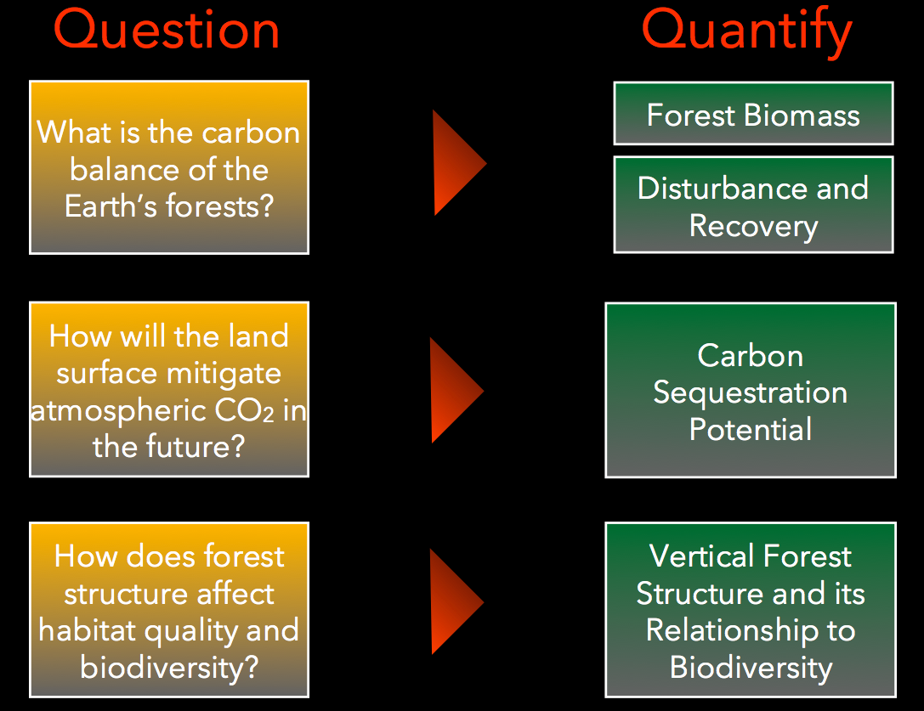
GEDI: Science Questions and Objectives
1)
2)
3)
4)

Slide 9
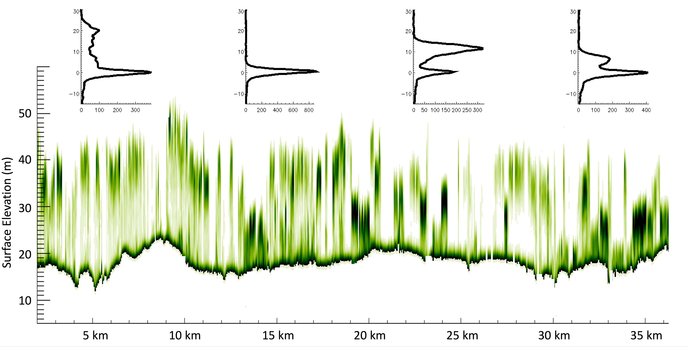
GEDI – Forest Canopy Profile and Waveforms
Vertical Structure (m)
Image Credit: Michelle Hofton (UMD) , Bryan Blair (NASA/GSFC) & Ralph Dubayah (UMD)
Notes:
This slide shows a transect of canopy structure taken over South Carolina. Each vertical bar represents one waveform or GEDI shot, where darker green is indicative of more canopy material, and lighter colors of less canopy material. The insets show examples of actual waveforms – each green bar shown below is derived from such waveforms. GEDI is unique among Earth observation missions in that its sensor is optimized for vegetation structure measurements — each shot provides a detailed profile of vertical canopy structure — which allows for accurate estimates of canopy height, canopy cover, vertical leaf area index, among other canopy metrics, as well as sub-canopy topography. GEDI collects data along 8 tracks simultaneously, one track of which is illustrated above. Each track is comprised of 25 m diameter footprints, with a spacing of about 50 m between adjacent footprints along track. GEDI has already collected more than 200 million footprints during its commissioning phase.

Slide 10
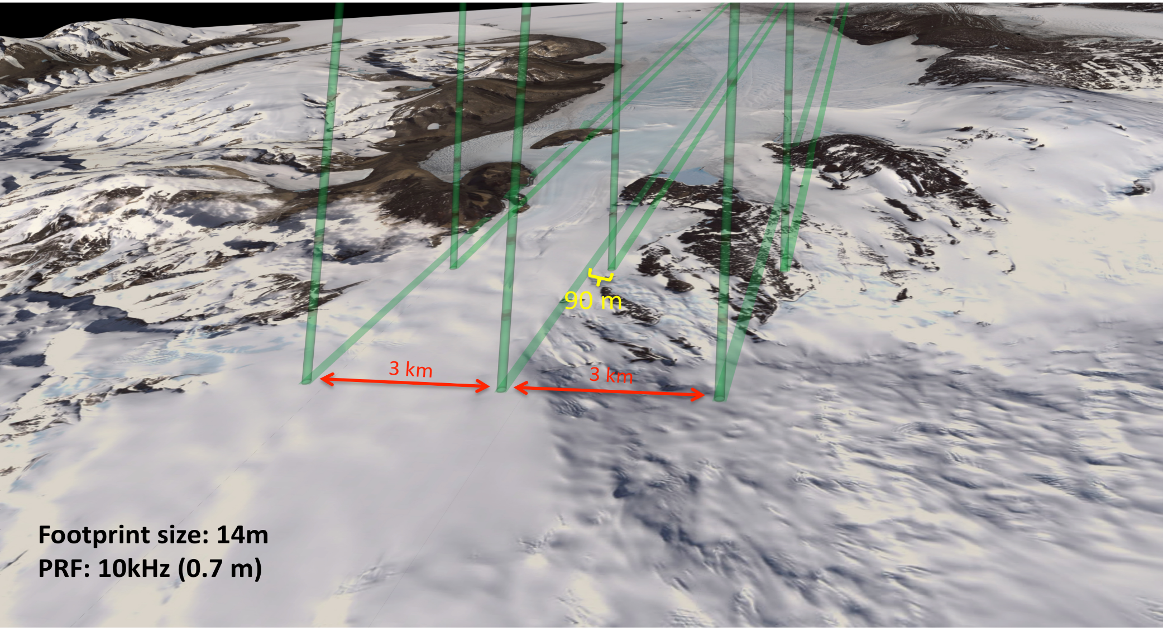

Single laser pulse at 532nm split into 6 beams.
Single-photon sensitive detection.
3 km spacing between pairs provides spatial coverage
90 m pair spacing for slope determination (2° yaw)
high-energy beams (4x) better perf over low-reflectivity targets.
Laser transmits 10,000x per second, ~70cm footprint spacing
Launched 15 Sept 2018!

Slide 11

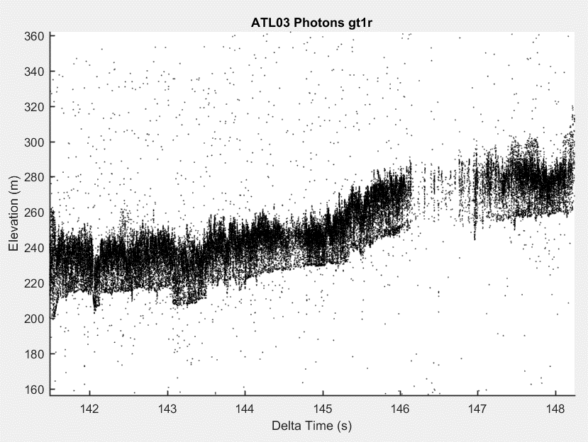
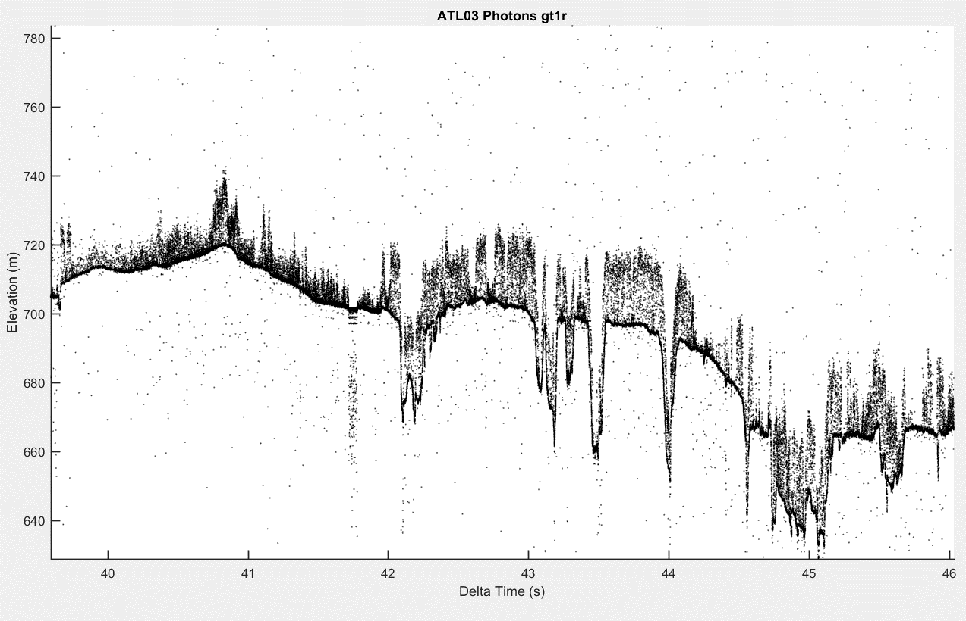
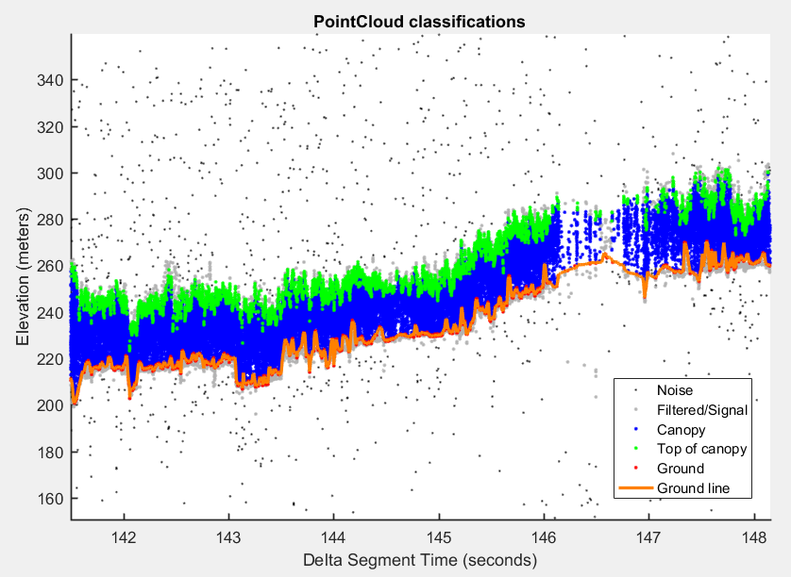
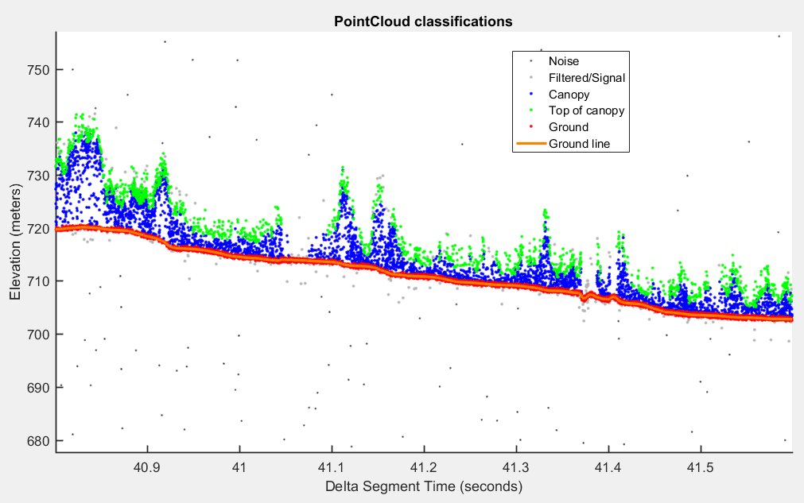
ICESat-2 Vegetation Measurements
Night time acquisition of Tropical Forest in Peru
Profile through Boreal Forest in Eastern British Columbia
2
9
16
23
30
37
45
3.5
10.7
18
25.1
32.3
39.5
46.7
Along Track Distance (km)
Along Track Distance (km)
Example of ATL08 Photon Classification for Tropical and Boreal Forest. Data from ICESat-2 will aim to provide global estimates of canopy heights and/or improve biomass estimates globally.
0.8
1.5
2.1
2.8
3.5
4.3
5.1
3.5
10.7
18
25.1
32.3
39.5
46.7
Along Track Distance (km)
Along Track Distance (km)
Amy Neuenschwander, U Texas

Slide 12
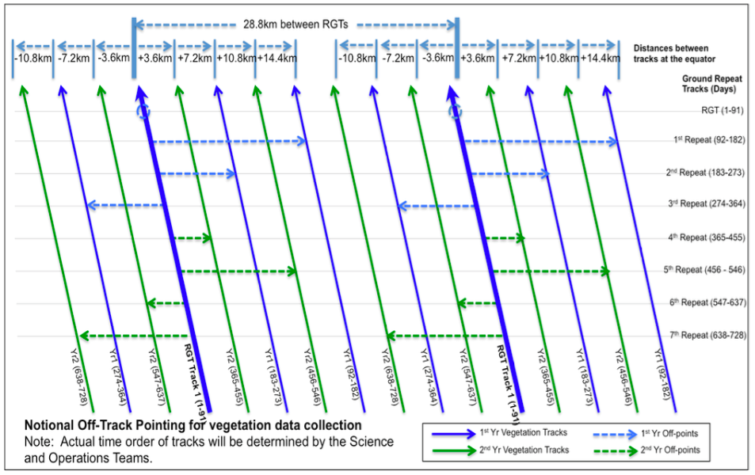
ICESat-2 Mid-latitude Vegetation Measurements
ICESat-2 off-points in mid-latitudes to map global vegetation height.
Track spacing of < 2 km over 2 years.

Slide 13
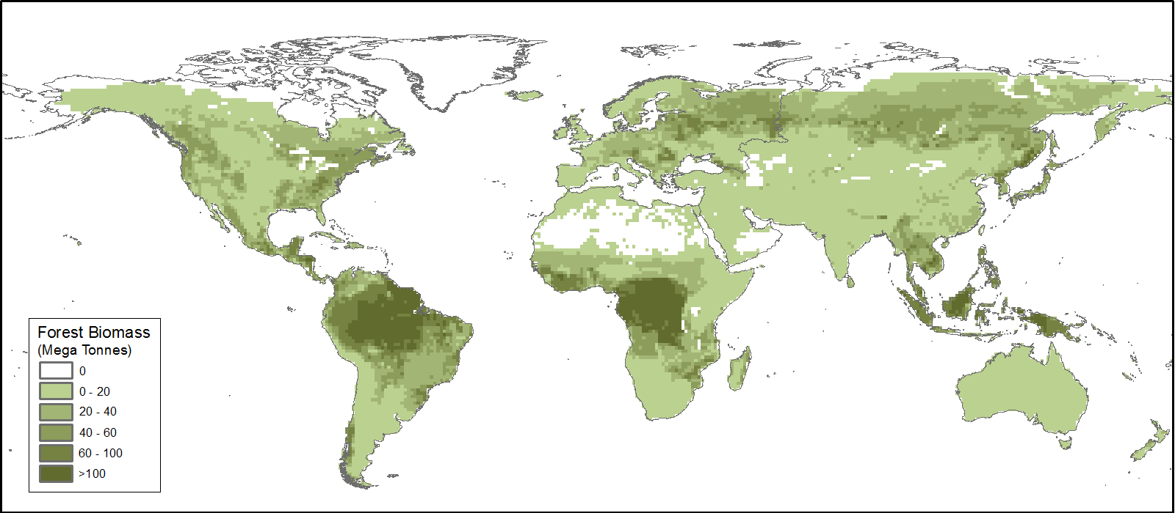
ICESat-2 is Synergistic with GEDI
Combination of ICESat-2 and GEDI height measurements will lend to the first GLOBAL directly measured biomass product.
ICESat-2 can fill gaps in GEDI coverage, both in lower latitudes and above 51.5 degrees
ICESat-2 only biomass estimates
GEDI and ICESat-2 fused biomass estimates
Amy Neuenschwander, U Texas

Slide 14
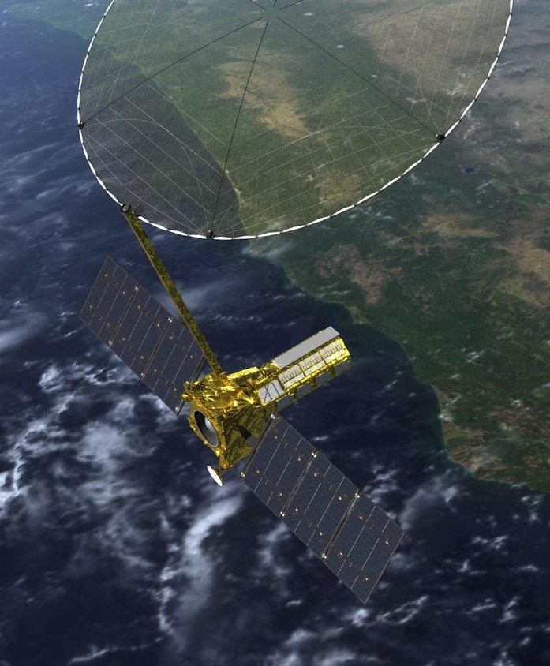
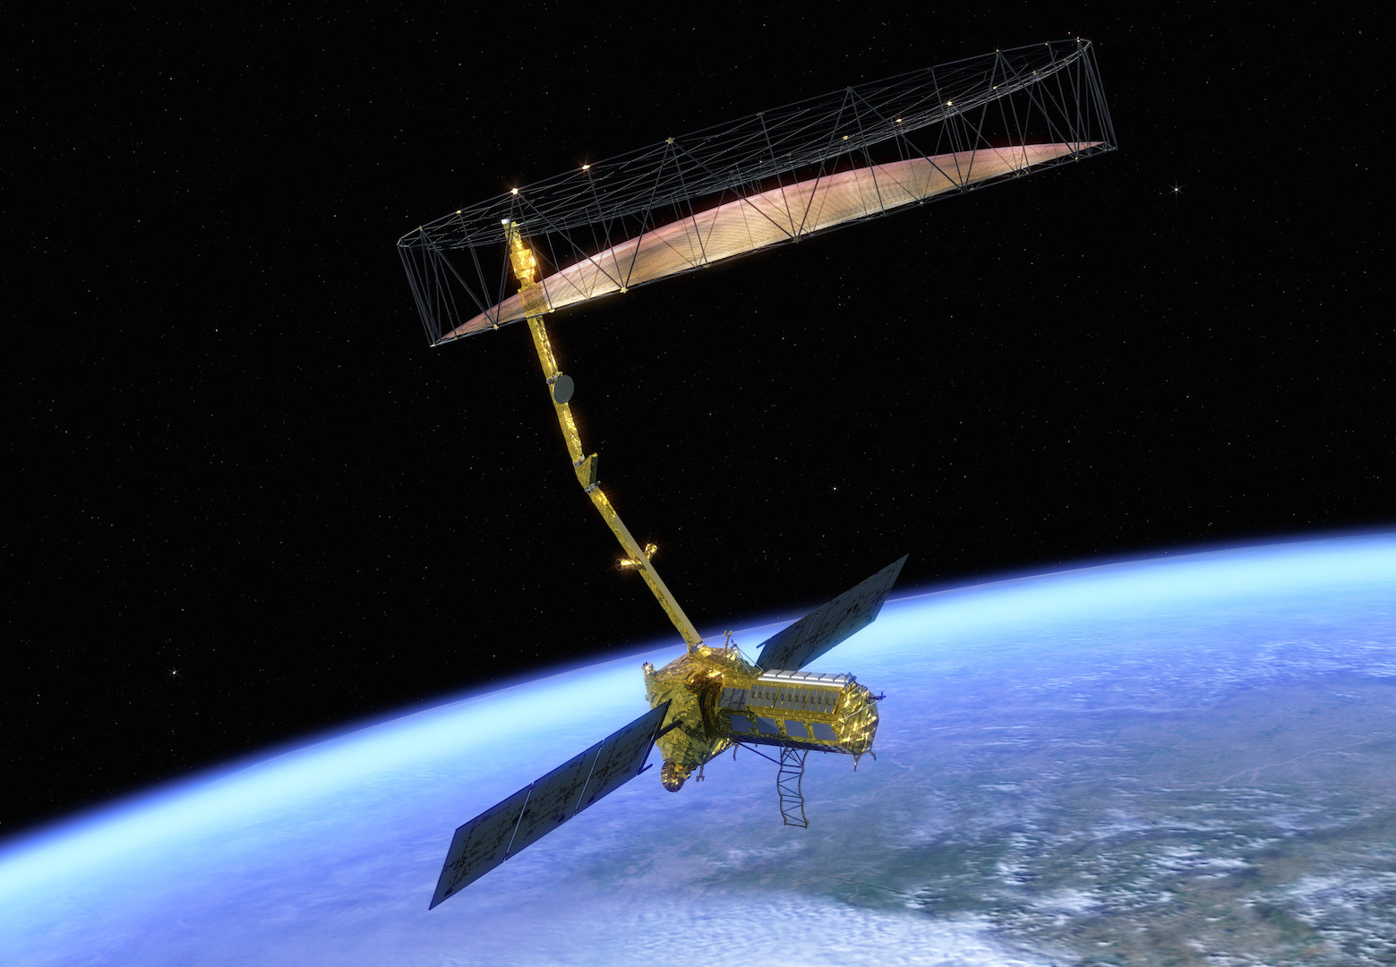


NASA-ISRO Synthetic Aperture
Radar Mission (NISAR)
Near-global land coverage
Free & open data policy
Launch: January 2022
Lifetime: 3+ years
High resolution, cloud-free imagery twice every 12-days

Slide 15

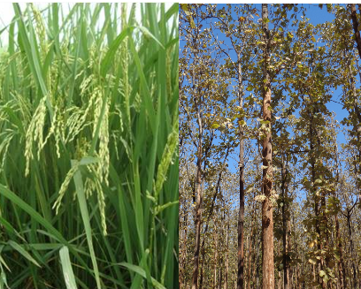
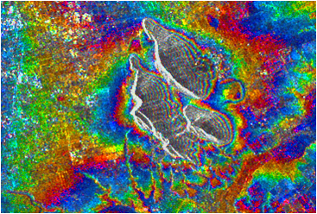
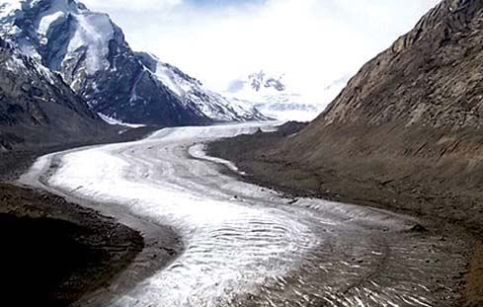
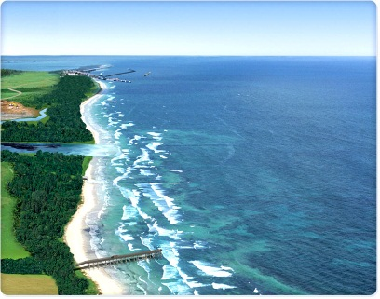
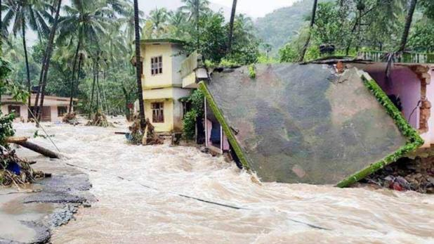
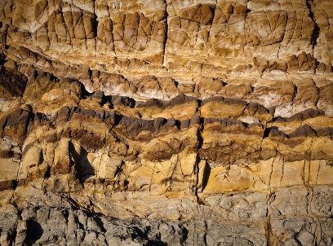
NISAR: Indian Space Research Organisation Proposed Applications
Ecosystem Structure: 1.1 Agriculture biomass & Crop monitoring; 1.2 Forest biomass; 1.3 Forest disturbance; 1.4 Mangroves / Wetlands; 1.5 Alpine vegetation; 1.6 Vegetation phenology; 1.7 Soil moisture; 1.8 Ecosystem stress assessment
Land Deformation: 2.1 Inter-seismic / Co-seismic deformations; 2.2 Landslides; 2.3 Land subsidence; 2.4 Volcanic deformations
NASA-ISRO Synthetic Aperture Radar (NISAR) Mission
Cryosphere: 3.1 Polar Ice Shelf / Ice sheet; 3.2 Sea Ice Dynamics; 3.3 Mountain snow/ glacier 3.4 Glacier dynamics/ hazard (Himalayan Region); 3.5 Climate response to glaciers; 3.6 Sea–Ice advisory on safer marine navigation in Antarctica region
Coasts & Ocean: 4.1 Coastal erosion / shoreline change; 4.2 Coastal subsidence and vulnerability to sea-level rise; 4.3 Coastal bathymetry; 4.4 Ocean surface wind; 4.5 Ocean wave spectra; 4.6 Ship detection; 4.7 Coastal watch services; 4.8 tropical cyclone
Disaster Response: 5.1 Floods; 5.2 Forest fire damage assessment; 5.3 Coastal oil spill; 5.4 Earthquakes / Others
Geological Applications: 6.1 Structural & Lithological mapping; 6.2 Lineament mapping; 6.3 Paleo-Channel study; 6.4 Geomorphology; 6.5 Land degradation mapping; 6.6 Geo-archaeology; 6.7 Mineral explorations
nisar.jpl.nasa.gov

Slide 16

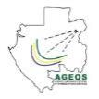





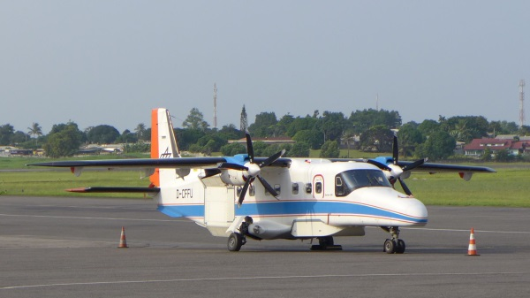
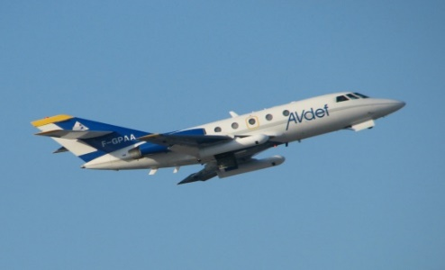
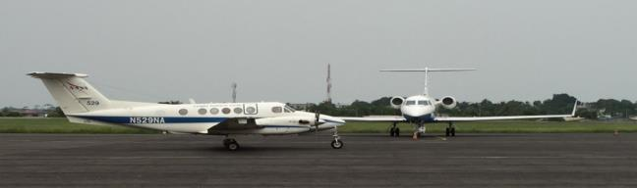


AFRISAR Airborne Campaign: Forest Structure & Biomass
  Three Missions - One Goal
  BIOMASS (ESA) is a P-band spaceborne SAR (launch 2021)
  NISAR (NASA-ISRO Synthetic Aperture Radar) is an L-band S-band spaceborne SAR (launch 2022)
GEDI (NASA Global Ecosystem Dynamics Initiative) is a spaceborne Lidar on the International Space Station (launch December 2018)
  AfriSAR – One campaign serving three missions
  ESA coordinated campaign joined by NASA GSFC and JPL teams
  4 Airborne Instruments: DLR F-SAR (P- and L-band SAR), ONERA Sethi (P-band SAR), JPL UAVSAR (L-band SAR), GSFC LVIS (waveform lidar)
  Collect data at the same time (February 2016) at the same site (Gabon)
  Provide a framework for common Level-2 algorithm development, data validation and research into the synergistic use of lidar/SAR for ecosystem mapping.
NASA

Slide 17
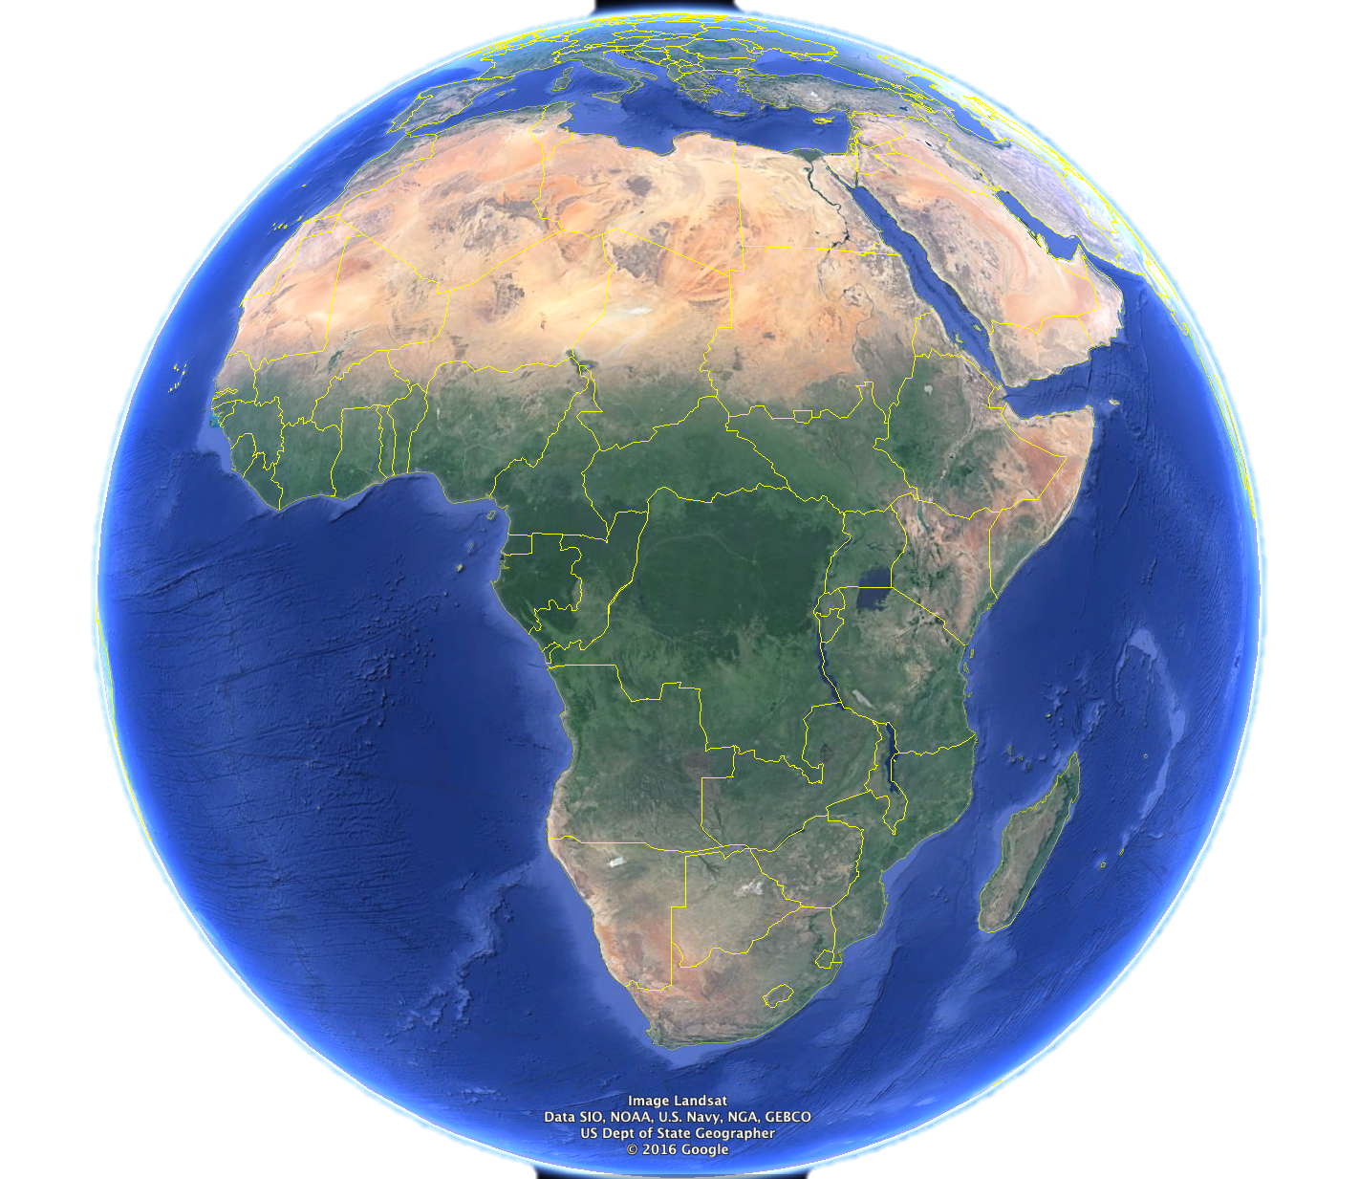
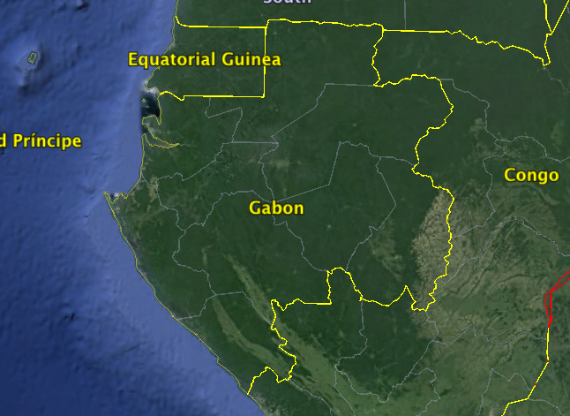
Why Gabon?
2nd most forested country in the world (88.5%)
2nd highest carbon density after Malaysia
Extensive high quality field measurements through AfriTRON, ANPN and Smithsonian
Most challenging conditions for space-based biomass retrieval- tall, high canopy cover and cloud cover
Understudied Ecosystem
20% of its species are endemic to the country.
Easy to get to (for ESA!)

Slide 18
The AfriSAR Campaign – Airborne Data
NASA AfriSAR sites
Mondah Forest
Lope National Park
Mabounié (IRD)
Rabi CTFS plot
Akanda National Park
Lower Ogooué River
Gamba Complex
GEDI East-West
Biomass Gradient
GEDI-TanDEM-X Transect
Pongara National Park
Mouila
Notes:
Mondah: 55% secondary forest, created in 1934 as a timber production forest and research area, exploited since 1400. Highest deforestation rate in the country
Lope: Oldest National Park, savannah, low biomass and closed-canopy tropical rainforest
Mabounié: IRD plot in the lower Ogooue river area, mix of forest and forested wetlands, logging concession
Pongara: mangrove and leatherback turtle nesting site. density of nesting leatherback sea turtles, with approximately 30% of the global population.

Slide 19
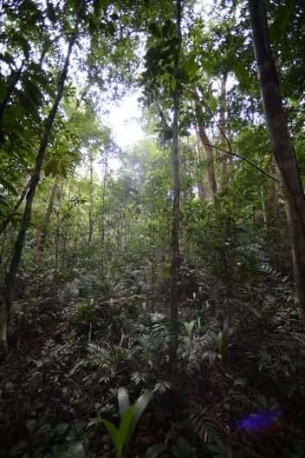
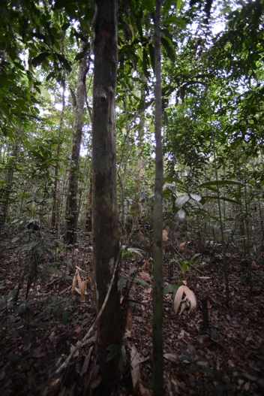
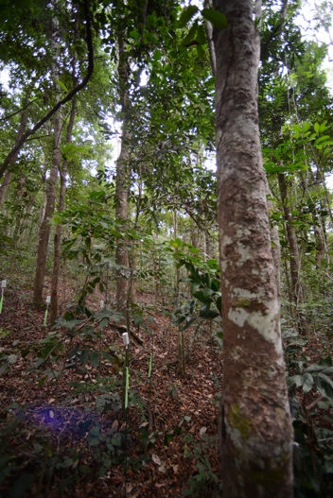

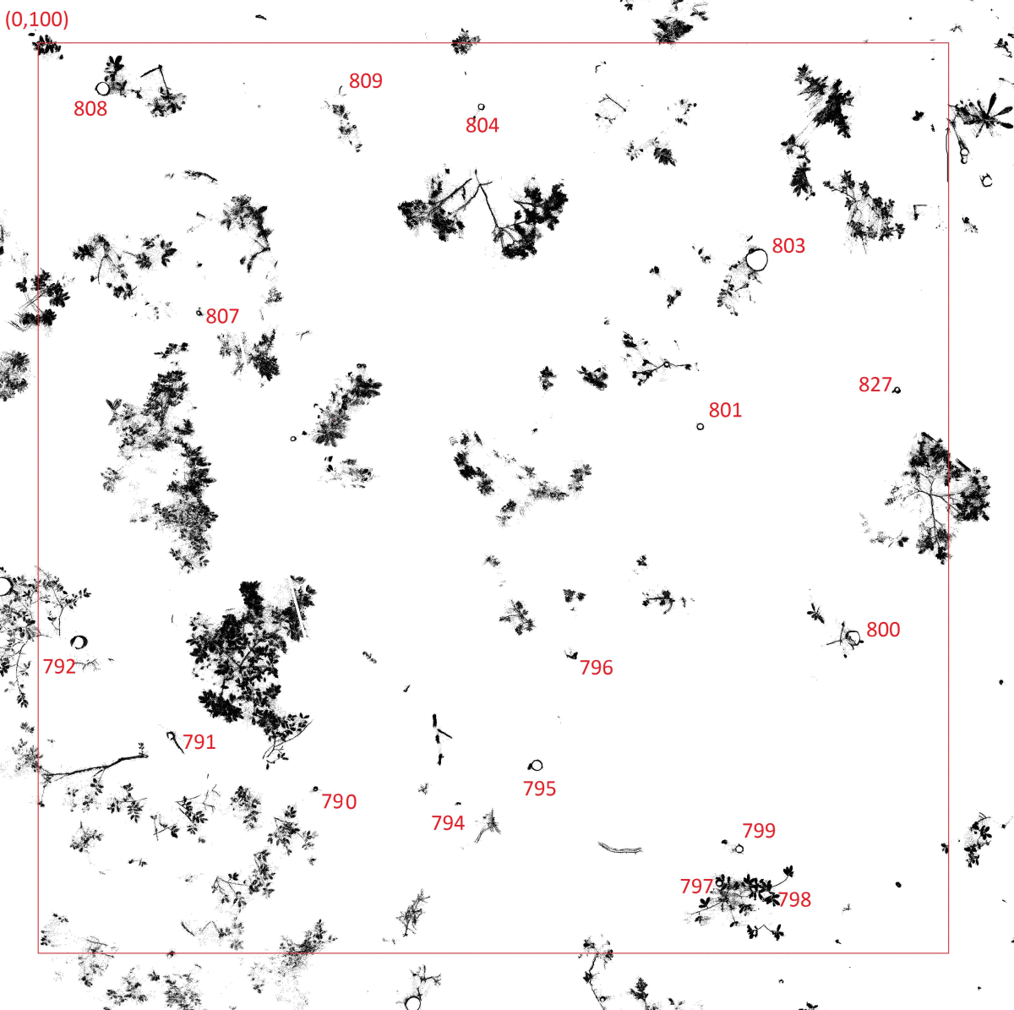
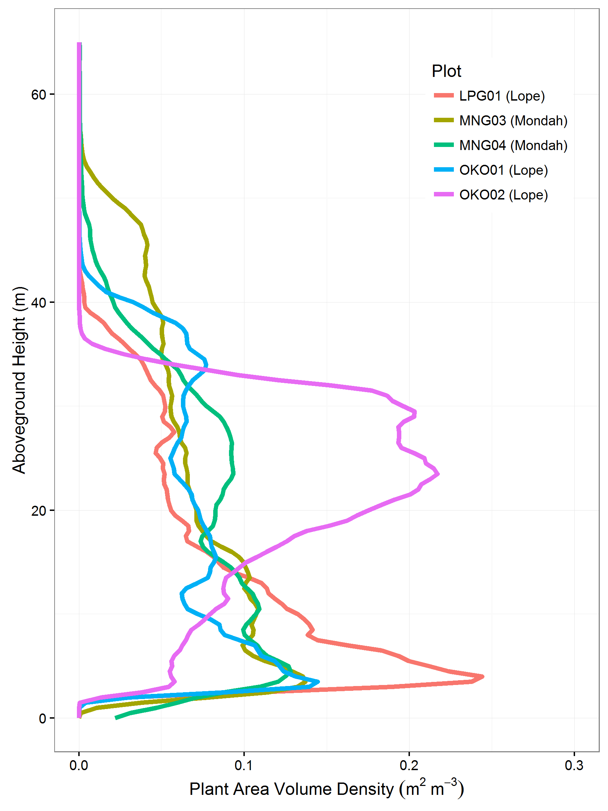
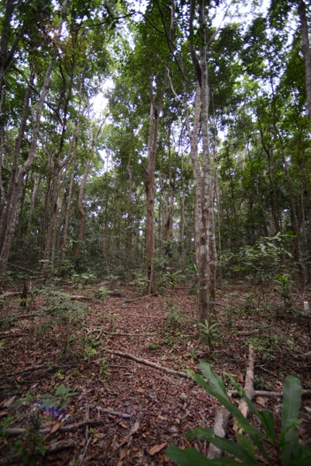
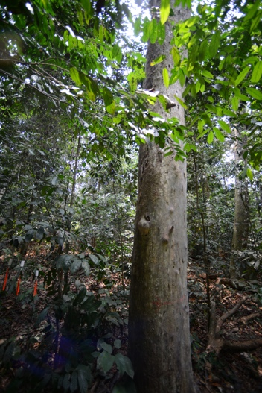
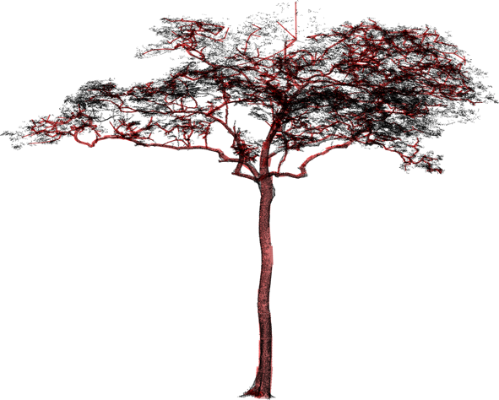
The AfriSAR Campaign - Ground Data
Mondah: 16 - 1 ha
collected by NASA/ANPN in Jan 2016
Lope: 10 - 1 ha
collected by ESA in Jan – June 2016
Six plots with TLS acquisitions
Collected by UCL in July, Aug 2016
Pongara: 18 - 30 m diameter plots
Collected by NASA in Feb 2017, TLS & 360 degree camera
MNG03 Mondah
MNG04 Mondah
OKO1 Lopé
Mat Disney
Andy Burt
(UCL)
OKO2 Lopé
LPG01 Lopé
LPG01-39
MNG04
Notes:
MNG03 Monodominant Aucoumea
MNG04 Mixed species, old growth
OKO01 Monodominant Aucoumea
OKO02 Monodominant Aucoumea
LPG01 Mixed species, old growth
OKO03 Monodominant Aucoumea

Slide 20


Joint ESA-NASA Multi-Mission Algorithm and Analysis Platform (MAAP)
A science focused virtual environment dedicated to the unique needs of sharing and processing data from relevant field, airborne and satellite measurements related to ESA and NASA missions (in this case BIOMASS, NISAR, and GEDI).
  Jointly managed by ESA and NASA.
  Science focus is to improve the understanding of global terrestrial carbon dynamics
  Address Scientific Community Needs
  Initially populated with pre-launch and complimentary data from other projects.
MAAP
Joint access to data and algorithms
Data and Computing
Data and Computing
Notes:
Addresses an immediate need expressed by the science community to more easily share and process data collected by NASA and ESA activities in preparation for BIOMASS, NISAR, and GEDI missions.
These activities will advance collaborations prior to launch.

Slide 21
MAAP Development Schedule
2018 through summer 2019: Pilot Phase Development
  Completed first Delivery
Expected completion of Pilot MAAP Platform: Summer 2019
Summer 2019 through Summer 2020: Pilot Phase Operations
  Limited release to UWG and beta users
Early 2020: Begin Full Phase Development
Mid- 2021: Full MAAP becomes operational and open to the public

Slide 22
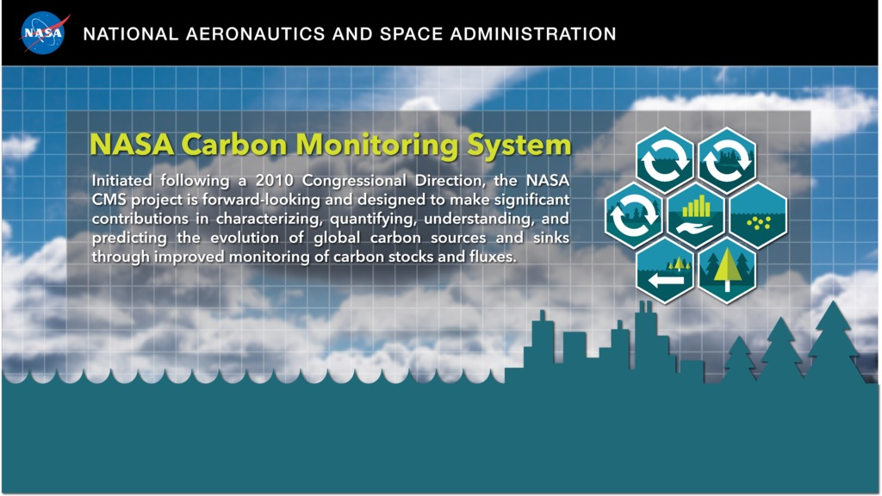

Slide 23
CMS At-a-Glance
Started in response to a 2010 Congressional appropriation
Designed to characterize, quantify, understand, and predict the evolution of global carbon that can be affected by human activity through improved monitoring of carbon stocks and fluxes.
Takes full advantage of and prioritizes NASA’s ongoing (current and future) space-based observations and associated research and applied activities.
Now budgeted for at approximately $10M annually.
NASA incorporates several other agencies into CMS through their participation in competitively-selected investigations (e.g., USDA, USGS, EPA, and DOE)
Includes three primary facets: biomass, flux, and scoping/outreach.
5 solicitations to date.
2018 solicitation currently open.

Slide 24
NASA’s High-Level CMS Objectives
Make significant contributions in characterizing, quantifying, understanding, and predicting the evolution of global carbon sources and sinks as well as biomass
Use the full range of NASA satellite observations and modeling/analysis capabilities to support national and international policy and policymakers
Ensure high quality community involvement through open solicitations and peer review.

Slide 25
2017 Decadal Survey & The Future for NASA Biomass Measurements from Space
2017 Decadal Survey
Publicly released January 5, 2018
Supports the ESD (and international) Program of Record
Prioritizes observations rather than specific missions
Emphasis on competition as cost-control method
Explicitly allows implementation flexibility
Explicitly encourages international partnerships
Endorses existing balances in ESD portfolio
25
Notes:
25

Slide 26



NASA Flight Program
Elements
Earth
Decadal Survey
Program of Record.
The series of existing or previously planned observations, which should be completed
as planned.
Execution of the ESAS 2017 recommendation requires that the total cost to NASA of the Program of Record flight missions from FY18-FY27 be capped at $3.6B.
Designated. A new program element for ESAS-designated cost-capped medium- and large-size missions to address observables essential to the overall program and that are outside the scope of other opportunities in many cases.
Can be competed, at NASA discretion.
Earth System Explorer. A new program element involving
competitive opportunities for medium-size instruments and
missions serving specified ESAS-priority observations.
Promotes competition among priorities.
Incubation. A new program element, focused on investment for priority observation opportunities needing advancement prior to cost-effective implementation, including an Innovation Fund to respond to emerging needs.
Investment in innovation for the future.
Ventures. Earth Ventures program element, as recommended in ESAS 2007, with the addition of a new Ventures-Continuity component to provide opportunity for low-cost sustained observations.

Slide 27
Designated Observables Summary as Described in the Decadal Survey
Observable | Science/Applications Summary | Candidate Measurement Approach | ESAS maximum cost
Aerosols | Aerosol properties, aerosol vertical profiles, and cloud properties to understand their effects on climate and air quality | Backscatter lidar and multichannel/multi-angle/polarization imaging radiometer flown together on the same platform | CATE Cap $800M
Clouds, Convection, And Precipitation | Coupled cloud-precipitation state and dynamics for monitoring global hydrological cycle and understanding contributing processes including cloud feedback | Radar(s), with multi-frequency passive microwave and sub-mm radiometer | CATE Cap $800M
Mass Change | Large-scale Earth dynamics measured by the changing mass distribution within and between the Earth’s atmosphere, oceans, ground water, and ice sheets | Spacecraft ranging measurement of gravity anomaly | Est Cap $300M
Surface Biology and Geology | Earth surface geology and biology, ground/water temperature, snow reflectivity, active geologic processes, vegetation traits and algal biomass | Hyperspectral imagery in the visible and shortwave infrared, multi- or hyperspectral imagery in the thermal IR | CATE Cap $650M
Surface Deformation and Change | Earth surface dynamics from earthquakes and landslides to ice sheets and permafrost | Interferometric Synthetic Aperture Radar (InSAR) with ionospheric correction | Est Cap $500M

Slide 28
Earth System Explorer Observables Summary from Decadal Survey
Observable | Science/Applications Summary | Candidate Measurement Approach
Greenhouse Gases | CO2 and methane fluxes and trends, global and regional with quantification of point sources and identification of sources and sinks | Multispectral short wave IR and thermal IR sounders; or lidar**
Ice Elevation | Global ice characterization including elevation change of land ice to assess sea level contributions and freeboard height of sea ice to assess sea ice/ocean/atmosphere interaction | Lidar**
Ocean Surface Winds and Currents | Coincident high‐accuracy currents and vector winds to assess air‐sea momentum exchange and to infer upwelling, upper ocean mixing, and sea ice drift | Doppler scatterometer
Ozone and Trace Gases | Vertical profiles of ozone and trace gases (including water vapor, CO, NO2, methane, and N2O) globally and with high spatial resolution | UV/Vis/IR microwave limb/nadir sounding and UV/Vis/IR solar/stellar occultation
Snow Depth and Snow Water Equivalent | Snow depth and snow water equivalent including high spatial resolution in mountain areas | Radar (Ka/Ku band) altimeter; or lidar**
Terrestrial Ecosystem Structure | 3D structure of terrestrial ecosystem including forest canopy and above ground biomass and changes in above ground carbon stock from processes such as deforestation and forest degradation | Lidar**
Atmospheric Winds | 3D winds in troposphere/PBL for transport of pollutants/carbon/aerosol and water vapor, wind energy, cloud dynamics and convection, and largescale circulation | Active sensing (lidar, radar, scatterometer); passive imagery or radiometry‐based atmos. motion vectors (AMVs) tracking; or lidar**
**From the ESAS Report: Could potentially be addressed by a multi‐function lidar designed to address two or more of the Targeted Observables

Slide 29
Incubation Observables Summary from DS
Observable | Science/Applications Summary | Candidate Measurement Approach | Measurement Requirements
Planetary Boundary Layer (PBL) | Diurnal 3D PBL thermodynamic properties and 2D PBL structure to understand the impact of PBL processes on weather and AQ through high vertical and temporal profiling of PBL temperature, moisture and heights | Microwave, hyperspectral IR sounder(s) (e.g., in geo or small sat constellation), GPS radio occultation for diurnal PBL temperature and humidity and heights; water vapor profiling DIAL lidar; and lidar* for PBL height | From High resolution and diurnally resolved 2D/3D measurements of PBL 200 m vertical resolution for 3D variables (Temperature, Humidity and Horizontal wind vector) with 2-3 hourly temporal resolution and 20 km horizontal resolution
Surface Topography and Vegetation (ST&V) | High-resolution global topography including bare surface land topography ice topography, vegetation structure, and shallow water bathymetry | Radar; or lidar* | Contiguous 5m sampling with 0.1m vertical accuracy from space Contiguous 1m sampling with 0.1m vertical accuracy from aircraft With seasonal repeat
  Notable that both observables list a multi-function lidar for candidate measurement approach

Slide 30
Incubation Program Solicitation Plans (1/2)
Incubation Solicitation in FY19, FY20 funds, release ~ Early Spring 2019
  Solicitation (ROSES) competes science team membership for each TO (PBL, ST&V)
    Team membership is competed through solicitation, where Individuals propose areas of investigation, and can self nominate for Team Lead Position. Expectation is for some team members to have expertise in instrumentation.
    Anticipate opportunities for community engagement, such as town halls (i.e. at AGU, AMS in FY20) and workshops that would be open beyond team membership
  Objective of teams would be to define desires, needs and capabilities
    Main deliverable – white paper summarizing present state - understanding of science and candidate measurement approaches, current capabilities, desired future state of relevant technology, analysis of field campaign data, role of modeling, and recommending future activity areas (Modeling, OSSEs, field campaigns, emerging technology developments, etc.) to be used as a basis for next solicitation.
    Period of performance up to 1 year with an interim and final report, and final presentation, after which team disbands.
  Subsequent solicitations are for activities and will be released every 2-3 years for duration of up to 3 years each

Slide 31
Outline
NASA Carbon Cycle and Ecosystems Focus Area
Current NASA Biomass-Related Space Missions
(a) GEDI; (b) ICESat-2; (c) NISAR
ESA-NASA AFRISAR Airborne Campaign
Multi-Mission Algorithm and Analysis Platform (MAAP)
Carbon Monitoring System (CMS) research initiative
Decadal Survey & the Future of Monitoring Forest Biomass from Space for NASA

