Slide 1

GFOI Overview
Name of presenter
Event
Location, Date

Slide 2

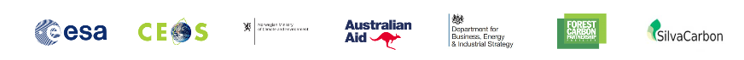

GFOI Partners
History: Founded under Group on Earth Observations (GEO) in 2011
  First work plan was 2012-13
  Review in 2016 led to development of Phase 2
Lead partners: currently Australia, Committee on Earth Observation Satellite (CEOS), European Space Agency (ESA), FAO, Norway, UK, USA, Germany & the World Bank
Many other contributors including UNFCCC, IPCC, universities, technical and policy experts.
Open to new partners.

Slide 3
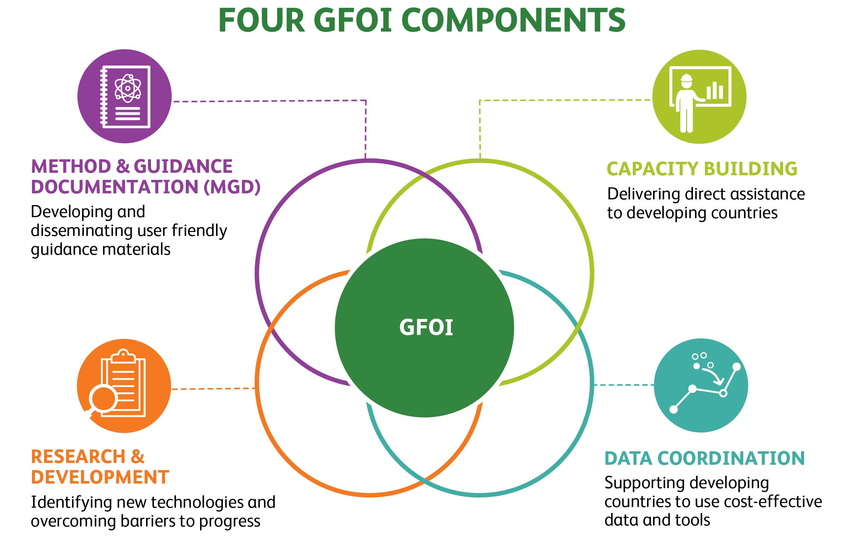

Slide 4
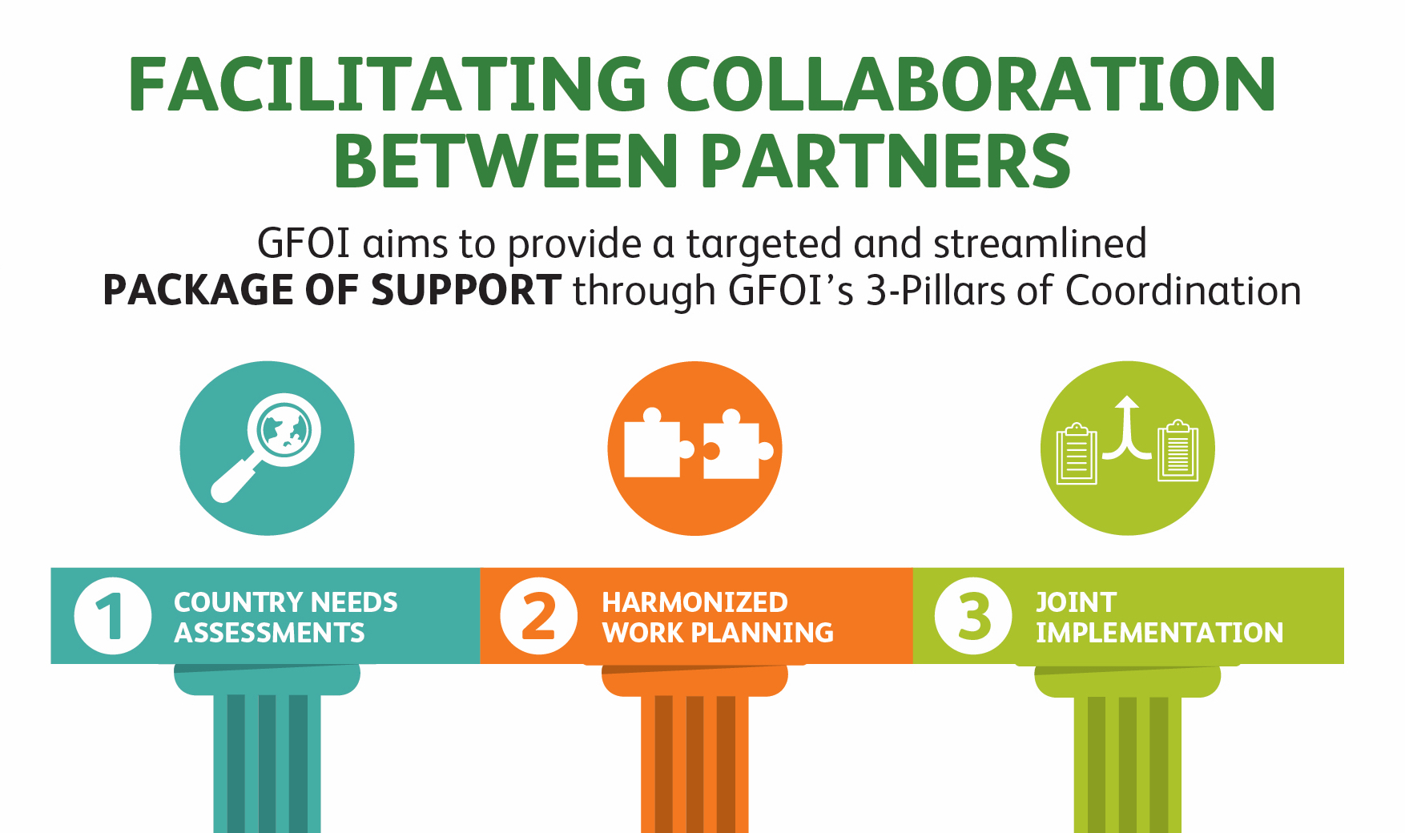
GFOI: 3 pillars of coordination

Slide 5
Key Updates
Greater focus on integration of partner activities across components.
Expanded GFOI office
New data component
New activities
  Inventory of capacity building activities
  Registry of tools
  Ground Data Review
  Country Needs Assesment

Slide 6
GFOI Organizational chart
GFOI Leads Group
Norway (chair)(Ellen Bruzelius Backer), Australia (Nikki Fitzgerald), CEOS (Osamu Ochiai),
ESA (Frank Martin Seifert), FAO (Anssi Pekkarinen), Germany (Lena Bretas)
UK (Selina Newell), US (Sylvia Wilson and Juliann Aukema) World Bank (Andres Espejo).
GFOI Office
Host agency: FAO
Donors: Australia and Norway
Capacity Building
Lead Partners:
FAO & SIlvaCarbon (US)
Inge Jonckheere - FAO
Sylvia Wilson - USGS
Data
Lead Partners
(proposed):
CEOS, WB, FAO
Andreia Siqueira (Acting) - GFOI
MGD
Lead Partner:
Australia
Carly Green
R&D
Lead Partner:
ESA
Martin Herold
Sarah Carter
(GOFC-GOLD,
MGD Avisory
group
Chair:
Maria Jose Sanz
Sanchez

Slide 7

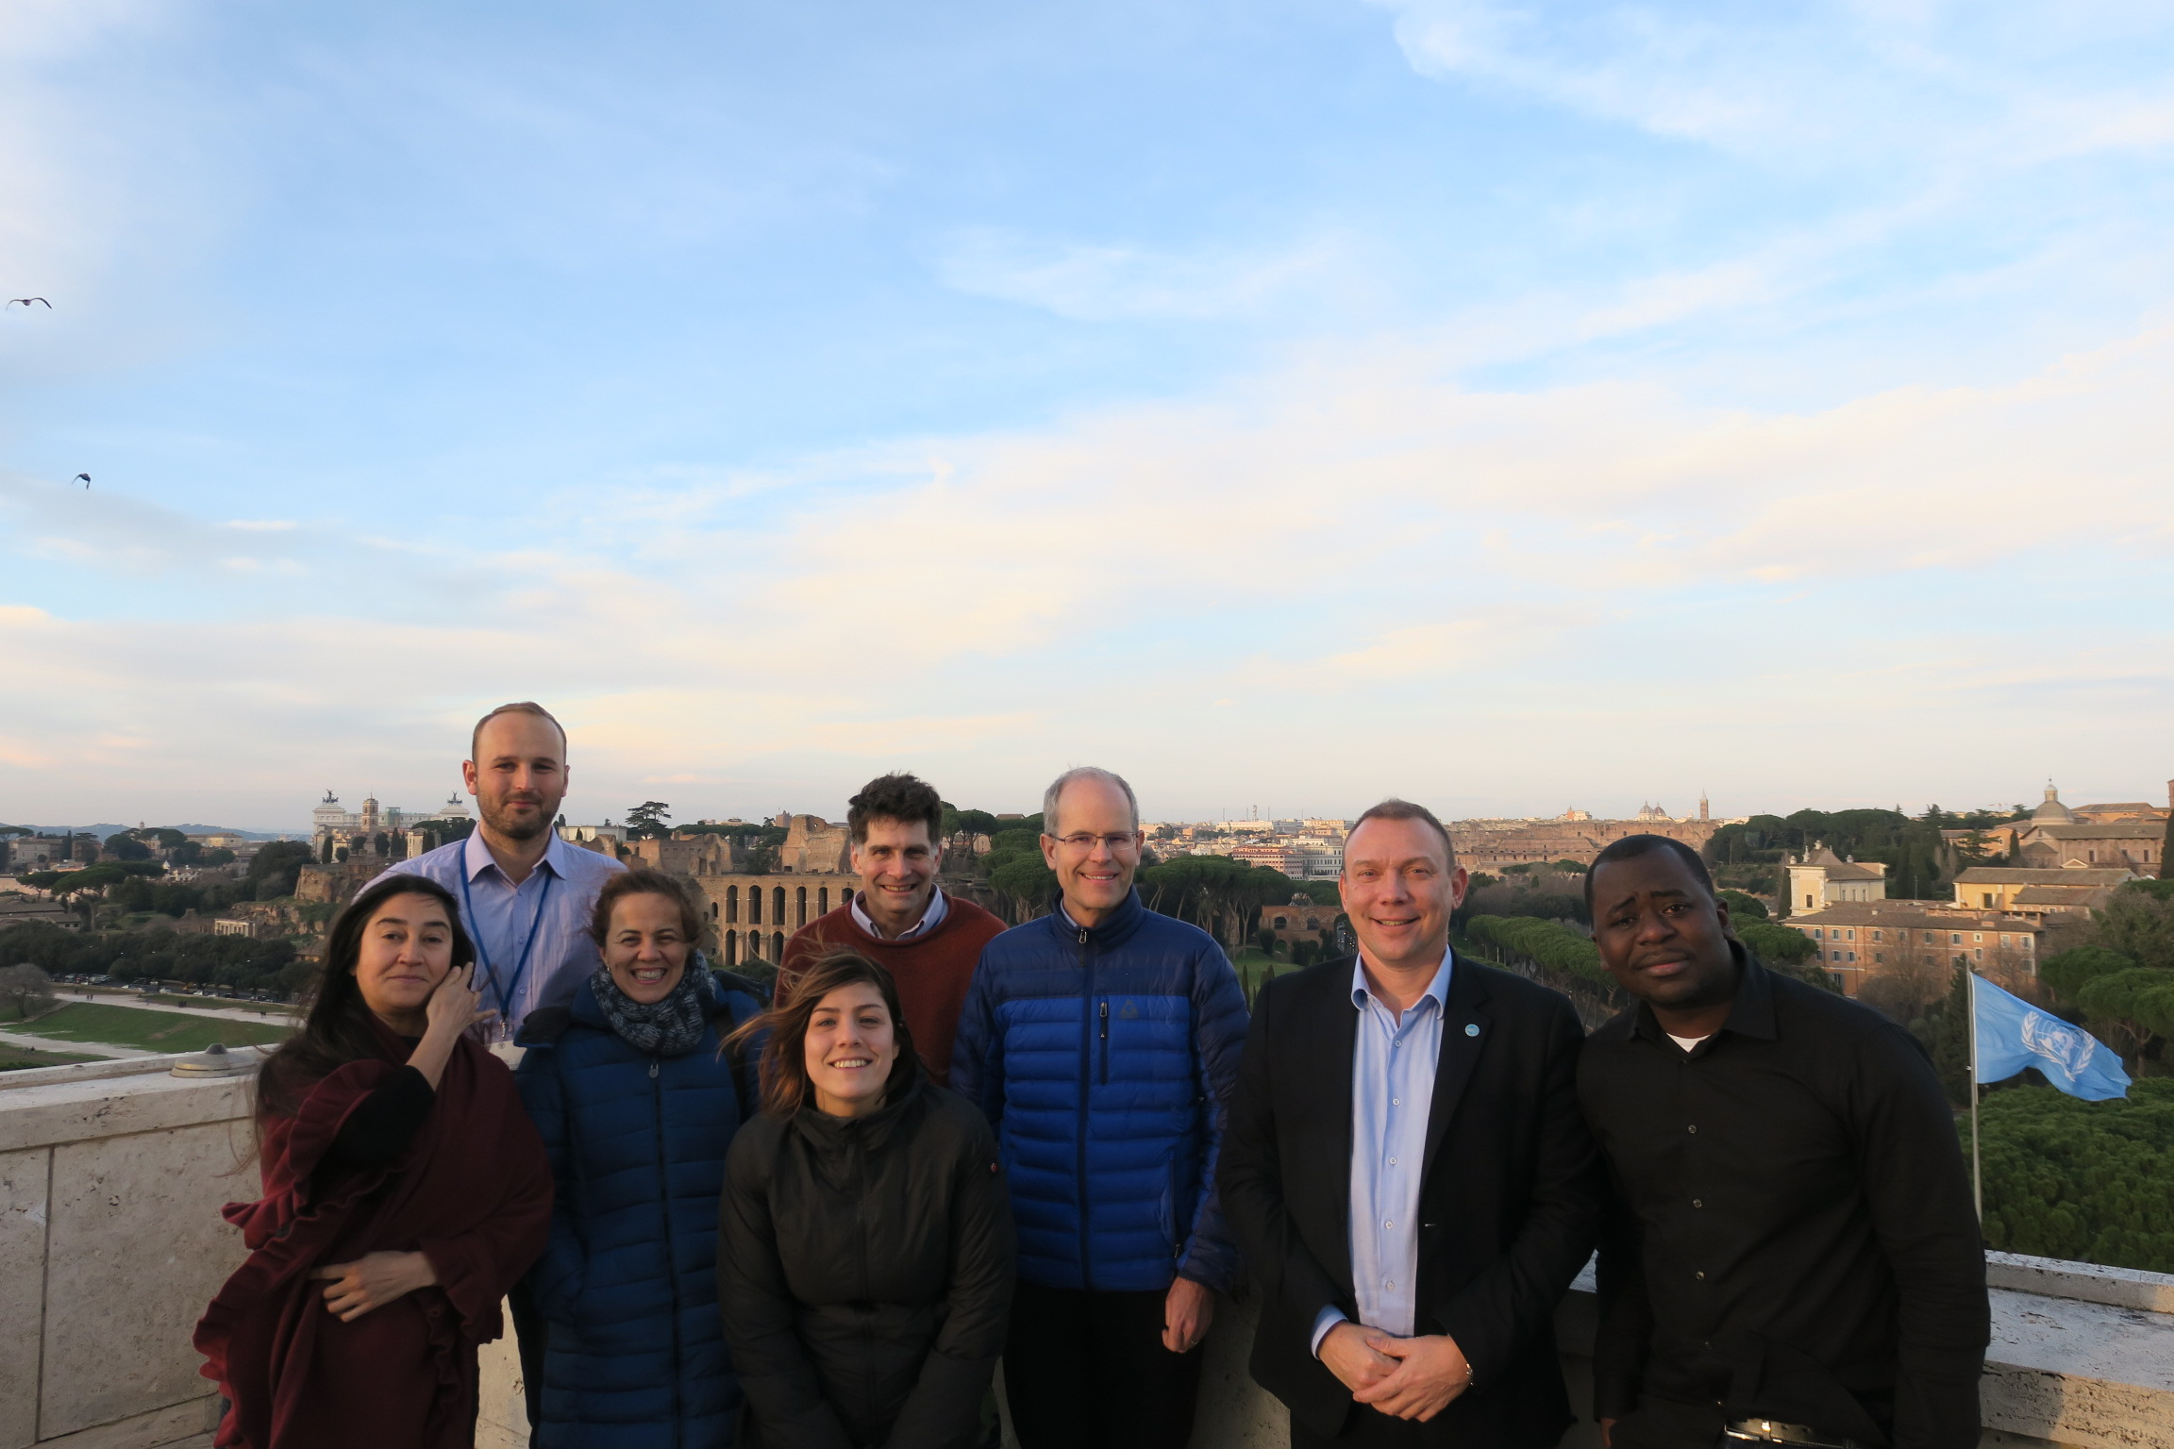
GFOI Office
The Initiative is supported by a Secretariat (the GFOI Office),
which is hosted by FAO’s Forestry Department.
The GFOI Office is responsible for providing secretariat services to the Initiative and to all its partners, through:
active communication,
programme and relationship management,
organizing and hosting of events,
and constructive engagement with GFOI partners.

Slide 8
Communications
clear and effective communication between GFOI partners and stakeholders
Strong global coordination in MRV is highly dependent on
Enhanced communications
as a means for improving coordination and collaboration between its partners.

Slide 9
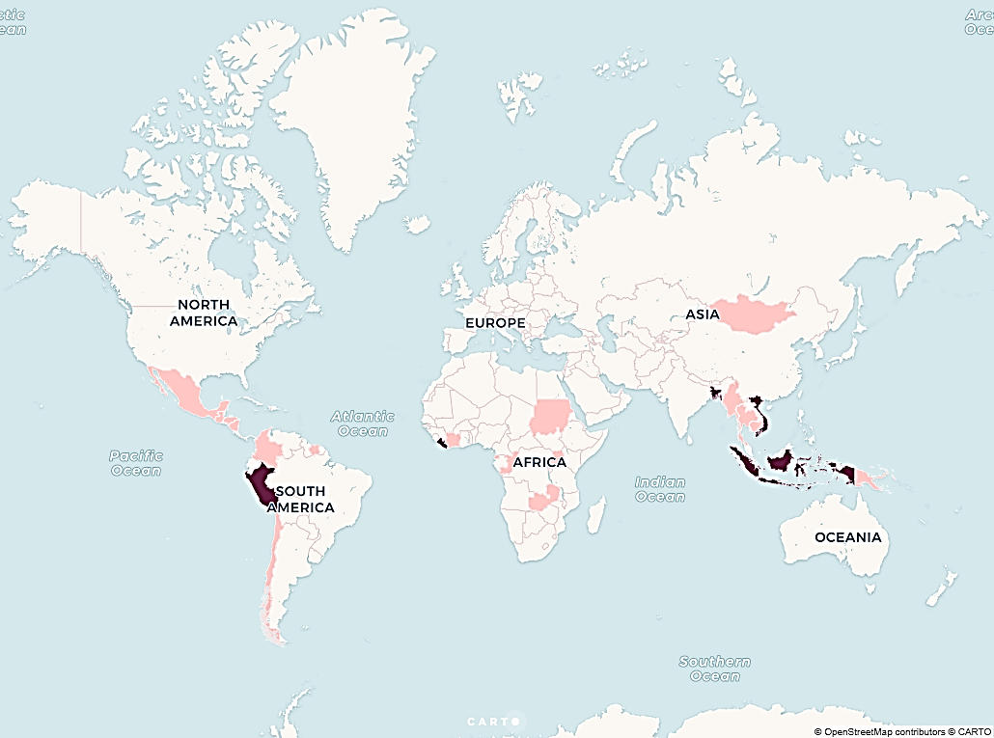

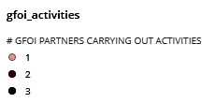
GFOI Stakeholders
Developing countries improving their forest monitoring systems and associated emissions
Measurement, Reporting and Verification (MRV) practices for REDD+ and other reporting needs
Map inventory of activities conducted by GFOI partners by country
*Based on voluntary submissions - March 2019
Soon on: www.gfoi.org

Slide 10
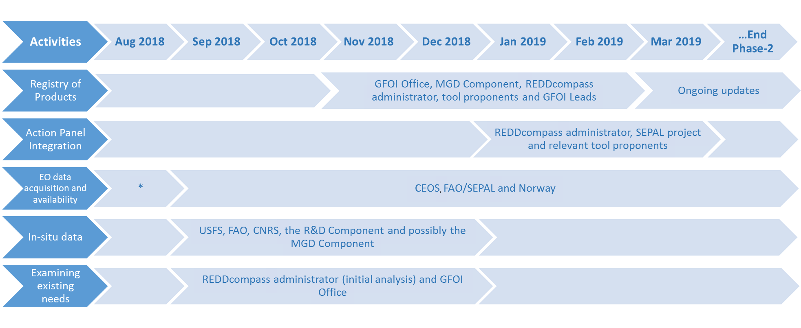
New Data component work plan

Slide 11



The GFOI Cycle: identifying + addressing country needs
R&D
Pre-operational
CALM
Operational
Country Identified Needs
Training
MGD Advisory Group
Countries
Guidance
MGD
Capacity Building partners
Dataset or tool etc.
Operational
CALM
REDDcompass
Pre-Operational
*Criteria for consistently Assessing Levels of Maturity (CALM)

Slide 12
Implementing CALM across the components
Research and Development (R&D): encourages their community to report the status of their research using CALM in order to communicate progress toward operational status. Uses information to highlight gaps in research to achieve operational ready technology
The Methods and Guidance: Utilises CALM in assessing and prioritizing the development of new guidance on pre-operational/operational concepts.
Data component: uses CALM to communicate the maturity levels of data platforms and tools that help bridge the gap between scientific and technological developments and country MRV needs.
Capacity Building communicates maturity level through the development of training materials and may use information to advise countries on building capacity and systems that use technologies that are considered operational.

Slide 13
Ground Data Review
Goals: identify options for GFOI to facilitate increased global coordination in the provision of support and guidance in the collection, storage and use of ground data in the context of a NFMS that benefits developing countries
Scope of Review: Existing GFOI Guidance, partner support, tools, data sets and other products
Timeline:
* TOR and implementation approach discussed and refined at the GFOI Plenary in April
* Inception report drafted: June 2019
* Review conducted: July-September
* Draft report sent out for comments: end of September
* Review complete and recommendations provided to GFOI for consideration at the final face-to-face Leads meeting for the year: approximately, the November timeframe.

Slide 14
Country Needs Assessment
Goals: To develop a holistic process for supporting developing countries to assess their National Forest Monitoring Systems (NFMS), and associated emissions MRV procedures, in order increase national coordination, identify and prioritize improvements and communicate needs to both national decision makers and GFOI partners for international support
The CNA Process:
1. Should be geared toward developing country led assessments
2. Should consider priority goals of NFMS and focus needs assessment on these goals
3. Development and implementation of CNA process should include participants from all of the components.
4. Be flexible to take into account different regional and country needs and situations.
5. Include clear tools and processes for clearly communicating the results of the assessment to national stakeholders and international partners.

Slide 15
Country Needs Assessment
Lessons learned from regional pilots:
Two regional meetings were held in Asia (5 countries) and Africa (6 countries) to trial an interactive card based system for using the REDDcompass to pilot the methods. Workshop included small country teams with the goal of these teams following up with other nationals in country.
A holistic process will generally take time and involve multiple steps working with relevant country institutions
Active follow up required with country teams
Further development of templates or tools to improve communication of results to national stakeholders and funders and capacity building organizations.
Further follow up will take place during GFOI plenary

Slide 16




Want more?
gfoi.org
facebook.com/gfoi1
twitter.com/gfoi_forest
office@gfoi.org

