Slide 1

BIOMASS
K. Papathanassiou & M. Pardini
Microwaves and Radar Institute
DLR Oberpfaffenhofen

Slide 2
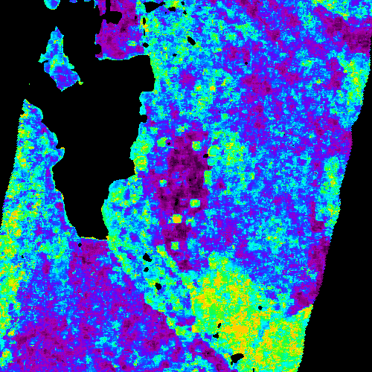
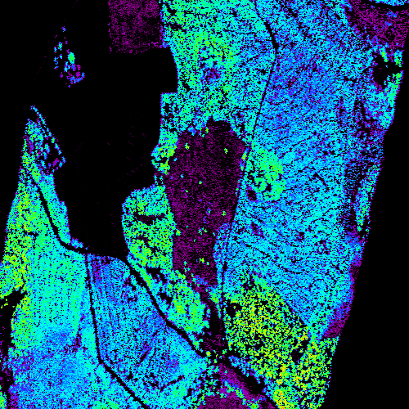
DLR-HR Contributions to BIOMASS
Member of the international team of scientist submitting the original BIOMASS proposal in response to ESA’s Earth Explorer 7th call, back in 2005.
Leading role in the science activities of BIOMASS.
Responsible for the definition, generation and validation of the forest height product. I
Design and Execution of key (and unique) airborne experiments: INDREX-II (2006), BioSAR I and II (2007 and 09), IceSAR (2007), TempoSAR (2012), AfriSAR (2016), DesertSAR(2020).
Development of key science algorithms (2005-date): Single- and Multi-baseline Pol-InSAR inversion in the presence of moderate temporal decorrelation and Height-2-Biomass;
Development of polarimetric / ionospheric calibration methodology (2010-date);
Since 2007 participation in the BIOMASS Mission Advisory Group (MAG).
P-band 6MHz Forest height Map
Lidar Forest height Map

Slide 3
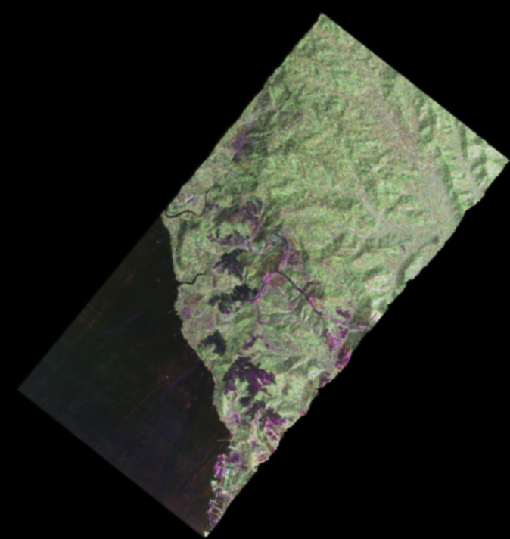
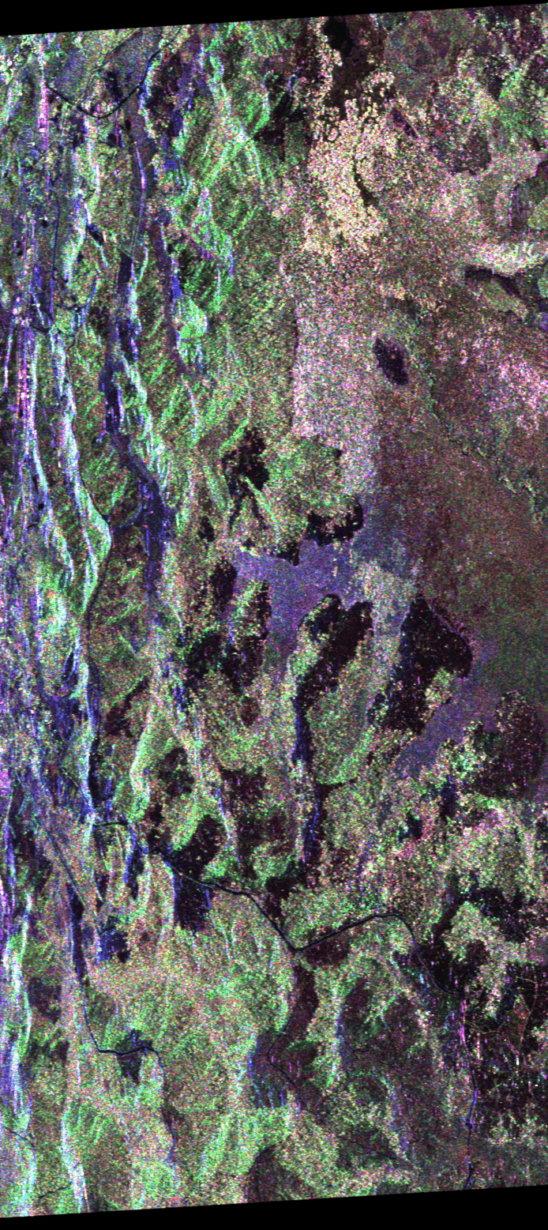
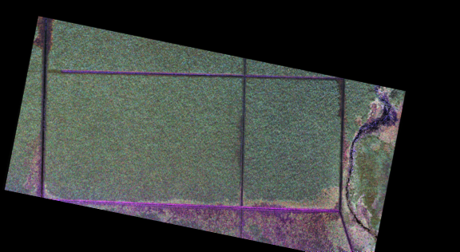
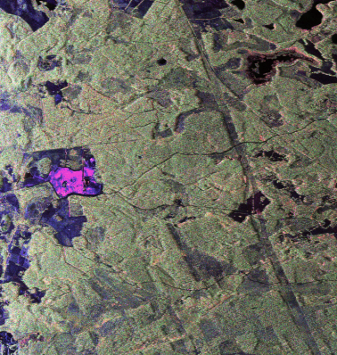

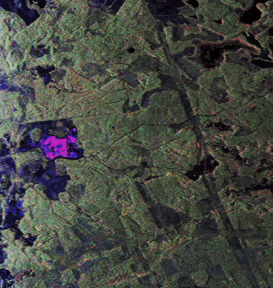
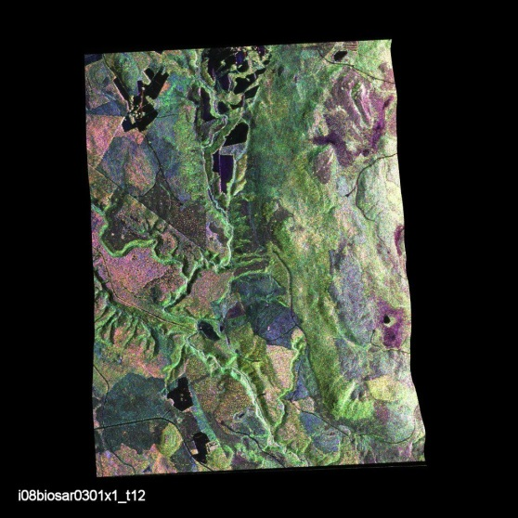
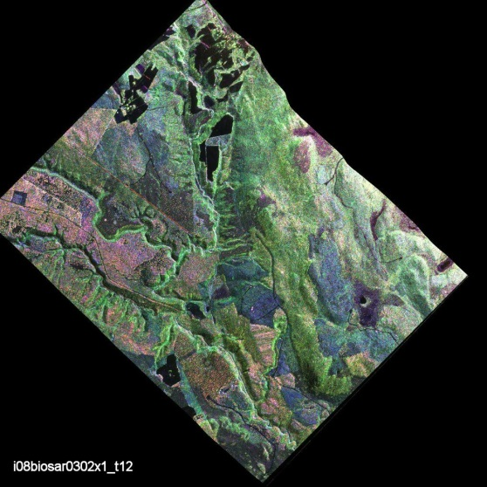
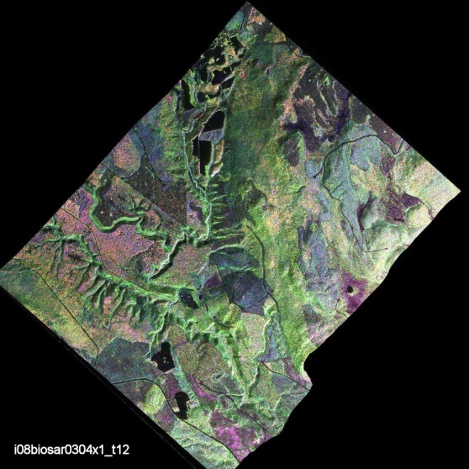
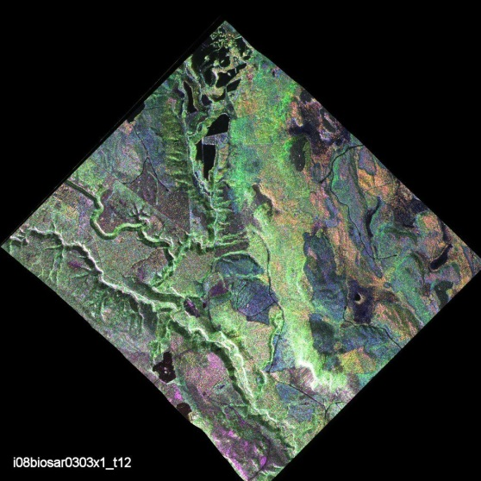
Campaigns
INDREX-II 2004
Sungain-Wein
Samboja Lestari
Mawas
BioSAR I 2007
BioSAR II 2009
March
April
May

Slide 4
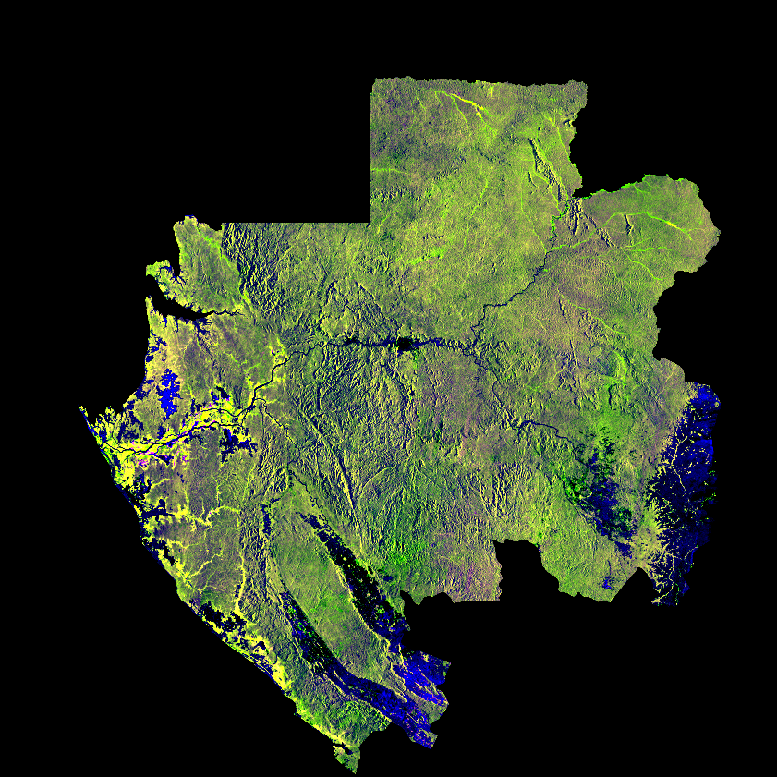






Objectives
Tandem-L:
Development & validation of algorithms for forest structure characterisation @ L-band
GEDI
Development & validation of methodology for combining TD-X and GEDI measurements
BIOMASS
Establishment & validation of a common framework for PolSAR, Pol-InSAR and TomoSAR massurements to support Biomass estimation @ P-band
AfriSAR 2016
Mondah
Nkok
Pongara
Lope National Park
Mabounie
Rabi
JERS LHH MOSAIC of GABON
R: LHH-1 (Oct-Nov, 1996)
G: LHH-2 (Jan-Mar, 1996)
B: Ratio LHH-1/LHH-2
DLR.de • Chart 4

Slide 5
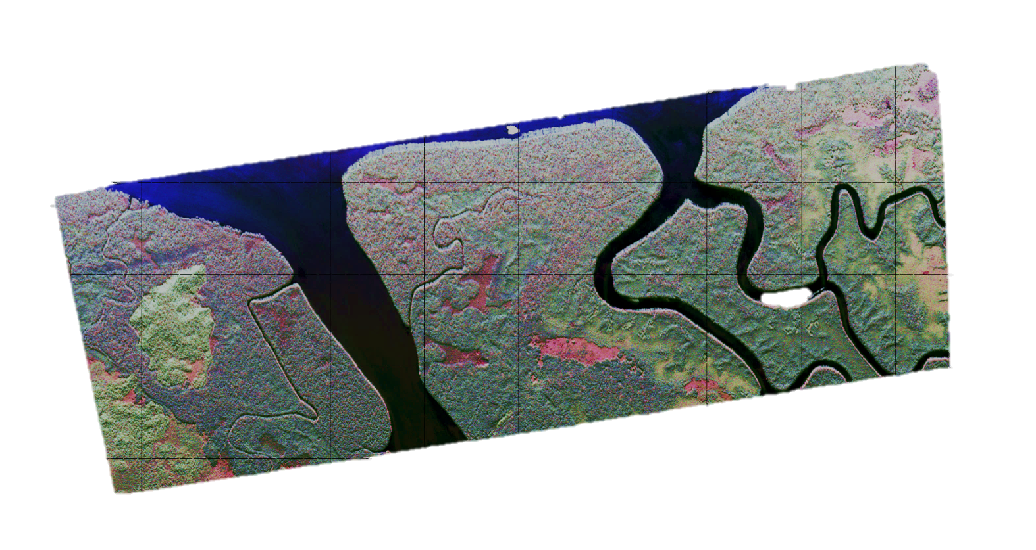
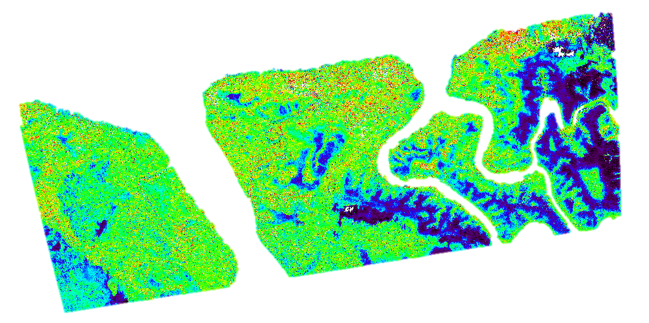
Forest Height Estimation: Pongara Test Site, Gabon
SAR Forest Height [m]
Lidar Height [m]
Polarimetric Pauli RGB
Forest Height

Slide 6
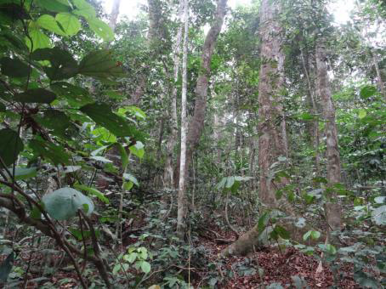
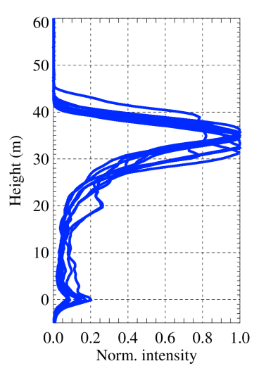
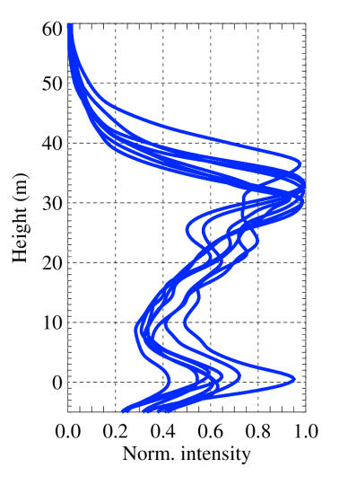
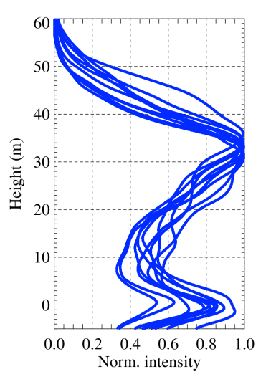
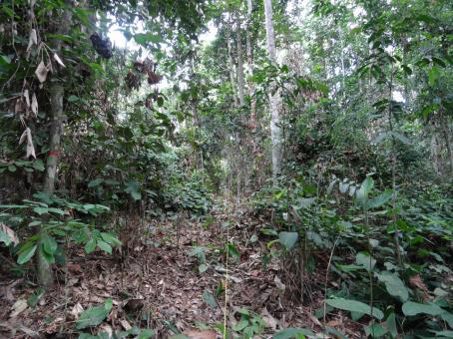
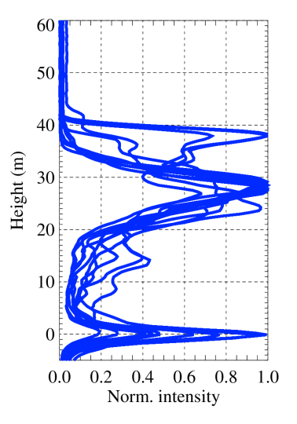
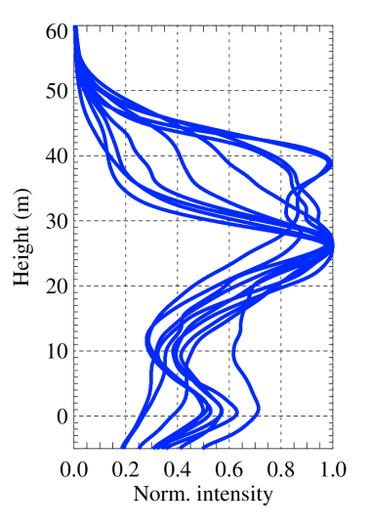
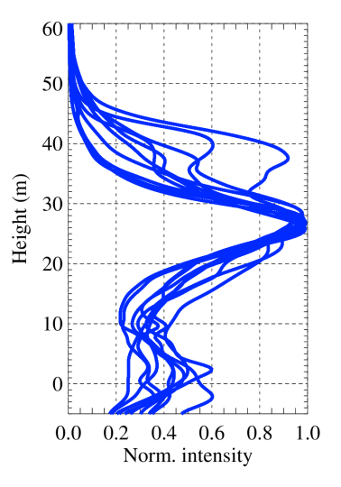
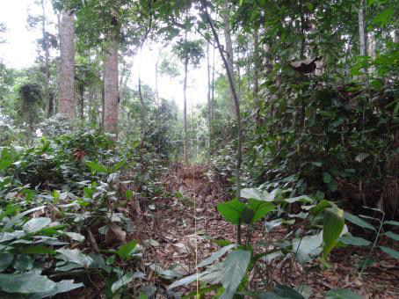
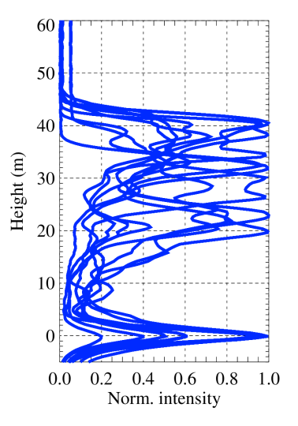
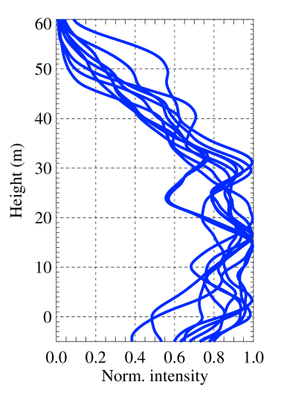
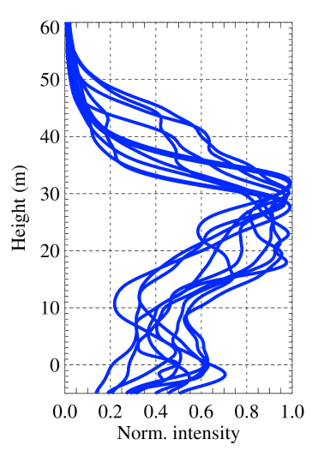
LVIS full waveforms
AfriSAR: LVIS vs TomoSAR profiles (Lopé)
TomoSAR L-band – DLR F-SAR, HV, Capon, 15m vert. res.
TomoSAR P-band – DLR F-SAR, HV, Capon, 15m vert. res.

Slide 7
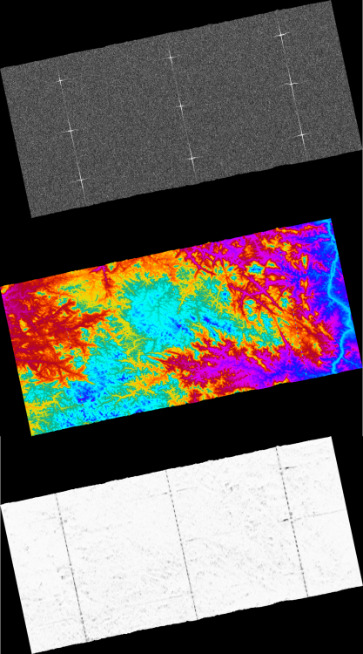
DLR-HR Contributions to BIOMASS
In parallel to the science and calibration activities DLR-HR the institute is involved in core activities launched in the frame of Phase B2 (Preliminary Definition), C (Detailed Definition) and D (Qualification and Acceptance):
1. DLR-HR leads the work for the BIOMASS End-to-End Performance Simulator (BEEPS) Space Segment Simulator, a complete end-to-end chain of modules representing the Space Segment.
2. DLR-HR leads the development of the Ground Processor Prototype (GPP) that process BIOMASS Level 0 data to Level 1a/1b (i.e. Calibrated Single Look Complex SLC data).
3. DLR-HR is further responsible for developing, implementing and verifying the prototype processor for the operational forest height product in the frame of the BIOMASS Level-2 Implementation Study.
Simulated BIOMASS scene
geocoded amplitude
interferometric phase
interferometric coherence

Slide 8
BIOMASS
K. Papathanassiou & M. Pardini
Microwaves and Radar Institute
DLR Oberpfaffenhofen

Slide 9
TanDEM-X – GEDI Fusion for Global Vegetation Mapping
K. Papathanassiou & M. Pardini
Microwaves and Radar Institute
DLR Oberpfaffenhofen

Slide 10

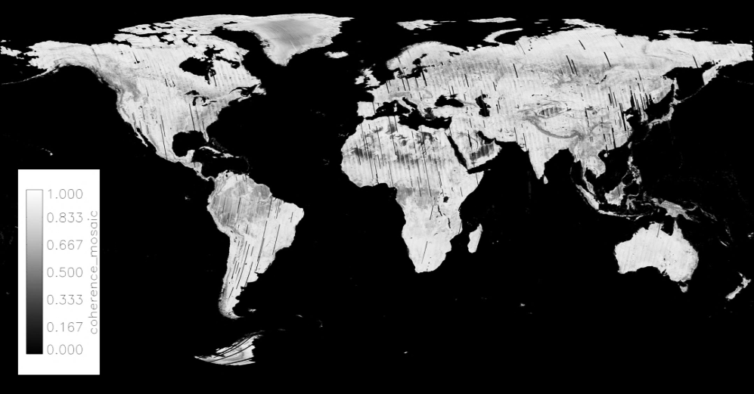


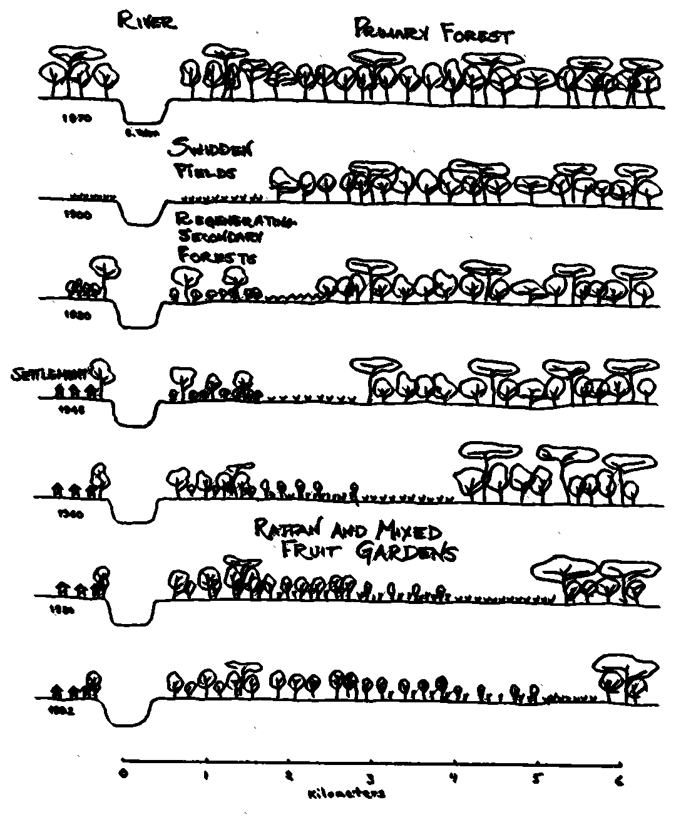
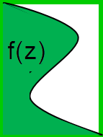
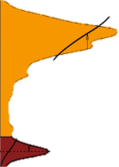
TanDEM-X
TerraSAR-X add-on for Digital Elevation Measurement
Mission Objective:
Generation of global Digital Elevation Model
Implementation:
First single pass interferometer in space operated at X-band (9.65GHz, λ=3cm).
GEDI LIDAR
Global Ecosystem Dynamics Investigation Lidar
Science Objective:
Characterize the effects of changing climate and land use on ecosystem structure and dynamics
Implementation:
Multi-beam NIR waveform lidar deployed on ISS in 2018
25m beam
footprint
~ 60 m footprint
distance
~500 m beam distance
Forest Transect

Slide 11
TanDEM-X – GEDI differences and complementarities
… side-looking vs nadir-looking
… InSAR coherences vs full reflectance profiles
… continuous and high resolution mapping vs discrete footprint-based sampling
Objective: development of algorithms combining TanDEM-X single-pass InSAR data and GEDI profiles towards improved forest height and biomass products
TanDEM-X data are expected to contribute to …
… Fill in spatial gaps in GEDI’s coverage
… Support Produce with higher spatial resolution and/or higher accuracy
… Create structural strata to guide biomass equation creation
… Provide alternate pathways to biomass calibration and estimation
Forest Transect

Slide 12
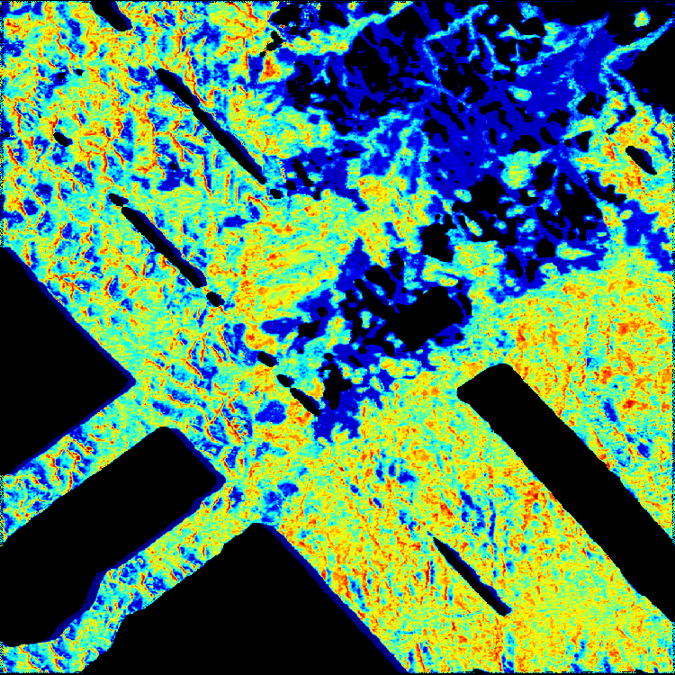
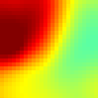
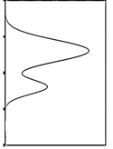

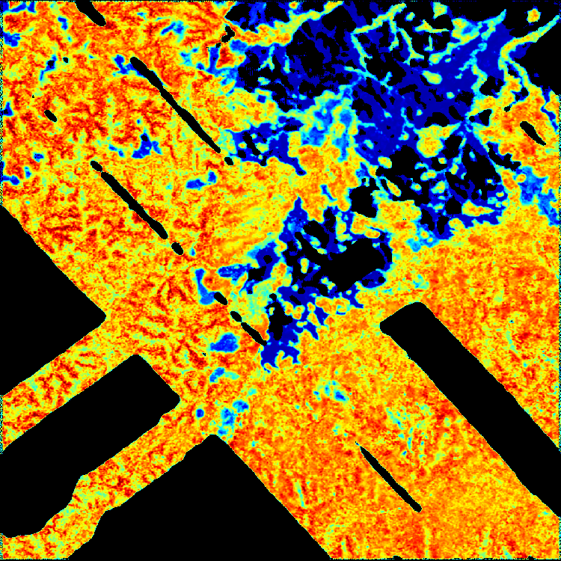
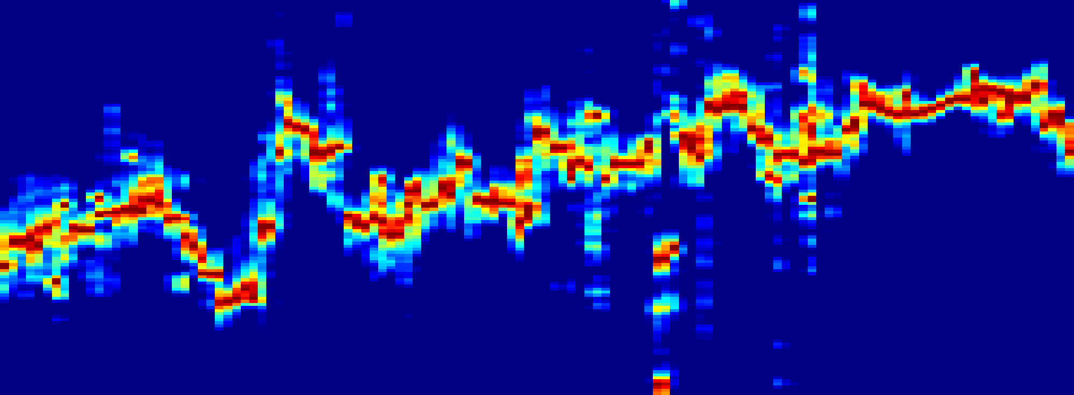
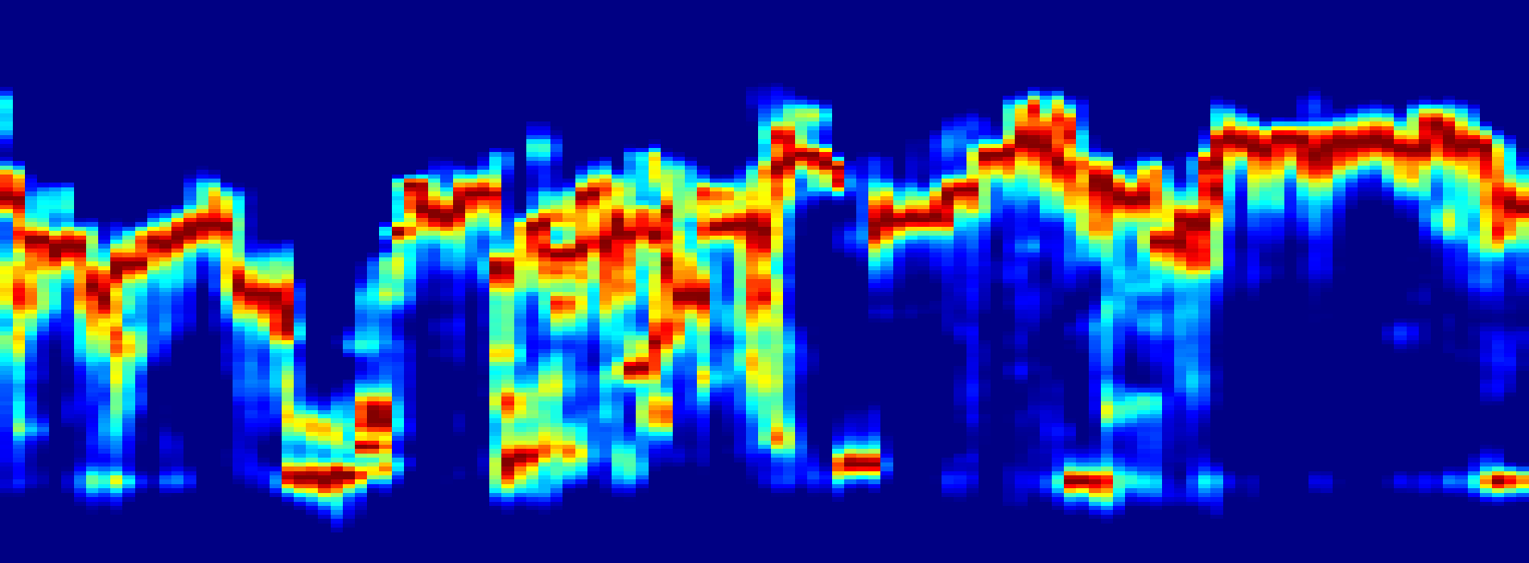
Formation of TanDEM-X InSAR height profiles
InSAR height profile Histogram of the DEM heights in a certain area
25 m
Height
TanDEM-X InSAR DEM
25 m
Example from the AfriSAR experiment – Lopè, Gabon
Acquisition of TanDEM-X and NASA LVIS (Land, Vegetation and Ice Sensor) full-waveform lidar data, simulating GEDI data
0 m
60 m
60 m
TanDEM-X height profile
Height
Lidar Top Height
-10 m
60 m
LVIS lidar full-waveforms (AfriSAR campaign)
Height
-10 m
~ 2 km
Notes:
From height to phase centers

Slide 13
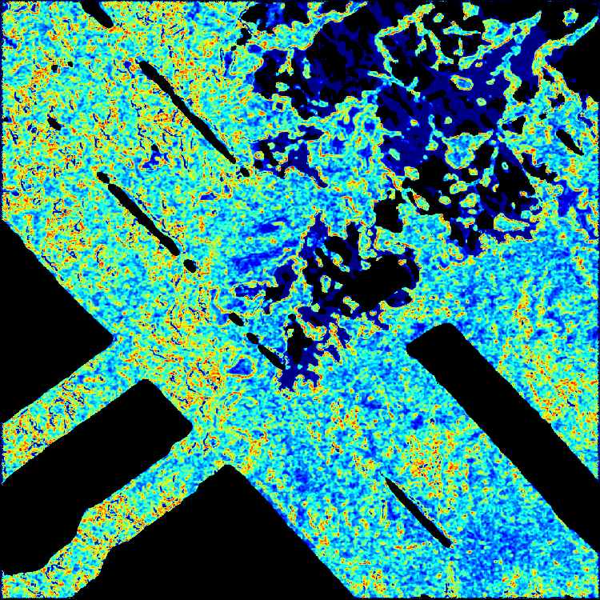
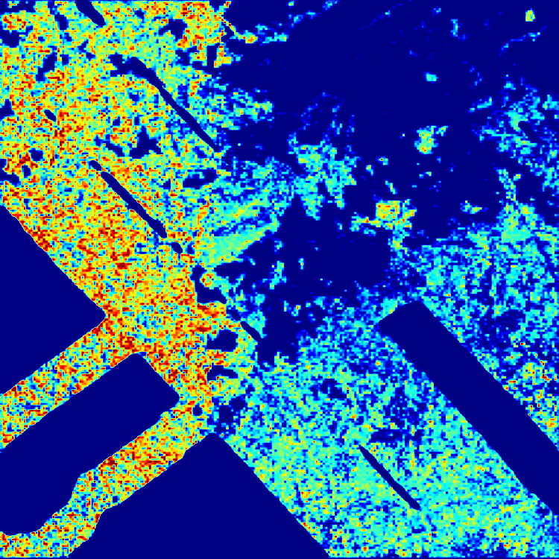

TanDEM-X structure information for biomass
Ongoing activity: development of methodologies for the combination of continuous TanDEM-X forest structure information and GEDI biomass estimates at footprint level in order to obtain high-resolution continuous biomass maps
Standard deviation (1ha resolution) of the height of the top peak of the TanDEM-X profiles
Biomass map (1ha resolution)
estimated from LVIS profiles
0
Std (m)
10
0
t/ha
700

Slide 14
TanDEM-X – GEDI Fusion for Global Vegetation Mapping
K. Papathanassiou & M. Pardini
Microwaves and Radar Institute
DLR Oberpfaffenhofen

