Slide 1
ALOS-2 ScanSAR data provision (UPDATE)
Shinichi Sobue, Kei Oyoshi, Ko Hamamoto, Takeo Tadono, Osamu Ochiai, Masanobu Shimada,
Ake Rosenqvis and Stephen Ward
Japan Aerospace Exploration Agency

Slide 2
Application | Disaster, Land, Agriclture, Natural Resources, Sea Ice & Maritime Safety
L-band SAR (PALSAR-2) | Stripmap: 3 to 10m res., 50 to 70 km swath ScanSAR: 100m res., 350km/490km swath Spotlight: 1×3m res., 25km swath
Orbit | Sun-synchronous orbit Altitude: 628km Local sun time : 12:00 +/- 15min Revisit: 14days Orbit control: ≦+/-500m
Life time | 5 years (target: 7 years)
Launch | JFY2013, H-IIA launch vehicle
Downlink | X-band: 800Mbps(16QAM) 400/200Mbps(QPSK) Ka-band: 278Mbps (Data Relay)
Experimental Instrument | Compact InfraRed Camera (CIRC) Space-based Automatic Identification System Experiment 2 (SPAISE2)
Notes:
ALOS-2 carries L-band Synthetic Aperture Radar called PALSAR-2.
The local sun time is at noon in order to complement other SAR satellites which are in dawn-dusk orbits. The revisit time is shortened from that of ALOS and the orbit is controlled within 500m tube for interferometry.
The observation data is transmitted either directly to a ground station via X-band at 800Mbps or through inter-satellite communication via Ka-band at 278Mbps.
ALOS-2 will contribute to Disaster monitoring, Land monitoring, Agricultural monitoring, Natural Resource Exploration and Global Forest monitoring as ALOS did.
And potential use such as maritime safety will be expected.

Slide 3
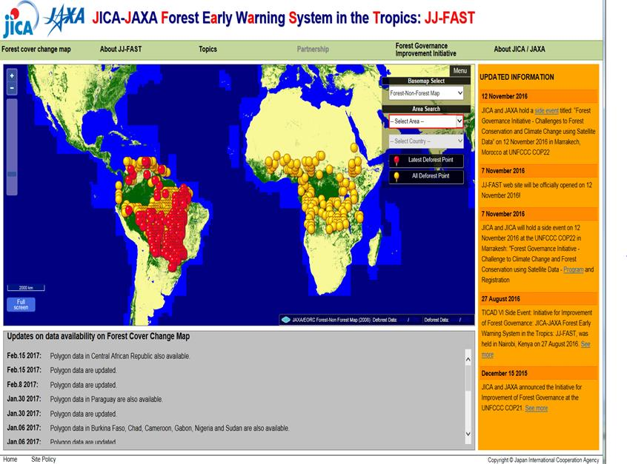
JICA-JAXA Forest Early Warning System in the Tropics (JJ-FAST)
ScanSAR Ortho-slop corrected DN data will be processed during production of forest cover change (deforest / logging area)
ADB INAHOR project countries and APRSAF SAFE prototyping country (Indonesia, LaoPDR, Philippine, Thailand and Vietnam) ScanSAR data will be freely accessible from JAXA archive from next year.under JJ-FAST for those countrys’ own government use under a bilateral agreement
Provide deforest area data (1 degree mesh)
Yellow: All avalable data
Red: Latest update data
http://www.eorc.jaxa.jp/jjfast/
http://www.eorc.jaxa.jp/jjfast/

Slide 4
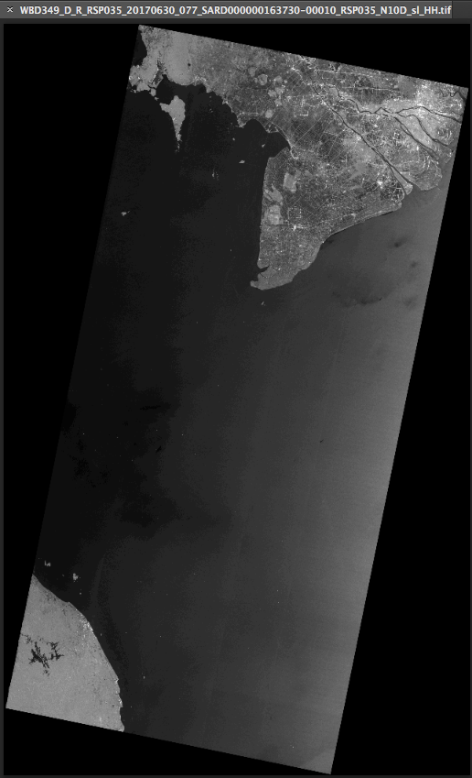
ALOS-2 ScanSAR data specification for GFOI and other applications(DRAFT)
Product characteristics as ARD (under discussion)
Path data
Polarisation: HH + HV
Gamma-0
Image size: arbitrary
Pixel spacing: 50 m
Image segment start & end: arbitrary
Orho & slope correction by SRTM1
Data type: 16 bits UInt
File format: GeoTIFF
Temporal resolution: every 1.5 months (9 times per a year (target)
Spatial resolution: All paths in target region
Limitations:
Indonesia, Thailand, LaoPDR, Cambodia, Vietnam
For non commericail users only authorized by space related agencies in target countries
PALSAR-2 ScanSAR (HH)
30 June 2017

Slide 5
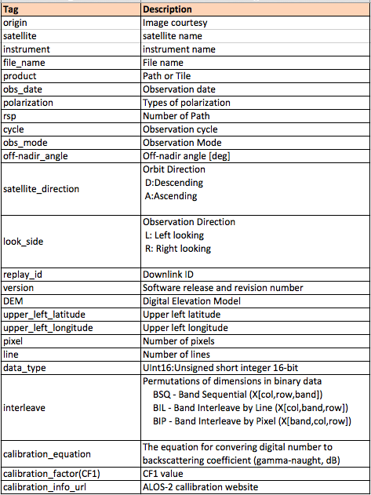
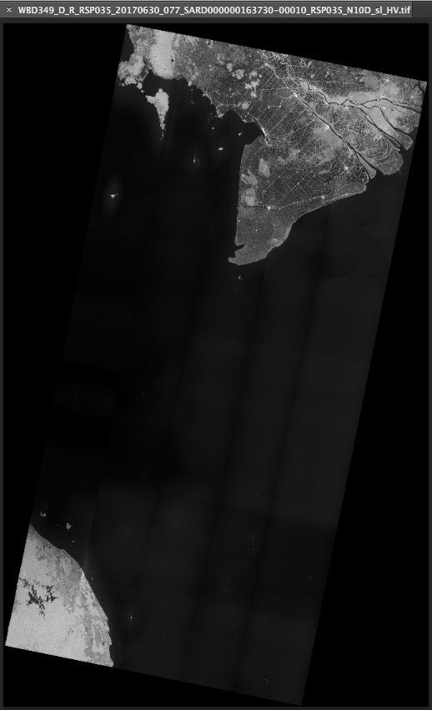
ALOS-2 ScanSAR data samples
PALSAR-2 ScanSAR (HV)
30 June 2017
Data header

Slide 6
ALOS-2 ScanSAR data provision status
For GEOGLAM and CEOS
Under GEOGLAM/Asia Rice and ALOS K&C project, JAXA provides ScanSAR data at technical demonstration sites (100km x 100km – one province) in Cambodia, Myanmar, Malaysia, Lao, India, China, Thailand and Taiwan to Asia Rice crop team members with ALOS-2 download system now.
Under Asia Pacific regionsal space agency forum (APRSAF) framework with GEOGLAM/Asia Rice, JAXA provides scale up activity for Indonesia (Top 10 rice crop production provinces) and Vietnam (Mekong)
Will discuss with GFOI team
Proposal from JAXA
Under cooperation with JICA and commerical data providers, JAXA starts to prepare to provide on-line access to intermidate JJ-FAST products = ScanSar ortho-slop corrected DN data and/or ALOS-2 50m path ortho-slop correct data (gamma naught) from ALOS-2 path mosaic to selected countries for each target country data where JAXA, ADB and APRSAF countries have cooperative aggeement (Indonesia, LaoPDR, Thailand, Philippine, Low Mekong (Vietnam + Cambodia)) for governmental use in respecting countries.
JAXA starts to prepare sample data of ScanSAR data to ingest Vietnam data cube and propose CEOS ARD of SAR (1-5 degree mesh tiled data or path orth-slop corrected data).
Other than ASEAN area, JAXA will discuss with commercial data distributor to have same framework of ALOS-2 ScanSAR intermidate product to target countrys’ governmetal use if CEOS and GEO community are interested in.

Slide 7
Coordination status with respecting countries
1. Vietnam
VNSC and CSIRO/GA already prepare to implement CEOS Mekong data cube by the end of this year
VNSC and JAXA agreed to coordinate ALOS-2 ScanSAR data ingestion with rice crop area estimation software (INAHOR) to CEOS Mekong data cube
JAXA and VNSC coordinate MOU for Vietnam data cube with ALOS-2 ScanSAR data and will have Data cube workshop as a pre-workshop of GEOSS-AP agriculture working group (WG5)
2. Indonesia
LAPAN, MOA and JAXA agreed to coordinate coordinate ALOS-2 ScanSAR data ingestion to LAPAN data archive
JAXA and LAPAN start to coordinate MOU to archive and use ALOS-2 ScanSAR data in Indonesia
3. Thailand
JAXA and GISTDA start to discuss ALOS-2 ScanSAR data of Thailand and Lao provision to GISTDA
-> If GFOI partners in those countries recommend to contact with the space related agency in your country.
-> If GFOI team members are interested in using those data, please contact with JAXA ALOS-2 POC

Slide 8
Vietnam SAR based rice crop monitoring scheme (draft)
JAXA
GA/CSIRO
Ground data
ALOS-2
GEORICE
VNSC
Data Cube
ScanSAR every 42 days (JJ-FAST
products) by JJ-FAST system
+ INAHOR software
Statistical info
MARD
ESA
Met info
Sentinel
MONRE
MODIS
Landsat
Analyzed info
Dual every 12 days
CSIRO
VNSC, VAST, MARD

Slide 9
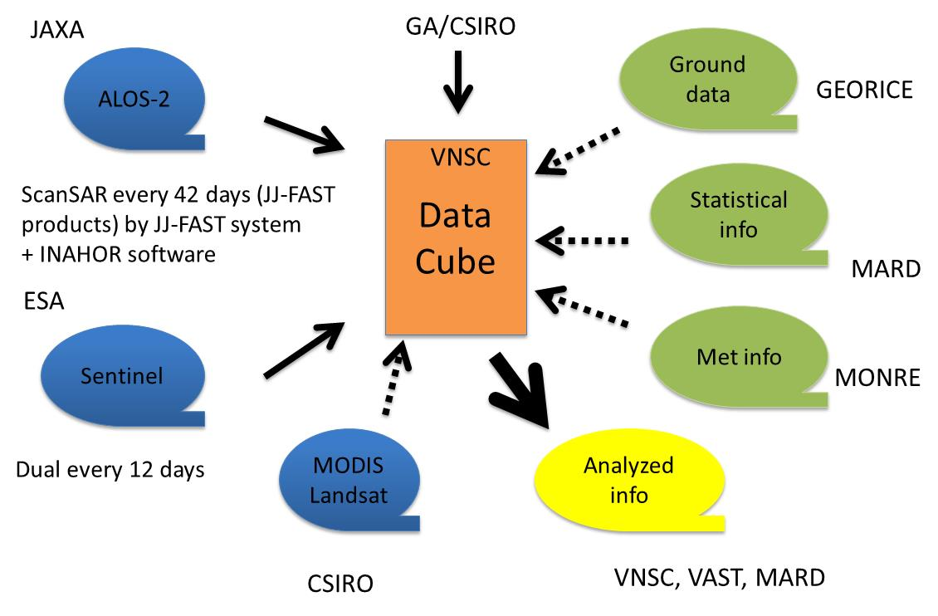
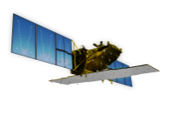
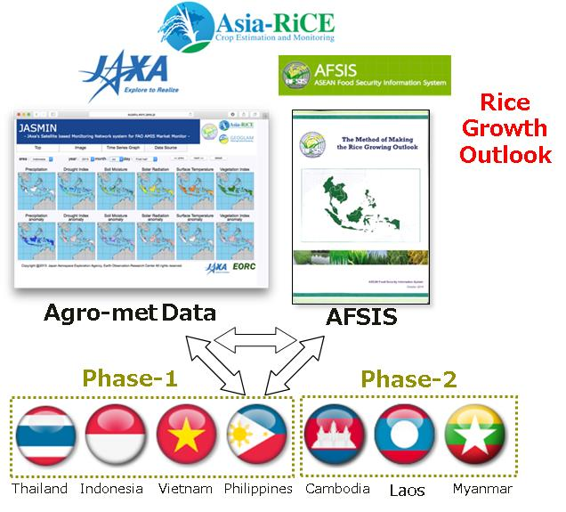
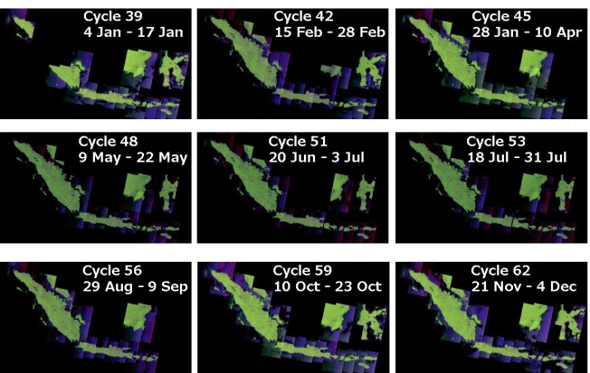
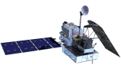
GEOGLAM AsiaRiCE (from demo to operation)
http://www.asia-rice.org
Asia-RiCE (Asia Rice Crop Estimation & Monitoring) program led by JAXA with CNES and more than 20 Asian Space agencies and Ministries of Agriculture with International organization such as ASEAN/AFSIS, UN/FAO, IRRI from 2013 (POC: Sobue.shinichi@jaxa.jp, ohyoshi.kei@jaxa.jp, Thuy.letoan@cesbio.cnes.fr
ID | Target Agricultural Products | Requirements of EO data for operational use
P1 | Rice Crop Area Estimates/Maps | Wall-to-wall observation with SAR dual polarization with Opticals (week – bi-weekly - monthly) : Indonesia, Vietnam/Cambodia and Thailand/Lao projects
P2 | Crop Calendars/Crop Growth Status | Mid/coarse resolution opitcal frequent observation (MODIS, GCOM-C, Landasat, Sentinel-2, etc.) with SARs weekly
P3 | Crop Damage Assessment | Very High resolution SAR and Optical timely under international disasater charter, Sentinel Asia, etc.
P4 | Agro-meteorological Information Products | Daily Mid/coarse resolution optical, passive microwaver and PR with geostatinary met sat frequent observation (MODIS, Sentinel, GCOM-C/W, GPM, Himawari, etc.)
P5 | Production Estimation and Forecasting | Data fusion, data integration with ground base observation / statisitcal information and crop models
Time series observation by SAR for top 10 Indonesia main rice regions by ALOS-2 with MOA
Vietnam Data Cube starting from GEOSS-AP
(Hanoi, September) by VNSC/VAST with CEOS

Slide 10
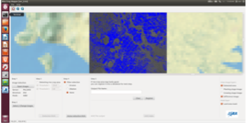
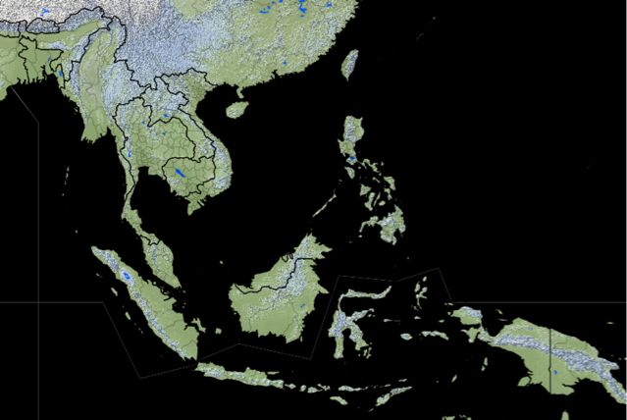
Product 1: Rice Crop Mapping in Southeast Asia
ADB Technical Assistance project and SAFE project under the APRSAF have successfully demonstrated INAHOR using ALOS-2 with the mapping accuracy of 80-90% for the target provinces.
Scaling-up for major rice producing areas is currently demonstrated in Vietnam and Indonesia.
ADB TA Project
SAFE Project (Test site)
Laos
Thailand
Vietnam (North)
Philippines
Rice-planted Area Mapping Software (INAHOR)
Myanmar
Cambodia
[2016-]
SAFE Project （Scaling-up）
[2014-2016]
Vietnam (Mekong Delta)
Indonesia
[2014-]

Slide 11
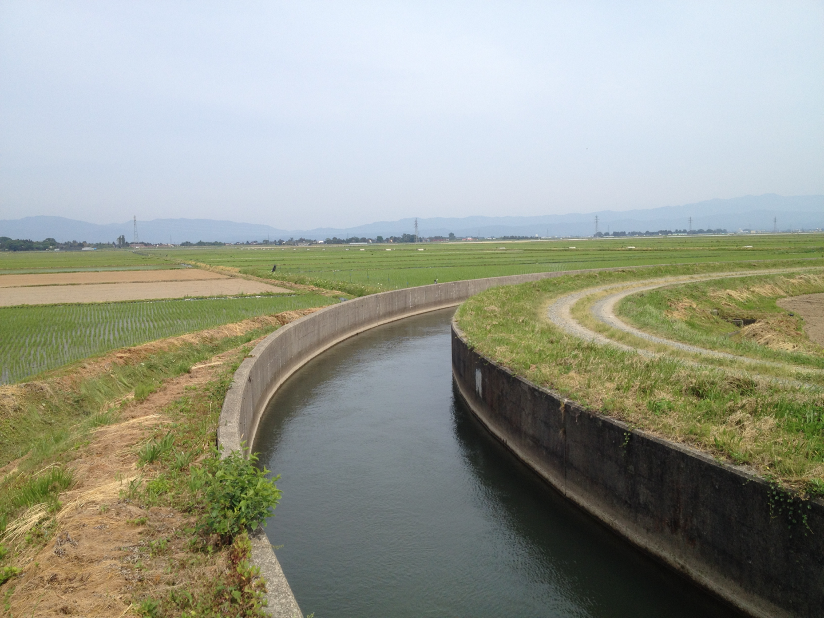
Thank you very much for your attention.
sobue.shinichi@jaxa.jp
@Tsuruoka, Yamagata Pref.
TDS Site in Japan

