Slide 1
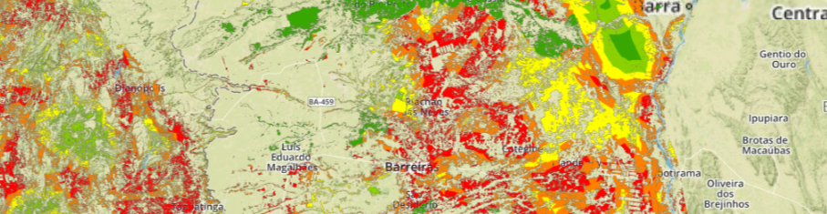
Advancing UK inputs to GFOI
Overview of inputs from UK Climate and Space Programmes into GFOI
September 2016

Slide 2


Contribution Mechanisms

Slide 3
  The International Climate Fund (ICF) is the UK’s commitment to support developing countries with climate change adaptation, low carbon growth and reducing deforestation
  Approximately £1 billion ODA expenditure per year to 2020
  Approx 20% on forest related projects
  Includes DFID, DECC, DEFRA bilateral and multilateral channels
  Strong emphasis on accountability to tax payers for results
  Monitoring, Evaluation and Learning (MEL) and value for money

Slide 4
  Key Performance Indicators

Slide 5
KPI Methodology Requirements
  Methods should be
  Robust (based on sound evidence / data and testable assumptions)
  Transparent
  Consistent (broadly applicable)
  Repeatable
  Affordable (and ideally a useful component of national forest monitoring)
  Challenges
  Different types of interventions
  Variable availability of data on forest areas and forest change
  Reference levels (different approaches possible)
  Contribution / Attribution

Slide 6
  Background work on methods and data
  2014 DFID funded review of potential methods and data sources
  2014 - 2015 ESA Funded pilot testing of a risk based methodology in Brazil, Nepal and Ghana
  2015 ESA Funded assessment of accuracy of UMD Forest Loss data product (aka Global Forest Watch) in Brazil and Ghana
  Proposed work 2016 - 2019
  Expand programmes and countries to test and apply Hectares Indicator method (Brazil, Indonesia, Ghana, Colombia, Nepal)
  Integration with other forest KPIs (Livelihoods, Ecosystem Services)
  Provide mapping platforms to curate data, access results

Slide 7

ICF Hectares Indicator Methodology Overview
Step
1
Define relevant areas
Use “theory of change”, logframes and other information to define the geography and types of forest covered by project.
2
Set reference levels (risk mapping preferred)
Find best available data to map expected loss categories based on Accessible, Cultivable / Extractable, Unprotected (ACEU) forest.
3
Monitor loss and degradation
Overlay forest loss data (Assess accuracy of UMD forest loss in Brazilian cerrado and Ghana high forest).
4
Analysis of results
Calculate “hectares avoided loss” ([expected loss – observed loss] in each risk category). Followed by contribution analysis

Slide 8
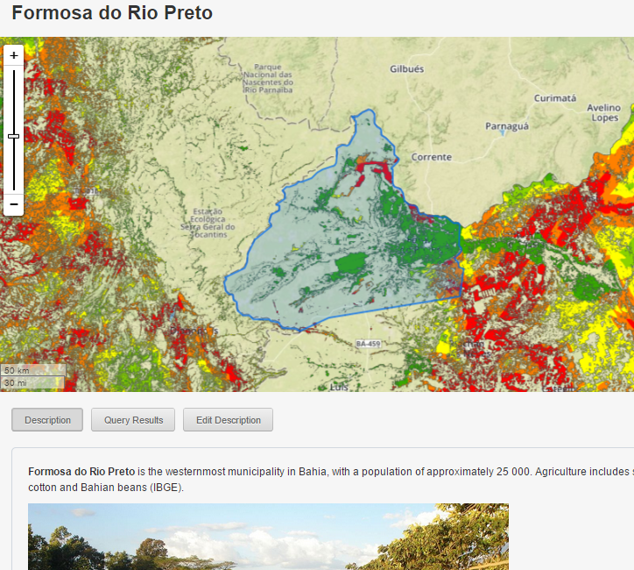
Reference Level Setting by Risk Mapping
Cerrado loss is driven mainly by agricultural expansion. We made an initial map and refined with expert input from EMBRAPA and INPE. Factors include:
Proximity to roads
Proximity to previous loss
Not-PPA or LR
Rainfall >1000 mm
Flat topography

Slide 9
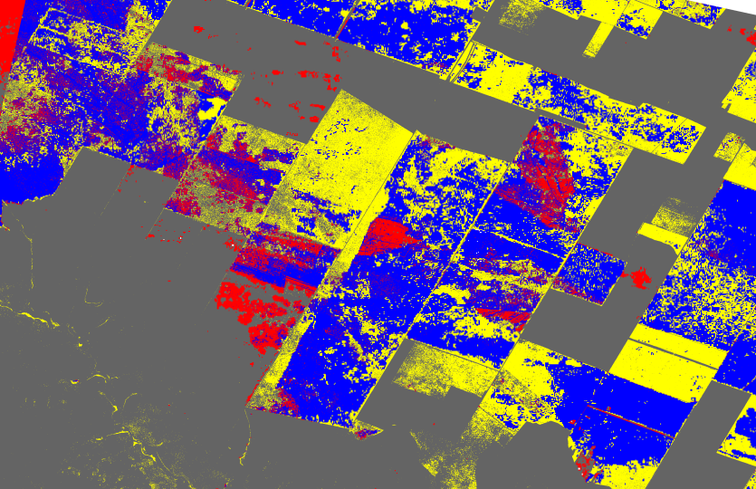
Monitor actual forest loss
3
Find best available Earth Observation data or methods for monitoring forest loss and/or degradation
Results of testing of Global Forest Watch – UMD forest loss data Bahia, Brazil between 2003 - 2013
Red = false forest loss detected
Yellow = forest loss missed
Blue = correct forest loss detection
Grey = correct forest intact
Conclusions from tests in Ghana and Brazil: UMD Forest Loss V1.0 is good for large scale forest clearance to agriculture or pasture but poor for small scale conversions and degradation

Slide 10
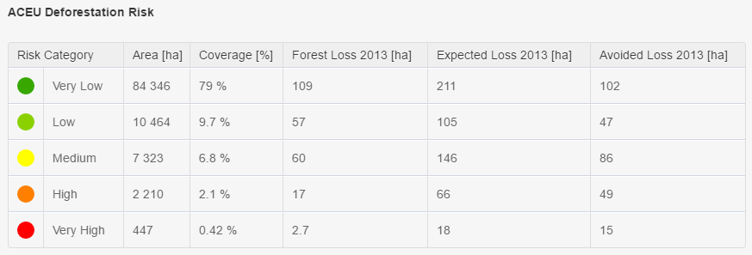
Analysis
4
The mapping platform automates the calculation of avoided forest loss, based on the data sets and assumptions selected
For any area of interest, the mapping platform automatically calculates avoided loss (actual – expected) based on the reference level and forest loss data sets selected

Slide 11
Key Findings
  The risk method worked at multiple scales for setting transparent reference levels for KPI 8 and calculation avoided forest loss
  Sufficient data was found to map risk and run methodology in 3 test countries, with reasonable consistency
  Spatial data stewardship is a major issue for all countries, especially less advanced
  The UMD Forest Loss product works well for large clear-cut areas but not suitable for small scale clearance / degradation
  Risk maps should be updated periodically to reflect changing economic patterns, governance and new data

Slide 12

Forests 2020
Calibration – validation areas to test forest change detection methods in different situations
Improved detection of forest loss and degradation in difficult to measure areas
Maps of priority areas for interventions (e.g. restoration, management, conservation)
Risk and priority mapping: local > regional > national
More effective data processing, management and information sharing
Data sharing applications for strategic planning and monitoring

Slide 13
Forests 2020 Proposal
£15 to £18m UKSA investment to improve the application of Earth Observation to forests in important partner countries over 3.5 years, focused on the following technical challenges:
detection of forest degradation, small scale loss or fragmentation
identification of priority areas for restoration, risks of LUC
digital infrastructure for scaling, streamlining and sharing data
Candidate Countries
Indonesia
Brazil
Colombia
Mexico
Ghana
Kenya
Ethiopia
UK Partners
Ecometrica
University of Edinburgh
Leicester University
Carbomap
International Links
ESA
NASA
GFOI
Norway
Germany

Slide 14
How do we input to GFOI?
  Input to methods and guidance, particularly on change detection and accuracy assessment in different situations
  Assessment of needs of National Forest Monitoring Systems and support incremental improvement, where possible
  Support end-user uses of information outputs
Partner Countries
Indonesia
Brazil
Colombia
Mexico
Ghana
Kenya
Ethiopia
UK Partners
Ecometrica
University of Edinburgh
Leicester University
Carbomap
International Links
ESA
NASA
GFOI
Norway
Germany

