Slide 1

The Future of the CEOS Ad Hoc Working Group on
GEOGLAM
A timeline and some preliminary options
GEOGLAM Secretariat
akwhitcraft@geoglam.org

Slide 2
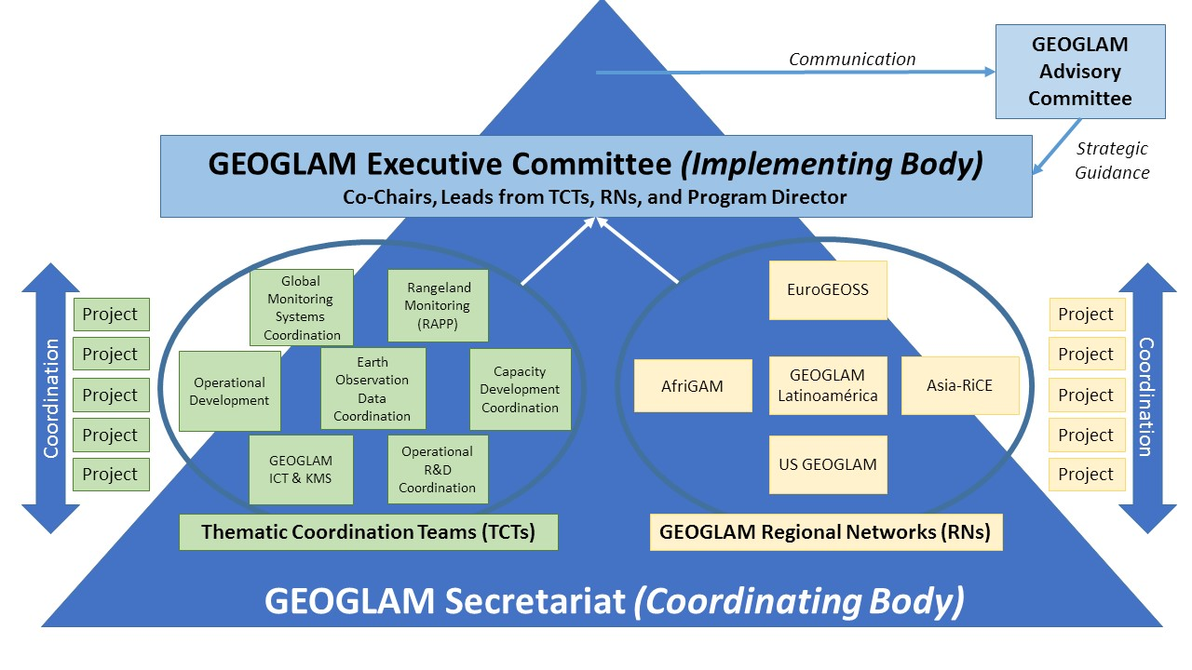

Slide 3
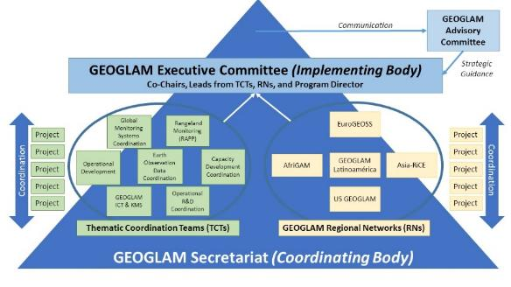
GEOGLAM now has a Thematic Coordination Team on
“EO Data Coordination [and Management]”
This is where the main tasks that have been handled by the AHWG will live.
  Collecting acquisition Requirements
  Strategic interactions with space agencies and CEOS
  Work on things like ARD+, EAVs definition
  Link to space agencies
CEOS support is still integral.
  Characterizing CEOS capacity to support acquisition and access requirements
  Coordinating acquisition and access to satellite data
  Collaboration on ARD+ and EAVs – e.g. via LSI-VC and LPV
  Coordination across capacity development efforts
  Coordination on “the cloud”

Slide 4


Teams
General Coordination Facilitated by GEOGLAM EO Data Coordination lead & A designated CEOS Lead
Teams
Capacity Development
Agriculture EO Cap Dev
WG Cap D
R&D
EAVs (LPV)
WG Cal Val
ICT
Operational Systems Enhancement
- “The Cloud”
- Data Cubes
- Data Requirements
- Data Requests
- QA/QC
LSI-VC, SEO, FDA
EO Data Coordination & Management

Slide 5


Timeline of Meetings, Actions, and Decisions on the question of the future of the
CEOS Ad Hoc Working Group on GEOGLAM
Sep-18 Oct-18 Nov-18 Dec-18 Jan-19 Feb-19 Mar-19 Apr-19 May-19 Jun-19 Jul-19 Aug-19 Sep-19 Oct-19
Telecon
Annual Meeting
CEOS Plenary
Core Group Meeting on Future Options
CEOS SIT
CEOS SIT TWS
CEOS Plenary
Meetings
Scope Tasks to Evaluate Future AHWG
Develop Options for Future AHWG, including interactions with other groups in CEOS
Present Options to SIT
Evaluate Options, with SIT comments.
Present AHWG Recome-ndations to SIT
Final Present-ation to Plenary
Actions
Feedback from CEOS on GEOGLAM letter
Finite Set of Options Developed
SIT to provide feedback on options presented
SIT Approve options, perhaps endorses one
Final Decision at CEOS Plenary
Decisions

