Slide 1
SEO Report for GEOGLAM
GEOGLAM Meeting
September 5, 2018
Ispra, Italy
Brian Killough
CEOS Systems Engineering Office
NASA Langley Research Center

Slide 2
Data Cube Algorithms for Agriculture
Spectral Indices: NDVI, EVI, Fractional Cover
Mosaics: Median, Geomedian, Max-NDVI
Land Classification: K-Means, Random Forest
Land Change: PyCCD, PCA, NDVI Anomaly
Phenology: NDVI time series

Slide 3
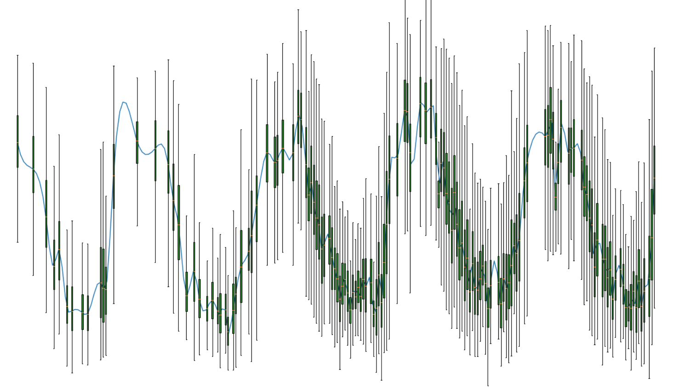
Weekly Landsat 7+8 NDVI over a Tanzania Cropland
Lacking data during rainy season
2011
2012
2013
2014
2015
Launch of Landsat-8 in 2013 significantly increased available data for phenology studies

Slide 4
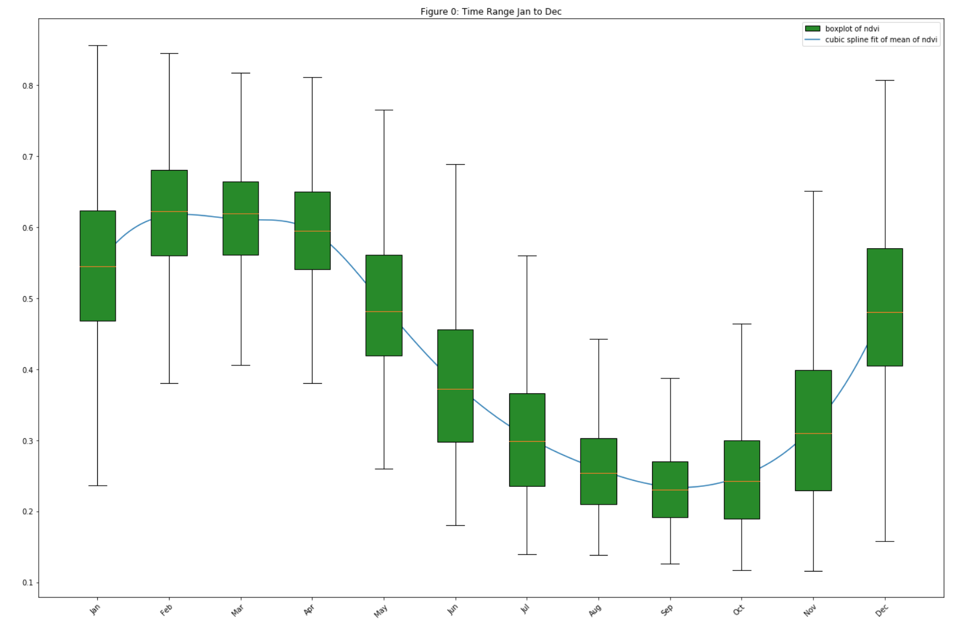
Landsat 7+8 Aggregated NDVI over a Tanzania Cropland Area
Aggregation of satellite data into monthly ”bins” is useful for the study of crop phenology. It is possible to use this data to determine crop ”start of season” and “end of season” at moderate resolution. The data above is for 2010 thru 2015 over a sample cropland.

Slide 5
Other Relevant Data Cube Items
Analysis Ready Data (ARD) – The basis for all CEOS data cubes. CEOS is working on specifications and desires feedback from GEOGLAM regarding agriculture variables.
Interoperability – Testing land and vegetation change detection using Landsat/Sentinel data cubes with similar spatial resolution and projections
RAPP / JECAM Test Site Data – We have several sample data cubes located over RAPP or JECAM test sites. These include JECAM (Taiwan, Kenya, Senegal, S.Africa) and RAPP (Colombia, Kenya, S.Africa)
Sentinel-1 Cubes – We have been working with the Google Earth Engine team to develop a process to rapidly generate S1 data cubes using their pre-processed gamma-nought intensity (ARD).
Africa Regional Data Cube – The SEO plans to link its user interface and Python notebooks to the Kenya, Tanzania, Ghana, Senegal, Sierra Leone data cubes. These could be used for GEOGLAM testing.

