Slide 1



ASIA RICE CROP TEAM (ASIA-RICE) ACTIVITY
IN GEO GLAM
Shinichi Sobue
On behalf of Asia RiCE team in GEOGLAM

Slide 2



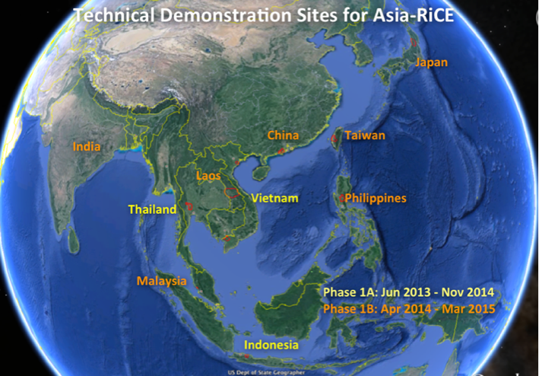

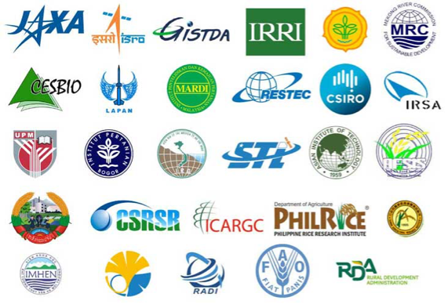

Asia-RiCE for GEOGLAM (Global Agriculture Monitoring)
GEOGLAM was endorsed by the G20 Summit, aims to enhance regional and global agricultural production (wheat, maize, soybean, and rice) estimates through the use of Earth observations
[Meeting of G20 Agriculture Ministers, G20 France 2011 Summit final declaration, 2011]
Asian agencies are implementing Asia-RiCE (Asia Rice Crop Estimation & Monitoring) to strengthen rice crop monitoring ability by using remote sensing, which is a component for GEOGLAM.
Asia-RiCE Website: http://www.asia-rice.org

Slide 3

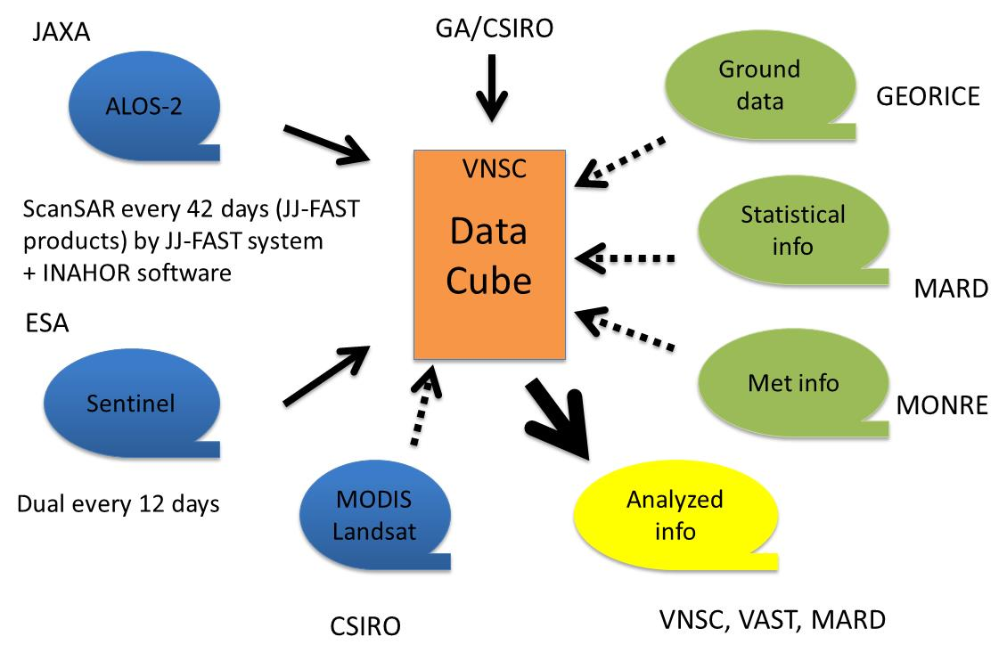
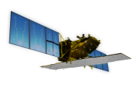
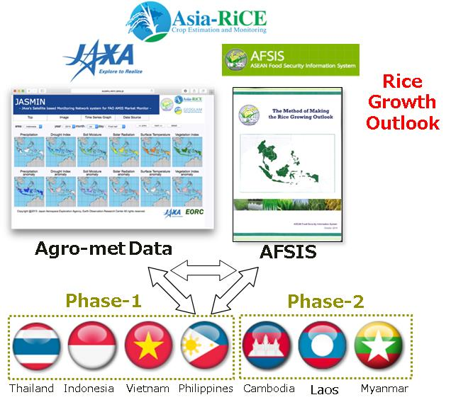
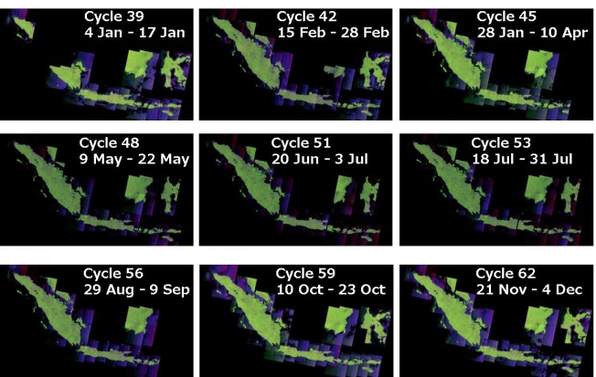


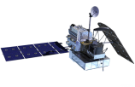
GEOGLAM AsiaRiCE (from demo to operation)
http://www.asia-rice.org
Asia-RiCE (Asia Rice Crop Estimation & Monitoring) program led by JAXA with CNES and more than 20 Asian Space agencies and Ministries of Agriculture with International organization such as ASEAN/AFSIS, UN/FAO, IRRI from 2013 (POC: Sobue.shinichi@jaxa.jp, ohyoshi.kei@jaxa.jp, Thuy.letoan@cesbio.cnes.fr
ID | Target Agricultural Products | Requirements of EO data for operational use
P1 | Rice Crop Area Estimates/Maps | Wall-to-wall observation with SAR dual polarization with Opticals (week – bi-weekly - monthly) : Indonesia, Vietnam/Cambodia and Thailand/Lao projects
P2 | Crop Calendars/Crop Growth Status | Mid/coarse resolution opitcal frequent observation (MODIS, GCOM-C, Landasat, Sentinel-2, etc.) with SARs weekly
P3 | Crop Damage Assessment | Very High resolution SAR and Optical timely under international disasater charter, Sentinel Asia, etc.
P4 | Agro-meteorological Information Products | Daily Mid/coarse resolution optical, passive microwaver and PR with geostatinary met sat frequent observation (MODIS, Sentinel, GCOM-C/W, GPM, Himawari, etc.)
P5 | Production Estimation and Forecasting | Data fusion, data integration with ground base observation / statisitcal information and crop models
Time series observation by SAR for top 10 Indonesia main rice regions by ALOS-2 with MOA
Vietnam Data Cube starting from GEOSS-AP
(Hanoi, September) by VNSC/VAST with CEOS

Slide 4
Recent highlight activities in Asia Rice
Rice Crop Mapping in Southeast Asia
  Technical demonstration site in Asia using SARs - R2/Sentinel-1/2/ALOS-2/RISAT
  Scale up in Indonesia, Vietnam using ALOS-2
  Vietnam data cube preparation
  ALOS-2 ScanSAR provision with free internet access for governmental use in selected Asia countries under JAXA-JICA cooperation
Agricultural Damage Estimation by Multi-Temporal ALOS-2 in Philippine with ADB and PSA
Agro-meteorological Monitor for Asia-RiCE
  Continuous and stable operation with ASEAN countries in cooperation with ASEAN food security information project using MODIS/GCOM-W/GPM
  GCOM-C (MODIS type morning sensor – SGLI) will be available from next year to provide more high resolution information with MODIS and GCOM-W
Next challenge will be discussed at APRSAF in India and JECAM/Asia rice meeting in Taiwan
  Data integration / data fusion (L/X/C with optical)
  Crop model for Yield estimation and GHG support

Slide 5


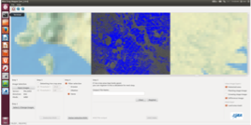
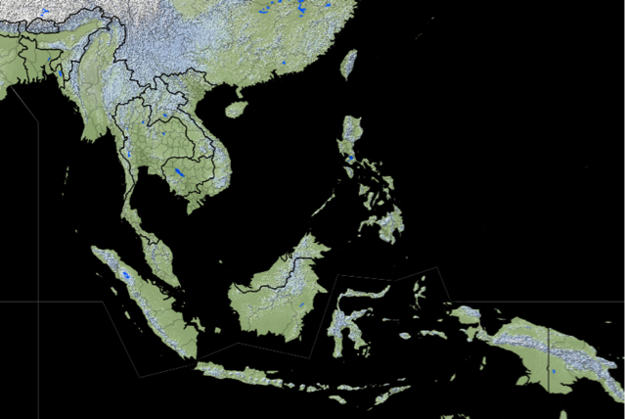
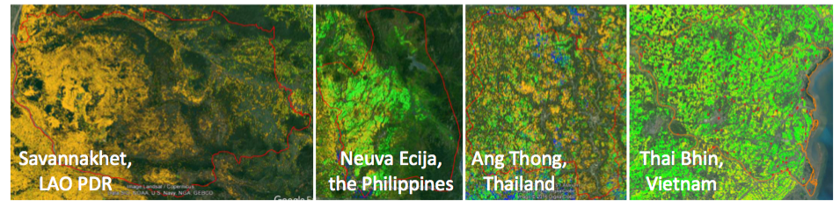
Product 1:
Rice Crop Mapping in Southeast Asia
ADB Technical Assistance project and SAFE project under the APRSAF have successfully demonstrated INAHOR using ALOS-2 with the mapping accuracy of 80-90% for the target provinces.
Scaling-up for major rice producing areas is currently demonstrated in Vietnam and Indonesia.
ADB TA Project
SAFE Project
(Test site)
Laos
Thailand
Vietnam (North)
Philippines
Rice-planted Area
Mapping Software
(INAHOR)
Myanmar
Cambodia
[2016-]
SAFE Project
（Scaling-up）
[2014-2016]
Vietnam (Mekong Delta)
Indonesia
[2014-]

Slide 6
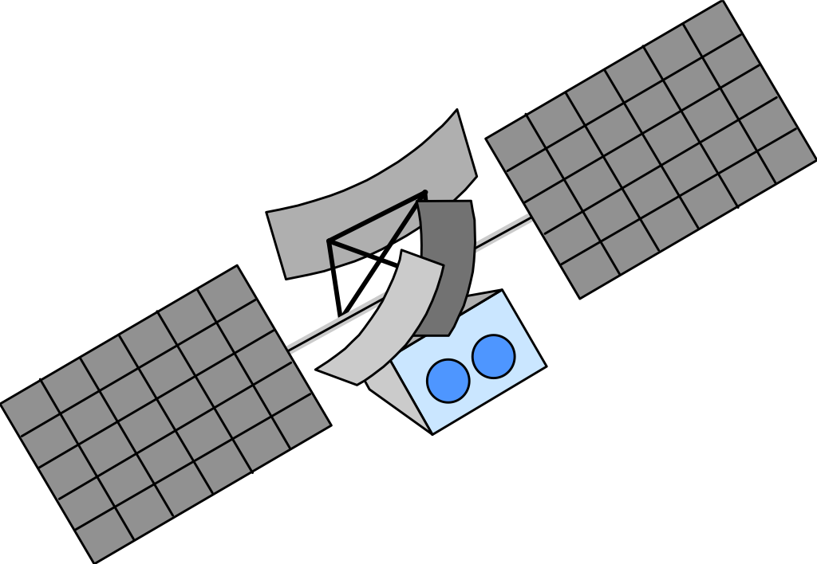
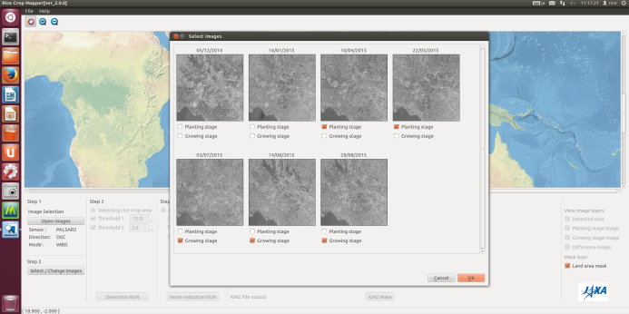
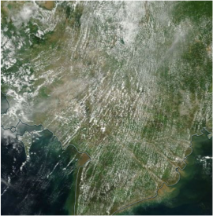
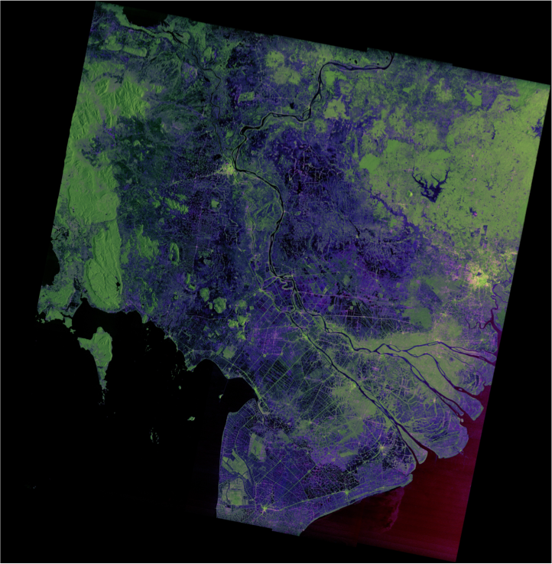
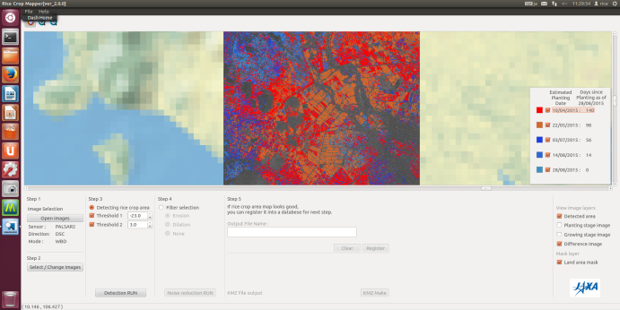
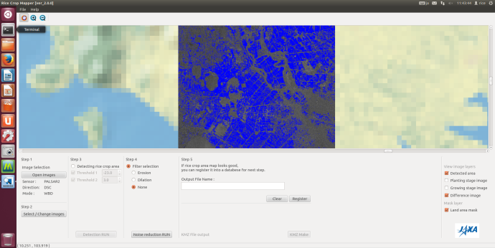


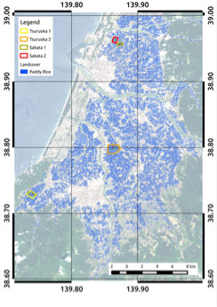
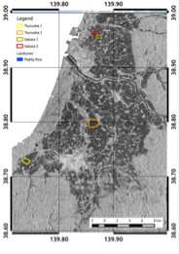
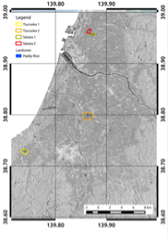
Rice Crop Monitoring using ALOS-2 ScanSAR
SAR: Synthetic Aperture RADAR
- Penetrate cloud -
Rice Mapping Software (INAHOR)
- Estimate rice planted area and growing stage -
Optical
SAR
Ang Tong
Province
※Observed on the same day
Rice planted Area Identification
Planting
Growing
Planted area
[Oyoshi et al., Paddy Water Env, 2016]

Slide 7
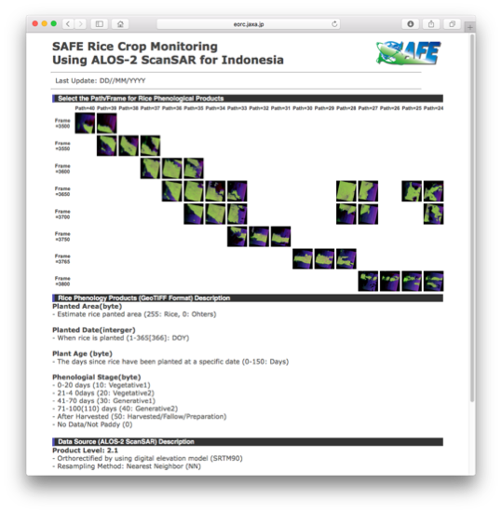
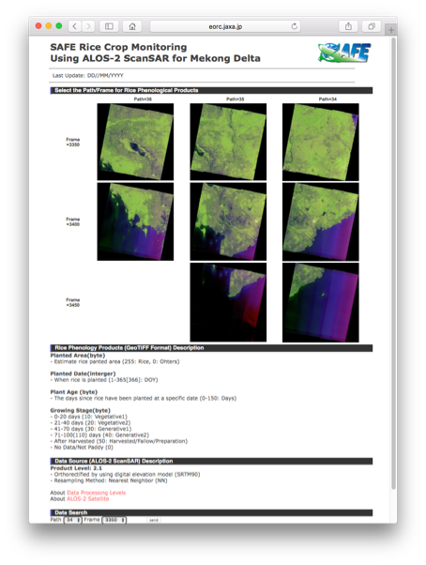
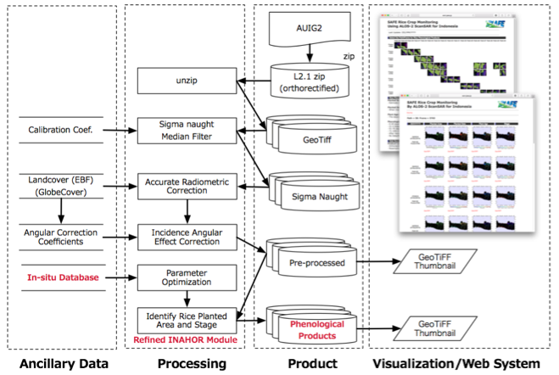
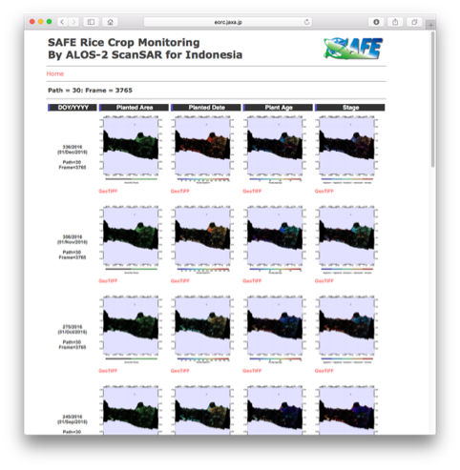
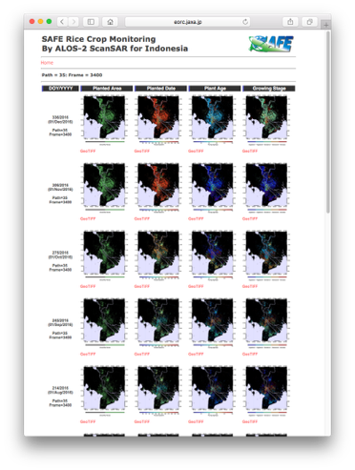


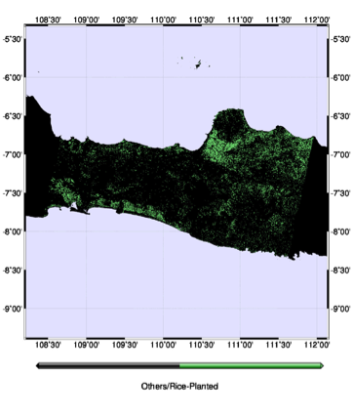
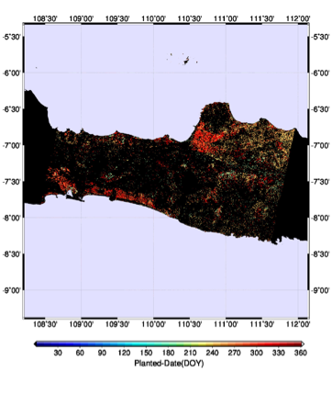
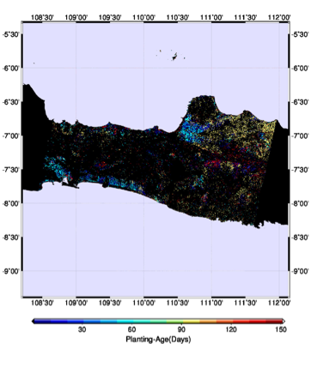
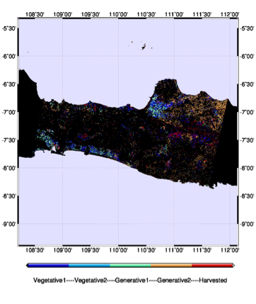
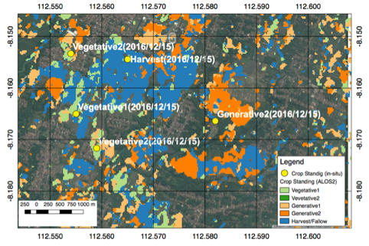
Rice Crop Monitoring System for Scaling-up
Indonesia
Mekong Delta
Data Processing Flow
Validation with in-situ data
Planted Area
Planted Date
Plant Age (days)
Growing Stage
Demonstrating scaling-up monitoring for rice by multi-temporal SAR data.

Slide 8
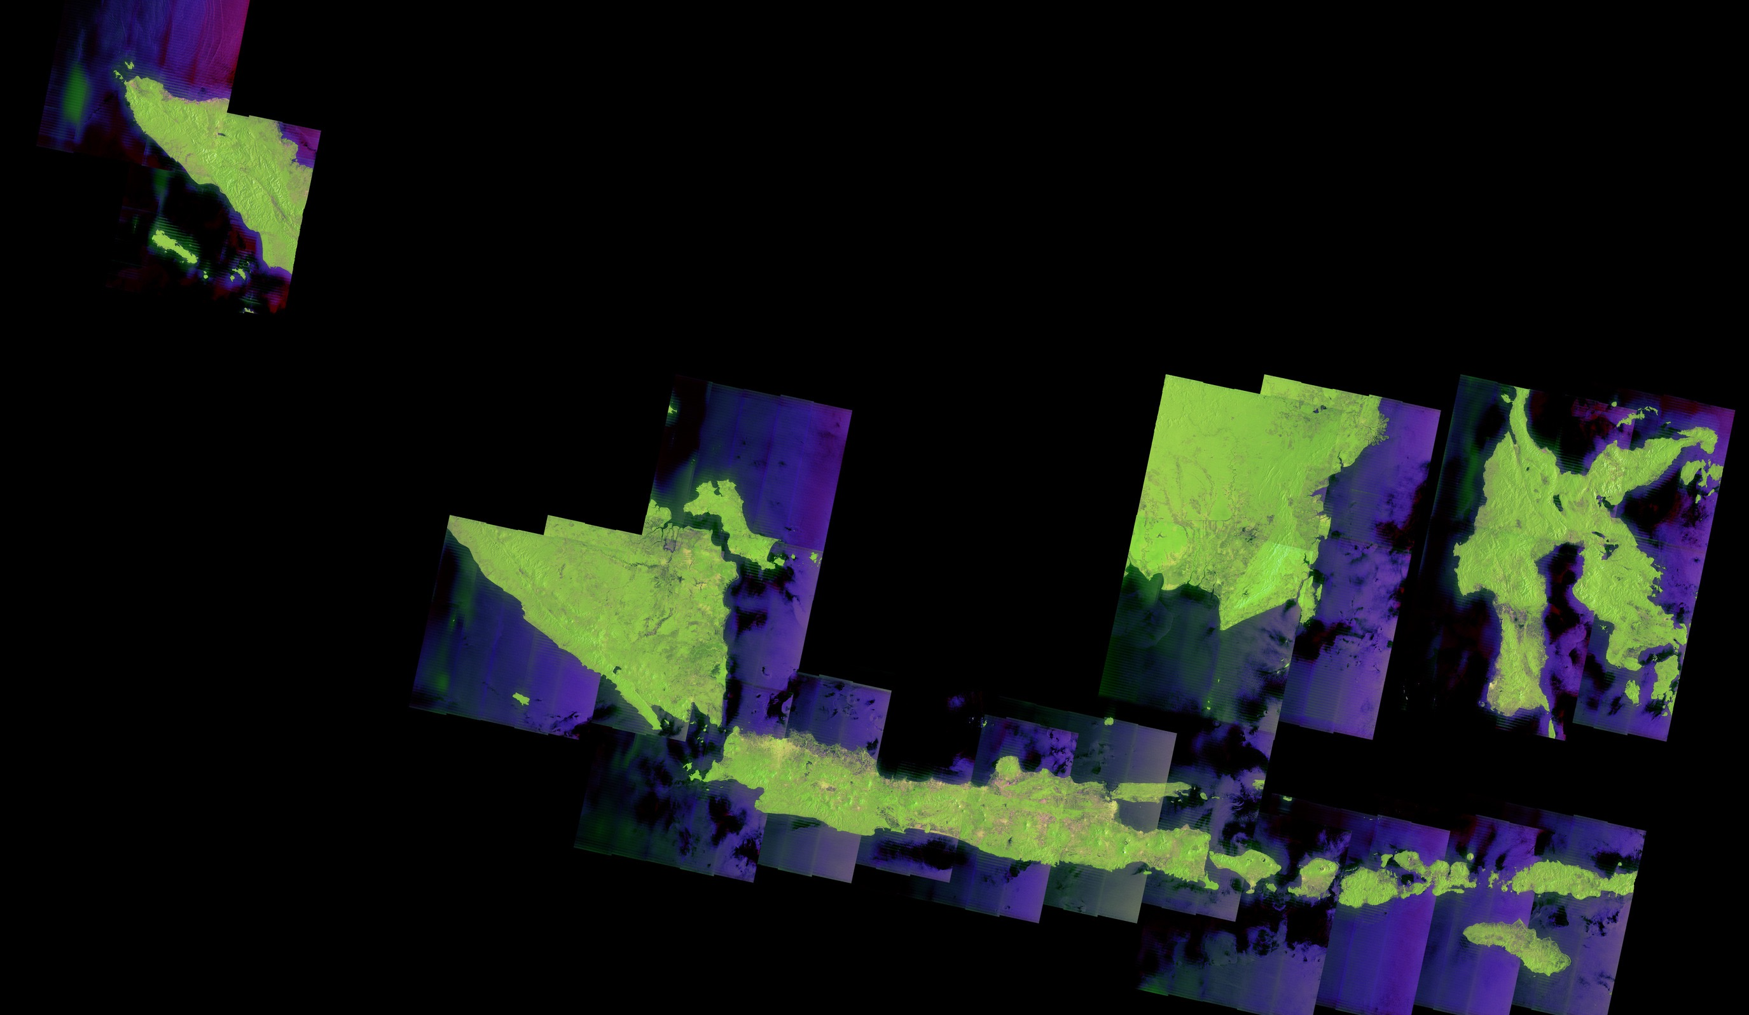
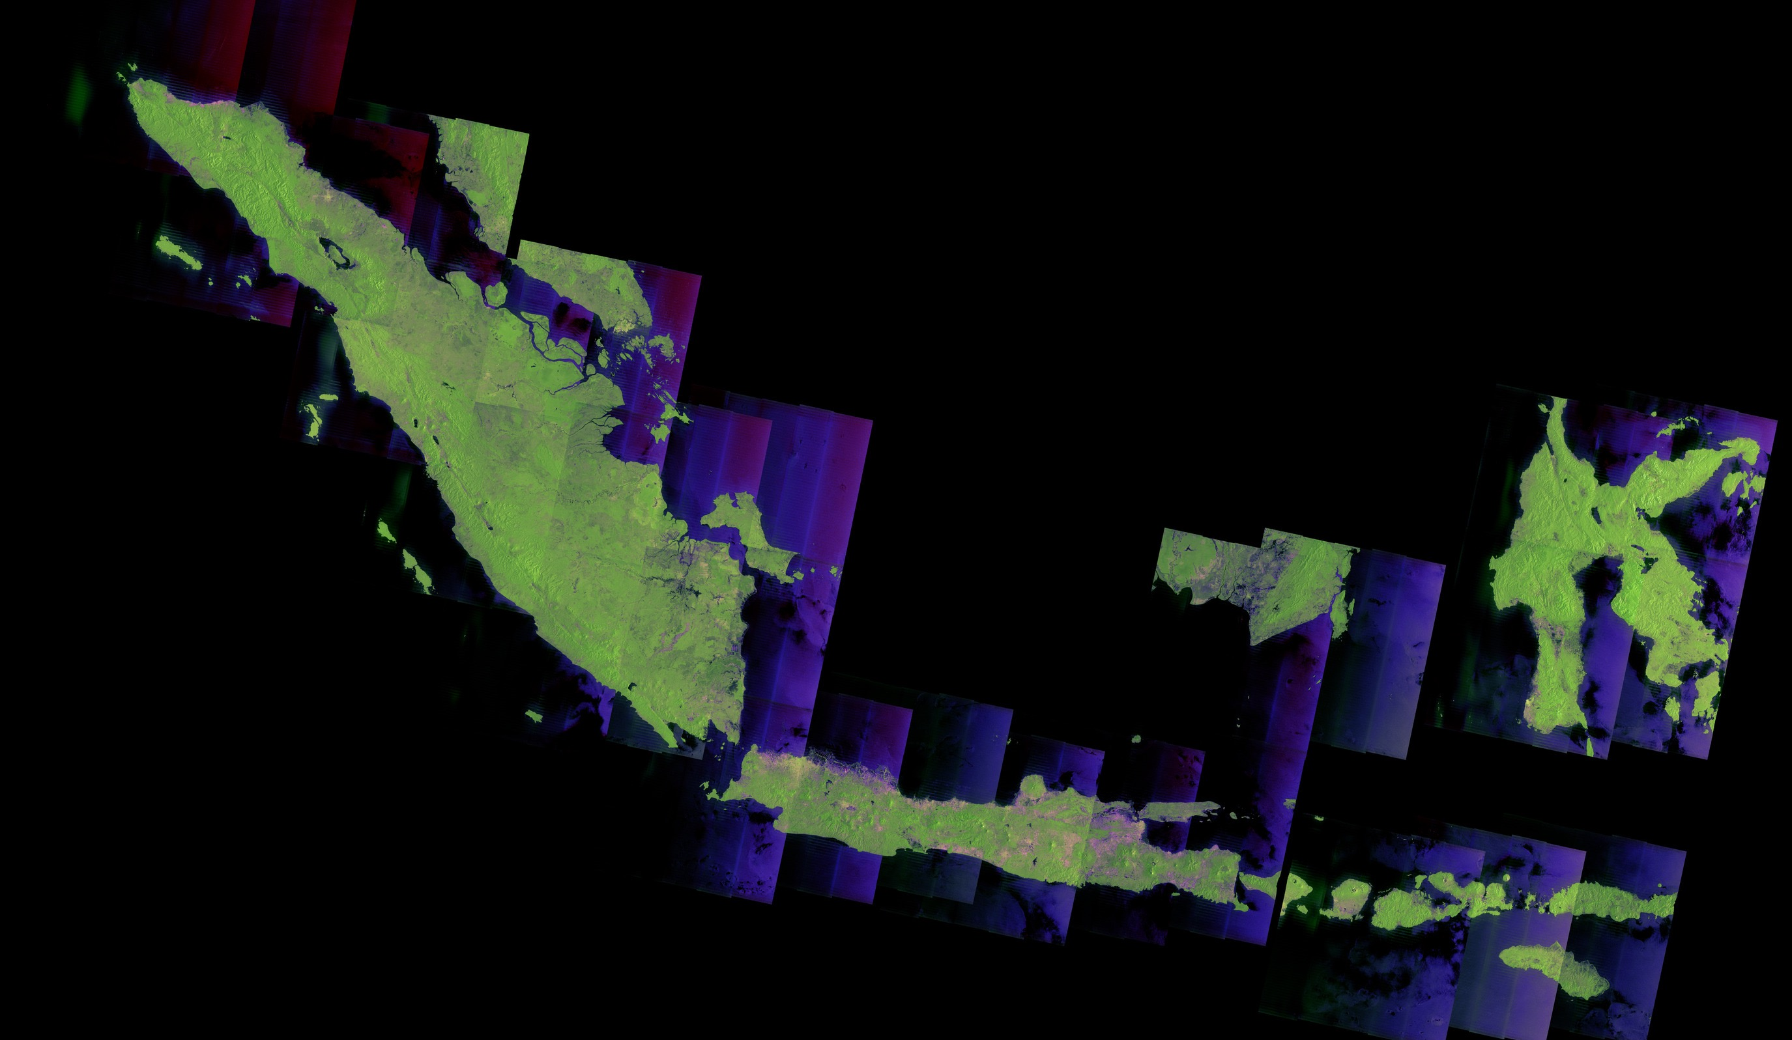
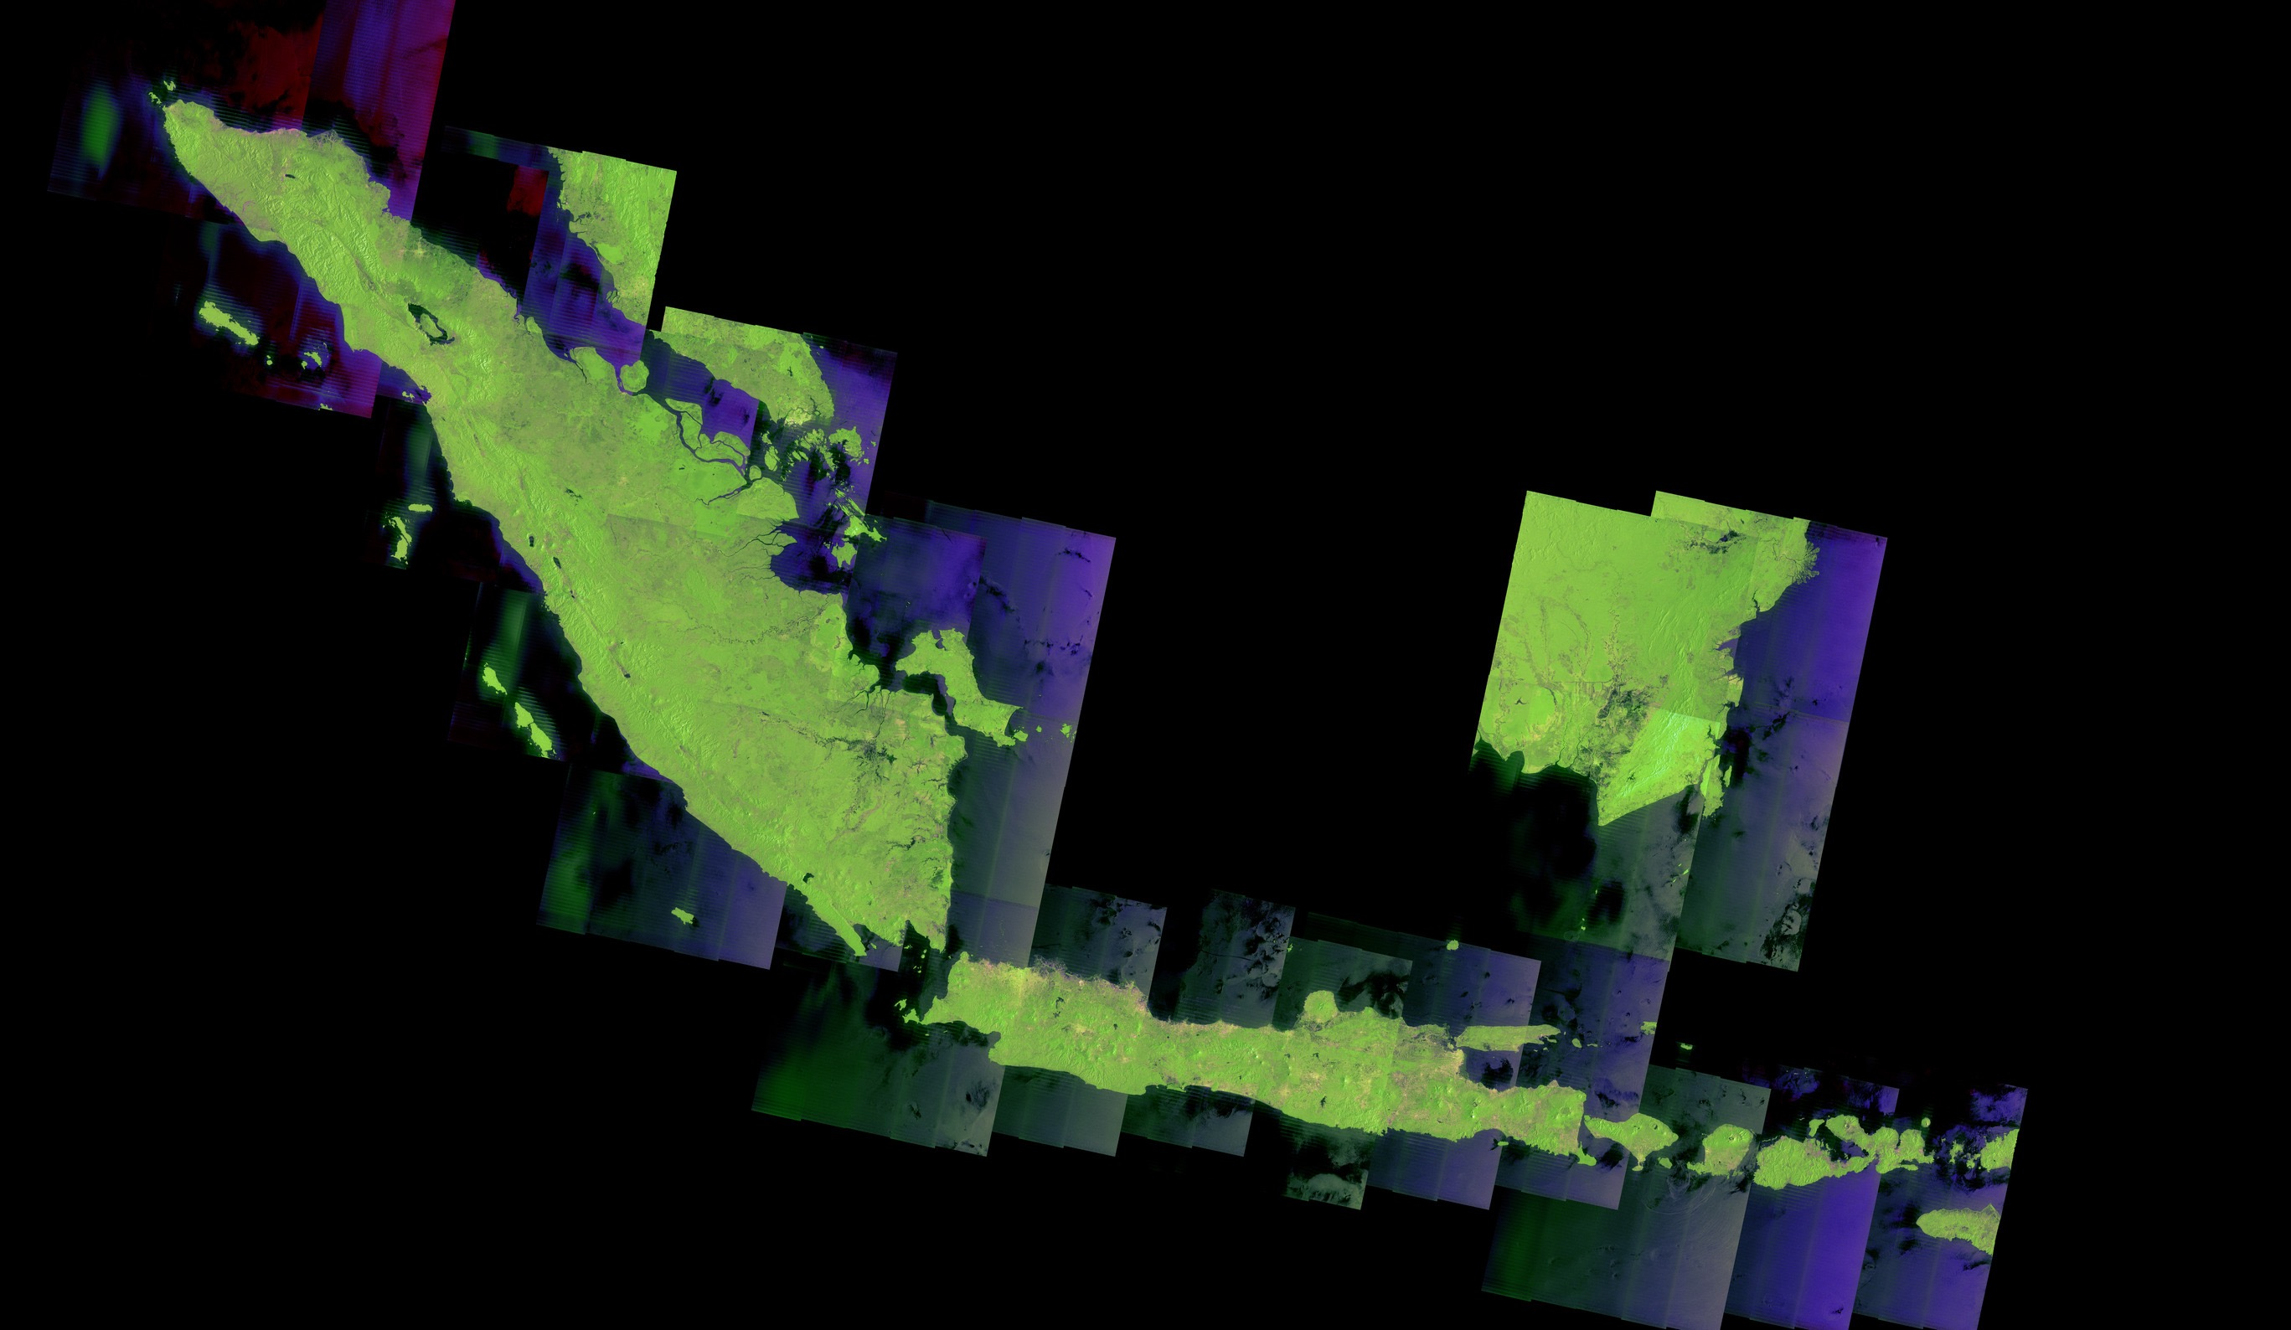
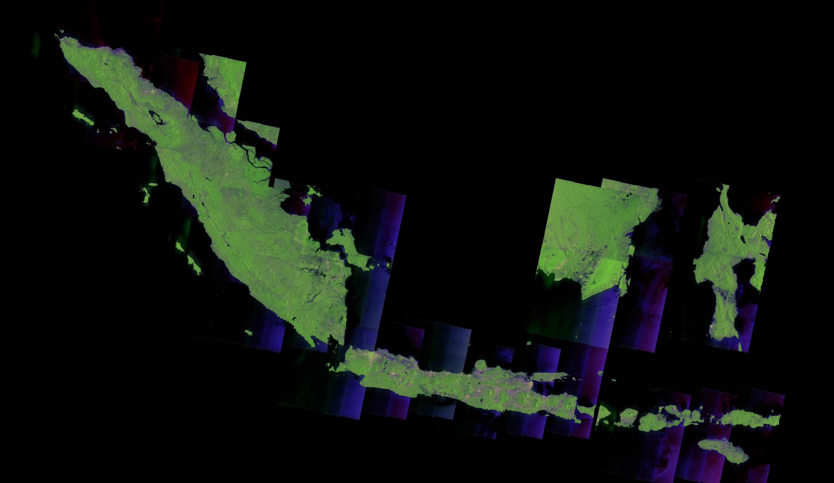
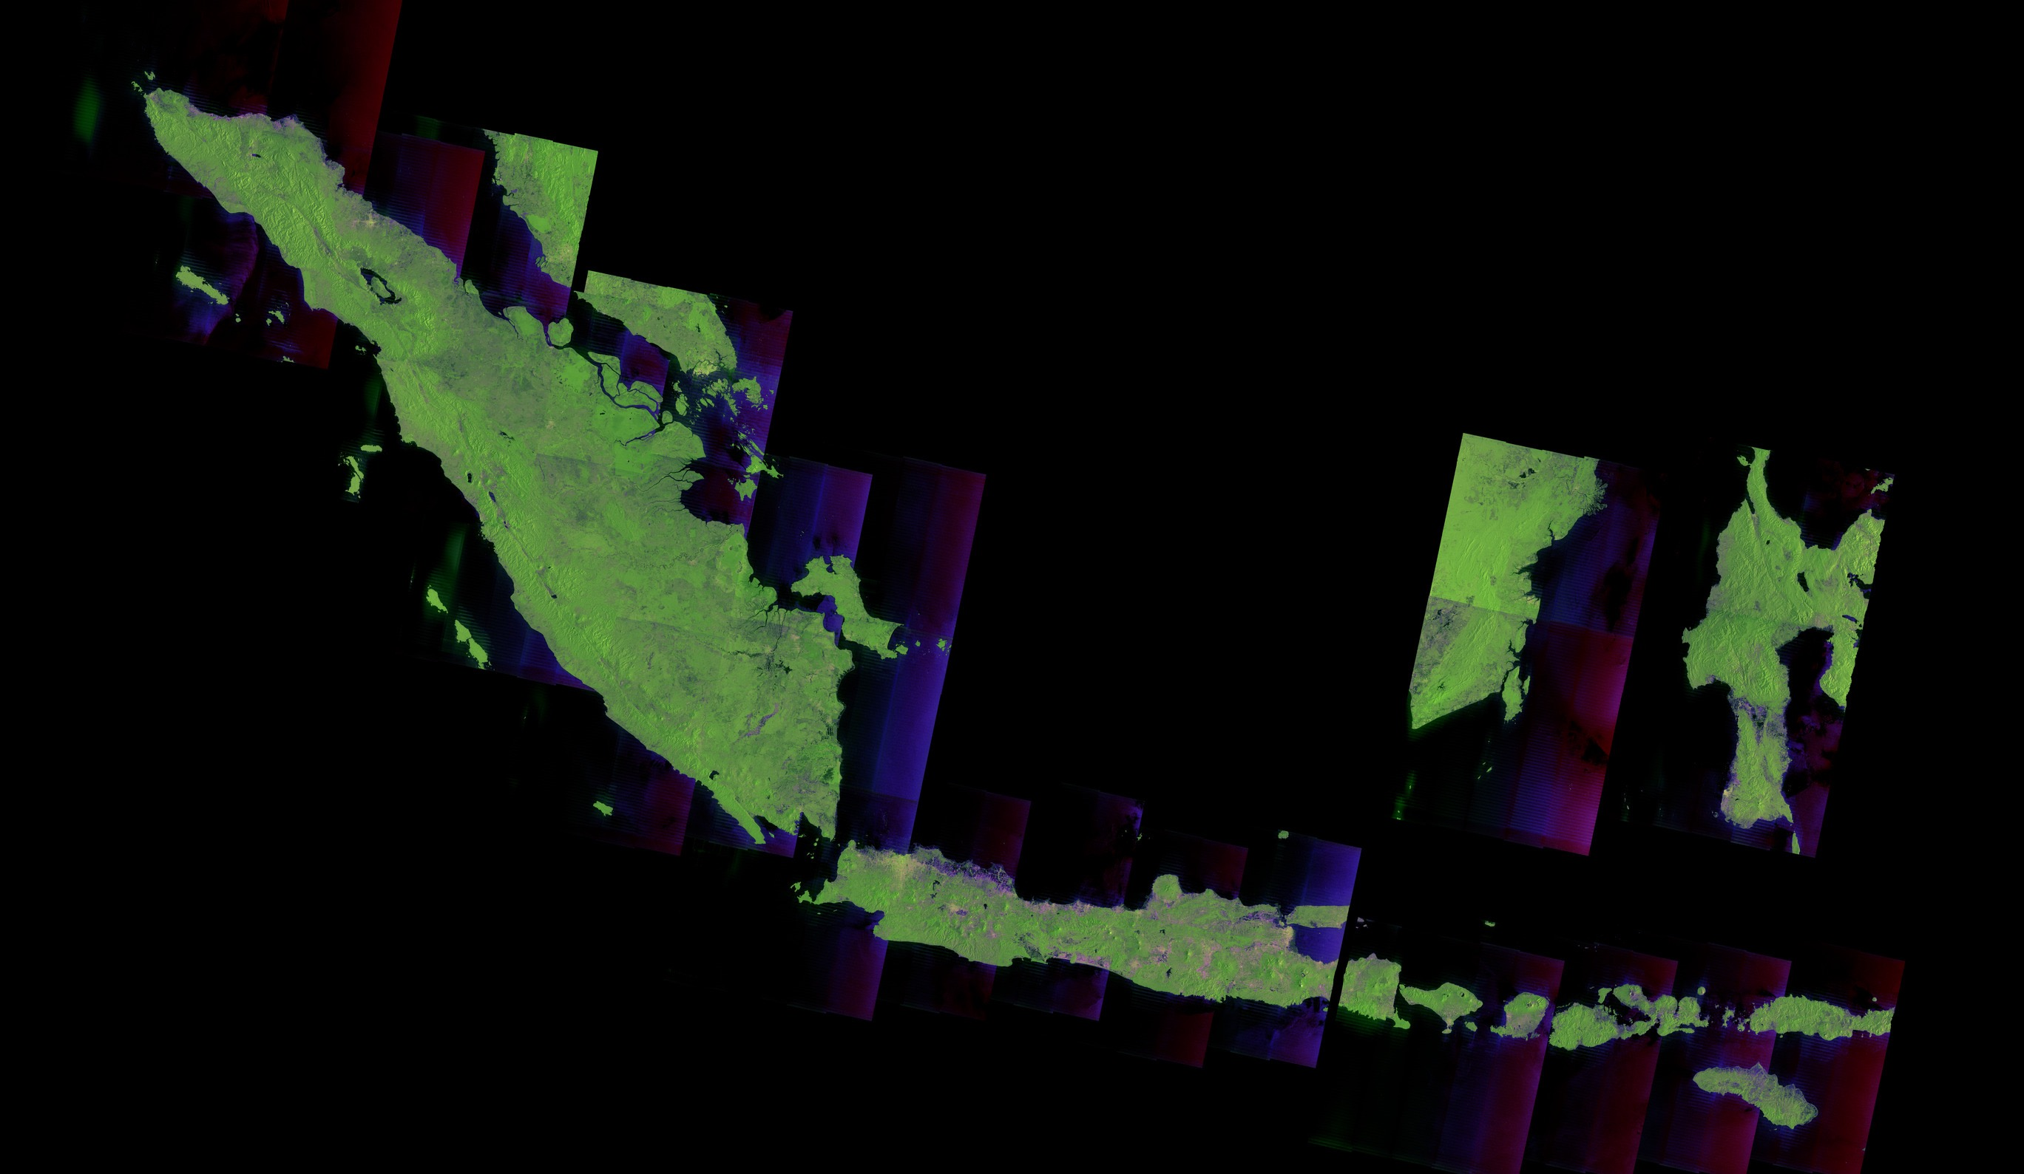
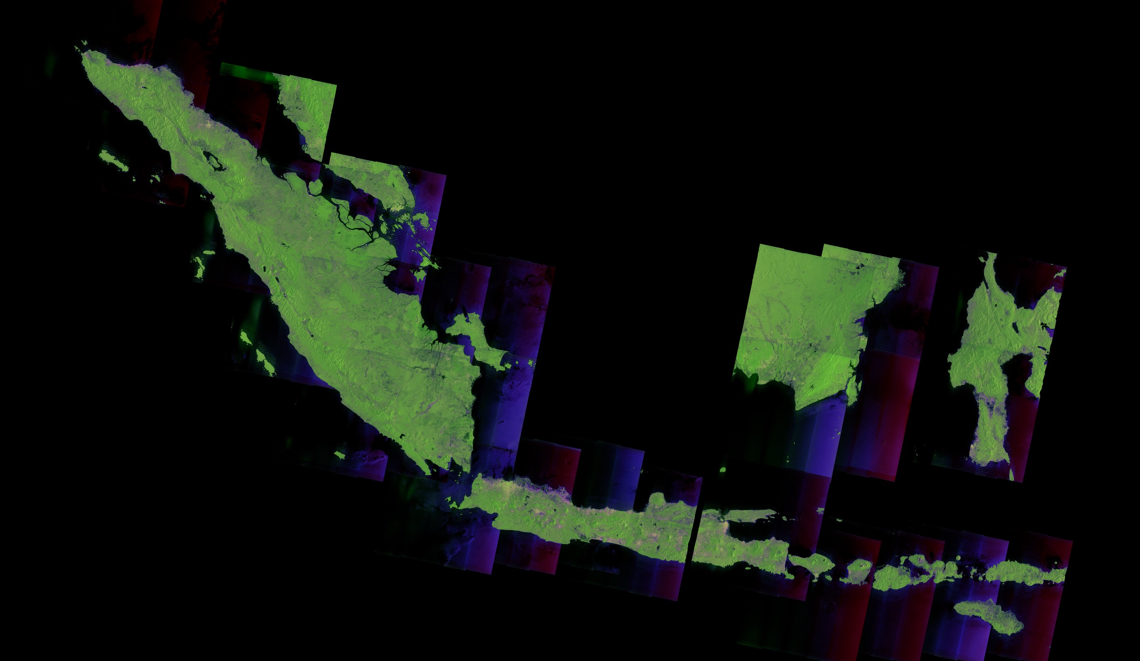
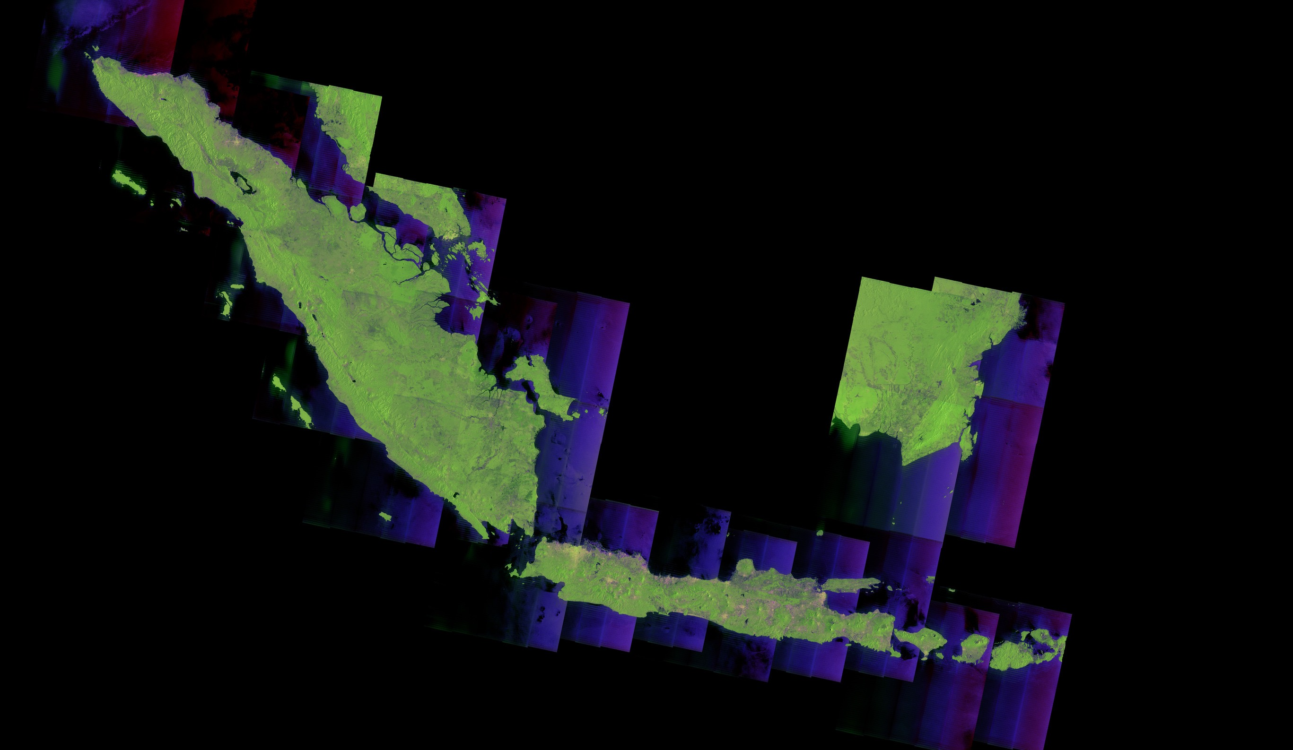

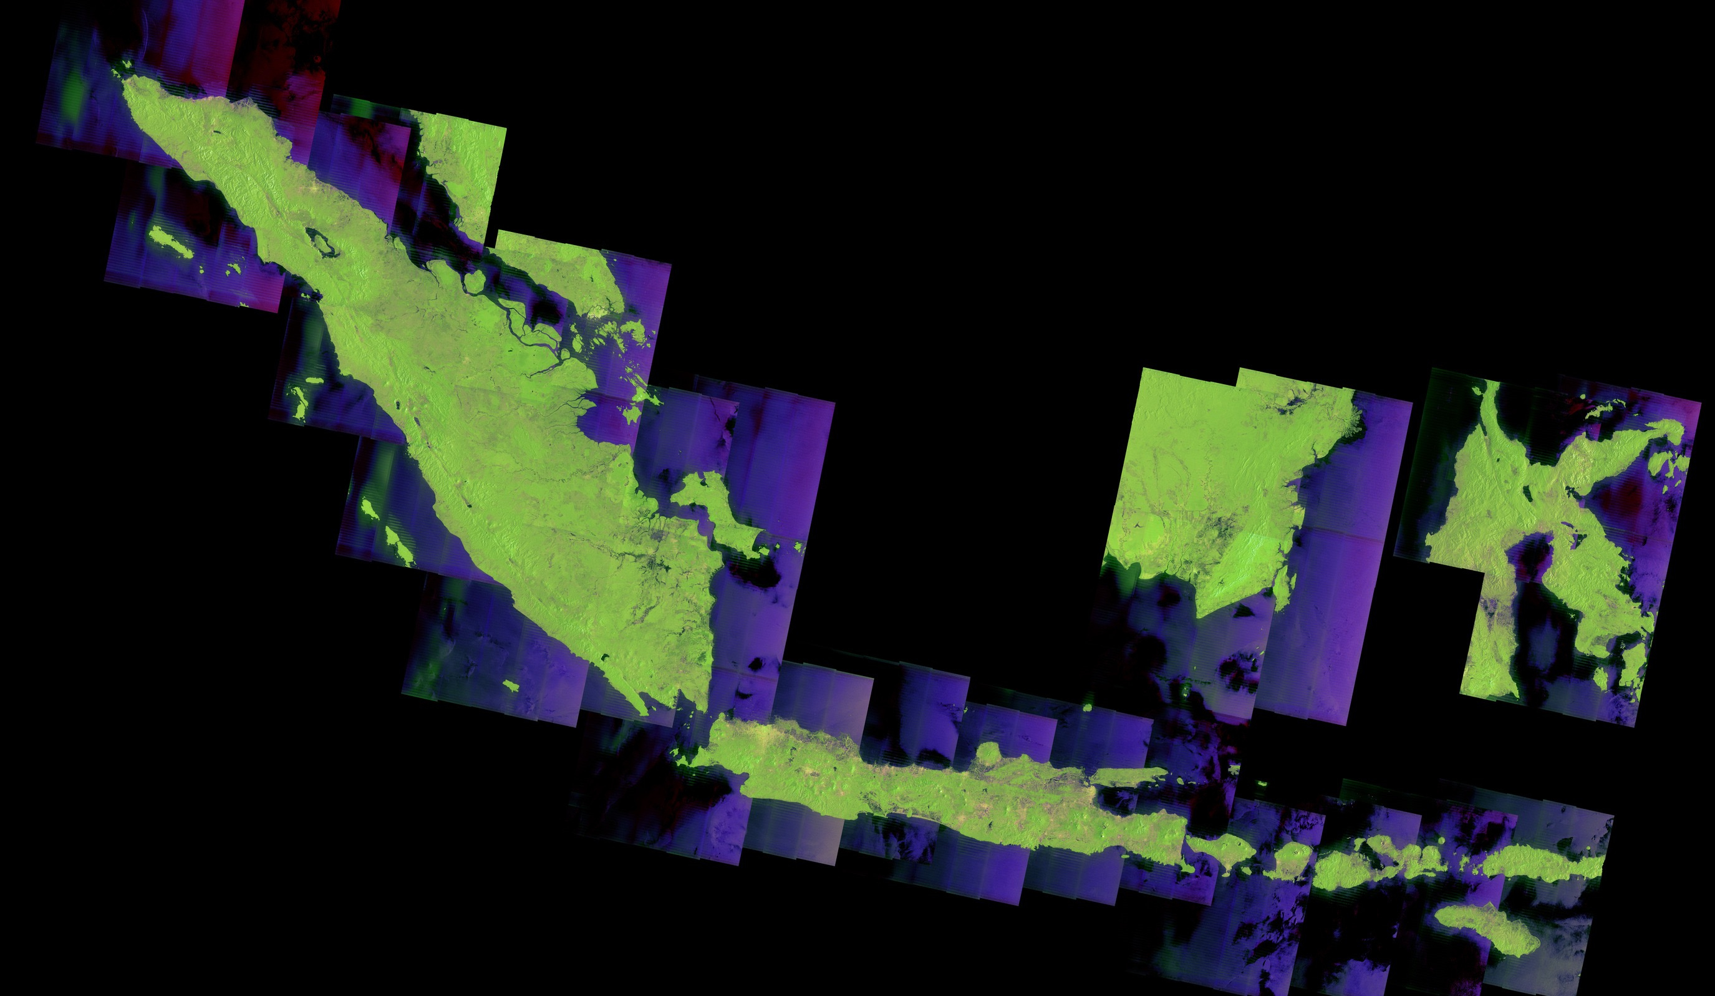
Scaling-up Activities Towards Operational Use
Cycle 39
4 Jan - 17 Jan
Cycle 42
15 Feb - 28 Feb
Cycle 45
28 Mar - 10 Apr
Cycle 48
9 May - 22 May
Cycle 51
20 Jun - 3 Jul
Cycle 53
18 Jul - 31 Jul
Cycle 56
29 Aug - 9 Sep
Cycle 59
10 Oct - 23 Oct
Cycle 62
21 Nov - 4 Dec
3000 km
ScanSAR Mode: 25m Spatial Resolution with 300km swath

Slide 9
CEOS Mekong Datacube Pilot
This pilot project will develop a Geoscience Datacube for the Mekong region based on satellite information to support forest and crop mapping, water resources assessments, marine monitoring, water quality and fisheries and in support of disaster risk reduction. The datacube will be developed using Australian open source software, with satellite information derived from US, Japanese and EU satellite systems.
As an open source activity, other partners including other nations in the region, non-governmental organisations, and scientists from around the global, will be able to both benefit from, and contribute to, this work led by Australia and Vietnam. Upon successful completion of the pilot, the model can be developed and tailored for other economies in the APEC region.
Economy project partners: Australia: Geoscience Australia, CSIRO; United States: USGS, NASA; Vietnam: VNSC, VAST, MARD; Japan: JAXA; and other countries (Europe, etc.)

Slide 10
Vietnam SAR based rice crop monitoring scheme
JAXA
VNSC
Ground data
ALOS-2
GEORIICE
GA/CSIRO
Data Cube
ScanSAR every 42 days
Statistical info
MARD
ESA
Met info
Sentinel
MONRE
MODIS
Landsat
Analyzed info
Dual every 12 days
CSIRO
VNSC, VAST, MARD

Slide 11


Application | Disaster, Land, Agriclture, Natural Resources, Sea Ice & Maritime Safety
L-band SAR (PALSAR-2) | Stripmap: 3 to 10m res., 50 to 70 km swath ScanSAR: 100m res., 350km/490km swath Spotlight: 1×3m res., 25km swath
Orbit | Sun-synchronous orbit Altitude: 628km Local sun time : 12:00 +/- 15min Revisit: 14days Orbit control: ≦+/-500m
Life time | 5 years (target: 7 years)
Launch | JFY2013, H-IIA launch vehicle
Downlink | X-band: 800Mbps(16QAM) 400/200Mbps(QPSK) Ka-band: 278Mbps (Data Relay)
Experimental Instrument | Compact InfraRed Camera (CIRC) Space-based Automatic Identification System Experiment 2 (SPAISE2)
Notes:
ALOS-2 carries L-band Synthetic Aperture Radar called PALSAR-2.
The local sun time is at noon in order to complement other SAR satellites which are in dawn-dusk orbits. The revisit time is shortened from that of ALOS and the orbit is controlled within 500m tube for interferometry.
The observation data is transmitted either directly to a ground station via X-band at 800Mbps or through inter-satellite communication via Ka-band at 278Mbps.
ALOS-2 will contribute to Disaster monitoring, Land monitoring, Agricultural monitoring, Natural Resource Exploration and Global Forest monitoring as ALOS did.
And potential use such as maritime safety will be expected.

Slide 12
ALOS-2 ScanSAR data provision
For GEOGLAM and CEOS
  Under GEOGLAM/Asia Rice and ALOS K&C project, JAXA provides ScanSAR data at technical demonstration sites (100km x 100km – one province) in Cambodia, Myanmar, Malaysia, Lao, India, China, Thailand and Taiwan to Asia Rice crop team members with ALOS-2 download system now.
  Under Asia Pacific regionsal space agency forum (APRSAF) framework with GEOGLAM/Asia Rice, JAXA provides scale up activity for Indonesia (Top 10 rice crop production provinces) and Vietnam (Mekong)
Proposal from JAXA
  Under cooperation with JICA and commerical data providers, JAXA starts to prepare to provide on-line access to intermidate JJ-FAST products = ScanSar ortho-slop corrected DN data and/or ALOS-2 25m path ortho-slop correct data (gamma naught) from ALOS-2 path mosaic to selected countries for each target country data where JAXA, ADB and APRSAF countries have cooperative aggeement (Indonesia, LaoPDR, Thailand, Philippine, Low Mekong (Vietnam + Cambodia)) for governmental use in respecting countries.
  JAXA starts to prepare sample data of ScanSAR data to ingest Vietnam data cube and propose CEOS ARD of SAR (1-5 degree mesh tiled data or path orth-slop corrected data) in cooperation with CEOS SEO (NASA)
  Other than ASEAN area, JAXA will discuss with commercial data distributor to have same framework of ALOS-2 ScanSAR intermidate product to target countrys’ governmetal use if CEOS and GEO community are interested in.

Slide 13
Coordination status with respecting countries
1. Vietnam
VNSC and CSIRO/GA already prepare to implement CEOS Mekong data cube by the end of this year
VNSC and JAXA agreed to coordinate ALOS-2 ScanSAR data ingestion with rice crop area estimation software (INAHOR) to CEOS Mekong data cube
JAXA and VNSC will finalize MOU for Vietnam data cube with ALOS-2 ScanSAR data and will have Data cube workshop as a pre-workshop of GEOSS-AP agriculture working group (WG5)
2. Indonesia
LAPAN, MOA and JAXA agreed to coordinate coordinate ALOS-2 ScanSAR data ingestion to LAPAN data archive
JAXA and LAPAN start to coordinate MOU to archive and use ALOS-2 ScanSAR data in Indonesia
3. Thailand
JAXA and GISTDA start to discuss ALOS-2 ScanSAR data of Thailand and Lao provision to GISTDA

Slide 14
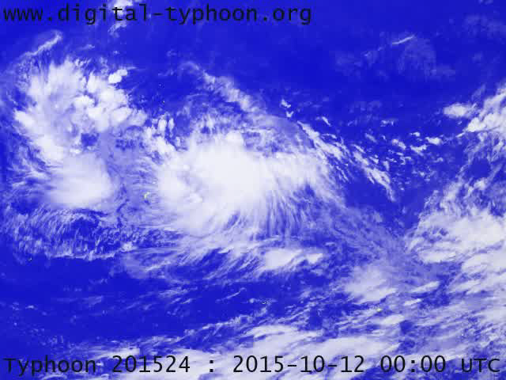
Product 3: Damage Assessment
Typhoon Lando hit Philippines (13-21 October 2015)
Digital Typhoon (Prof. Kitamoto, NII, Japan)
http://agora.ex.nii.ac.jp/digital-typhoon
Observed by Himawari-8
Japanese Geostationary Satellite

Slide 15
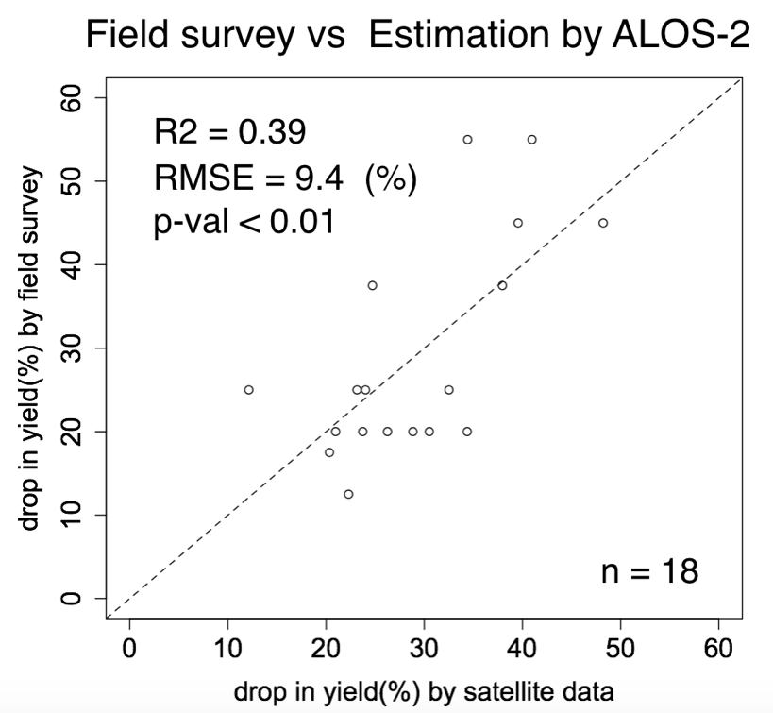

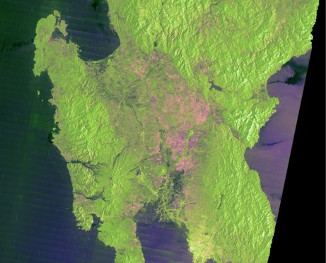
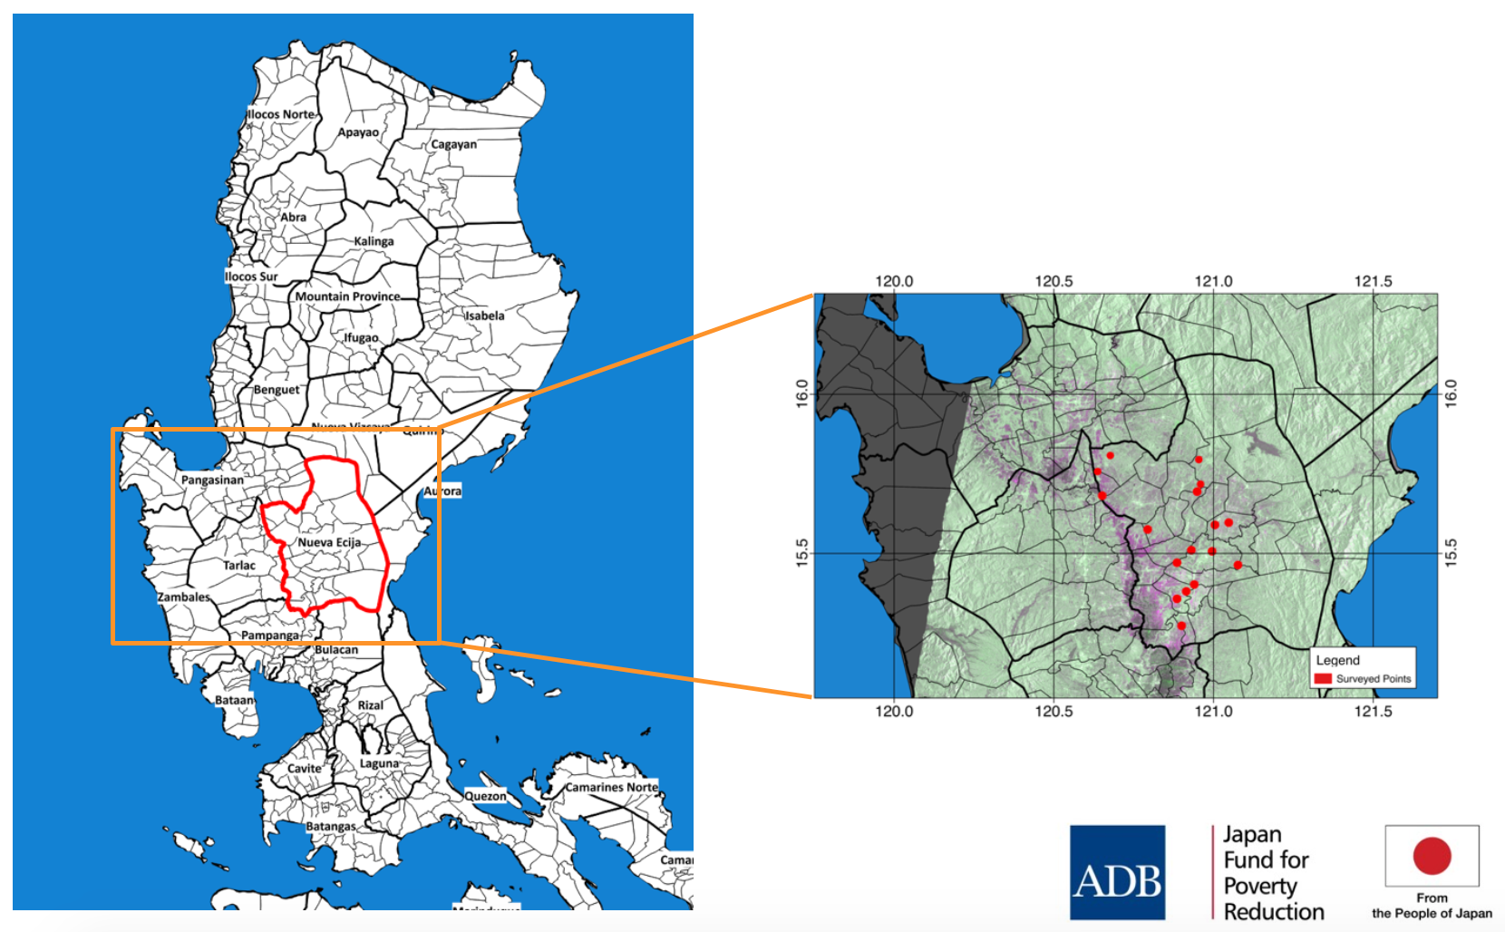
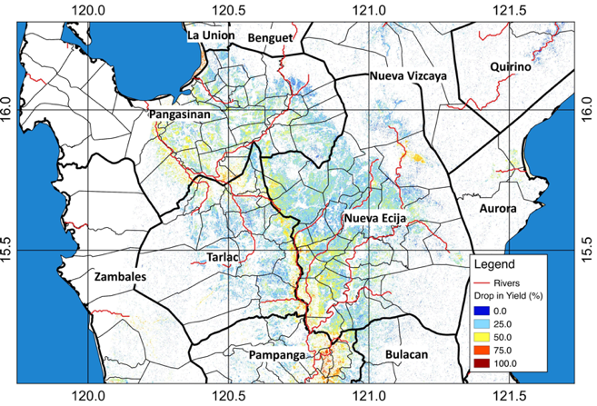
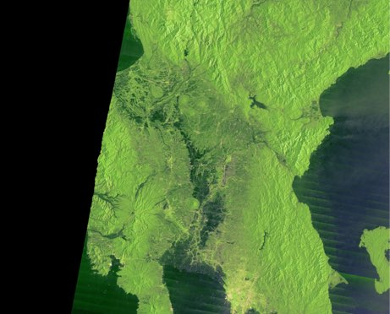
Agricultural Damage Estimation by Multi-Temporal ALOS-2
Damage (yield decrease) were estimated by using ALOS-2 data (before/after flooding).
Before Flood
(27 Sep 2015)
After Flood
(20 Oct 2015)

Slide 16
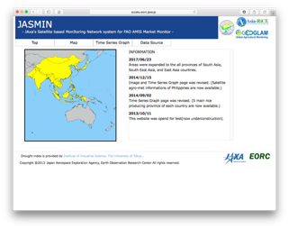
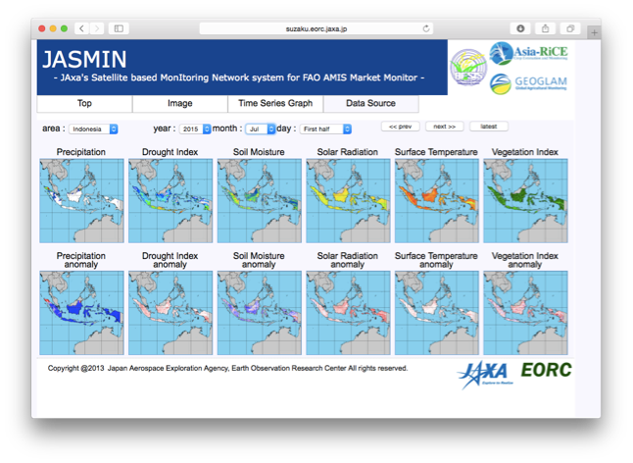
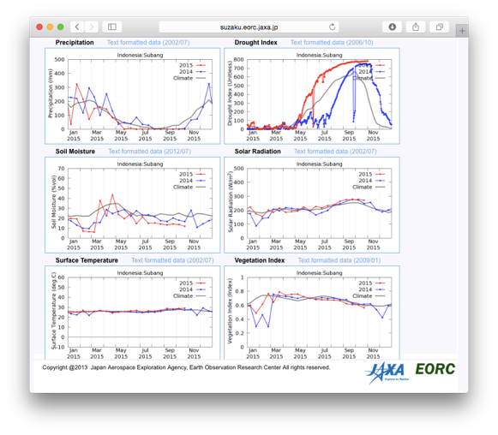
Product 4: Agro-meteorological Monitor for Asia-RiCE
JASMIN provides satellite-based precipitation, drought index, solar radiation, land surface temperature, soil moisture, and vegetation index (updated twice a month).
Map, Time-series plot, and text data are available.
Top Page
Map
Time-series plot
http://suzaku.eorc.jaxa.jp/JASMIN/index.html
[Oyoshi et al., JSPRS., 2016]
Notes:
GSMaPの降水量など、月2回更新している。
ウェブシステム自体も公開している。
JASMINはJAXAが開発して運用している。

Slide 17
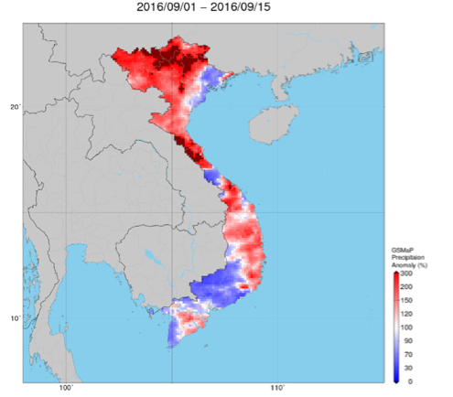
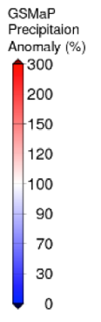
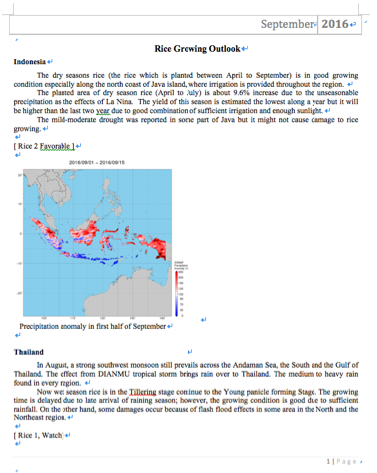
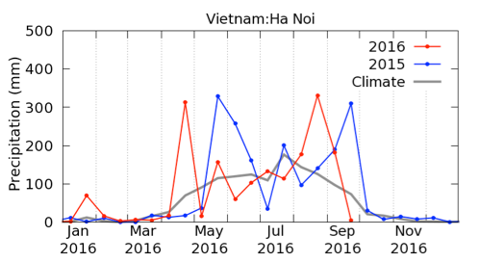
Example: Rice Growth Outlook in Vietnam
Rice Growth Outlook
(September 2016)
Precipitation
(Hanoi Province)
Precipitation anomaly in first half of September
Vietnam
In the North, the seeding of autumn-winter rice (wet season rice) is completed. The sown area is around 1.1 million ha, accounting for 99.2% of the last year area. The weather in the North is not good for paddy due to storm and flood.
In the South, the summer-autumn rice enters a harvesting time. The harvested area is around 1.0 million ha …..
Satellite derived agro-met information can support to judge rice growth.
Notes:
実際にどのようにつかっているか？：ベトナムの例
現地の農水省と組んで、現地の作況情報と衛星のデータを組み合わせてレポートを作成している

Slide 18













Rice Growth Outlook to GEOGLAM for FAO AMIS
Market Monitor is published by FAO.AMIS on monthly basis to assess international agricultural market situation and outlook of wheat, maize, rice, and soybeans.
Rice
Growth
Outlook
Agro-met Data
AFSIS
Phase-1
Phase-2
Thailand
Indonesia
Vietnam
Philippines
Cambodia
Laos
Myanmar
Agricultural Statisticians
Monthly Rice Growth Outlook is reported to GEOGLAM for FAO/AMIS
Notes:
JASMINやAFSISを用いて、米のアウトルックを作成してGEOGLAM（FAOに対して作況情報を提供する役割を担っている）に提供している。
国連農業食糧機関（FAO）：
AFSIS (ASEAN Food Security Information System)： 日本の農水省統計部がASEANでの農業統計の精度向上のために実施しているプロジェクト。オフィスはバンコクにあるがASEANが対象。農水省がASEAN向けに実施している。
国旗：タイインドネシアベトナムフィリピンカンボジアラオスミャンマー
Phase2で対象国を3か国（カンボジアラオスミャンマー）を増やした。
農業統計官を教育して毎月レポートを作れるようにする意味もある。

Slide 19


Coming satellite for Agri-met with MODIS and Sentinel
GCOM-C: Global Change Observation Mission- Climate
shortwave & thermal InfraRed (T) Scanner (IRS)
Polarization (along-track slant) radiometer (P)
Visible & Near infrared push-broom Radiometer (VNR)
GCOM-C SGLI characteristics
Orbit | Sun-synchronous (descending local time: 10:30), Altitude: 798km, Inclination: 98.6deg
Launch Date | JFY 2017
Mission Life | 5 years
Scan | Push-broom electric scan (VNR: VN & P) Wisk-broom mechanical scan (IRS: SW & T)
Scan width | 1150km cross track (VNR: VN & P) 1400km cross track (IRS: SW & T)
Spatial resolution | 250m (land and coastal areas), 500m, 1km
Polarization | 3 polarization angles for POL
Along track tilt | Nadir for VN, SW and TIR, & +/-45 deg for P
19
Notes:
Then, I am going to introduce our future planned satellites.
This is GCOM-C, which is to be launched in next Japanese fiscal year.
It will carry SGLI, the Second generation Global Imager.

Slide 20












Examples of GCOM-C SGLI Products
GCOM-C
observation
Global data accumulation and synthesis with other satellite data
SGLI VNR one-day coverage
Surface albedo and land cover
Photosynthetically available radiation
Aerosol amount and properties
Land vegetation, ocean chlorophyll-a, and primary production
Sea and Land surface temperature
Cloud fraction and properties
Notes:
From SGLI observed data, many products will be created.
Namely, …

Slide 21




Crop Calendar using MODIS (West Bago, Myanmar)
GCOM-C can capture crop phenology including crop intensity and growing season globally using its multi-temporal observation data.
Crop Intensity
Monsoon
Winter (Dry)
Summer
2012/
2013
2014/
2015

Slide 22
Next challenge
Scaling-up CH4 Measurement at a regional scale for MRV by SAR/Optical with GHG observation from space
Data fusion / integarted usage and inter comparison (L/X/C SARs and VHR and medium optical)

Slide 23














Scaling-up CH4 Measurement at a regional scale for MRV
Direct Measurement
by GOSAT
Integrate Monitoring by Opt, SAR and MWR
GCOM-W
ALOS-2/
Sentine-1
GCOM-C/
MODIS
Himawari
GOSAT
・Point Source Obs.
（10.5kmθ）
Phenology＋
Water Condition
Mekong
Delta
Flux site
(in-situ)
・identifying the conditions of paddy field whole
rice cropping cycle including fallow season
NDPI（AMSR2）
Backscatter（ALOS-2 HH, HV）
In-situ Measurement
Scaling-up CH4 Emission
Model / Evaluation
CH4 emission modeling with environmental factors

Slide 24





Paddy Rice Monitoring using Multiple-SAR in Tsuruoka, Japan
30 May
11 Jun
14 Jul
17 Jul
30 Aug
10 May：Direct Seeding
20 Aug: Heading
15 Oct: Harvest

Slide 25



Food Security Related Products by JAXA
 | Portal Name and URL
 | G-Portal: JAXA’s Satellite data (for remote sensing expert) (GPM, TRMM, JERS-1, AQUA/AMSR-E....etc.) https://www.gportal.jaxa.jp/gp/top.html *Free and Open Data
 | JASMIN: Agro-Meteorological Information http://suzaku.eorc.jaxa.jp/JASMIN/index.html *Free and Open Data
 | GSMaP: Global Satellite Mapping of Precipitation http://sharaku.eorc.jaxa.jp/GSMaP_crest/index.html *Free and Open Data
 | Precise Global Digital 3D Map "ALOS World 3D" (30m resolution) http://www.eorc.jaxa.jp/ALOS/en/aw3d/index_e.htm *Free and Open Data
 | JASMES: JAXA’s Satellite Monitoring for Environmental Studies http://kuroshio.eorc.jaxa.jp/JASMES/index.html *Free and Open Data
Raw Satellite Data
Agro-Meteorology
Rainfall
Topography
Climate Variables

Slide 26
Summary
Asia Rice team meeting was held at Asia Pacific Regional Space Agency Forum in Manila with ADB in November, 2016 and GEOSS-AP working group 5 was also held in January, 2017 in Tokyo
-> GEOSS-AP and mekong data cube workshop in September in Vietnam, ACRS in India in October (GEOGLAM/AsiaRiCE session by ISRO and JAXA), APRSAF in India in November, 2017 and AsiaRice/JECAM rice meeting will be held in Taiwan next year
1. Rice crop area and growth monitoring
Techinical demonstration sites = one province (Chinese Taipei, India, Japan, Malaysia, Philippine, Thailand + Cambodia and Myanmar from 2016).
Regional area (wall-to-wall): Vietnam and top 10 rice production provinces in Indonesia
GEORIICE for Vietnam
ADB project for 4 countries – rice crop area estimation Innovative Data Collection Methods for Agricultural and Rural Statistics results sharing finished by November 2016 with holding regional workshop with on-line training course with INAHOR and ALOS-2 (this training course will be open in ADB from March, 2017)
L/X/C with optical sensors (S2/Landsat/Venus/Formosat-5) integration usage study is going with JECAM for rice to estimate rice yield
Start to set up pre-operational service for rice crop growing monitoring using ALOS-2 ScanSAR on-line service, Sentinel and other satellites in Indonesia and Vietnam (as a suucessful result of wall-to-wall study by Asia Pacific Regional Space Agency Forum SAFE prototyping in Vietnam and Indonesia with ADB project). Especiall, for Vietnam, under the cooperation with CSIRO and VNSC, JAXA prepares ALOS-2 ScanSAR data on-line access as SAR ARD to CEOS Mekong Data Cube.
2. Rice crop outlook using agro-met information derived from EO satellites such as GPM, GCOM-W, MODIS, Himawari
5 countries (Indonesia, Philipine, Thailand, Vietnam, Japan) from 2013 + Cambodia, Laos, Myanmar in cooperation with AFSIS
3. Capacity Building and training
Held a workshop for rice crop growth and outlook monitoring using space technology to ASEAN countries (Vietnam, Lao, Thailand, Philippine and Indonesia) in cooperation with AFSIS in March, 2017 and will discuss with ESCAP and APRSAF/ADB

Slide 27
Upcoming Events
9/19; GEOSS-AP WG5 (agriculture and food security) with Mekong data cube workshop @ Hanoi
10/15-; ACRS2017 @ India – GEOGLAM and Asia Rice session
11/20-; APRSAF2017@India – Space Application working group and Asia Rice side meeting
JECAM/Asia Rice meeting @ Chinese Taipei
Plan to have publishment of international journal

