Slide 1
Meeting Protocol
Be aware that the meeting will be recorded
Change your name into ‘Organization: Full name’
Example: ‘GEOSEC: Hendrik Baeyens’
Mute your audio until the Q&A/Discussion
Q&A/Discussion
Click ‘Raise hand’ (recommended) or request the floor in the Chat
The moderator will give you the floor to ask the question verbally
The intervention may be directed to one or more panelists
Comment
Make comments or share information in the Chat without requesting the floor
Twitter
Follow @GEOSEC2025 and use hashtags #EO4Inclusion #EO4Impact

Slide 2
GEO and CEOS COAST-An EO Partnership
June 21, 2021
DiGiacomo, Kumar,Cripe, Pinardi, Sharma

Slide 3
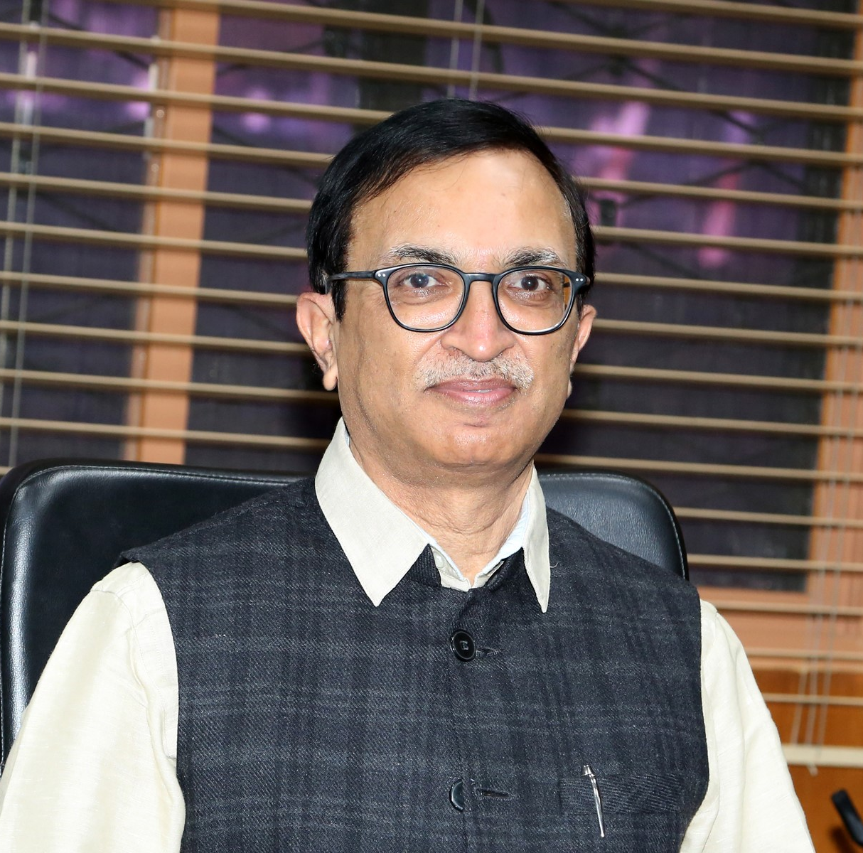
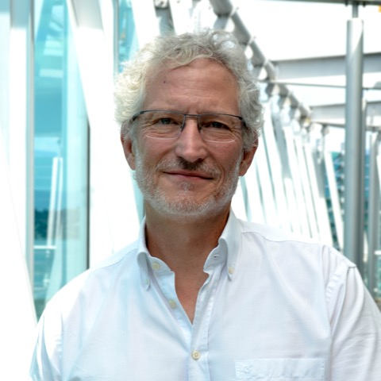
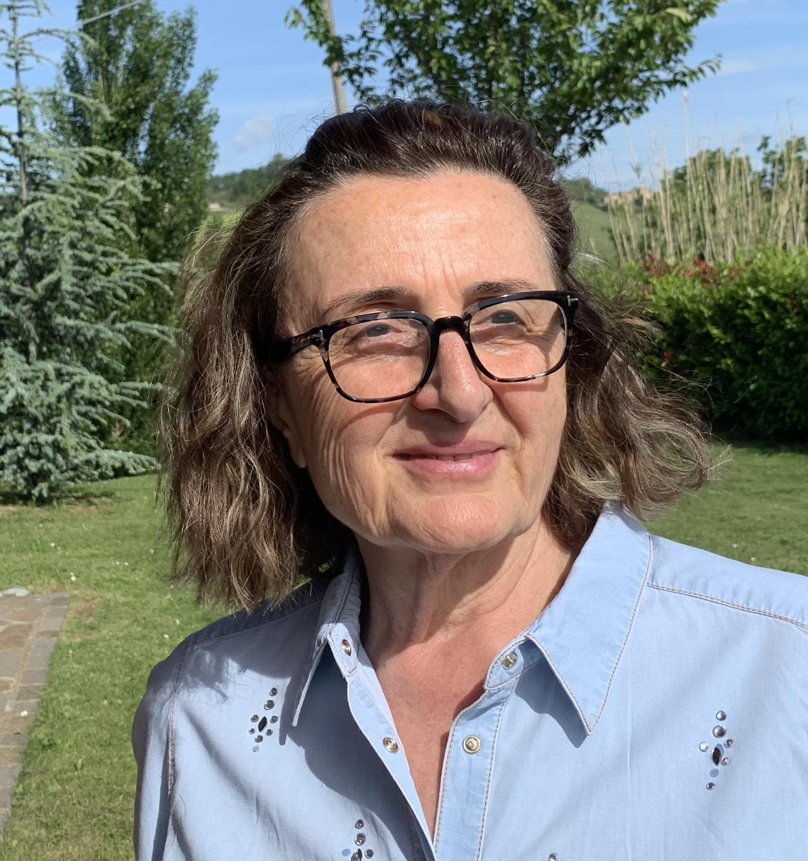
Presenters
COAST Overview: - Raj Kumar, Indian Space Research Organisation and COAST Co-Chair
GEO and CEOS COAST- Doug Cripe, GEO
COAST Partnership with CoastPredict - Nadia Pinardi, CoastPredict Chair

Slide 4
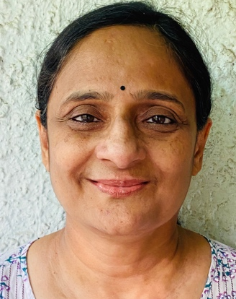
Presenter and Goal
Product Demonstration Bay of Bengal: Dr. Rashmi Sharma, Indian Space Research Organisation
Today’s Goal: Introduce CEOS COAST and hear your feedback and expressions of interest!

Slide 5
Overview of CEOS COAST
Raj Kumar, ISRO

Slide 6
Evolution
Who is CEOS? Committee on Earth Observation Satellites
What is CEOS COAST? Coastal Observations, Applications,
Services, and Tools Team within CEOS
Initiated in 2019 to define a CEOS Coastal Strategy
Encourage broader use of EO for societal benefits in coastal zones: We Want Big Impact for the Most People!
Enhancing CEOS engagement with external coastal stakeholders
How might CEOS COAST help you?
Leverage global EO Satellite Data for High Impact Issues affecting YOUR community.
Co-develop coastal information products to solve YOUR information needs.
Advance products and features YOU want and will be easy for you to use

Slide 7
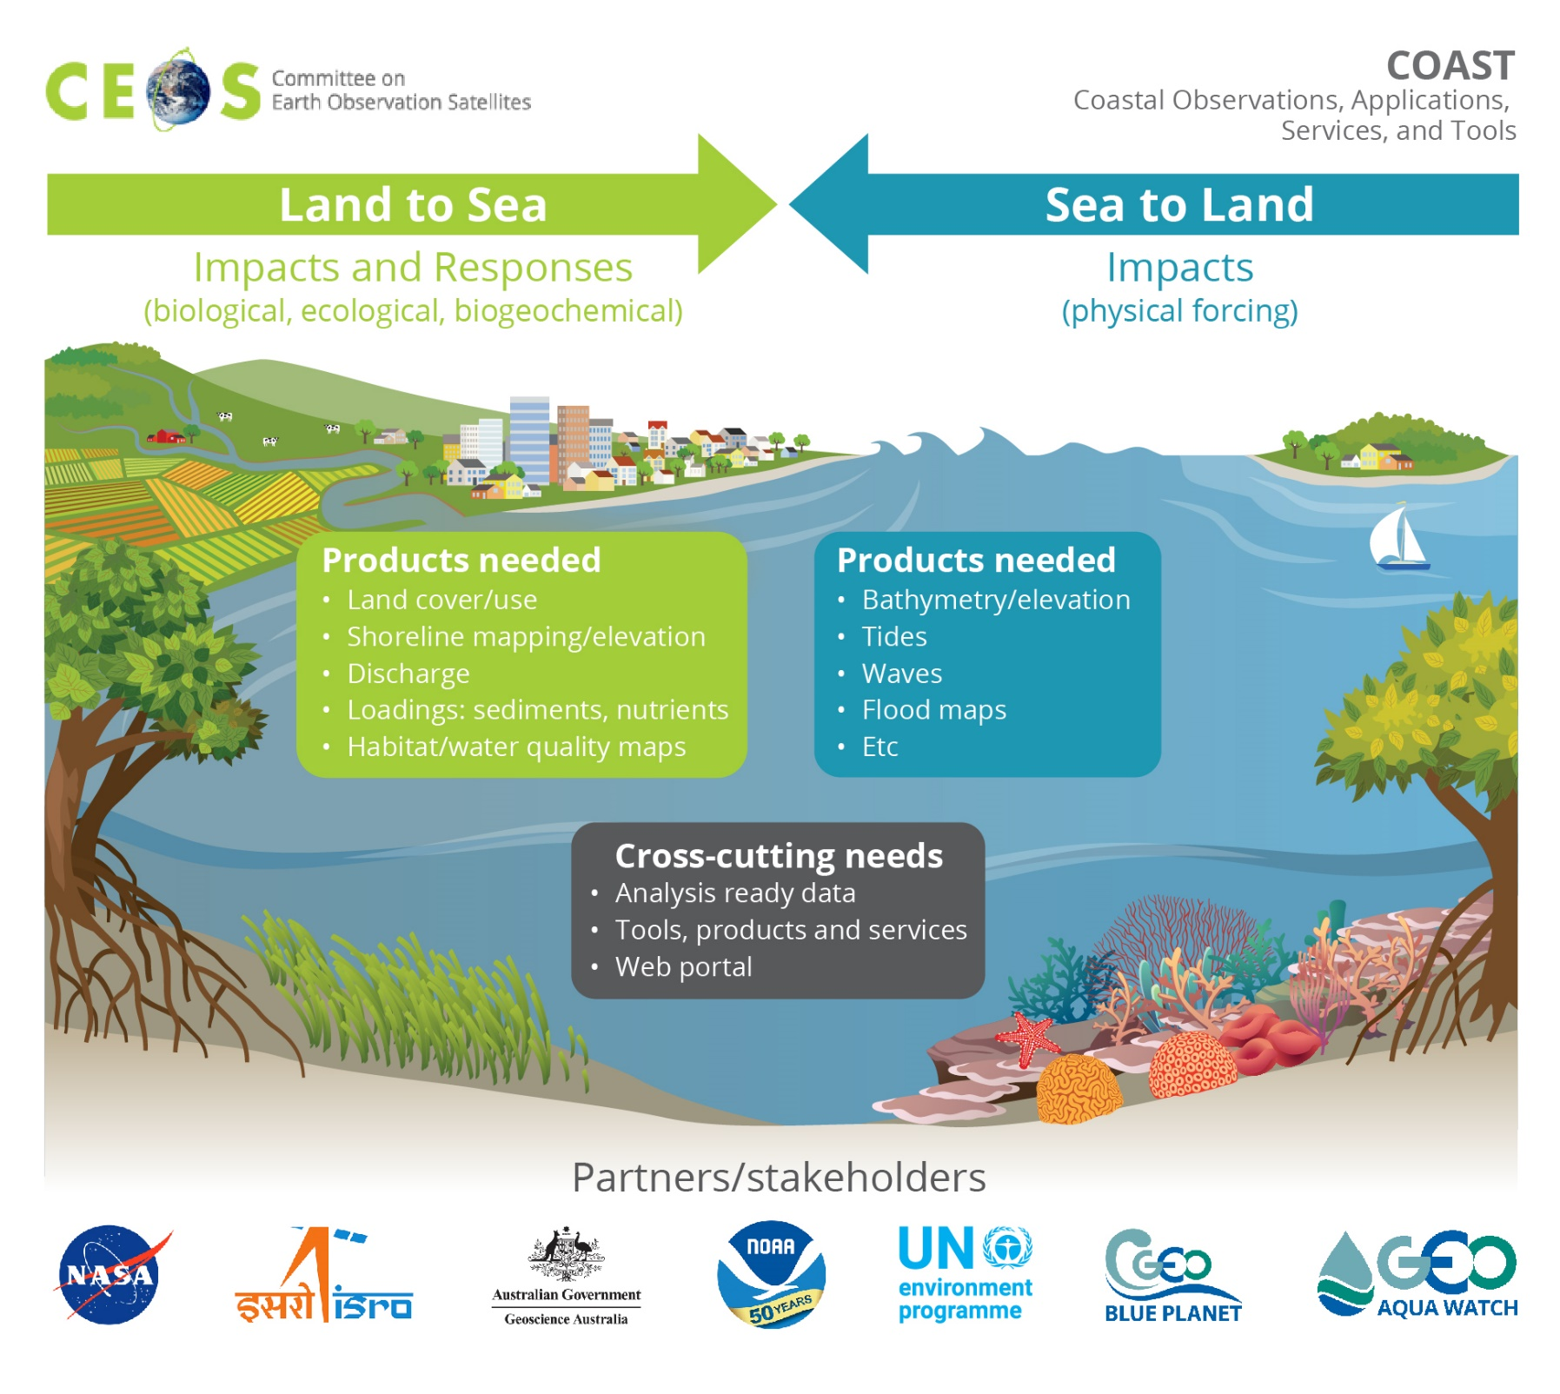
Phase 2: 2020-2022
Identified 2 Pilot Projects to develop coastal products, services and tools
1 - Land Impacts to Sea
2 - Sea Impacts to Land
Themes:
Coastal Characterization
Shoreline mapping
Bathymetry/
elevation
Flooding
Turbidity & Sediment Loading
Coastal Eutrophication

Slide 8
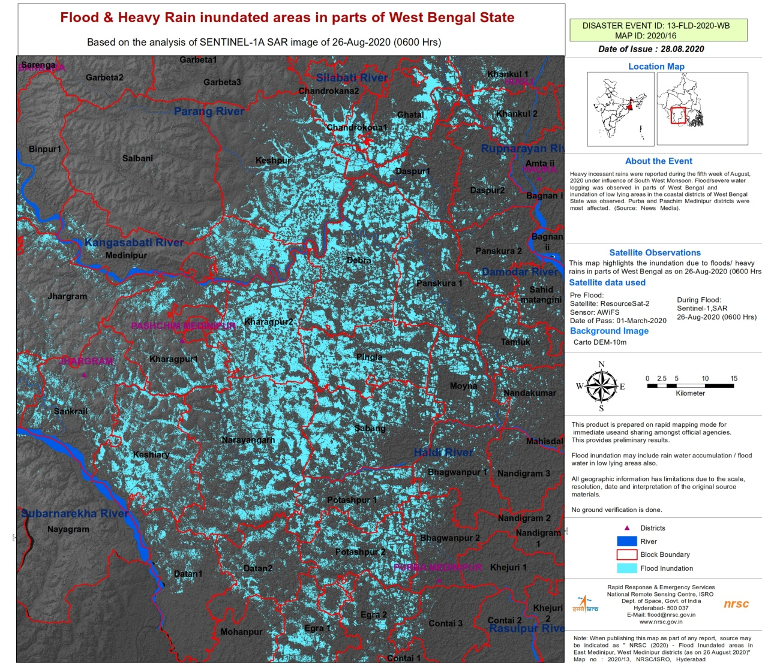
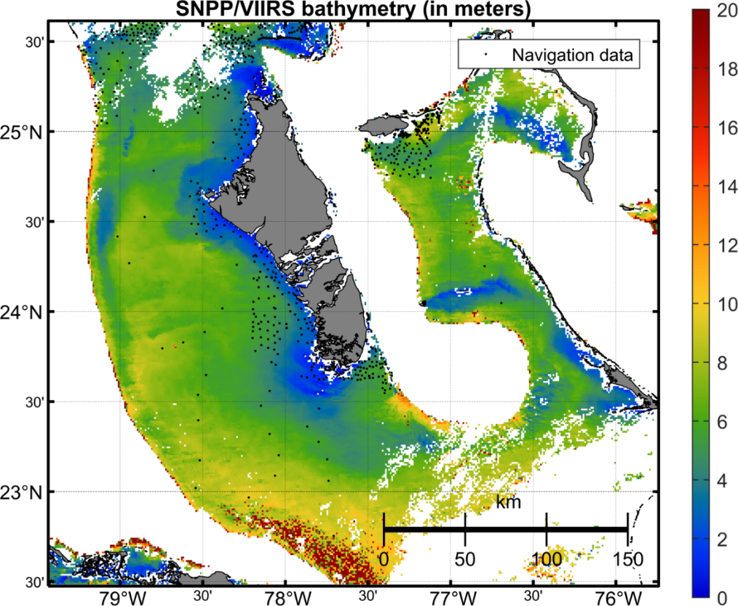
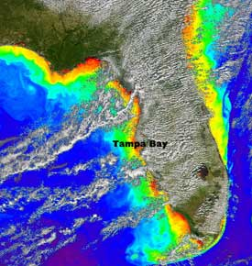
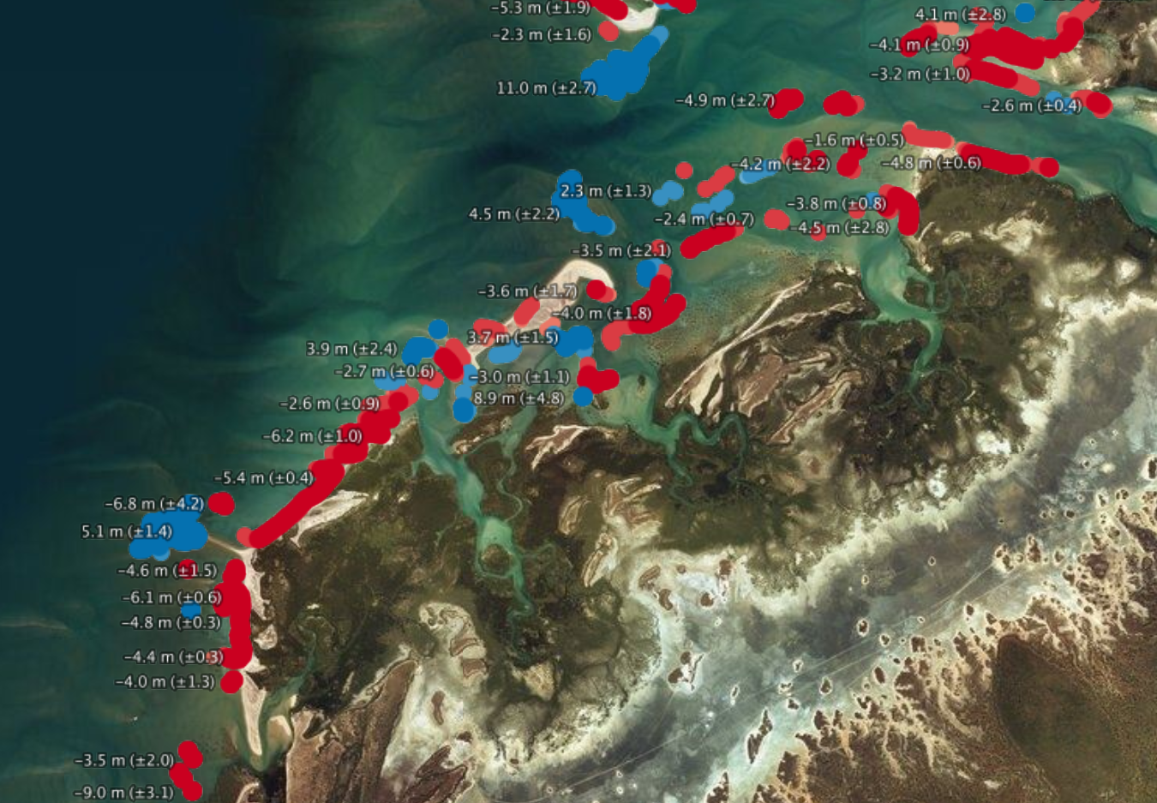
Initial COAST Pilot Locations
Continental:
Odisha/Bay of Bengal
Chesapeake Bay (USA)
West Coast of Africa
Rio de la Plata region (Latin America)
Small Island Nations:
Caribbean: Bahamas
Pacific: Marshall Islands
Others?
Depth (m)
Credit: NRSC/ISRO, Sentinel-1, International Disaster Charter
Credit: Jianwei Wei & Menghua Wang,
NOAA Ocean Color Team
Credit: NASA/USF
Credit: https://maps.dea.ga.gov.au/

Slide 9
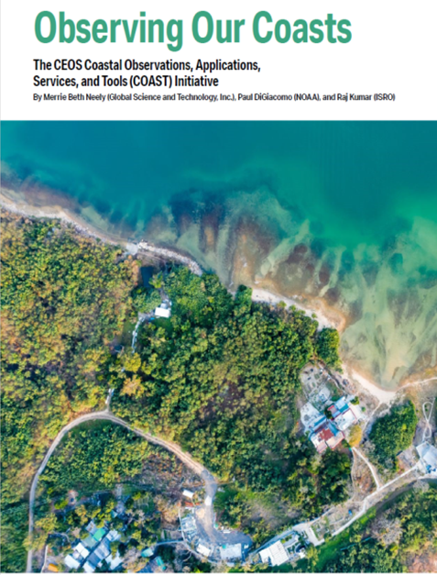
Way Forward
Data needs and Development of Pilot Products
Continue discussions with stakeholders
GEO Co-sponsored Product Showcase on October 5th 2021 for potential stakeholders
Spring 2022 Regional Stakeholder Workshops planned co-design/co-development
Support from all to understand the requirements and operationalise for societal benefits
page 108-111
CEOS: https://ceos.org
CEOS-COAST:
https://ceos.org/ourwork/ad-hoc-teams/ceos-coast/
ECO Magazine:
http://digital.ecomagazine.com/publication/frame.php?i=707374&p=&pn=&ver=html5

Slide 10
GEO Affinities for CEOS COAST
Doug Cripe
GEO Secretariat

Slide 11
Synergies across GEO
GEO Work Programme
F: GEO BON (Marine BON)
I: Oceans and Society: Blue Planet
I: AquaWatch
I: Earth Observations for Sustainable Development Goals (EO4SDG)
I: Digital Earth Africa
CA: Earth Observations for the Atlantic Region
CA: Global Observations of Deltas and Estuaries
CA: Arctic GEOSS
CA: GEO Essential Variables
CA: Open Earth Alliance
FT: GEOSS Data, Information and Knowledge Resources (GEOSS Platform, GEO Knowledge Hub)
Regional GEOs (AfriGEO, AmeriGEO, AOGEO, EuroGEO)
GEO Community
GEO Participating Organizations and Associates
Working Groups (CCWG, CDWG, DRRWG, DWG)
Pacific Island Advisory Group (PIAG)
GEO Indigenous Alliance
New Opportunities
UN Decade of Ocean Science for Sustainable Development
Ocean - Climate Nexus
page 108-111

Slide 12
CoastPredict
Nadia Pinardi, CoastPredict

Slide 13
CoastPredict – Observing and Predicting the Global Coastal Ocean
Chair: Nadia Pinardi
Co-chairs: Villy Kourafalou & Joaquín Tintoré
A PROGRAMME
FOR THE
UN DECADE OF
OCEAN SCIENCE
FOR SUSTAINABLE
DEVELOPMENT
A predicted global coastal ocean where society understands and can respond to changing ocean conditions
Focusing on the many common worldwide features of the coastal ocean
https://www.coastpredict.org
Notes:
More on Climate driver… at the coast…
WHY are we doing this…is not there…
IMPACTS !!
HOW ARE WE SOLVING THIS…. See RaulMedina

Slide 14
A participatory process for co-designing An open consultation from February 15, 2020
250 signatures
from 35 countries
29 “Projects”
submitted
International
Steering committee,
Advisory committee
ECOP
Program has been endorsed,
June 8 2021
Co-design partners:
GOOS, IODE, IODE/OBPS, CEOS-COAST, GEO-Blue Planet, WMO-WWRP
Synergistic Decade programs:
GEOS, EquiSea, DITTO, OceanPredict, etc.

Slide 15
Coastpredict has been, and will be, co-designed with international UN programs: GOOS

Slide 16
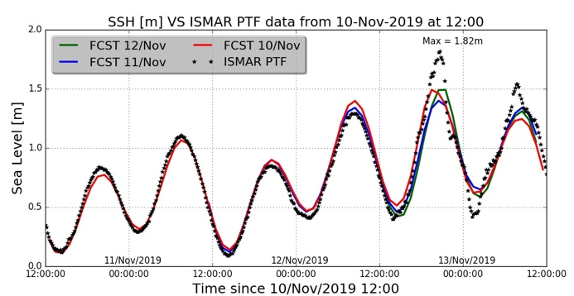
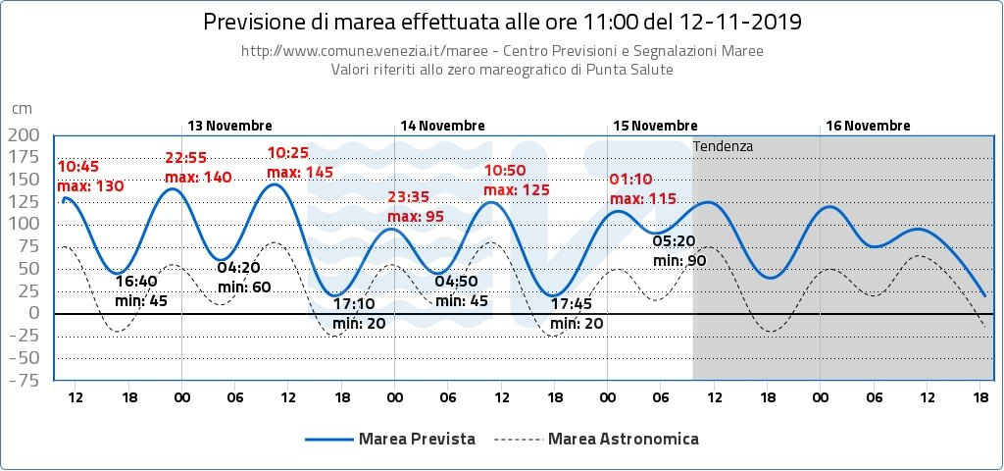
Why CoastPredict? Venice extreme Acqua Alta event, November 12, 2019, @ 23:55
The City of Venice local forecast:
Start of forecast at 11:00 am Nov. 12
CMEMS-CMCC forecast:
Start of forecast at 12:00 am Nov. 10
Max level fcst is 140 cm, should be 1.82 m
In conclusion: local, coastal forecasting models have less accuracy
than large scale models and too short forecast lead times
Max level fcst is 150 cm

Slide 17
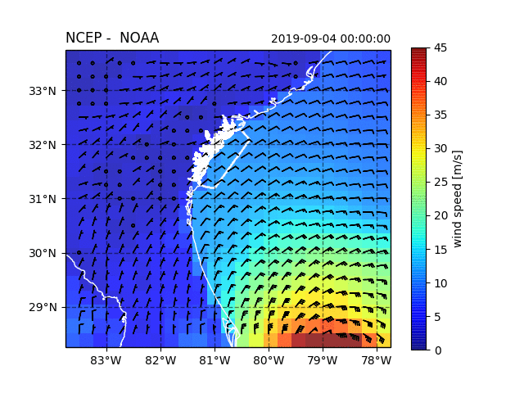
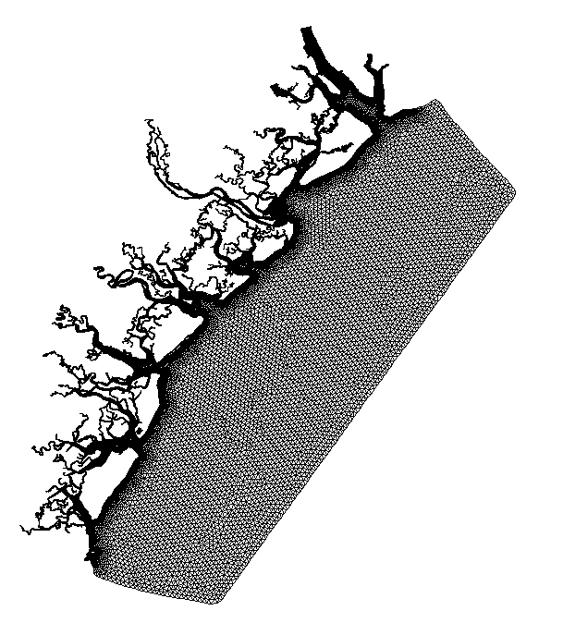
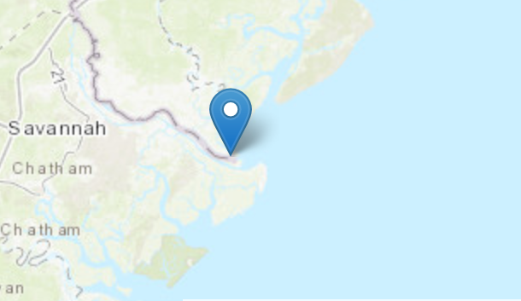
Why CoastPredict? Need to accelerate the closing of the gaps in continuously aligning ocean, weather, climate and the value-added process that follows
Fort Pulaski tide gauge
S-WITCH domain
New downscaling models connecting
the catchment to the sea
S-WITCH domain
Sea Level Forecasts
Hurricane passing
Park et al., 2020 submitted

Slide 18
The basic concept of a Global Coastal Ocean has been defined about a decade ago in five Volumes of The Sea (Vol. 10 to 14, Harvard Univ. Press)
Coastpredict will redefine the “coastal ocean”
PROPOSED STARTING DEFINITION:
the coastal ocean - that area, extending inshore from the estuarine mouths to river catchments, to the urban settlements on the one side and on the other to the offshore, from the surf zone to the continental shelf and slope where waters of continental origins meet open ocean currents.

Slide 19
CoastPredict high level objectives
1) A predicted global coastal ocean
2) The upgrade to a fit-for-purpose oceanographic information infrastructure
3) Co-design and implementation of an integrated coastal ocean observing and forecasting system adhering to best practices and standards, designed as a global framework and implemented locally

Slide 20
CoastPredict Principles
Have a clear stakeholder engagement plan
Have at least three ocean areas of implementation and study (relocatable solutions are essential), one of which in a developing country
Include data management and best practices for open access data
Provide end-to-end demonstrations
Multi-national, multi-disciplinary and diversity balanced groups
Make an effort to use new methodologies and technologies within the different aspects of the project
Include a plan for after-the-project continued development of the basic information infrastructure upgrades and solutions/services with adequate public/private partnerships
Include capacity building and ocean literacy activities
Notes:
Projects should be formulated following some basic principles, i.e.:

Slide 21
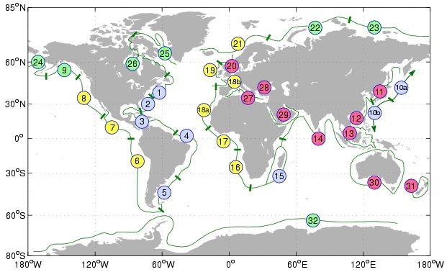
Coastpredict new knowledge
Redefining the concept of the global coastal ocean: a coastpredict project by J.Hopkins
A more comprehensive understanding of the multi-scale interactions that take place within the coastal ocean and the interconnected nature of coastal and shelf sea environments (land-shelf-atmosphere-open ocean).
A new process-based set of coastal ocean typologies, applicable worldwide
New understanding with which future coastal ocean observing systems can be optimally designed
An online tool, accessible to all, where users can generate a customised map of global coastal ocean typologies based on the processes and dynamics most relevant to their problem/interests.
Robinson and Brink, The Sea, Vol. 14 (2010)

Slide 22
CoastPredict: high resolution satellite images for the coast

Slide 23
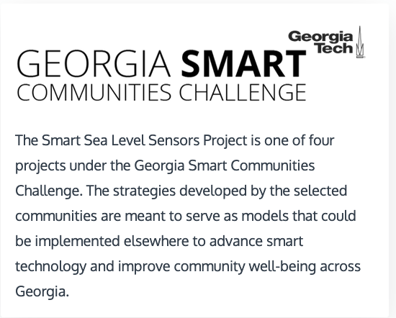
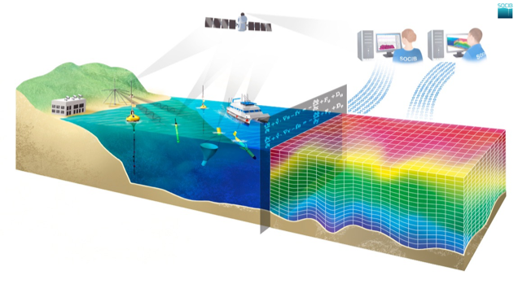
CoastPredict new observing

Slide 24
CoastPredict: Urban Oceanography for impact forecasting

Slide 25
CoastPredict: Integrating across scales
LARGE SCALE
SHELF/OBSERVATORY SCALE
● MOORED BUOY ARRAYS
● SOOP EXPANDABLE AND ONDULATING INSTRUMENTS
SATELLITE SENSING:
SEA LEVEL,
SEA SURFACE TEMPERATURE,
SEA SURFACE SALINITY,
COLOR, WINDS
● DRIFTING BUOYS
(SURFACE AND SUBSURFACE)
● GLIDERS
REPEATED MULTIPARAMETRIC VERTICAL SECTIONS
● SATELLITE AND AERIAL SURVEYS
● COASTAL RADARS
● AUTONOMOUS UNDERWATER
VEHICLES
CABLED MULTIPARAMETRIC STATIONS
● RIVER RUNOFF AND LOADING
MONITORING
SEDIMENT/WQ MONITORING
OBSERVING
SYSTEM
MODEL PHYSICS
● PRIMITIVE EQUATION (> 1-5 KM)
● TURBULENCE CLOSURE SUBMODELS
MODEL PHYSICS
PRIMITIVE EQUATION (<1- 5 KM)
● TURBULENCE AND LIGHT
SUBMODELS
DATA ASSIMILATION
OPTIMAL INTERPOLATION
3-DVAR, KALMAN FILTER
DATA ASSIMILATION
● KALMAN FILTERS
● ADJOINT MODELS
BIOCHEMICAL MODELS
● PELAGIC COMPARTMENT
● BENTHIC CLOSURE
PREDICTING
SYSTEM
BIOCHEMICAL MODELS
● PELAGIC COMPARTMENT
● BENTHIC-PELAGIC COUPLING
● SEDIMENT DYNAMICS
ATMOSPHERIC FORCING
OPERATIONAL ANALYSES AND FORECASTS FROM GLOBAL SCALE MODELS
ATMOSPHERIC FORCING
OPERATIONAL ANALYSES AND FORECASTS FROM LIMITED AREA MODELS

Slide 26
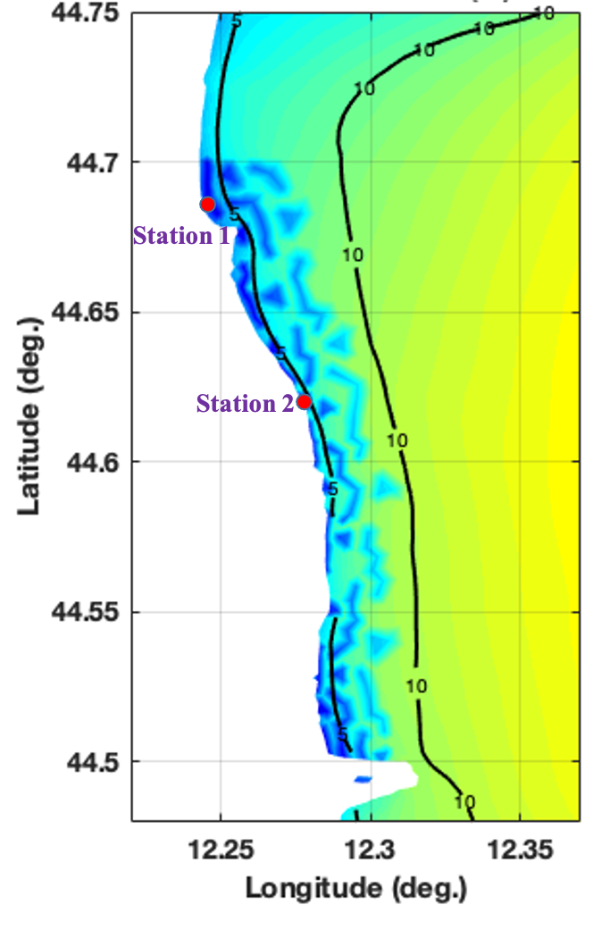
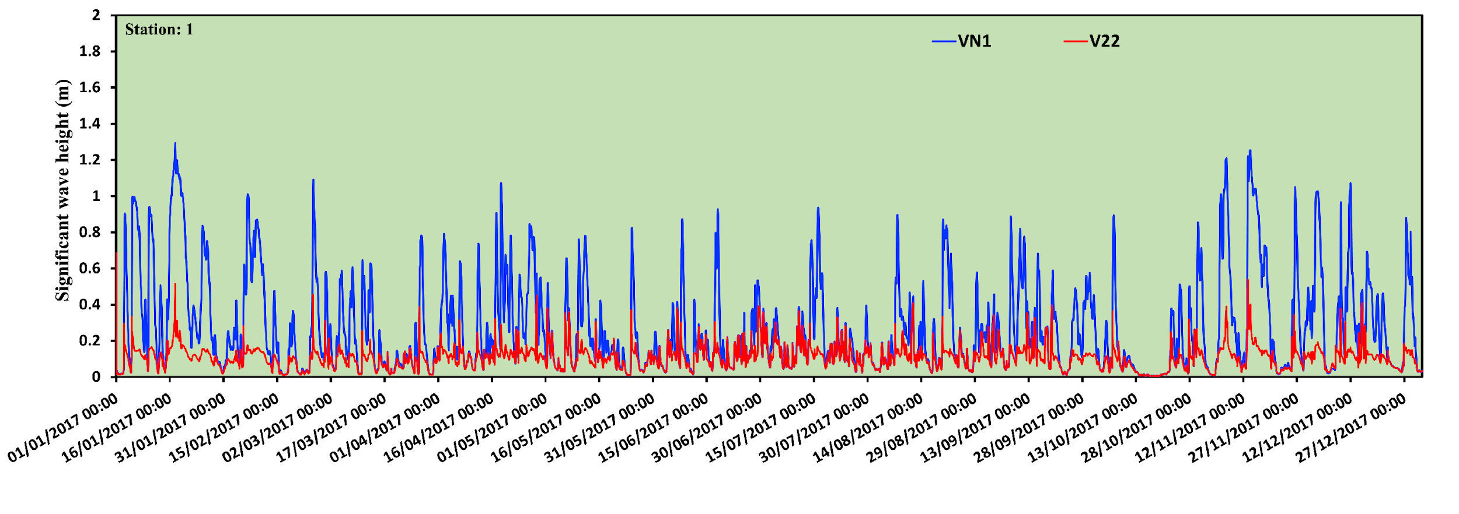
CoastPredict: Nature Based Solutions against storm surge
Station 1 –
blue no vegetation / red vegetation

Slide 27
Bay of Bengal Demonstration
Rashmi Sharma, ISRO SAC

Slide 28
Sea2Land - A Case Study for Bay of Bengal
Background -
East coast of India is frequently affected by cyclones (pre-monsoon & post-monsoon)
Damage Assessment models need high accuracy bathymetry and Digital Elevation Model
Bathymetry & DEM – Key component in storm surge inundation prediction
Bathymetry Estimation
Key Question -
Pilot site selection?
Bathymetry Estimation from satellites (accuracy, resolution, method)?
ARD Data (resolution, corrections, portability, format etc) ?
Validation data?
Contributions are from my colleagues working at SAC & NRSC, ISRO:
1.) Durga Rao KHV, 2.) Ratheesh Ramakrishnan, 3.) Abhisek Chakraborty, 4.) SVV Arun Kumar, and 5.) Anup Mandal
Thanks are due to :
Sh Nilesh M Desai (Director, SAC/ISRO) & Dr I. M. Bahuguna (Group Director, SAC/ISRO)

Slide 29
Why Bay of Bengal?
Requirements
Satellite data requirement to address the problem -
Shoreline mapping/coastal elevation
Shore line detection
Flood maps/Flood extent
Bathymetry
Coastal elevation and Intertidal Mapping
DEM's
River Discharge/Dam locations and specs
Land Use /Cover datasets
Water Temperature
Salinity
Tidal Data - altimetry, winds
Wave Data

Slide 30
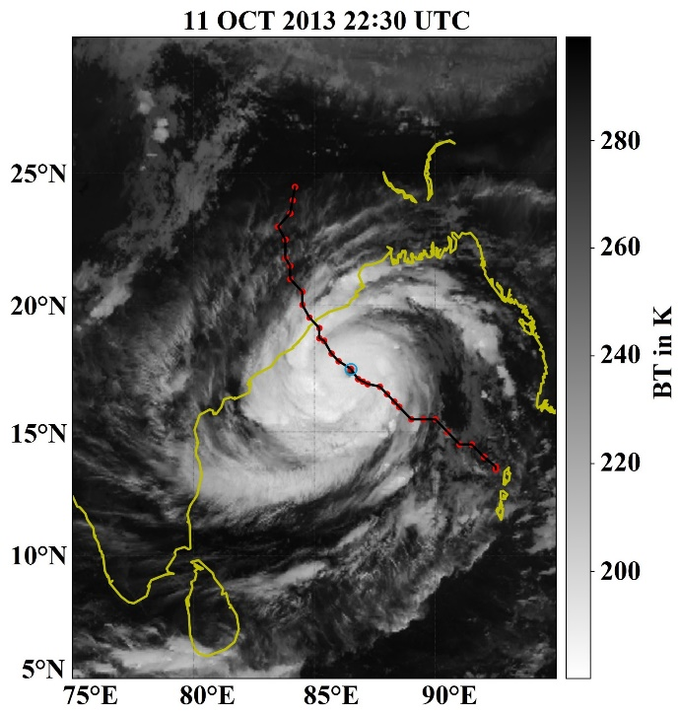
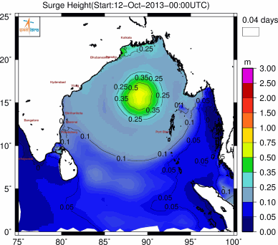
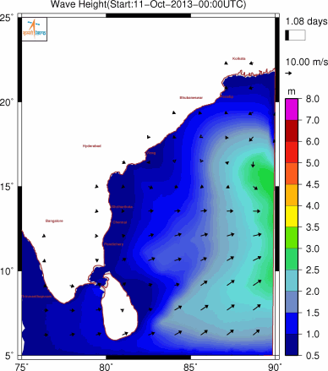
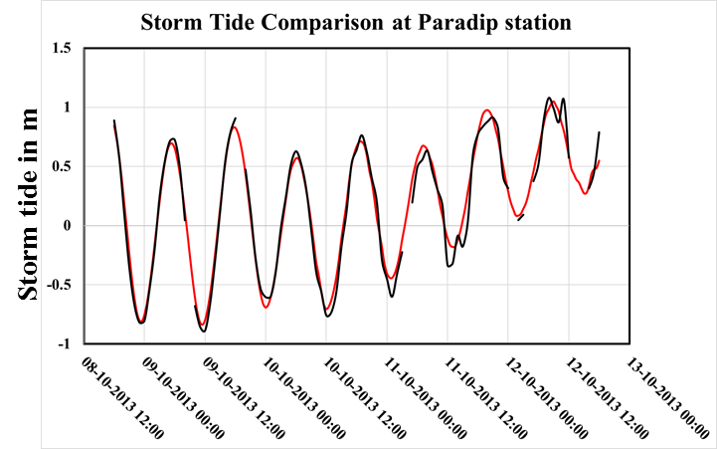
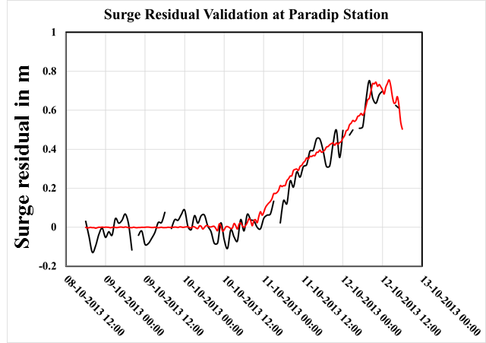
Our Experience : Satellite & Modeling Perspective
Cyclone Phailin (4-14 Oct, 2013)
INSAT TIR overlaid with cyclone track
OCEANSAT-2 OCM B1 360 m Image overlaid by
OCEANSAT-2 Scatterometer
12.5 Km Wind Vector
RMSE: 6 cm
CC : 0.97
Natural Hazards (2020)

Slide 31
A multi-fold approach for Coastal Bathymetry estimation
SAR DATA
OPTICAL DATA
2-D FOURIER TRANSFORM
DEPTH - CURRENT INTERACTION
REGRESSION & WATER QUALITY
Hybrid Method??
1.) Coast to Breaker zone…up to 15 m depth:
Optical Method
2.) Beyond Breaker zone …up to 100 m depth:
SAR based
CURRENT - WAVE INTERACTION
OCEAN WAVE SPECTRUM
WAVE BACKSCATTER INTERACTION
REFLECTION BASED MODEL
INVERSION SCHEME
WAVE REFRACTION
BACKSCATTER BASED MODEL
DEPTH DATA 1
DEPTH DATA 2
DEPTH DATA 3

Slide 32
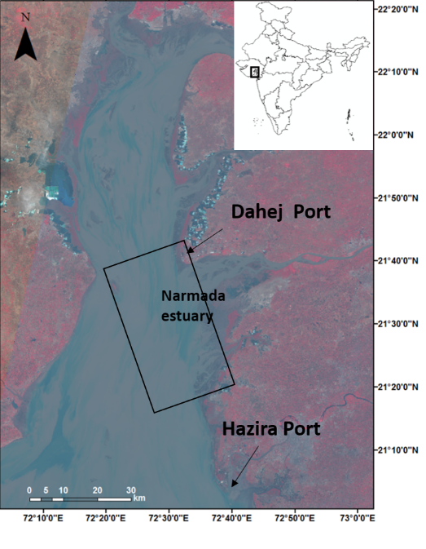
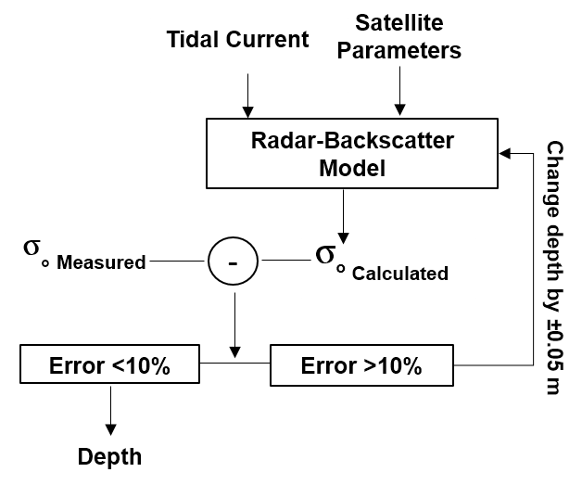
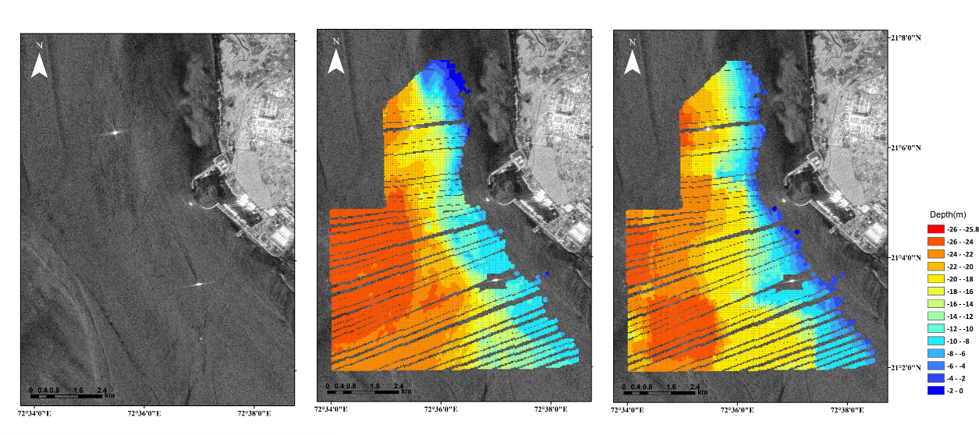
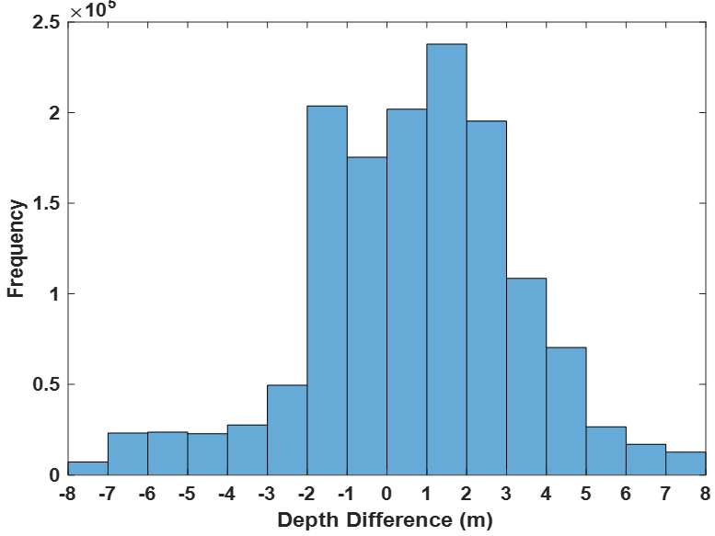
Bathymetry estimation using SAR images
Used ALOS 1&2 PALSAR data to estimate the depth of shallow bathymetric features along the coast of Gulf of Khambhat
Validated using echo-sound data
ASOS-2 PALSAR
In situ observation
SAR derived Bathymetry

Slide 33
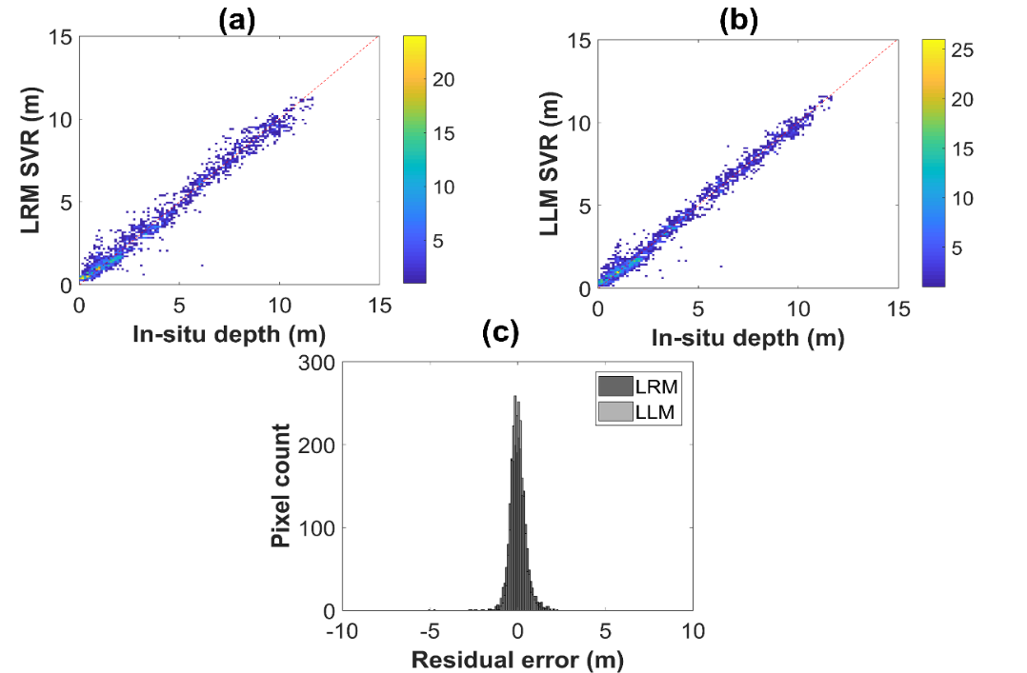
Bathymetry retrieval in shallow nearshore waters from optical satellite imagery
Study area: Visakhapatnam coast (East Coast of India)
Datasets: Sentinel-2A&B, JetSki sounding data (in-situ depths)
Methods:
Log-ratio model (LRM); Log-linear model (LLM)
Ensemble approach of LRM and LLM
Support Vector Regression (SVR) ML on LRM and LLM ensembles
LLM consistently showed good results for a best scene
SVR has best performance with least RMSE = 0.38 m (depth range of 0-15 m)
Best scene
Best scene
Best scene
R² =0.94
RMSE = 0.79 m
R² =0.95
RMSE = 0.67 m
R² =0.95
RMSE = 0.67 m
Customized JetSki with GNSS and Echo sounder
Validation of SVR approach with in-situ data
Improved results with LLM
R² =0.91
RMSE = 0.94 m
R² =0.96
RMSE = 0.66 m
R² =0.96
RMSE = 0.66 m
Residual errors are very low < 0.5 m
R² =0.97
RMSE = 0.53 m
R² =0.98
RMSE = 0.38 m
R² =0.98
RMSE = 0.38 m
Current Science (2020)
Under review ASR
Notes:
Ensemble means multi-scene compositing (generating a single data from multiple images)

Slide 34
Inundation during Recent Cyclone Taukate

Slide 35
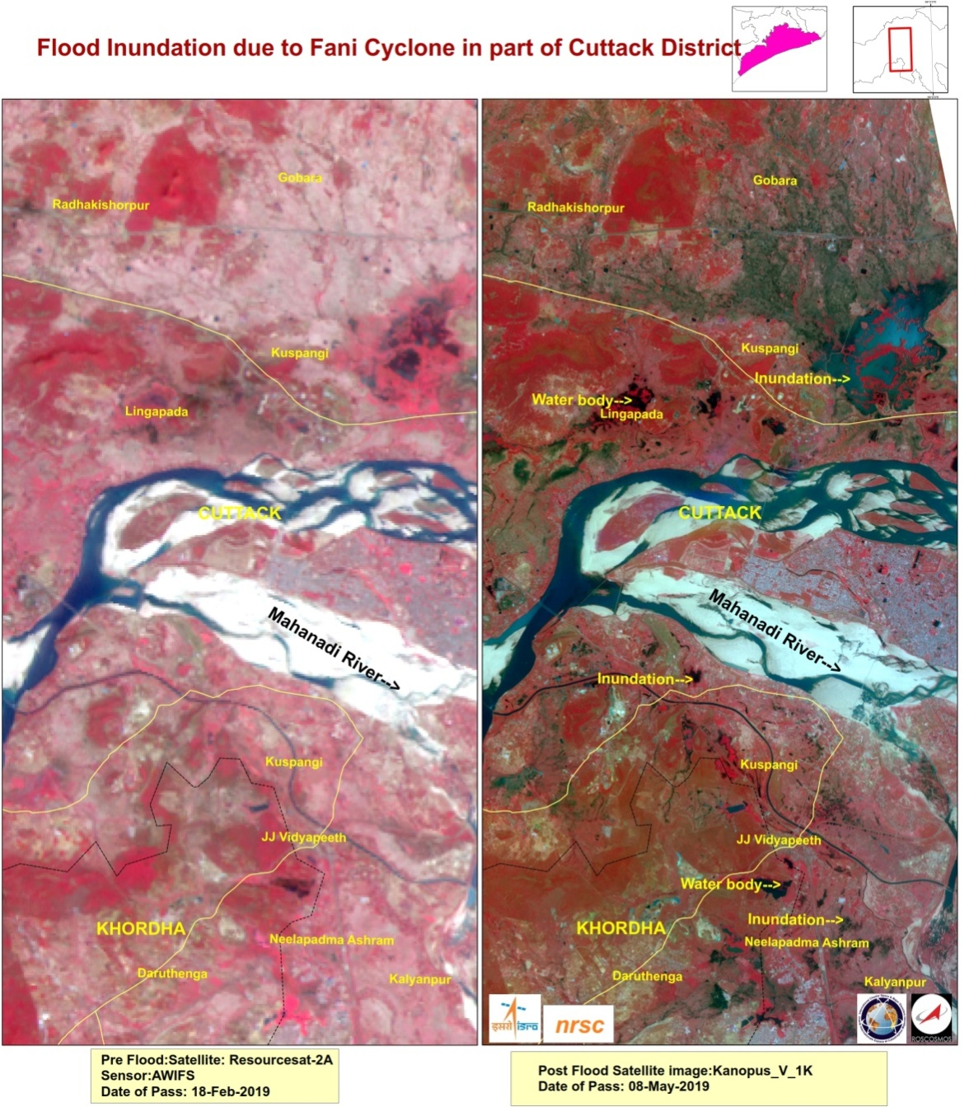
Flooding/Inundation using Satellite Observations

Slide 36
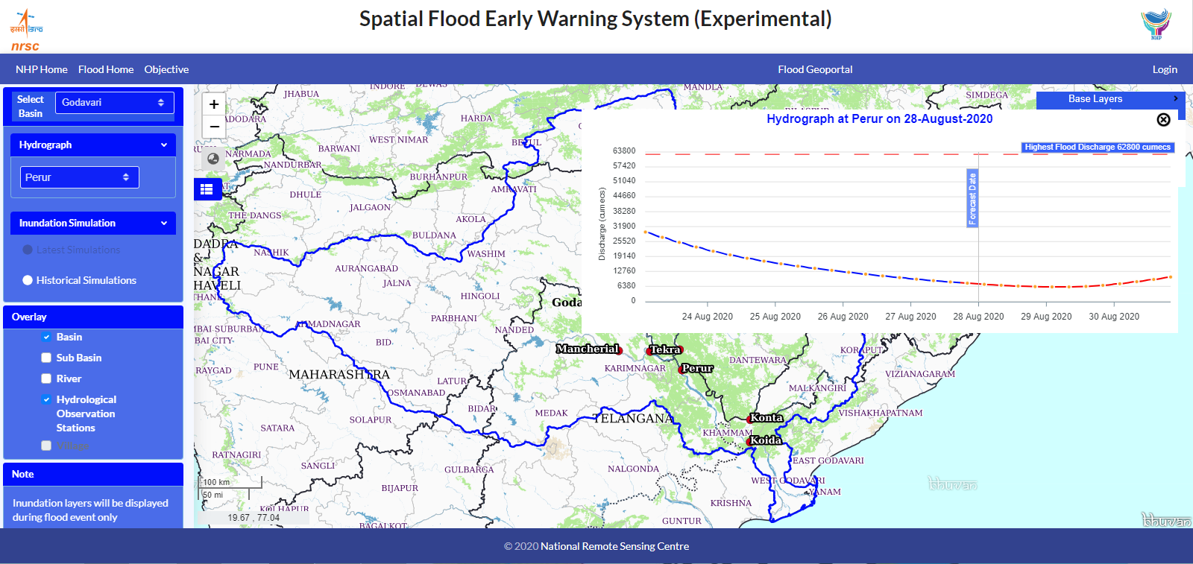
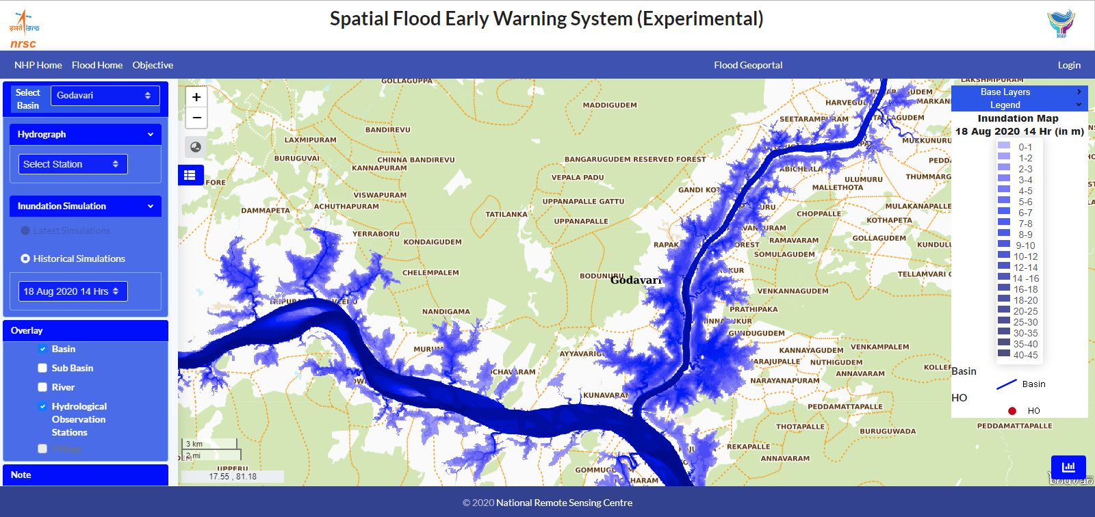
Flood Modeling for Early Warning
NEED
Flood Alarm System
Flood Relief and Rescue Operations
Flood Management
Important input for Disaster Management
MODEL INPUTS
Static Data : LULC, Soils , DEM, ALTM-DTM, Rating Curves
Dynamic Data : Real-time discharge, Daily Rainfall in real-time,
Daily Forecasted Rainfall, ET , Historic hydro-met data for model
cal & Reservoir operations data
Flood Early Warning (Aug 2020)
HIGHLIGHTS
Accurate flood discharge estimation (>85%) with 50 hours lead time
Real Time flood alert dissemination
Spatial Flood Inundation Simulation (Aug 2020)

Slide 37
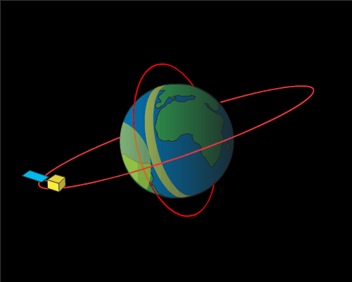
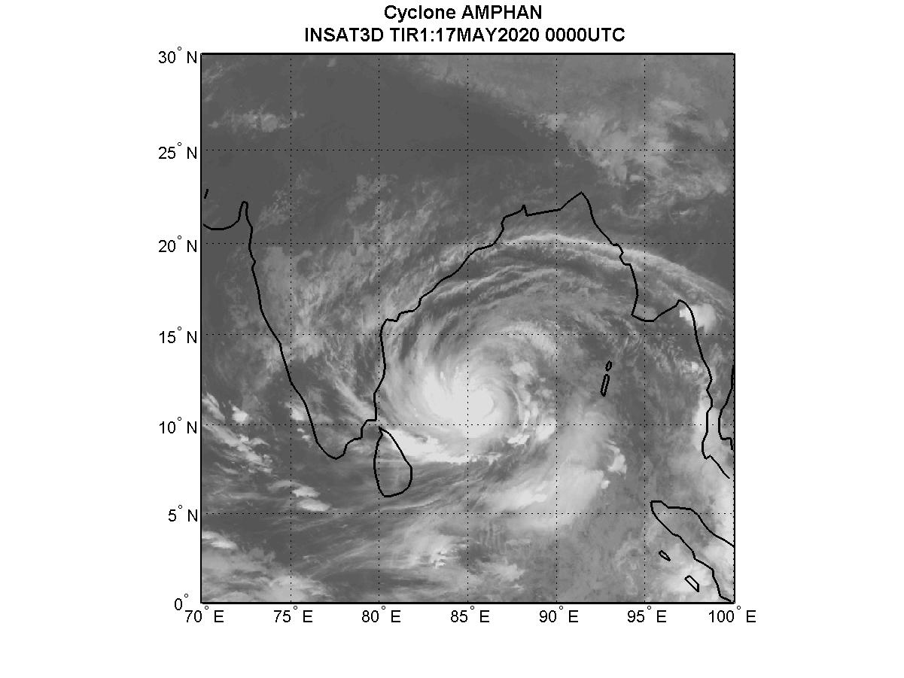
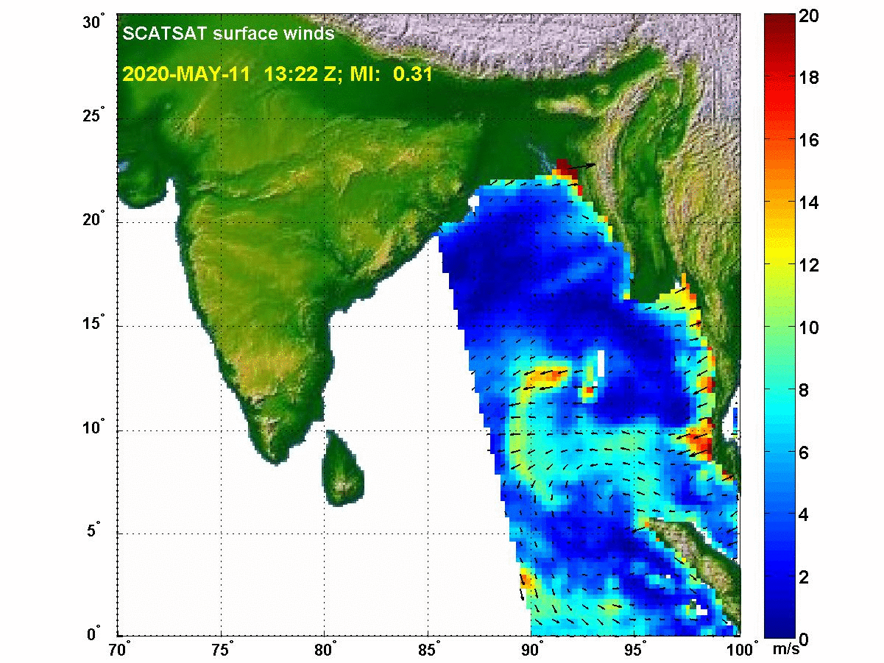
Plan Ahead
Cyclone “Amphan” - Test Case
JTWC Best Track Input
Bathymetry – SAR (Sentinel ) derived & Optical data (Sentinel) derived, Possibly hybrid bathymetry (combining near shore optical & SAR based beyond 15 m depth)
DEM – Cartosat
Bathymetry Validation using echo sounder/NHO chart
Surge model configuration with different bathymetry & DEM
Suit of Experiments with surge model
Validation of TWL and wave height with altimeter data
Inundation modelling
Inundation using SAR and optical data
Discussions in COAST Meetings & Presentations in Plenary

Slide 38
Thank You! Questions?
Paul.DiGiacomo@noaa.gov
director@nrsc.gov.in
dcripe@geosec.org
nadia.pinardi@unibo.it
rashmi@sac.isro.gov.in
@CEOSdotORG on Twitter
Collaborate and communicate with GEO:

Slide 39
Discussion

Slide 40
What is next?
To make sure you are invited to our future workshops, add your contact to our stakeholder list.
Place your information in the chat or email Merrie.neely@noaa.gov with the subject line CEOS COAST and tell us what region you need products for and which products you have interest in.
Find out more at our website: https://ceos.org/ceos-coast/
Plan to join us on October 5th for our CEOS COAST Product Showcase and in Spring 2022 for regional co-design workshops with identified users

