Slide 1
CEOS Coastal Observations & Applications Study Team (COAST): Phase 1 Results and Phase 2 Implementation Planning
Paul M. DiGiacomo
NOAA/NESDIS
CEOS-COAST Chair
CEOS SIT Technical Workshop 2020
Session 1.4 - COAST
7 September 2020

Slide 2
CEOS Coastal Observations & Applications Study Team: COAST
CEOS Coastal Observations and Applications Study Team (CEOS-COAST): Initiated at 33rd CEOS Plenary to define a CEOS Coastal Strategy and facilitate engagement with key international stakeholders
Bridging land and aquatic observations within CEOS, helping to integrate across multiple CEOS entities and domains, both thematic and technical.
Leveraging CEOS Systems, services and interoperability approaches, including the CEOS Analysis Ready Data (ARD) framework already demonstrated for terrestrial and oceanic applications.
Facilitating the broader utilization of Earth observations for greater societal benefits within coastal zones and enhancing CEOS engagement with external stakeholders such as GEO, IOC/GOOS, UN Environment, WMO and the UN Decade of Ocean Science for Sustainable Development (2021-2030).
COAST Study Team Approach:
Virtual monthly+ meetings
Collaborative offline document and project work via GoogleDocs
CEOS SIT Side Event and Technical Workshop Session
Briefings to partners and collaborators

Slide 3
CEOS Coastal Observations & Applications Study Team: COAST
COAST Team Members:
CEOS COVERAGE: Jorge Vazquez (JPL), Vardis Tsontos (JPL)
CEOS Executive Officer: Kerry Sawyer (NOAA)
CEOS SEC Support: George Dyke, Matt Steventon (Symbios)
CEOS Systems Engineering Office (SEO): Brian Killough (NASA)
CEOS VCs: Ed Armstrong (JPL), SST-VC; Eric Leuliette (NOAA), OST-VC
CEOS WGCapD: Nancy Searby, Lauren Childs-Gleason (NASA)
CEOS WGClimate: Albrecht von Bargen (DLR-DE), Joerg Schultz (EUMETSAT)
CEOS WGCV: Philippe Goryl (ESA)
CEOS WGISS: Rob Woodcock (CSIRO)
CEOS WG Disasters: David Green (NASA), David Borges (NASA)
CEOS SDG AHT: Flora Kerblat (CSIRO)
CNES: Aurelien Carbonniere
CSIRO: Janet Anstee
ESA: Jérôme Benveniste
EUMETSAT: Estelle Obligis
European Commission: Astrid-Christina Koch, Fabienne Jacq
GEO AquaWatch Initiative: Steve Greb (Univ of Wisconsin)
GEO Blue Planet Initiative: Emily Smail (UMD), Leah Segui
GEO Secretariat: Douglas Cripe
Geoscience Australia: Stephen Sagar
ISRO: Rashmi Sharma, Raj Kumar
NASA: Laura Lorenzoni (OCR-VC)
NOAA: Paul M. DiGiacomo (Chair); Merrie Beth Neely (Project Manager)
USGS: Steve Labahn (LSI-VC)

Slide 4
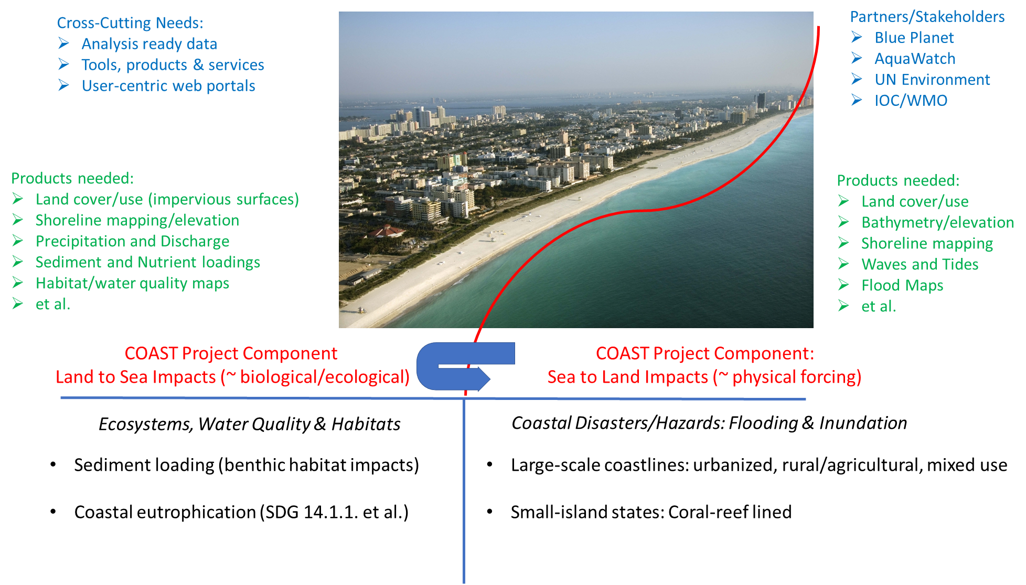
CEOS Coastal Observations & Applications Study Team: COAST

Slide 5
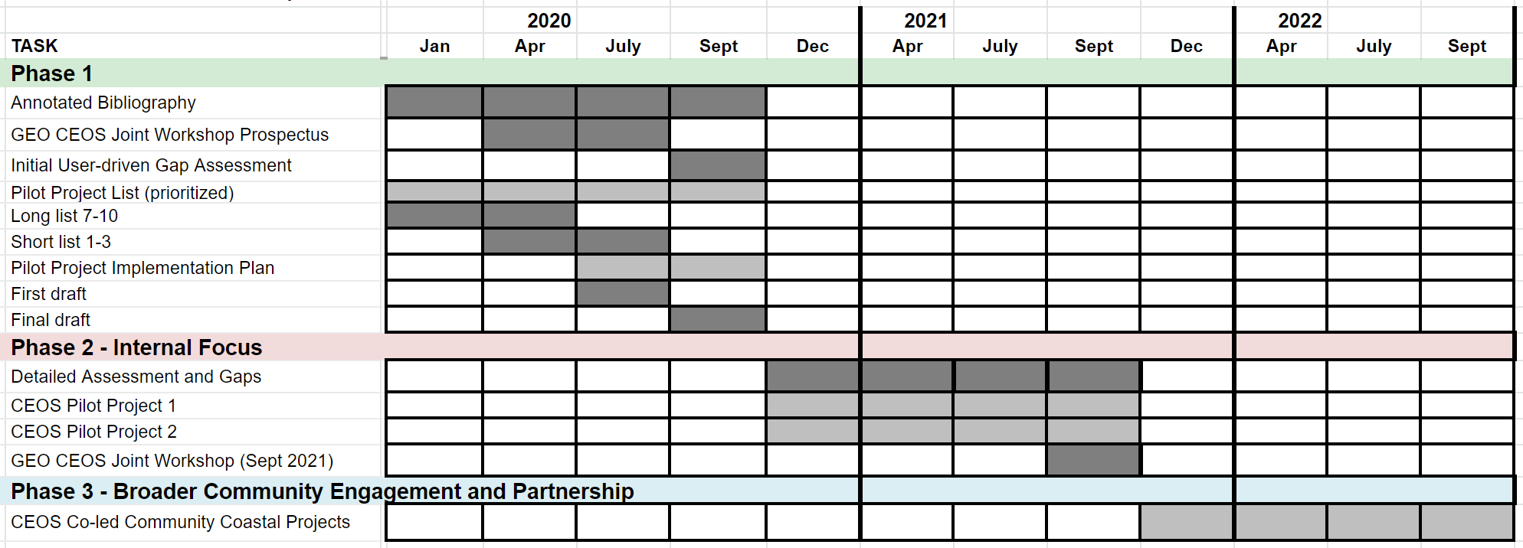
CEOS Coastal Observations & Applications Study Team: COAST
COAST Project: Phases, Milestones and Schedule

Slide 6
CEOS Coastal Observations & Applications Study Team: COAST
COAST Project: Phases, Milestones and Schedule

Slide 7
CEOS Coastal Observations & Applications Study Team: COAST
Summary of COAST Phase 1 Deliverables
(anticipated completion of all by ~30 September 2020)
⮚ Established - CEOS-COAST website: http://ceos.org/ourwork/ad-hoc-teams/ceos-coast/
⮚ Completed – Annotated COAST Bibliography; available soon at CEOS-COAST website
⮚ Completed – Compilation of COAST-related projects/activities; available soon at CEOS-COAST website
⮚ Pending – draft satellite data requirements inventory for SDG 14.1.1a (coastal eutrophication)
⮚ Completed - Phase 2 Pilot project components, priorities and sites identified
⮚ Delivered – Draft of CEOS-COAST Phase 1 White Paper #1: “Sea to Land Impacts: User Needs,
Observations, and Services”
⮚ Delivered – Draft of CEOS-COAST Phase 1 White Paper #2: “Land to Sea Impacts: User Needs,
Observations, and Services”
⮚ Delivered - CEOS-COAST Phase 1 White Paper #3: “Cross-Cutting Tools, Systems and Services”
⮚ Pending – COAST Phase 2 Implementation Plan
NB: On hold due to COVID: Planning for Joint GEO-CEOS COASTAL Workshop (~Summer 2020; now TBD)

Slide 8
CEOS Coastal Observations & Applications Study Team: COAST

Slide 9
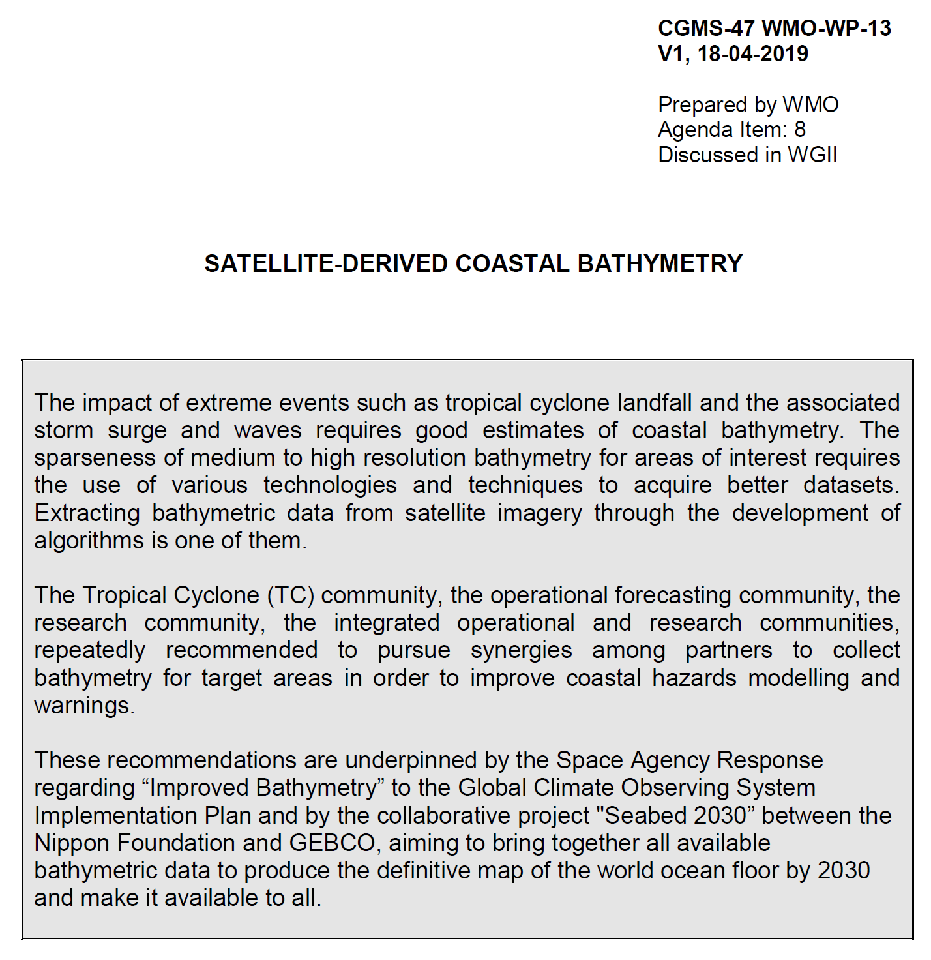
Coordination Group for Meteorological Satellites - CGMS
Pursuant to CGMS-47 WMO-WP-13: Satellite-Derived Coastal Bathymetry
Key issues of relevance to CGMS:

Slide 10
xxx
Bathymetry from NOAA Multi-Spectral Ocean Color Satellite Measurements
Depth (m)
density
Bahamas
Bathymetric map is derived from VIIRS-SNPP ocean color data, using the newly developed spectral optimization algorithm.
Validation of satellite-derived and Navigation Chart data (sampling locations are indicated in the map), showing useful data from VIIRS.
Jianwei Wei & Menghua Wang,
NOAA Ocean Color Team

Slide 11
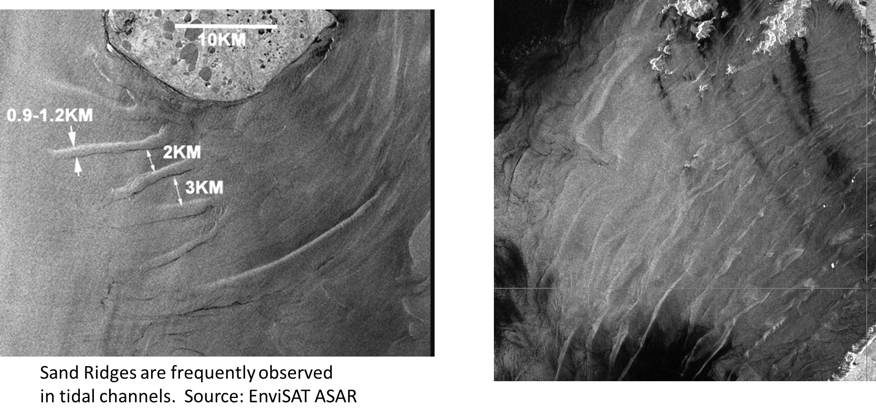
xxx
SAR Oceanography – Shallow Water Bathymetry < 30 m
NOAA Water Surface
Conditions Team
Xiaofeng Li & Sean Helfrich

Slide 12
Bay of Bengal

Slide 14
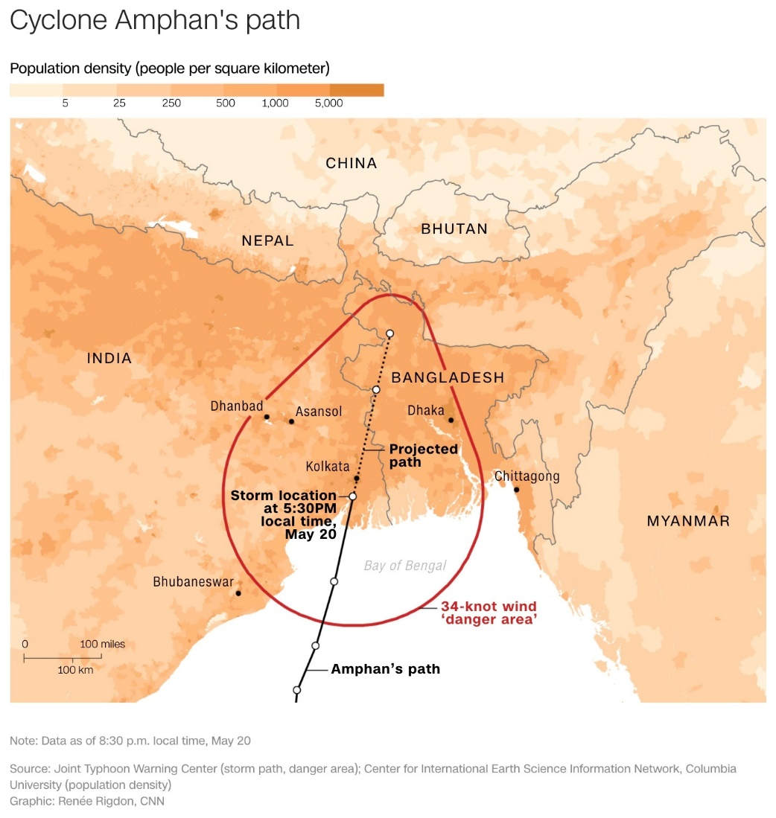
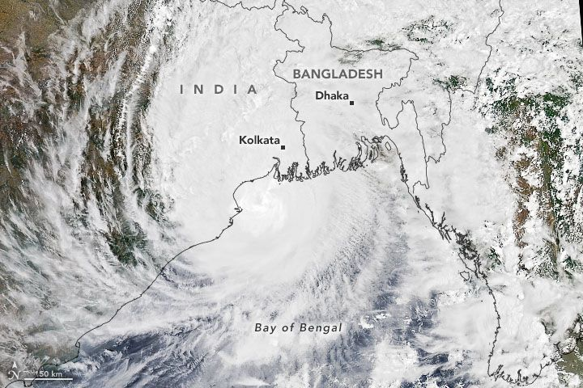
CEOS Coastal Observations & Applications Study Team: COAST
Anticipated COAST Pilot Locations
Continental:
Odisha/Bay of Bengal
Coastal Virginia/Chesapeake Bay
West Coast of Africa
Rio de la Plata region (Backup/TBD)
Small Island Nations:
Caribbean: Bahamas
Pacific: Tahiti/Kiribati/New Caledonia
Other sites/TBD

Slide 15
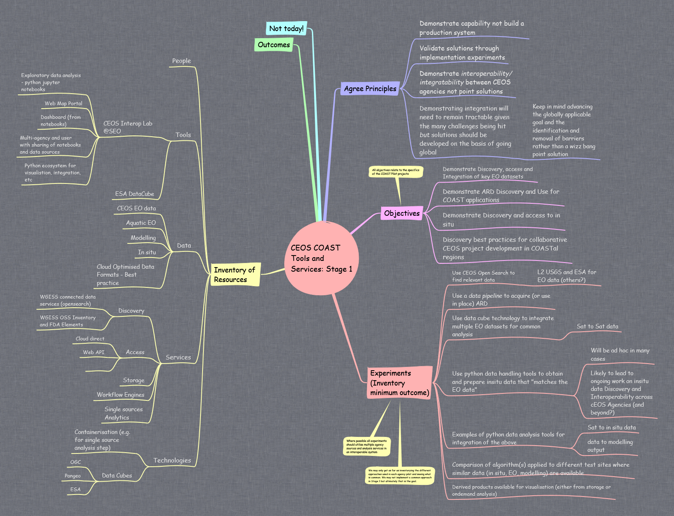
CEOS COAST Architecture Mind Map

Slide 16
CEOS COAST Architecture Mind Map

Slide 17
CEOS Coastal Observations & Applications Study Team: COAST
Summary and Forthcoming Request to Continue COAST Through September 2021
The COAST Team has made significant progress to date, including meeting and exceeding its initial deliverables as identified in its Phase 1 work plan for 2020.
Furthermore, it has identified compelling user needs and opportunities that CEOS can readily address via COAST.
As such, we will be requesting at CEOS Plenary continuation of COAST activities through Sept 2021 as a CEOS Ad Hoc Team, w/approval of impending Phase 2 Implementation Plan
Likewise, we will be requesting therein pledges/commitment of resources as appropriate by CEOS Agencies.

Slide 18
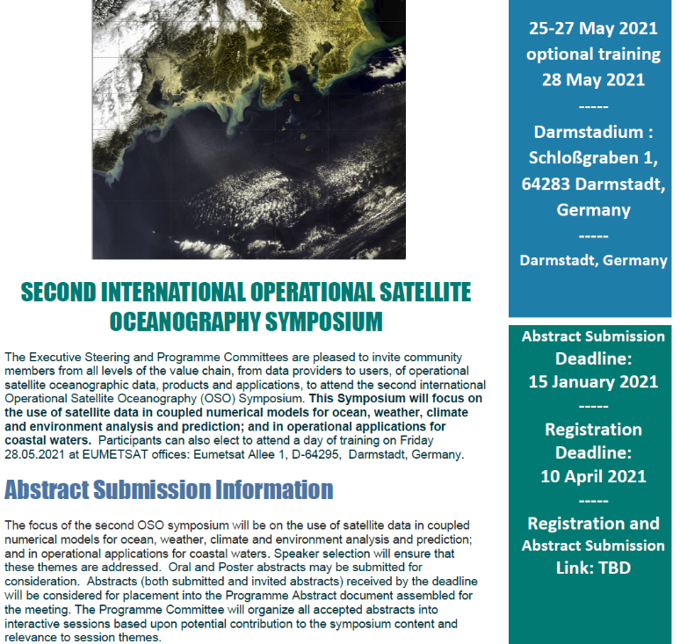
2nd International Operational Satellite Oceanography Symposium (OSOS-2) Virtual Meeting, 25-27 May 2021

Slide 19
CEOS Coastal Observations & Applications Study Team: COAST
Thank You!

Slide 20
CEOS Coastal Observations & Applications Study Team: COAST
Selection of Pilot Locations for CEOS COAST
The rating criteria for selecting pilot locations should be:
The project addresses a global societal need at the location and common (most) coastal regions
Local, Regional, and/or Global users of the pilot products have been identified (e.g., UN Environment)
Nation(s) and its people will realize demonstrable impacts and outcomes from the project
Project will be scalable to other coastal regions through tech transfer
The project location supports/fulfills an agency initiative(s)
The project location supports a GEO objective, e.g., an Initiative (such as Blue Planet)
The location will have partners (CEOS et al.) contributing data and/or other resources and interested in sustaining the work beyond the pilot phase
Sufficient data is available to make an initial product within 12 month time period
Required or supporting data format ideally can/will be ingested into the WGISS-CEOS Earth Analytics Interoperability Lab (or fit existing demonstration data input requirements)
Agency Commitment(s) of resources for task(s) and activity(ies) to make a product have been identified
CEOS COAST Team Member(s) have agreed to (co)lead the technical work of the pilot in the location
Bonus Considerations:
Another CEOS WG has a pilot in the same area for the same execution fiscal year (e.g. WG Disasters, etc.)
A CEOS agency has a project in the same area during the same fiscal year that can be leveraged (e.g. NASA SERVIR, etc.)
Another COAST (or CEOS) Pilot project can leverage the same area

