Slide 1
t
CEOS COAST Pilot Projects
Raj Kumar
CEOS-COAST Co-Chair
Indian Space Research Organisation

Slide 2
Evolution
CEOS Coastal Observations and Applications Study Team (CEOS-COAST)
Initiated at 33rd CEOS Plenary to define a CEOS Coastal Strategy
Bridging land and aquatic observations within CEOS, helping to integrate across multiple CEOS entities
Facilitating the broader utilization of EO for greater societal benefits within coastal zones
Enhancing CEOS engagement with external stakeholders such as GEO, IOC/GOOS, UN Environment, WMO and the UN Decade of Ocean Science for Sustainable Development (2021-2030).
Promoted to an Ad Hoc Team at 34th Plenary (October 2020)
COAST Study Team Approach:
Virtual monthly status meetings with ongoing work by task teams
CEOS SIT Side Event, Technical Workshop, WGISS, Plenary Sessions, etc.
Briefings to partners and collaborators

Slide 3
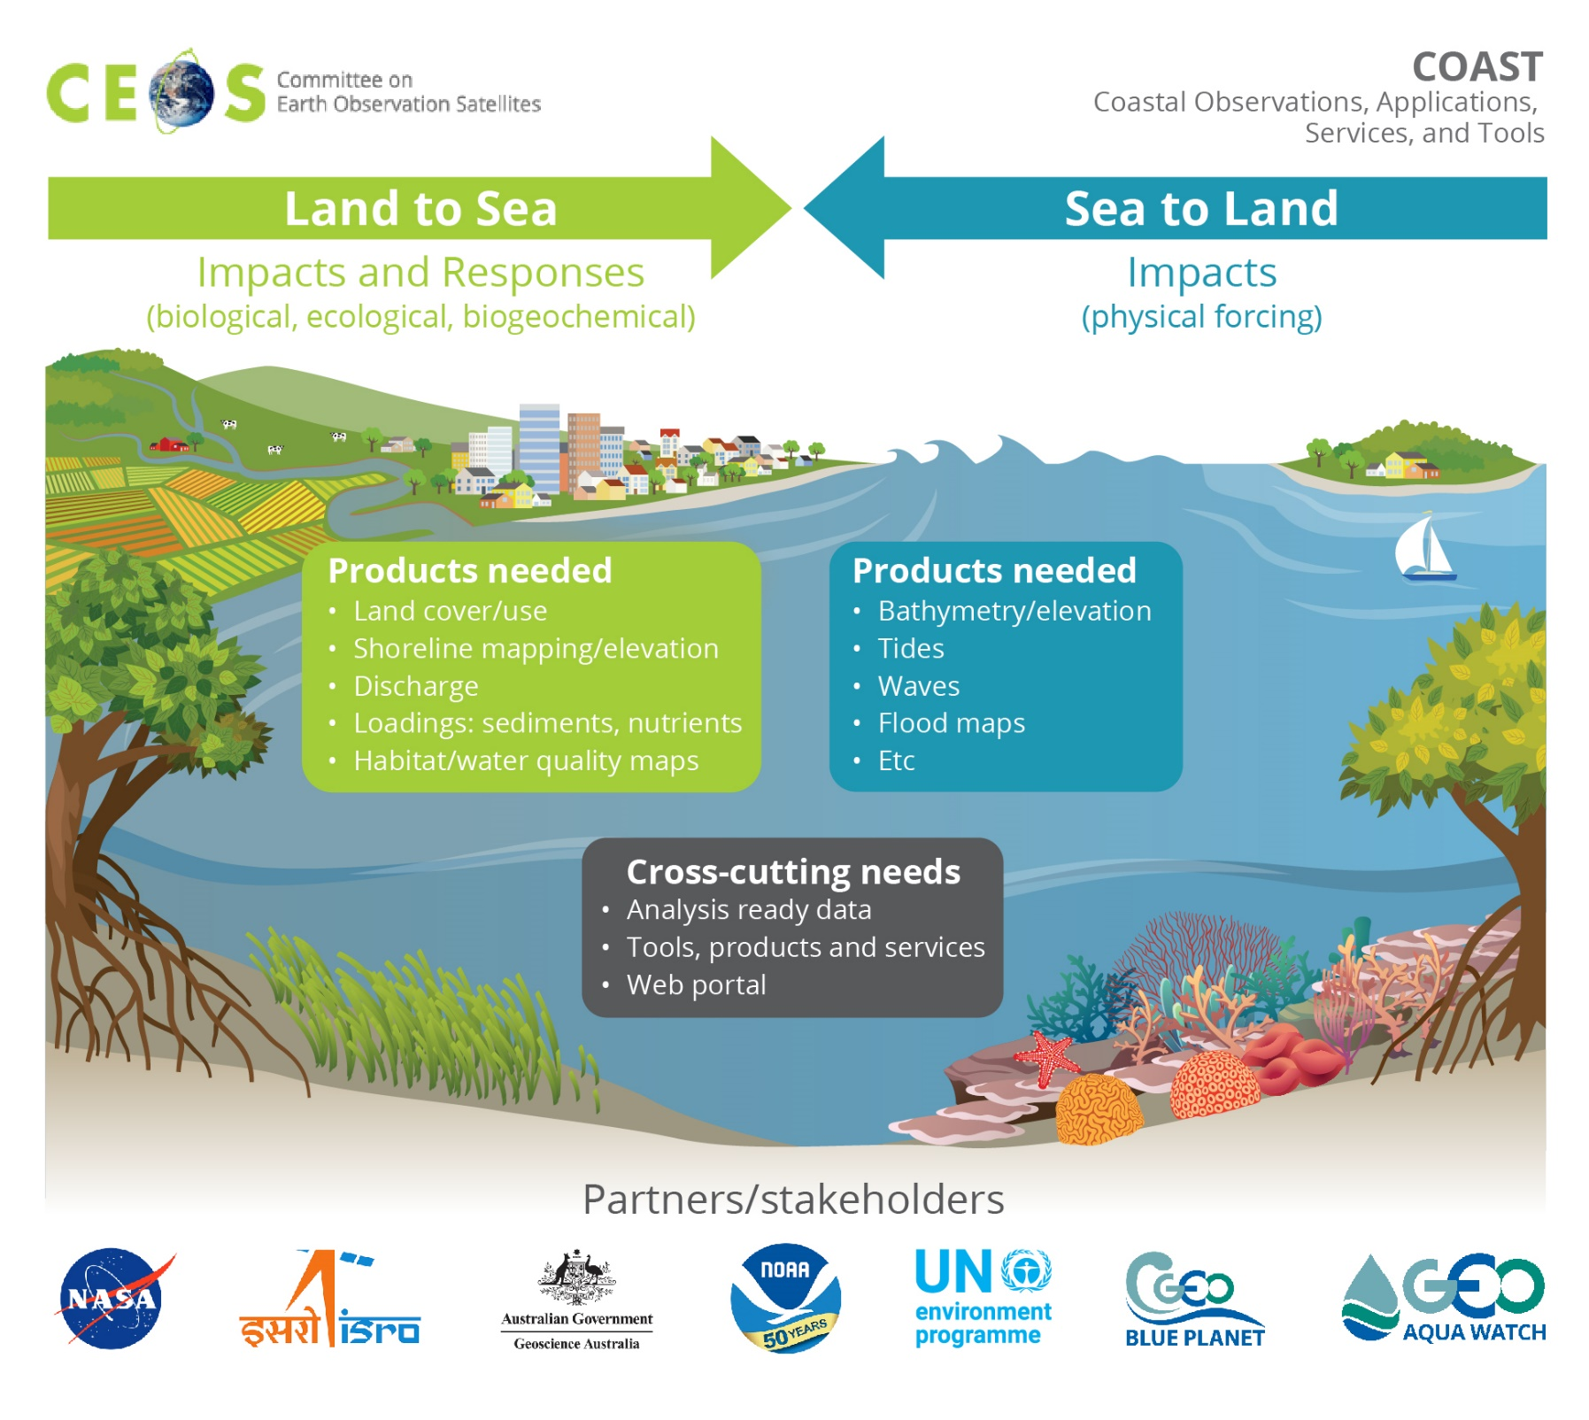
Phase 2: 2020-2022
Identified 2 Pilot Projects to develop coastal products, services and tools
- Land Impacts to Sea and Sea Impacts to Land
Themes:
1.Flooding
2.Coastal Mapping/
Bathymetry
3.Eutrophication
4.Sediment/
Turbidity
Pilot Demo Areas:
W Coast of Africa^{2, 3}
Bay of Bengal ^{all}
Chesapeake Bay ^{1, 4}
Small IslandNations ^{1, 2}
La Plata Estuary ^{3, 4}

Slide 4
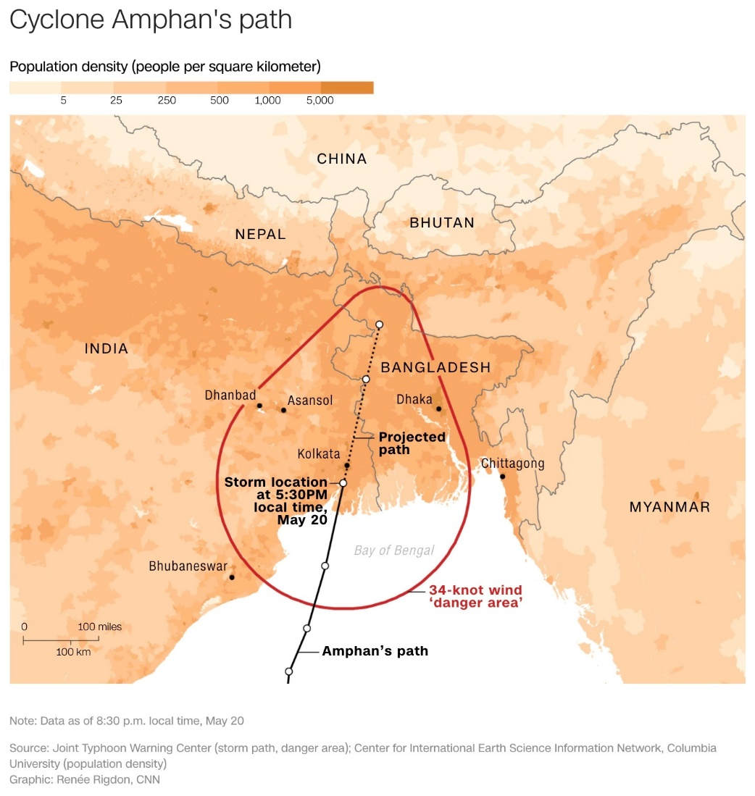
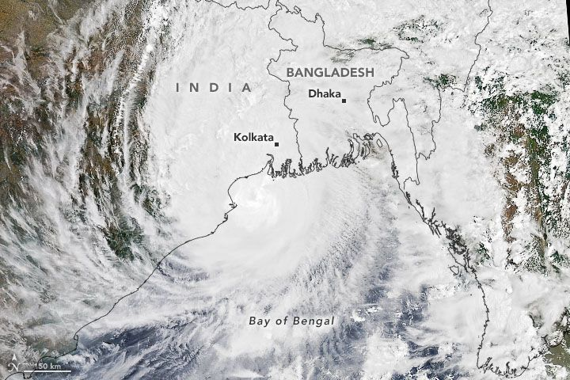
Anticipated COAST Pilot Locations
Continental:
Odisha/Bay of Bengal
Coastal Virginia/Chesapeake Bay
West Coast of Africa
Rio de la Plata region (TBC)
Small Island Nations:
Caribbean: Bahamas
Pacific: Tahiti/Kiribati/New Caledonia
Other sites/TBD

Slide 5
Themes:
Coastal Characterization
Shoreline mapping
Bathymetry/elevation
Flooding - WG Disasters
Turbidity and Sediment Loading
Coastal Eutrophication
Crosscutting Areas:
Continental shorelines
Small Island Nations
Resource Impacts (SAV, Mangroves, Corals, Human Health)

Slide 6
REQUIREMENTS
Shoreline mapping/coastal elevation
Shore line detection
Flood maps/Flood extent
Bathymetry
Coastal elevation and Intertidal Mapping
DEM's
River Discharge/Dam locations and specs
Land Use /Cover datasets
Water Temperature
Salinity
Tidal Data - altimetry, winds
Wave Data
Ecosystem Status/Change
Eutrophication Indicators

Slide 7
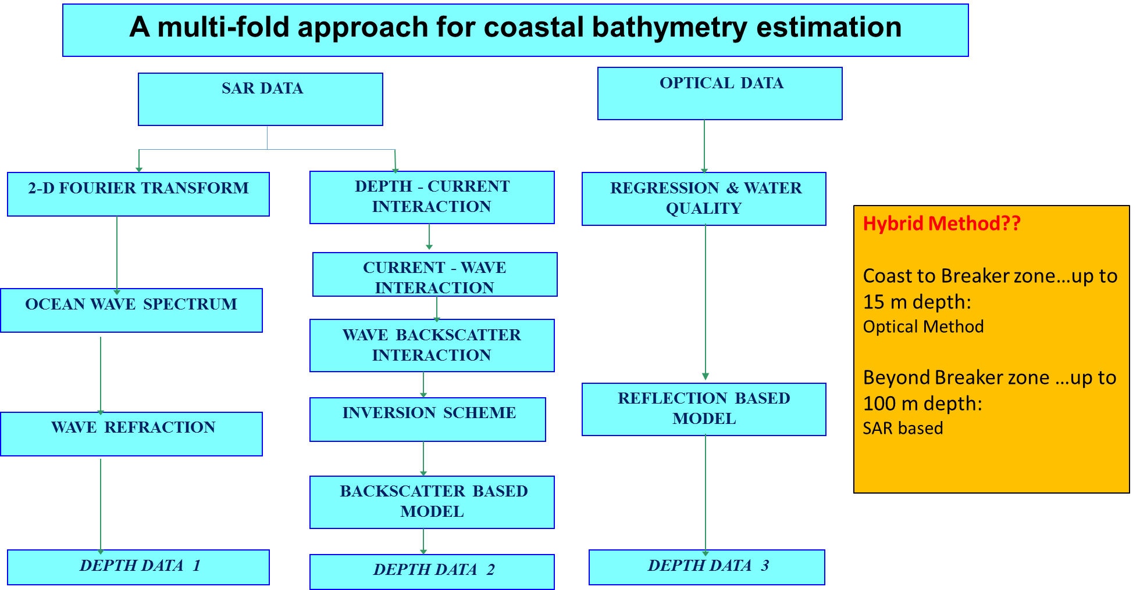
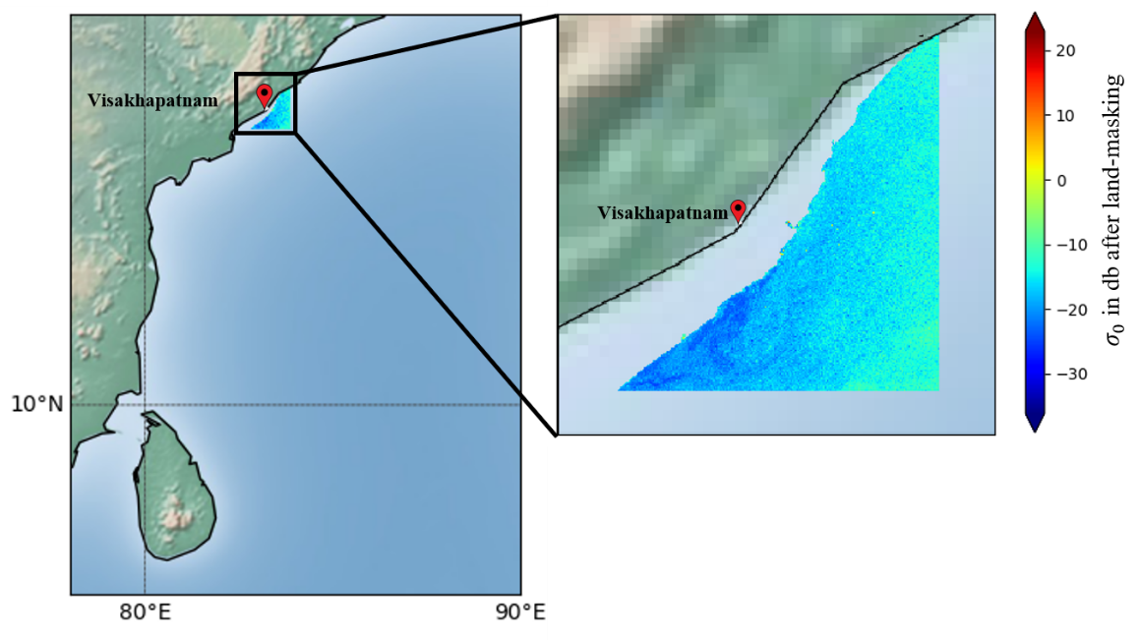
Coastal Bathymetry Estimation
East & west coast of India is highly vulnerable to getting hit frequently by tropical cyclones.
The coastal line is characterized by several river mouths, estuaries, deltas etc.
Warnings related to several coastal hazards (e.g., coastal inundation, tsunami etc.) require accurate bathymetry for the shallow coastal region
Satellite (both optical and MW-SAR) data in conjunction with in-situ observations can be utilized
Pilot study area: Visakhapatnam/Odisha/West-Bengal
Initial expts done for Visakhapatnam coast with availability of limited in-situ data

Slide 8
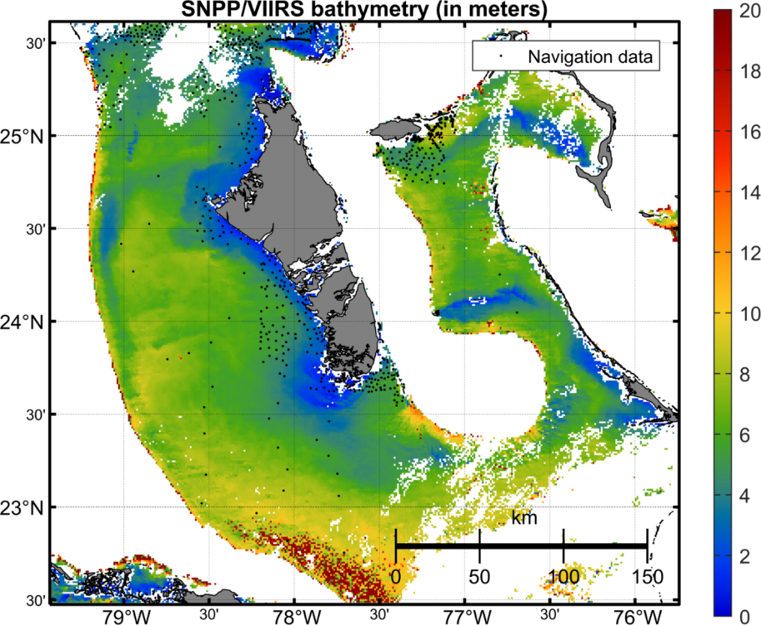
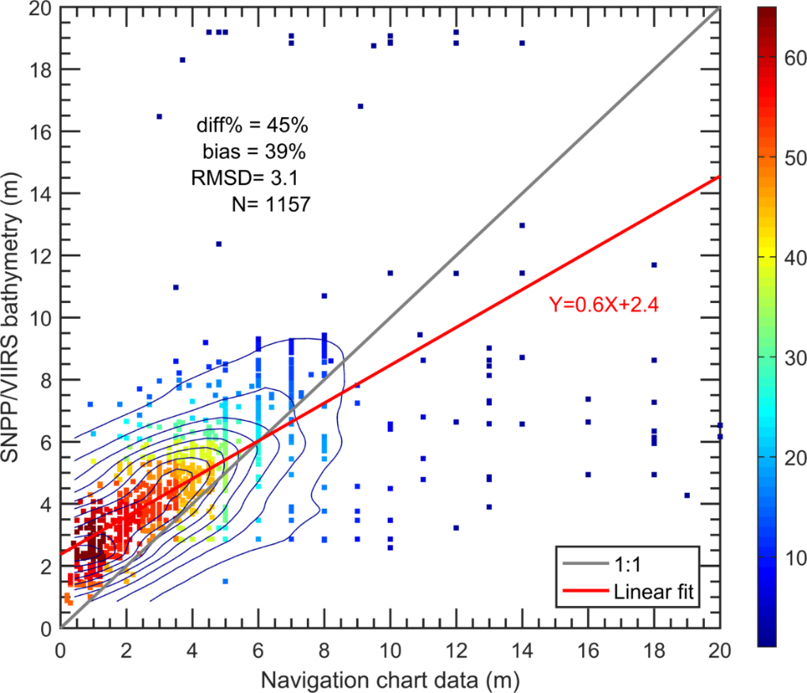
Bathymetry from Multi-Spectral Ocean Color Satellite Measurements
Depth (m)
density
Bathymetric map is derived from VIIRS-SNPP ocean color data, using the newly developed spectral optimization algorithm.
Validation of satellite-derived and Navigation Chart data (sampling locations are indicated in the map), showing useful data from VIIRS.
Jianwei Wei & Menghua Wang,
NOAA Ocean Color Team

Slide 9
Bathymetry retrieval in shallow nearshore waters from optical satellite imagery
Study area: Visakhapatnam coast (AP, India)
Datasets: Sentinel-2A&B, JetSki sounding data (in-situ depths)
Methods:
Log-ratio model (LRM); Log-linear model (LLM)
Ensemble approach of LRM and LLM
Support Vector Regression (SVR) ML on LRM and LLM ensembles
LLM consistently showed good results for a best scene
SVR has best performance with least RMSE = 0.38 m (depth range of 0-15 m)
Best scene
Best scene
Best scene
R² =0.95
RMSE = 0.67 m
RMSE = 0.79 m
RMSE = 0.67 m
Improved results with LLM
R² =0.96
RMSE = 0.66 m
RMSE = 0.94 m
RMSE = 0.66 m
Validation of SVR approach with in-situ data
Current Science (2020)
R² =0.98
RMSE = 0.38 m
Residual errors are very low < 0.5 m
RMSE = 0.53 m
RMSE = 0.38 m

Slide 10
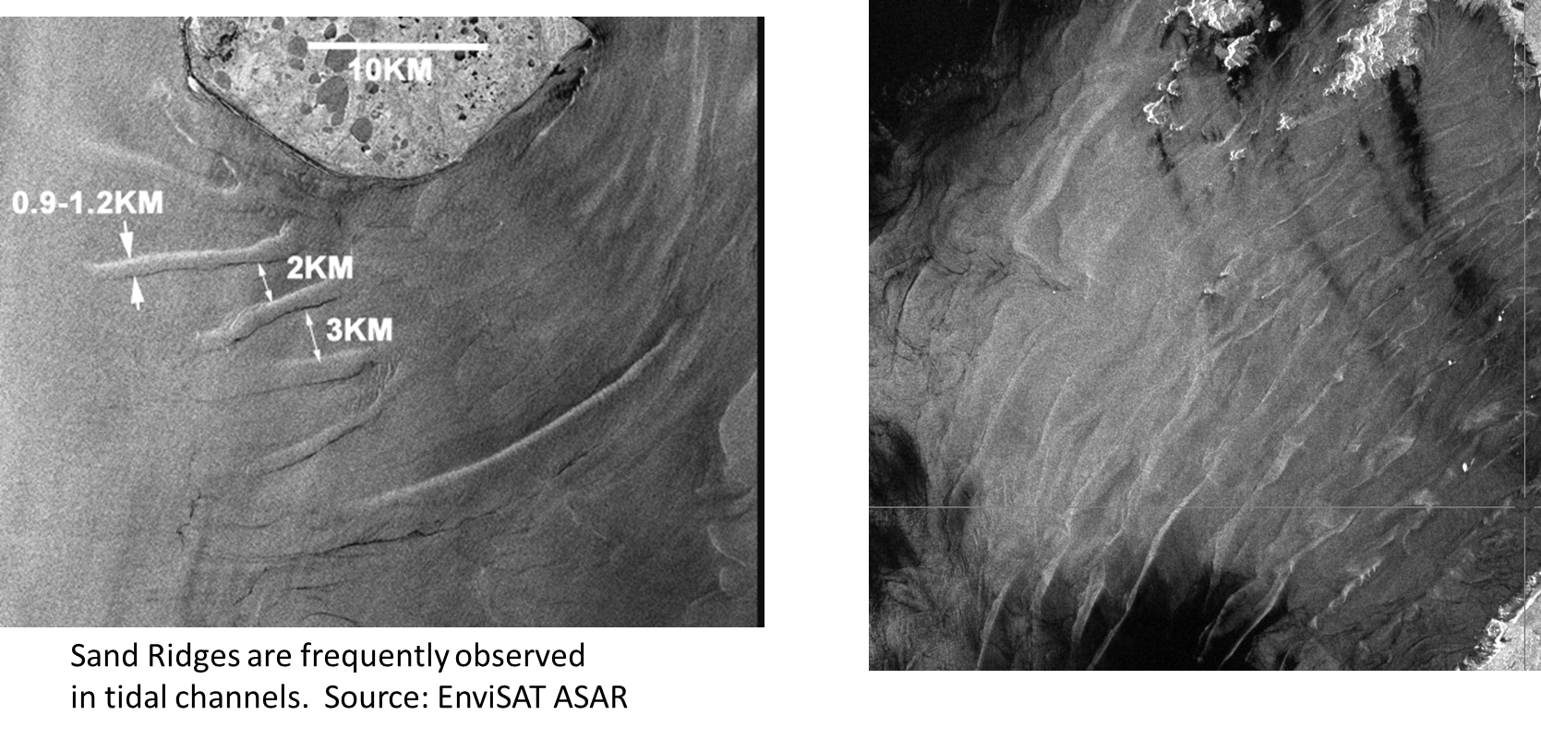
Shallow Water Bathymetry from SAR Measurements
NOAA Water Surface
Conditions Team
Xiaofeng Li & Sean Helfrich

Slide 11
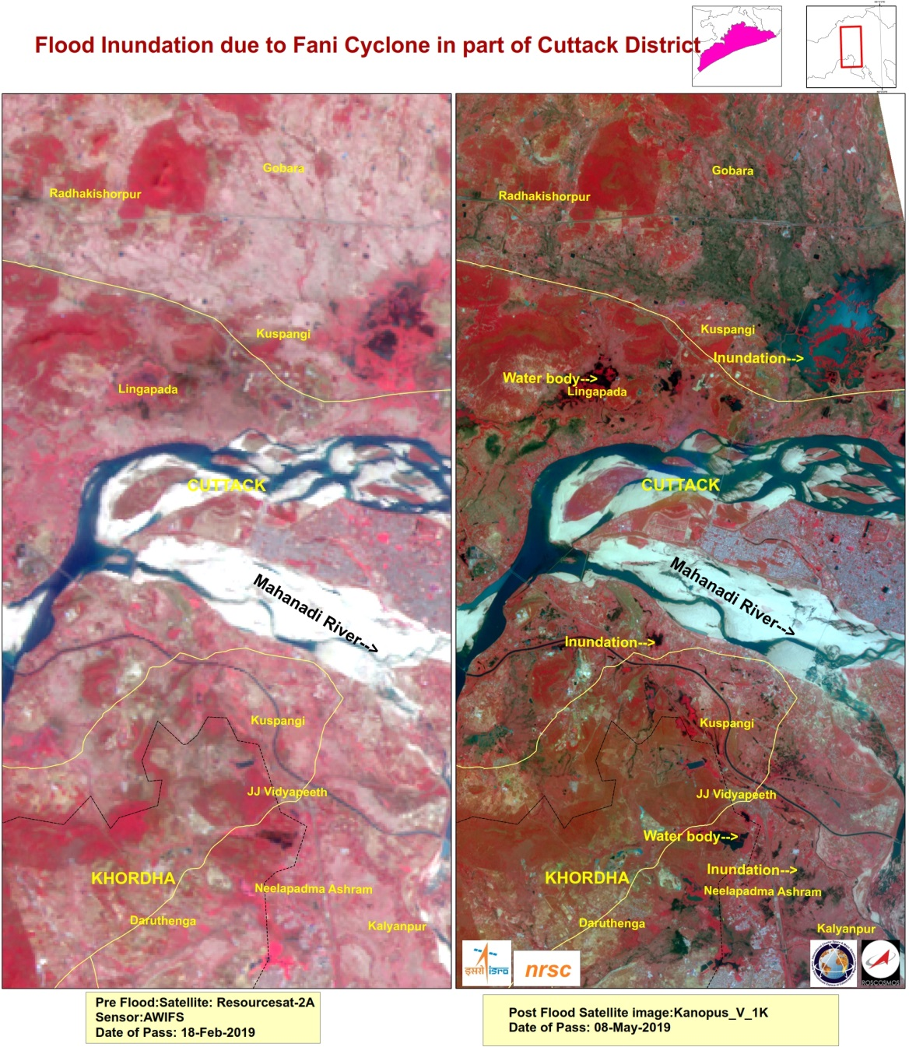
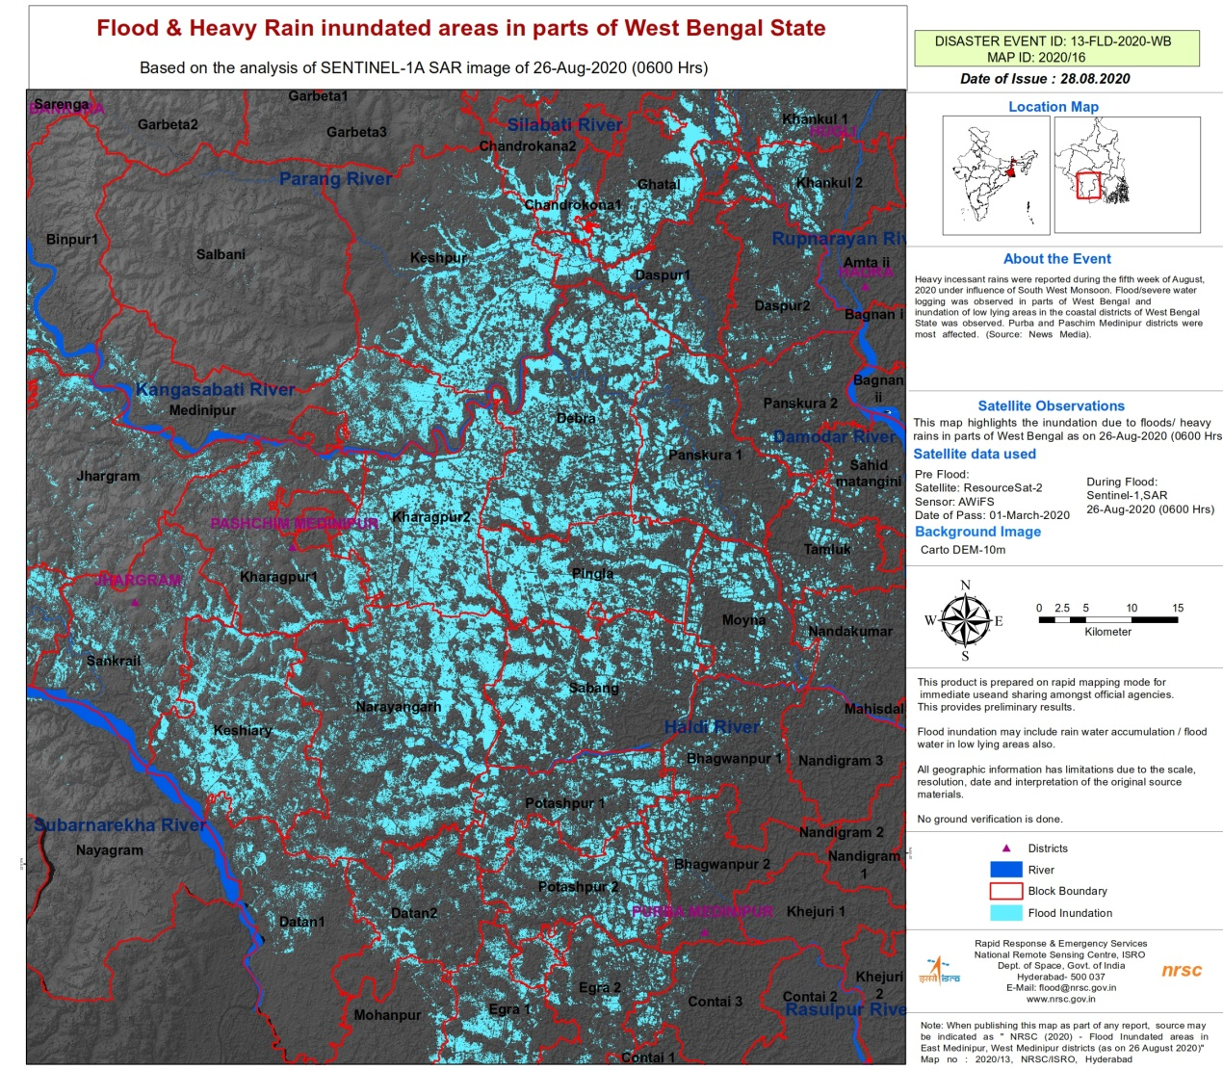
Flooding/Inundation using Satellite Observations

Slide 12
Inundation during Recent Cyclone Taukate

Slide 13
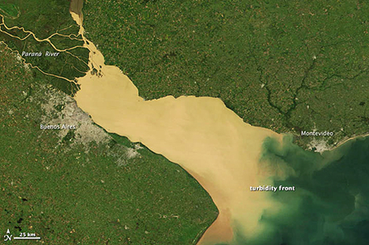
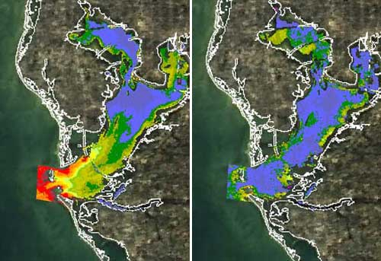
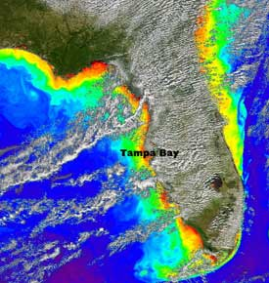
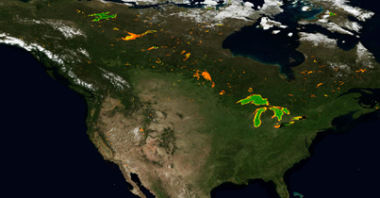
Coastal Sediment Dynamics
Images are composites of turbidity data collected in December and July, respectively, over a span of three years using NASA's MODIS instrument. Credit: NASA/USF
Copernicus turbidity products ingested into RealEarth Platform (University of Wisconsin SSEC)

Slide 14
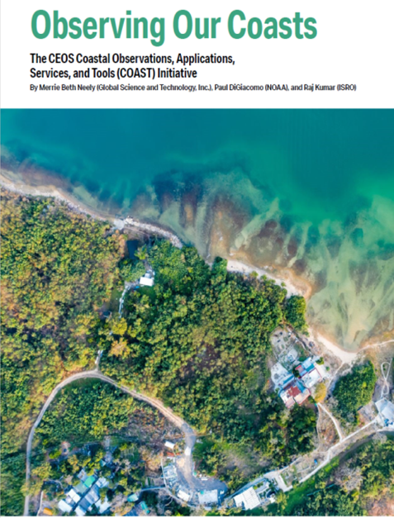
Way Forward
Deliverables document Finalisation
Data needs and Preparations for Pilot Projects
CEOS -GEO Showcase demonstrating capabilities with examples, scheduled for September 2021 Final
Support from all of you to understand the requirements and operationalise for societal benefits
CEOS: https://ceos.org
CEOS-COAST:
https://ceos.org/ourwork/ad-hoc-teams/ceos-coast/
ECO Magazine:
http://digital.ecomagazine.com/publication/frame.php?i=707374&p=&pn=&ver=html5
page 108-111
Thanks

