Slide 1
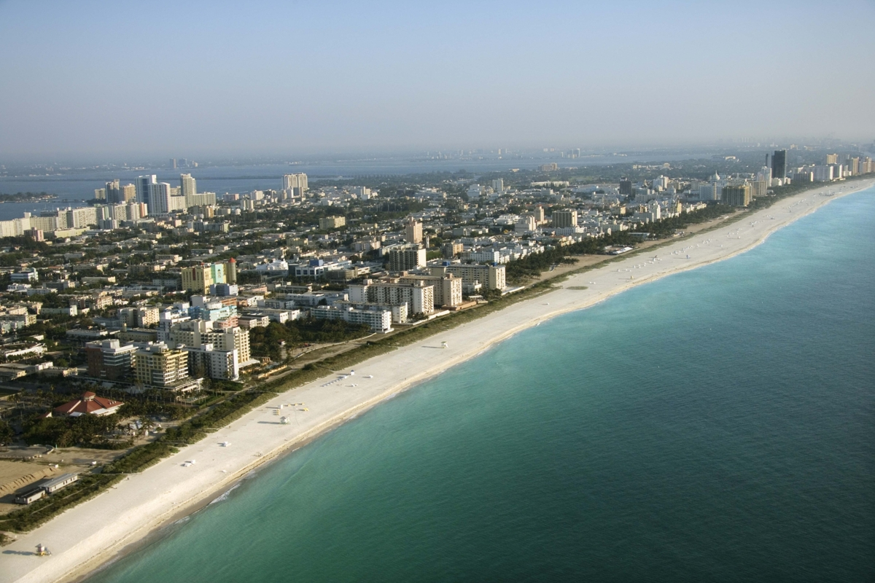
Cross-cutting needs:
Analysis ready data
Tools, products & services
Web portal
Partners/Stakeholders
Blue Planet
AquaWatch
UN Environment
IOC/WMO (TBC)
Products needed:
Land cover/use (e.g., impervious surfaces)
Shoreline mapping/elevation
Discharge
Loadings: sediments, nutrients
Habitat/water quality maps
Products needed:
Bathymetry/elevation
Tides
Waves
Flood Maps
etc
Land to Sea Impacts/Responses
(~ biological/ecological/BGC)
Sea to Land Impacts
(~ physical forcing)
Ecosystems, Water Quality & Habitats
Coastal Disasters/Hazards: Flooding & Inundation
Sediment loading (SAV, corals, mangroves)
Coastal eutrophication (SDG 14.1.1. et al.)
Large-scale coastlines: urbanized, rural/agri, mixed
Small-island states: Coral-reef lined, mangroves et al.

